Slide 1

Project Proposal
CSE 465
Group Members
Townim Faisal Chowdhury | 1721327042
Uchchwas Das | 1620016042
Faculty Advisor
Mohammad Ashrafuzzaman Khan(AZK1) North South University

Slide 2
Project Title
Table Of Content
Problem Definition | Page 1
Motivation, Dataset | Page 2
Approaches | Page 3
Expected Outcomes | Page 4
Problem Definition
Face mask plays a crucial role in the situation of covid-19 but not everybody wants to wear mask. And Identifying who does not wear mask from a mass amount of people is really tough. That's why we wanted to create a model that can help pick out people from video or picture who don't use mask.
Page 1

Slide 3
Motivation
Since it's very hard to maintain social distance for the huge number of people like Bangladesh, that's why face mask is the only way to protect people from this corona virus. Police may add a face mask detector to their surveillance cameras fleet to enforce the mandatory wearing of face masks in public spaces.
Dataset
Image-Net
kaggle.com /dohunkim/visualizing-medical-mask-dataset
Page 2

Slide 4
Approaches
1.Train Deep learning model
2.Apply mask detector over images / live video stream
Page 2

Slide 5
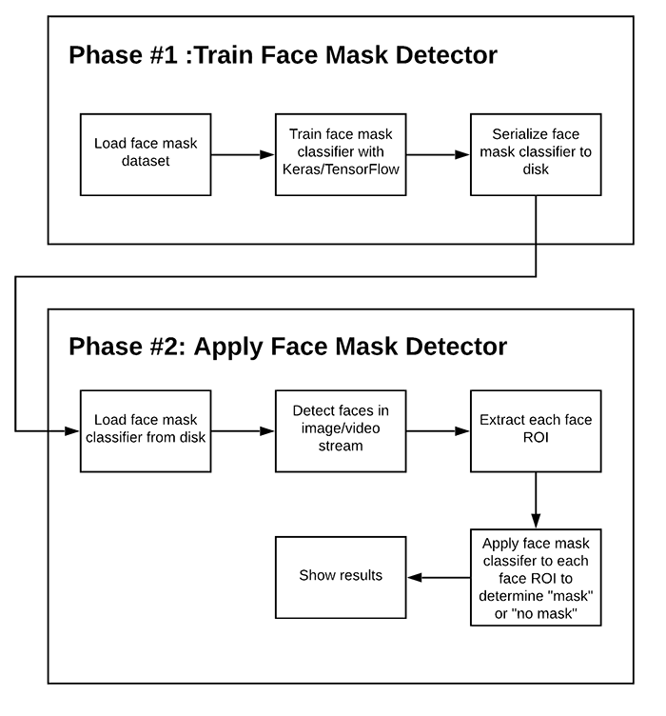
Diagram
Page 2

Slide 6

Expected Outcomes
It helps to more reliably distinguish people wearing mask or not from a given input photo / video.

