Slide 1
Cirrhosis Patient Survival Prediction
Using ML to predict survivability
Orie Wyatt

Slide 2
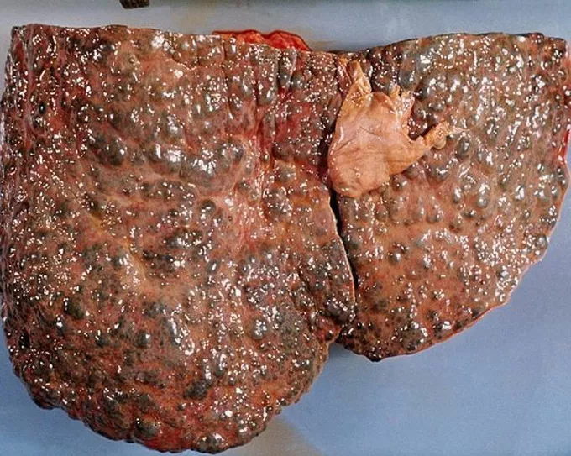
Cirrhosis
Cirrhosis is a disease affecting the liver that occurs when scar tissue impairs the function of the liver. Cirrhosis is often caused by alcoholism, heroin usage, and hepatitis.

Slide 3
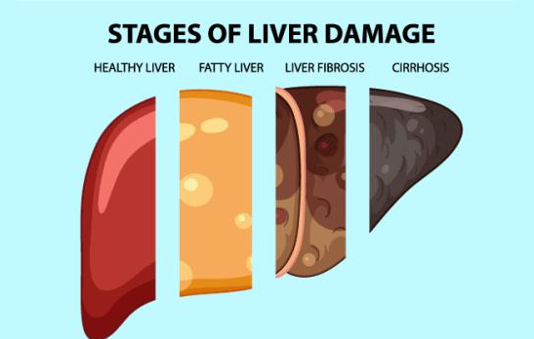

Slide 4
Exploratory Data Analysis

Slide 5
The Data
Target Variable
Features
Source
Source
Status
D- Deceased
C- Censored
CL- Censored due to Transplant
18 features including:
Drug treatments
Age (days)
Sex
Alkaline Phosphates
Edema
Cholesterol
Copper
Histologic stage
Alkaline Phosphotase
Tryglicerides
Sourced from Mayo Clinic study on primary biliary cirrhosis of the liver carried out from 1974 to 1984 via UC Irvine Machine Learning Repository.
(https://archive.ics.uci.edu/dataset/878/cirrhosis+patient+survival+prediction+dataset-1)

Slide 6
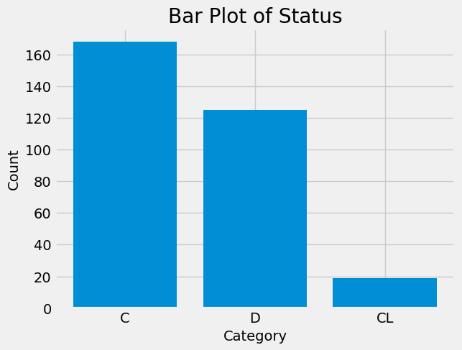
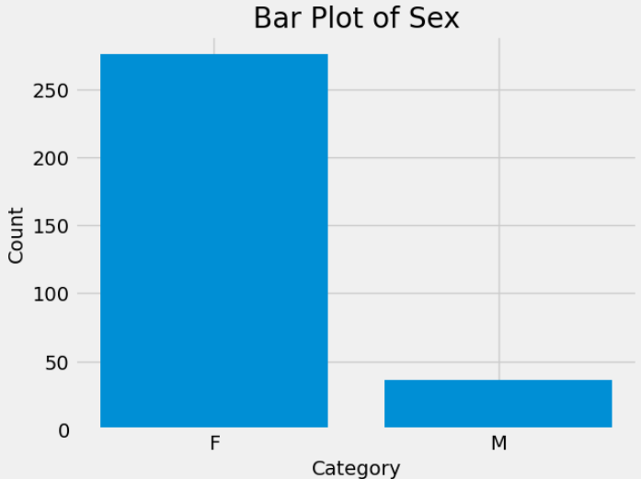
Status and Sex

Slide 7
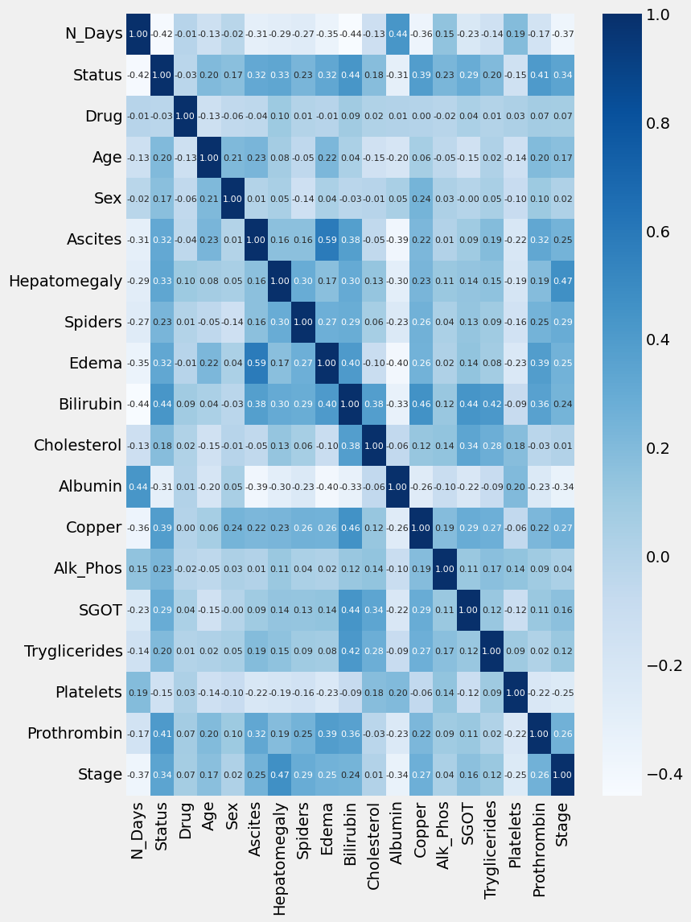
Correlation Heatmap
Albumin and platelets seem to be negatively correlated
The most positive correlations exists with prothrombin, copper, bilirubin and histologic stage.

Slide 8
Method 1. Bagging

Slide 9
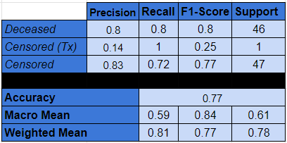
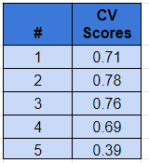
Bagging Results
Low sample volume of transplant patients
CV scores seem solid but there is a huge drop off in the final validation.

Slide 10
Method 2. Boosting

Slide 11
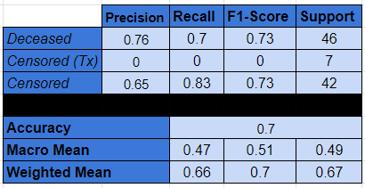

Boosting Results
Used GradientBooster
Albumin and platelets seem to be negatively correlated
The most positive correlations exists with prothrombin, copper, bilirubin and histologic stage.

Slide 12
Method 3. Stacking

Slide 13
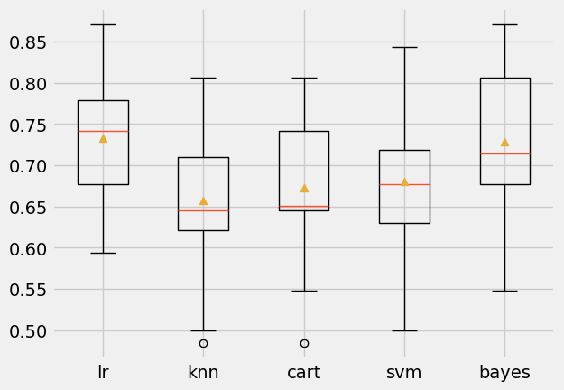
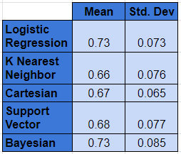
Stacking Results
Logistic regression and bayesian inference provided the most accurate model.
Cross-validation was not performed, so models may be overfitted.

Slide 14
Results

Slide 15
Comparison Between Ensemble Methods
Boosting and Bagging had similar outcomes of around 67% accuracy after undergoing cross-validation.
Stacking has a floor of around 67%, with Bayesian inference and Logistic Regression as the best performers at 73% accuracy

Slide 16
Results
Boosting and Bagging had similar outcomes of around 67% accuracy after undergoing cross-validation.
Stacking has a floor of around 67%, with Bayesian inference and Logistic Regression as the best performers at 73% accuracy
Stacking appears to be the best ensemble method for this dataset although it would be interesting to investigate different type of boosters (e.g. XGBoost)

Slide 17
Future Work
Create confusion matrices to better visualize results
Discuss whether Censored (Transplant) option is something than can realistically be modelled
Investigate the drop off in the final CV for bagging
Use different boosting methods such as XGBoost to see if there are any differences
Evaluate the data based on sex and see if there are any discrepancies

