Slide 1

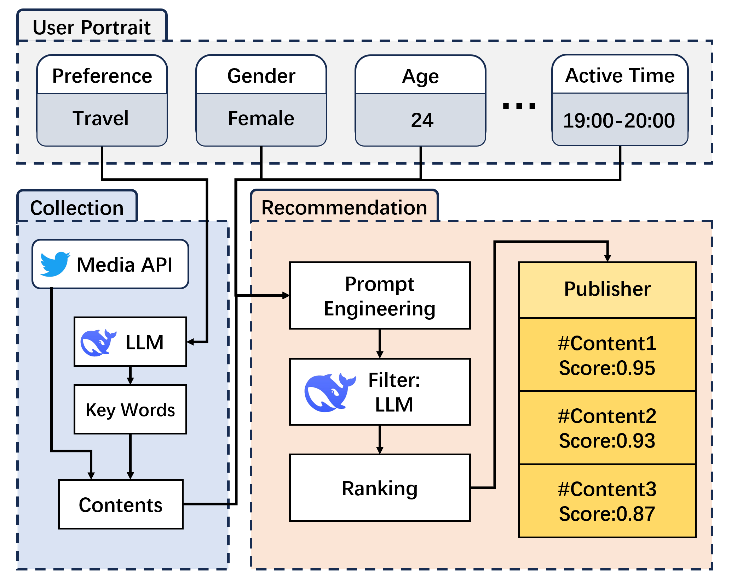
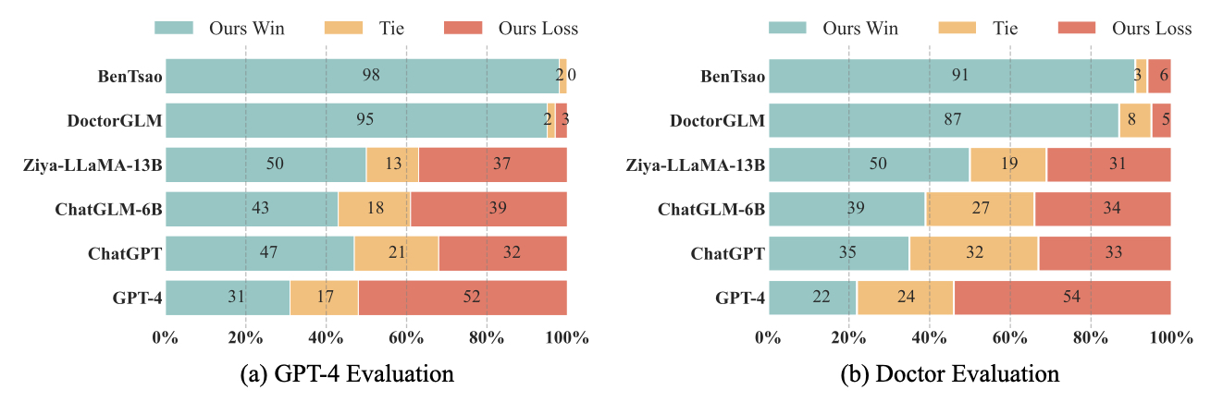
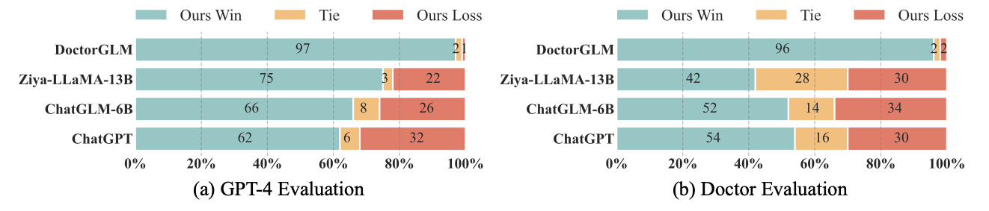
CSC6203 Large Language Models
SOCIAL MEDIA CONTENT MANAGEMENT AGENT
Authors: Sun Ao, Cai Jinpeng, Gao Kangwen
Student IDs: 224040294, 224040280, 224040287
Email: aosun3@link.cuhk.edu.cn, 1098122175@qq.com, kangwengao@link.cuhk.edu.cn.
Introduction
Ⅱ. Data Collection
Social Media Data Collection and Keyword Extraction
We integrated APIs from major social media platforms (such as Twitter and Reddit) to collect real-time trending content and user comments. To align content with user interests, we used a large language model (LLM) to semantically analyze users’ behavioral patterns and extract representative keywords. These keywords are then used to query relevant content via the APIs.
Ⅲ. Filter And Recommendation
Content Filtering and Recommendation with LLM
After collecting candidate content, we utilized a fine-tuned LLM to score each item based on multiple factors, including relevance to the user profile, popularity, and trendiness. The content is then ranked by score, and top-ranked items are passed to the Publisher module for automated publishing at optimal times.
Ⅳ. Interactive Frontend System
User-oriented interactive front end
We developed a web-based frontend where users can engage in real-time conversations with the LLM, ask questions, provide feedback, or request recommendations. The interface also includes a recommendation page displaying personalized trending content for each user. The recommendations are updated dynamically, enabling an engaging and interactive user experience.
In this project, we propose a Social Media Content Management Agent capable of automatically generating, filtering, and publishing social media content, as well as interacting with users through intelligent dialogue.
Traditional approaches to social media content management often rely on static recommendation systems and manually defined publishing schedules. These systems typically lack dynamic understanding of user interests and are unable to respond to real-time trends. Moreover, user interaction is often shallow and limited to passive content delivery, without effective feedback mechanisms.
To address these limitations, we design a dual-agent architecture: the first agent focuses on user analysis by building user profiles based on historical behavior and preferences; the second agent uses the generated profiles and trending topics to intelligently select and recommend content, and schedule publishing accordingly. This system significantly improves content relevance, personalization, and automation.
We constructed a user profile database containing 1,000 entries. Each entry includes information such as user preferences, gender, age, and active time periods. In addition, we developed a web-based frontend that allows users to interact with the language model via natural language conversations, and explore personalized content recommendations through a dedicated recommendation page. You can see details in https://github.com/towyz/NLP-Final-Project.
Methodology
Results
HuatuoGPT, trained on ChatGPT and real-world data, creates doctor-like, accessible responses. Its conversational ability, enhanced by reinforcement learning with mixed feedback, surpasses existing LLMs and often outperforms ChatGPT, highlighting its prominent role in future medical AI advancements.
Single-turn Evaluation
Multi-turn Evaluation
I. Dataset
User Profile Dataset Construction
We manually built a dataset consisting of 1,000 user profiles. Each profile contains four key fields: user preferences (e.g., technology, entertainment, food), gender, age group, and daily active time. This dataset provides the foundational features for personalized content recommendation.
LLM Course of CUHK-SZ

