Slide 1
A Brief Intro to Kubernetes (K8s)
Quan Zhou (quz3)
Yichi Zhang (yiz141)

Slide 2
Outline
The Facts
What is K8s
Basic Examples
Product Analysis
References

Slide 3
The Facts
21st Century
Users
24/7 Availability
Fast response
Developers
Frequent updates
Internet Era (Apps)
Inexpensive Hardware
Dynamic Demands
Full-stack
Easy to deploy & resize
Flocks in & out
Some of them can be achieved by container technologies, however resources are limited.
Notes:
Before we move onto K8s, I would like to take a look on the facts that we are facing now.
The background is, we’re in 21 century now, it’s an Internet era, lots of APPs, and everything could be connected via this net. In this fast-changing era, from the project managers’ views, the demands would alter rapidly.
As for users, they want 24/7 access (Facebook or WeChat will never shut down in the mid-night) and fast responses from these services (You don’t want to wait even 10s for posting a twitter). There’s also an important characteristics for users, that is they will flock in & out (Like Amazon will handle much more on Black Friday, but not on an ordinary Thursday night).
For developers, they want to update their apps quite often, and then deploy their apps onto servers ASAP. And when necessary, they would like to resize their servers to achieve a balance between user exp. and costs.
With the help from today’s inexpensive hardware, we can distribute complicated tasks to different nodes (like in Hadoop MapReduce). Some tasks may be easy enough to run on a small node. Problems like that could be achieved by container techs, however these are major problems for containers-we don’t have that much res available to us. We need to be able to scale application in line with the user demand and we expect them to make intelligent use of the available resources.

Slide 4
What is K8s
Kubernetes is an open source system for managing containerized applications across multiple hosts, providing basic mechanisms for deployment, maintenance, and scaling of applications.
Kubernetes provides a container-centric management platform. It orchestrates computing, networking, and storage infrastructure on behalf of user workloads.
Write your own configurations or controllers! Organize or monitor resources via K8s APIs.
Notes:
Kubernetes is a platform designed to meet those requirements, using the experience from Google, combined with some ideas from the community.
So What exactly is K8s and what can it do? ((Read Para 1))
From the first para, we probably think that K8s is nothing other than a ‘central console’, like a dashboard or something, so what’s so special with K8s? ((Read Para 2))
Some may have noticed that, there is one sort of words that appears quiet often – Scaling, on be half of user workloads… It seems that K8s really good at doing ‘scaling’. So let’s reveal the most powerful part in K8s, ((Read Para 3)) Yes, we can define a set of rules, and K8s will do the automatic allocation for us! Of course K8s can do some management work, but the most exciting part for K8s is it’s auto-scaling feature. So we are not going to cover the management part.

Slide 5
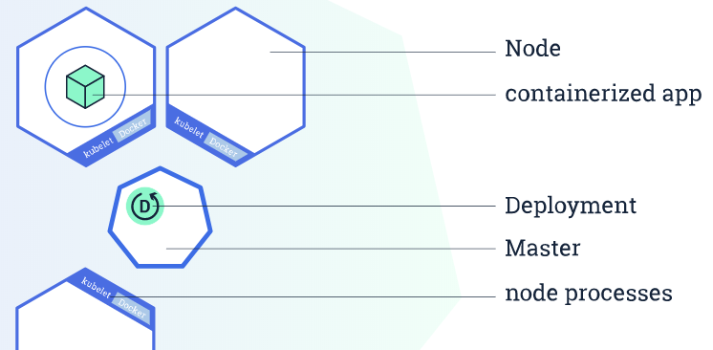
K8s Cluster
K8s is designed as a highly available cluster of computers that are connected to work as a single unit.
K8s is to automate the distribution (scheduling) of application containers across a cluster in an efficient way.
Cluster Diagram by K8s Bootcamp
Notes:
Kubernetes is designed as a highly available cluster of computers that are connected to work as a single unit.
This abstraction allows us to deploy applications without thinking about which specific machines they need to run on. To make use of this new model of deployment, applications need to be packaged in a way that decouples them from individual hosts: they need to be containerized. This is different compared to how applications were deployed in the past, when they were directly installed on specific machines as packages deeply integrated into the host.
Kubernetes role is to automate the distribution (scheduling) of application containers across a cluster in an efficient way.
So a K8s cluster would look like this: ((CLICK)) There are 2 types of resources. The Master is responsible for managing the cluster. And A node is a VM or a physical computer that is used as a worker machine to run applications.

Slide 6
App Deploy & Scale up
Deployment via “Kubernetes Object” yaml file.
Scale up: Just change the number of replicas in a Deployment! (Suppose you have deployed and exposed your services)
Load-balancing is integrated, network traffic will be distributed among all Pods of an exposed Deployment.
App update will be rolling-based. Rely on replica and load-balancing.
Notes:
Well, how to deploy a K8s cluster? This is actually beyond our scope. However, we will provide some basic steps for this.

Slide 7
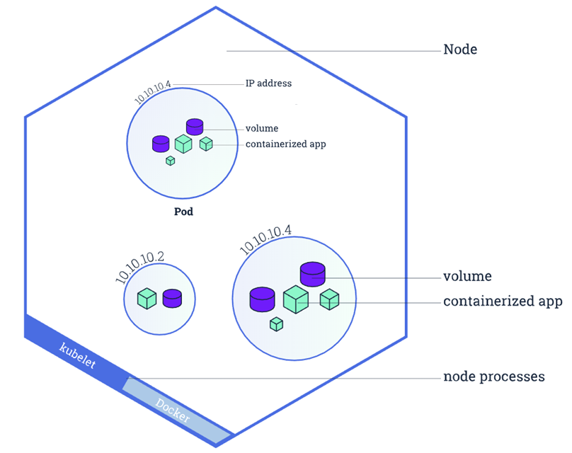
Node diagram by K8s Bootcamp, modifications made
Notes:
And this is a structure of a node inside a K8s Cluster.
Pods always run on Nodes.
A Pod is a group of one or more application containers (such as Docker) that includes shared storage (volumes), a unique cluster IP address and information about how to run them (like container image version or specific ports).

Slide 8
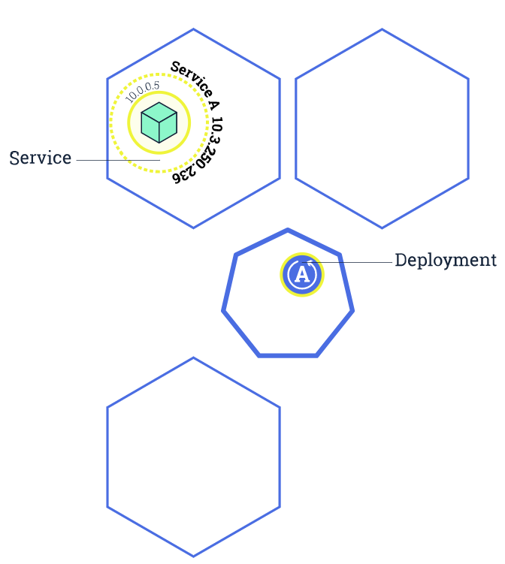
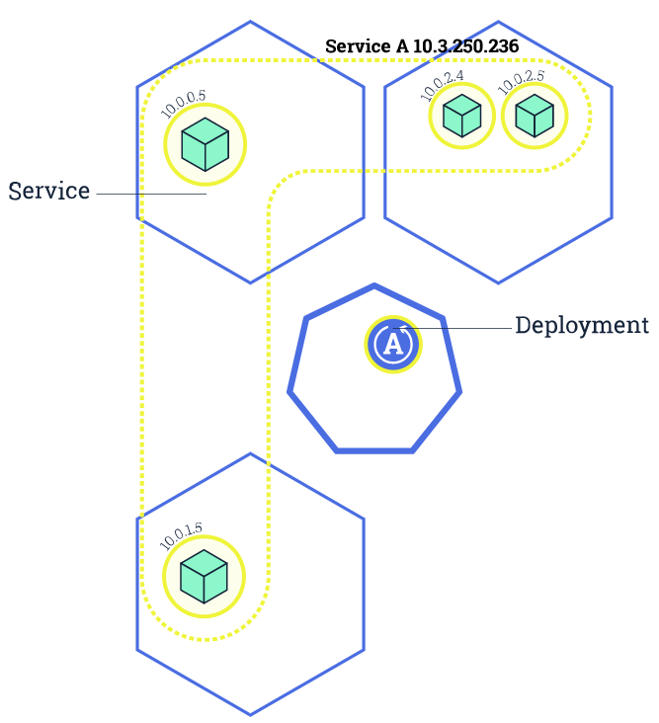
Scale up an App
Diagrams by K8s Bootcamp
Notes:
Here is a diagram overview for how to scale up an app.

Slide 9
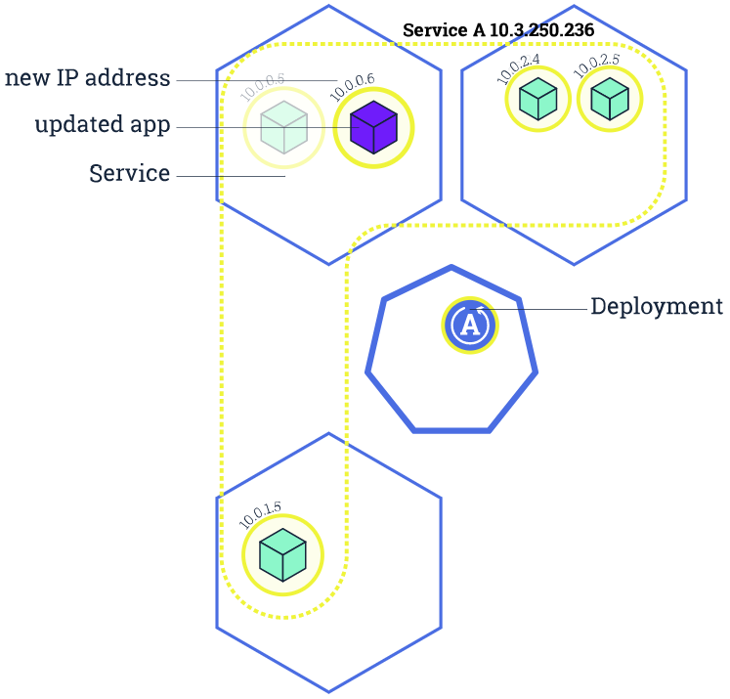
Rolling update
Diagrams by K8s Bootcamp
Notes:
… Then do an upgrade …

Slide 10
Setting up a Cluster
Google Cloud Platform – Kubernetes Engine
Azure Container Service (AKS)
Minikube – A cluster containing only one node on local machine
$ minikube start
Docker – Beta version integrated with K8s
Notes:
So, we've already talked a lot about the infrastructure of Kubernetes. Now, I will show you how easy it is to really deploy your application on to a cluster with Kubernetes.
Kubernetes has became really popular after it's initial release and as of now, almost every major cloud service providers have an integrated framework to cooperate with Kubernetes in some manner.
Google has it's K8s Engine, Microsoft has Azure Container Service based K8s, as well as Amazon. With their easy to implement command line APIs, programmers can easily start a cluster on the cloud.
The K8s community also offers a tool called minikube, which let you simply start a single node cluster on local machines to test the deployment functionalities of K8s.
Docker, as the most popular container management tool, on the other hand, recently released a beta version with K8s integrated. The integration of these two major tools really make the whole workflow easier than ever.

Slide 11
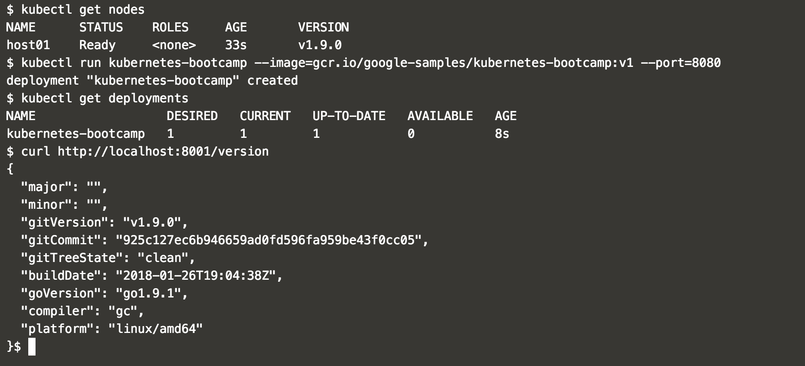
Deploying and Exposing
kubectl run <name> --image=<image>:<version> --port=<port> (deploy)
kubectl proxy (start proxy service)
kubectl expose <deployment> --type="NodePort" --port <port> (expose)
kubectl delete service -l run=<name> (stop service)
Notes:
After we successfully started the cluster, we can use the kubectl run command to start the service from a pre-built Docker image. Just specify the name, the image (either from the cloud or your local machine), and the port, it will be up and running.
Then you can start the proxy and expose the service to the public internet. After that, your users will be able to access your services.
When ever you want to stop the service, you just have to run the kubectl delete command.
Now this is not really the fascinating part, because most of the web services now can be deployed in this manner with all kinds of tools.

Slide 12
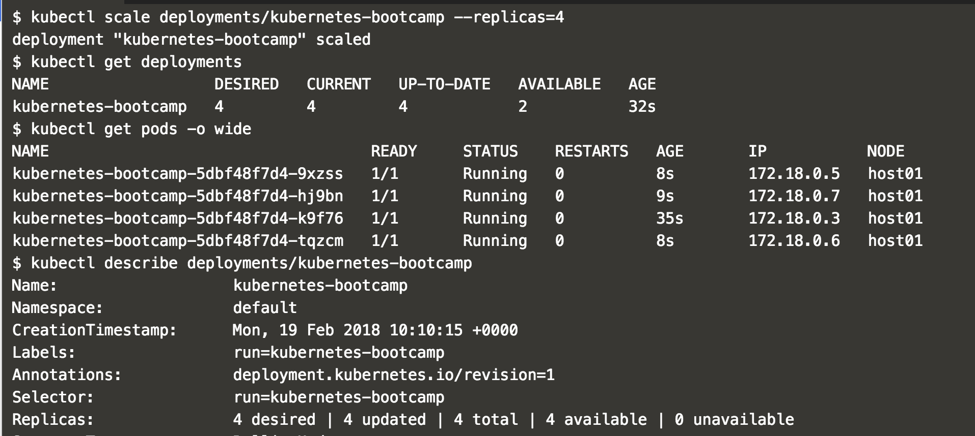
Scaling
kubectl scale <deployment> --replicas=<replica #>
Notes:
What made us really excited is the part where we want to scale our application.
Just run the kubectl scale command and specify your service and number of replicas, wait for a few second, and the application is automatically scaled.
The auto-scaling process also comes with integrated load-balancing, and fault tolerance mechanism. If one pod fails, K8s will start another pod to keep the total number of pods meet the replica number.
As my personal experience, a few years ago, when I tried to deploy a two node load-balancing service on a cloud manually, it took me about 5 hours to get the whole thing up and running. Now, with K8s, it's only one line of code which takes a couple second to run.
And the larger the scale, the more time you can save.

Slide 13
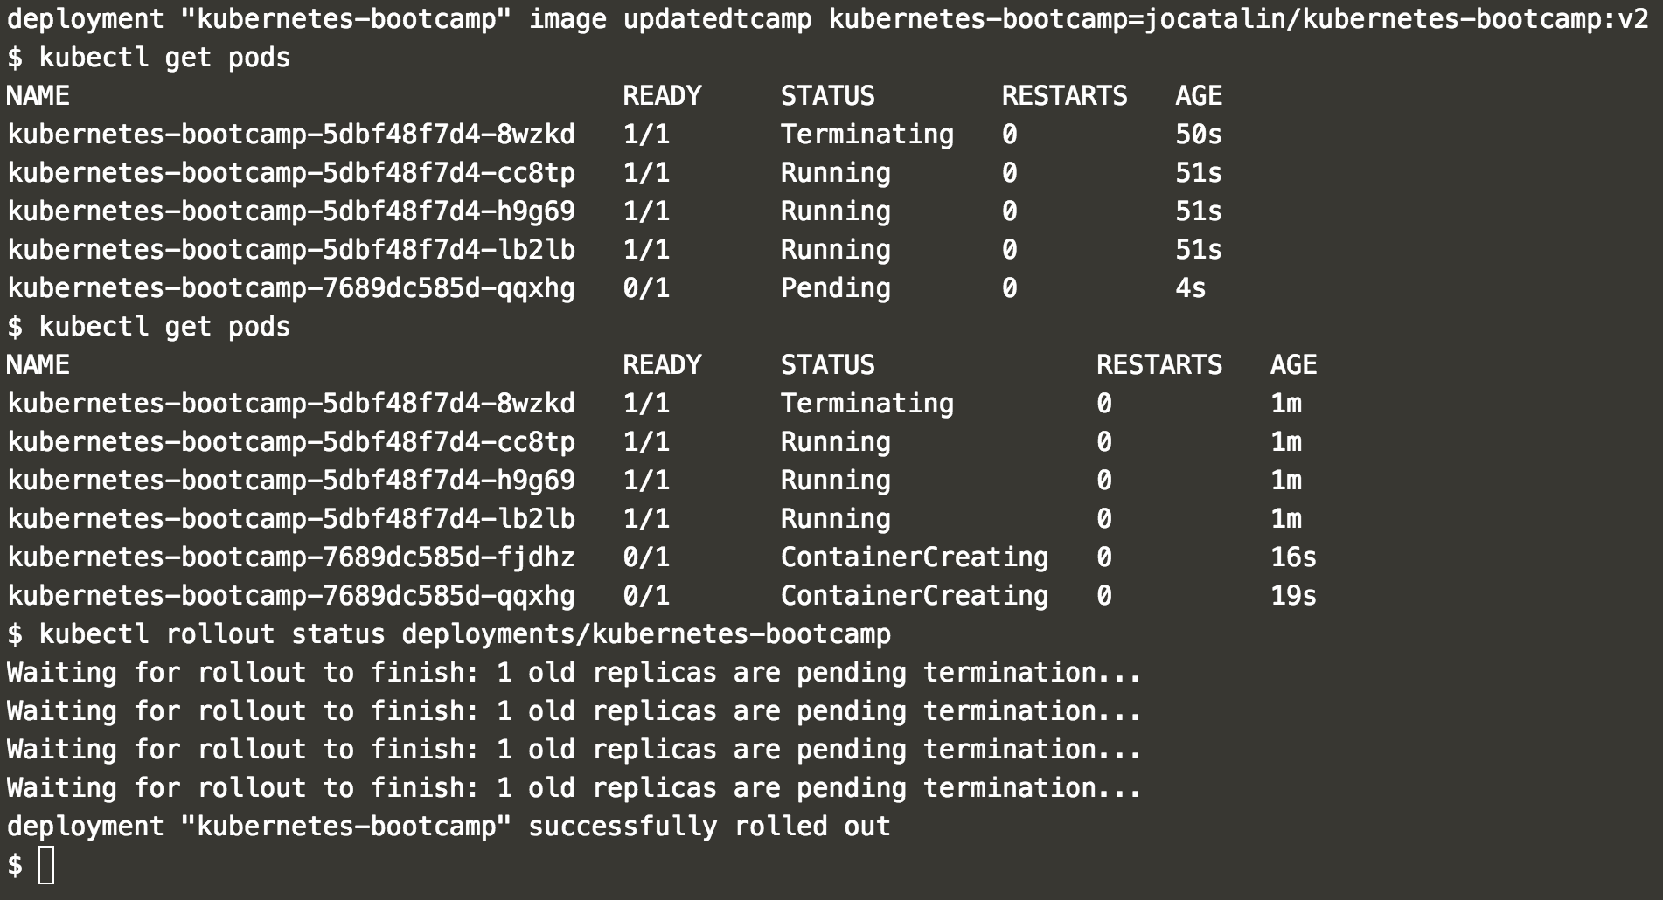
Updating & Rolling Back
kubectl set image <deployment> <image>:<version> (update)
kubectl rollout status <deployment> (status check)
kubectl rollout undo <deployment> (roll back)
Notes:
It is really easy to upgrade your application to a newer version with K8s.
With a pre-built image, you can run kubectl set image command to update to the new version.
The upgrade process is seamless with no down time. The end-users won't even notice the upgrading process.
K8s also has the capability of version control. If anything goes wrong with the new version, you can always roll back to the previous version by running the undo command.

Slide 14
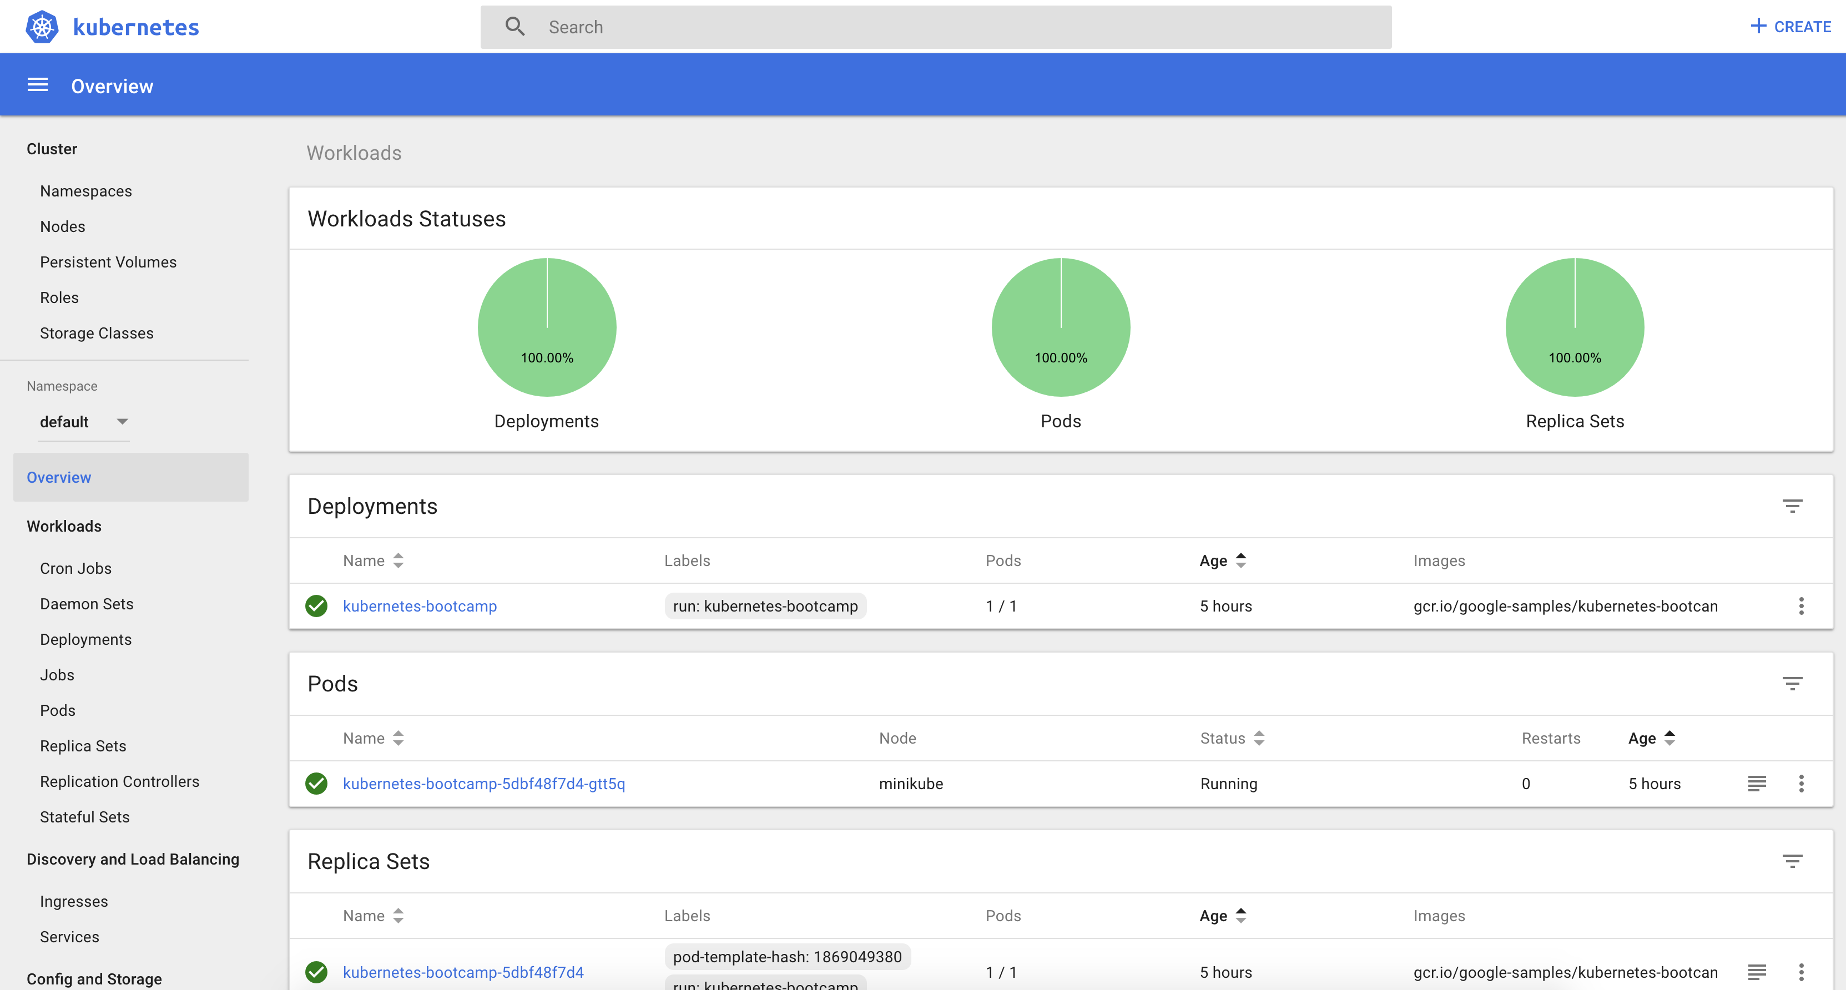
Web UI - Overview
Notes:
K8s also offer a web UI for developers to monitor the status of the cluster and the applications running on it.
You can observe different parameters on multi-layers.
For example, this graph shows the big picture of the cluster.

Slide 15
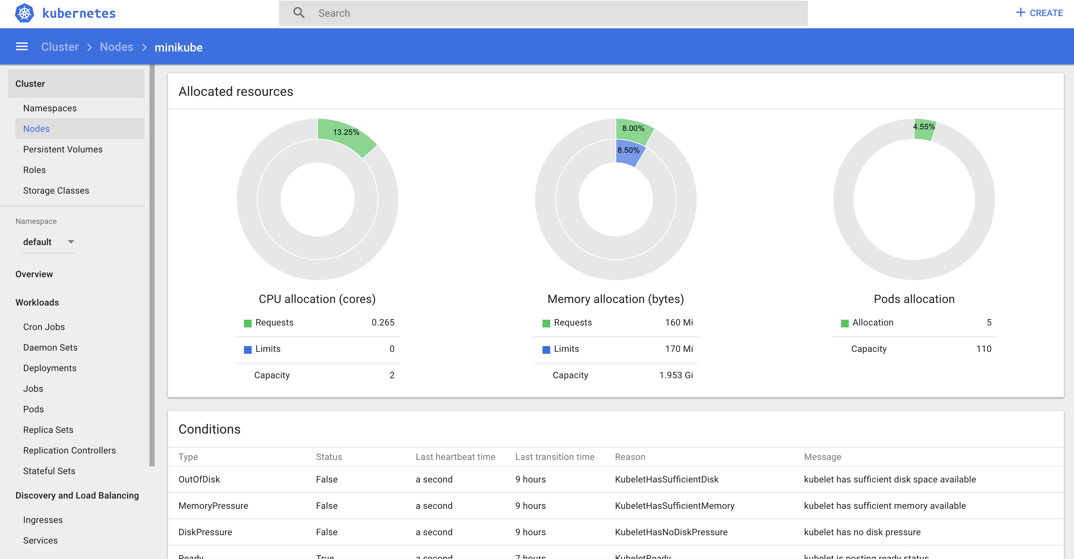
Web UI - Nodes
Notes:
And this one shows us the status of one of the nodes running on the cluster.
With this web UI, developers can manage the whole system with less effort.

Slide 16
Advantages
Solid background: started by Google before going open-source
Written in GO with great community support
Flexibility: large amount of plug-ins and third party supports
Wide variety of container support: Docker, rkt, Windows
Native support for auto-scaling
......

Slide 17
Disadvantages
Flexibility
Hard to setup with full customization for real-world applications
Steep learning curve
Documentation distributed over multiple websites

Slide 18
References
[1] Kubernetes. https://en.wikipedia.org/wiki/Kubernetes
[2] Kubernetes Documentation. https://kubernetes.io/docs/user-journeys/users/application-developer/foundational/
[3] Kubernetes vs Mesos vs Swarm: A Look at Major Container Orchestration Engines. https://www.sumologic.com/devops/kubernetes-vs-mesos-vs-swarm/
[4] Kubernetes vs Docker Swarm. https://platform9.com/blog/kubernetes-docker-swarm-compared/
[5] Why Kubernetes is Winning the Container War. https://news.ycombinator.com/item?id=12462261

Slide 19
Thank you!

