Slide 1
AI in Public Relations
Automating PR and Branding with Python

Slide 2
What is AI in PR?
AI can automate content creation, audience targeting, and media monitoring.

Slide 3
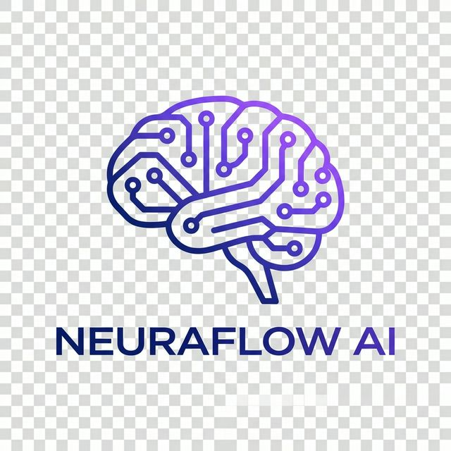
Branding Example

