Slide 1
AI in Public Relations
Automating PR and Branding with Python

Slide 2
Applications of AI in PR
Media Monitoring
Content Generation

Slide 3
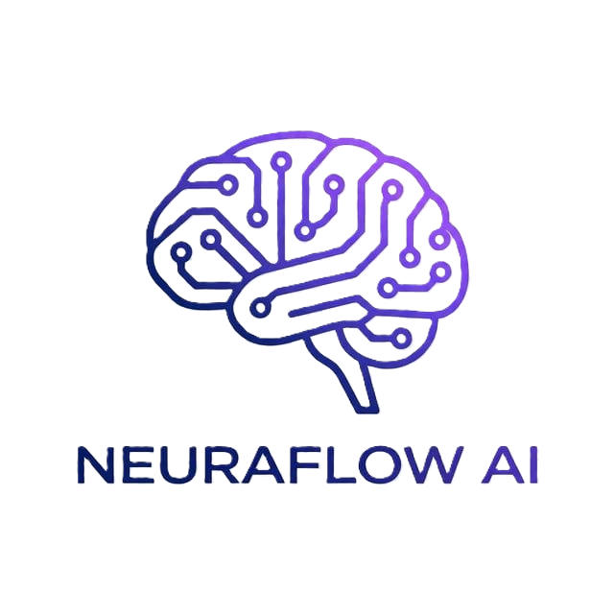
Brand Logo

