Slide 1

Name Of Student And UID
Ritesh Prasad Sah (23BCA10449)
Mumtaj Ali (23BCA10662)
Shaurya (23BCA10751)

Slide 2
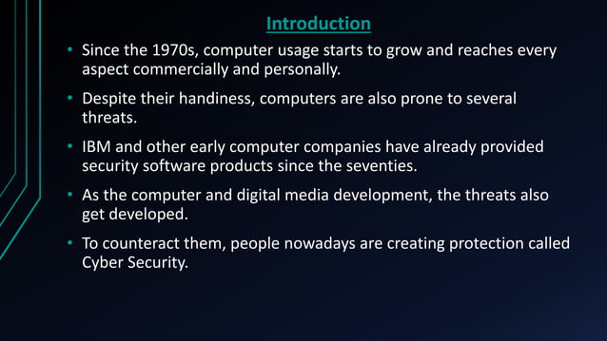

Slide 3
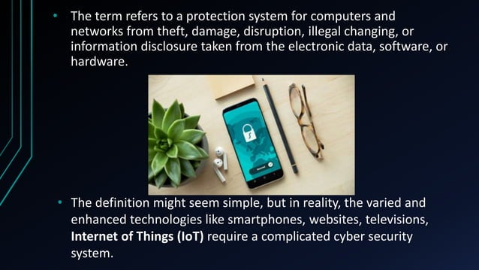

Slide 4
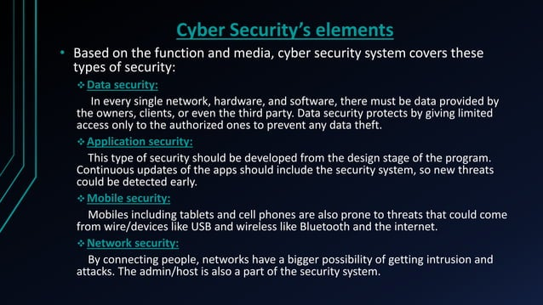

Slide 5
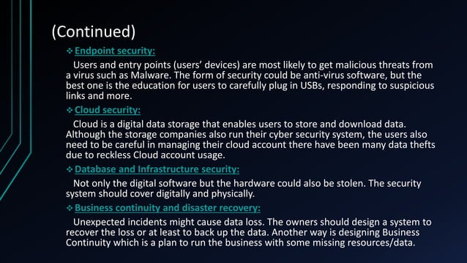

Slide 6


Slide 7
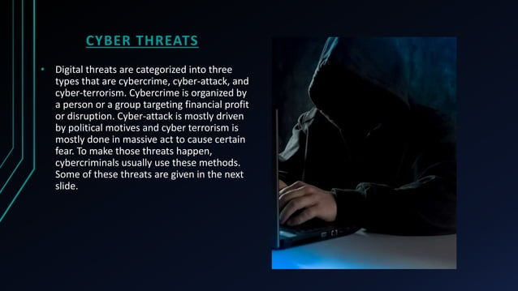

Slide 8


Slide 9


Slide 10
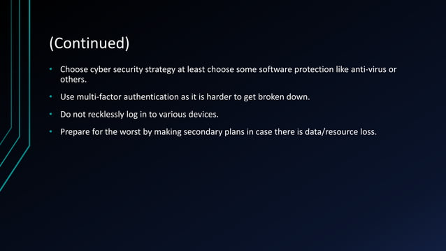

Slide 11


