Slide 1
Vizsgaremek
KSH IT Zrt.

Slide 2
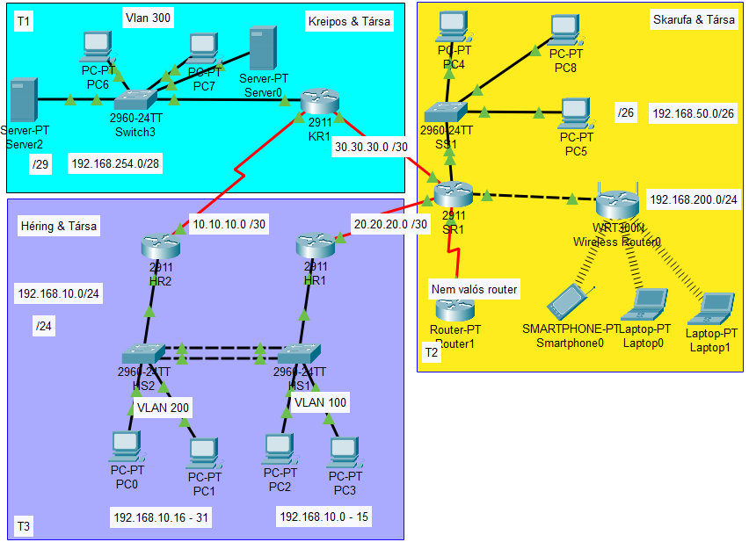
Topology types
:
Logical Topology concept
Physical Topology concept:
There is nothing yet.

Slide 3
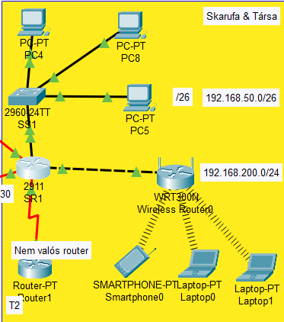
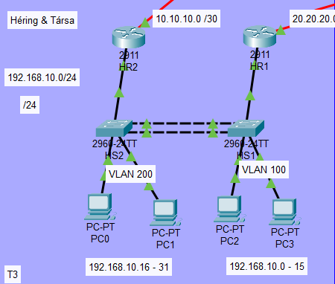
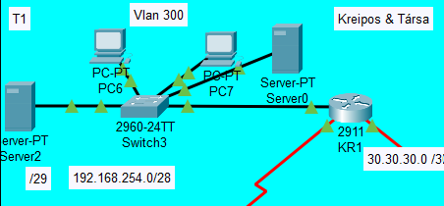
Divisions & members
Skarufa Ákos
Héring Máté
Kreipos Gábor

Slide 4
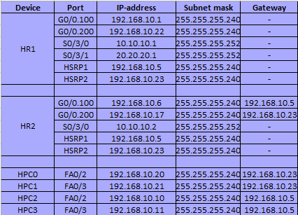
IP-ADDRESS TABLE

Slide 5
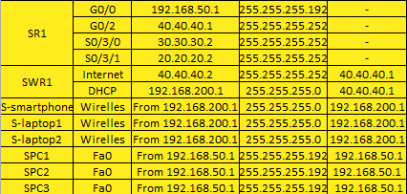
Ip-address table

Slide 6
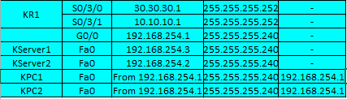
Ip-address table

Slide 7
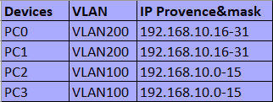
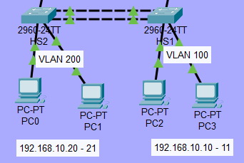
Vlan TABLE

Slide 8
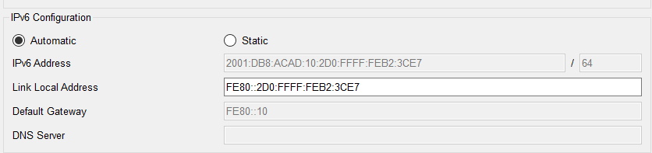
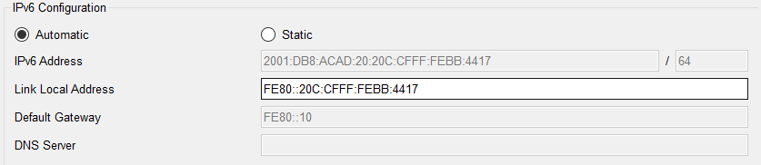
IPV6 adresses
Two different IPv6(SLAAC)

Slide 9
Passwords
SSH:
user: admin
password cisco
____________________________________
Console: cisco
Domain-name: kando.com
Password: cisco
WAN protocoll:
HR1:
user SR1
password cisco
SR1:
user HR1
password cisco

Slide 10
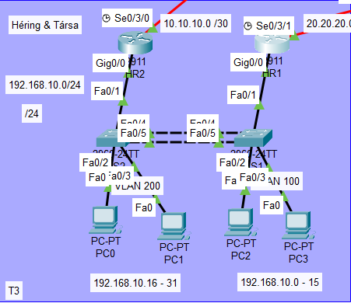
Héring máté

Slide 11
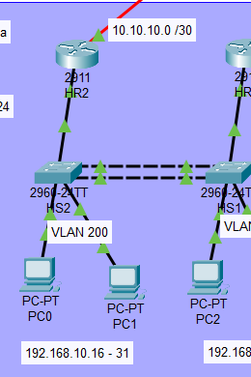
DIVISIONS (details)
HSRP protocoll:
It’s working perfctly
Virtual Router IP:
192.168.10.6
192.168.10.23
IPv6 cannot be done in Cisco.

Slide 12
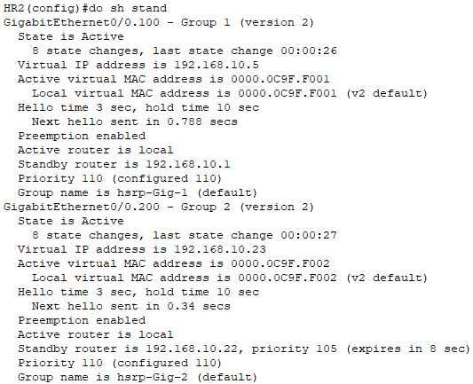
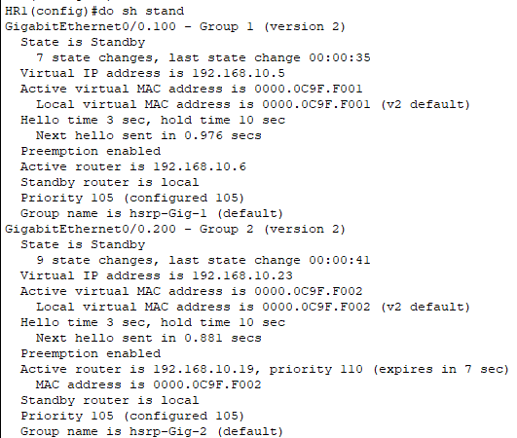
HSRP PROTOCOLL
HR2(Active)
HR1(Standby)

Slide 13
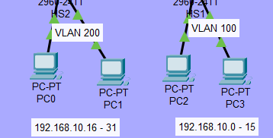
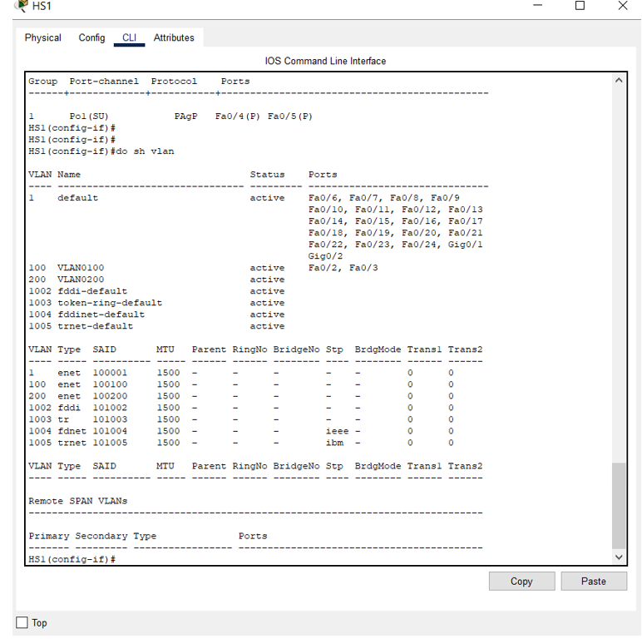
Divisions (details)
VLAN protocoll:
We have 2 different VLAN:
-100
-200
With two different IP range:
192.168.10.0-15
---------------------------
192.168.10.16-31

Slide 14
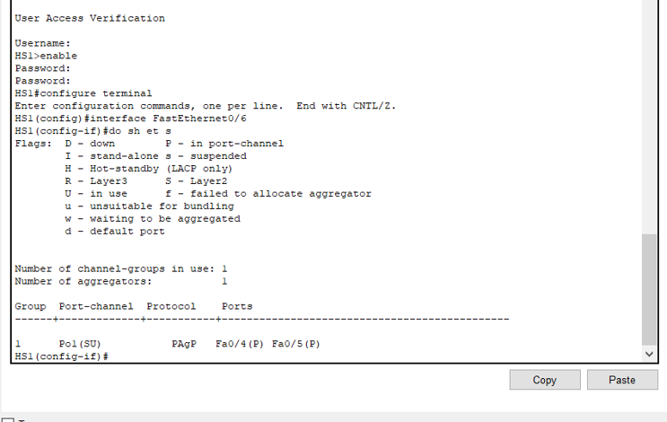
Division(details)
EtherChannel protocoll:
-It’s working good with LACP
protocoll

Slide 15


DIVISIONS(DETAILS)
NAT Protocoll:
PAT: 199.133.65.1 192.168.10.1 - 31 (HR2)
Static NAT: 188.77.66.1 -> 192.168.254.7 (KR1)
Static NAT: 89.76.32.11 -> 192.168.99.1 (ISP)

Slide 16
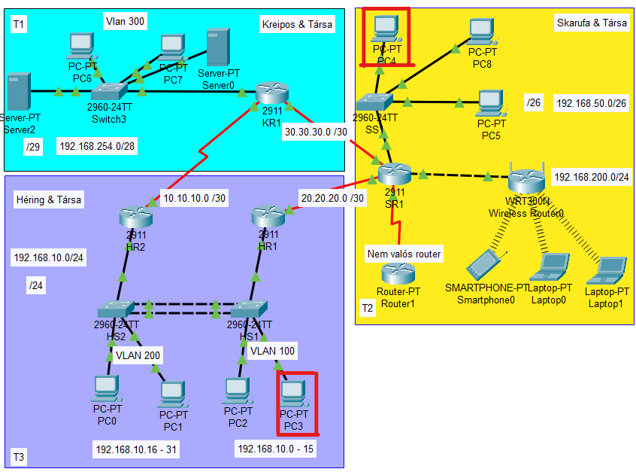
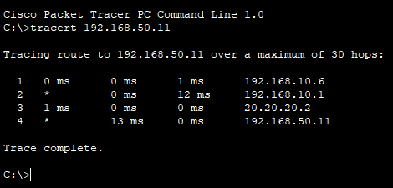
TRacert
PC3->PC4

Slide 17
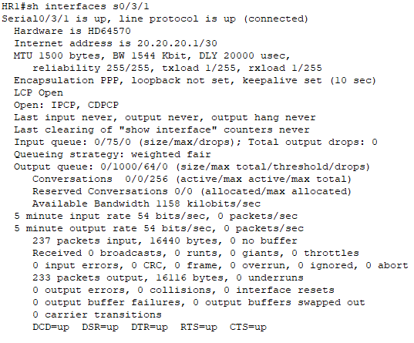
WAN
Divisions(Details)
WAN connections with PPP (HR1)

Slide 18
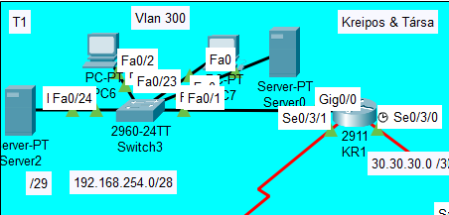
Kreipos Gábor

Slide 19
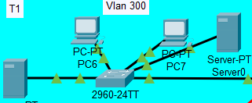
DIVISIONS (DETAILS)
LINUX & Windows server protocoll:
Windows : AD, DHCP
-----------------------------------------------------------------------------------------
Linux : DNS , WEB

Slide 20
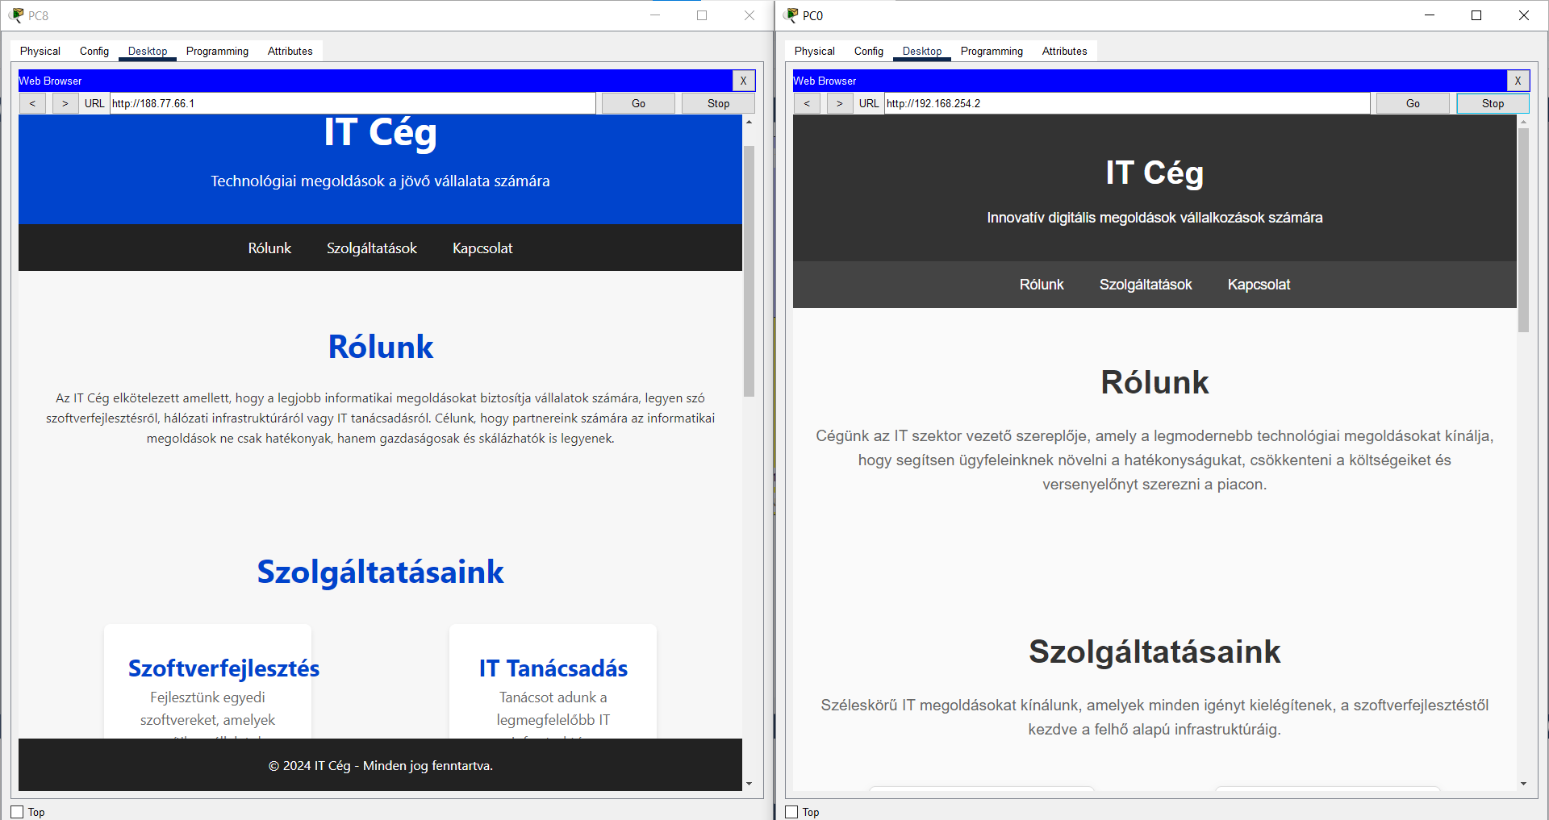
Divisions(details)
WEB Servers :
Server 0 : Left WEB page
--------------------------------------------------
Server 2 : Right WEB page

Slide 21
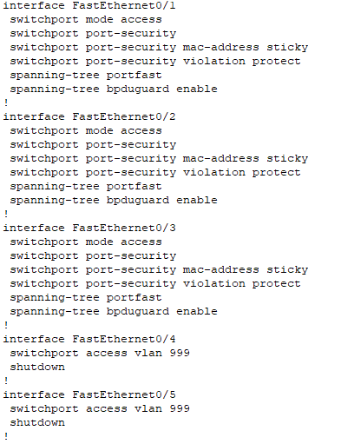
Divisions (details)
Port-security is working on every single device
(shutdowns,protects)

Slide 22
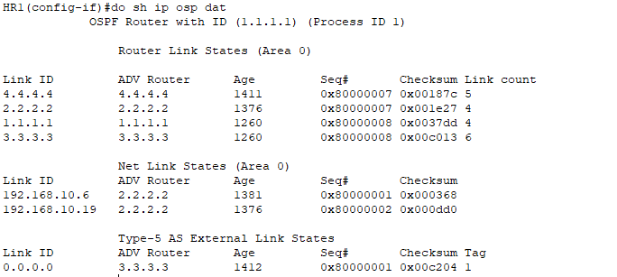
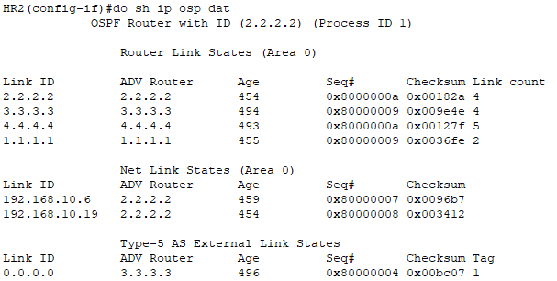
Ospf protocoll
HR1
HR2

Slide 23
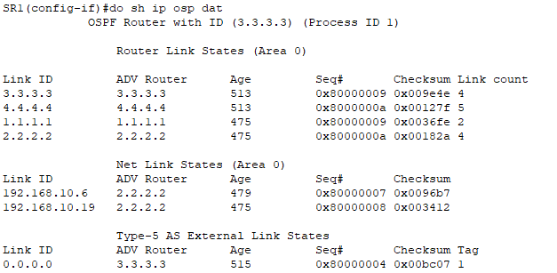
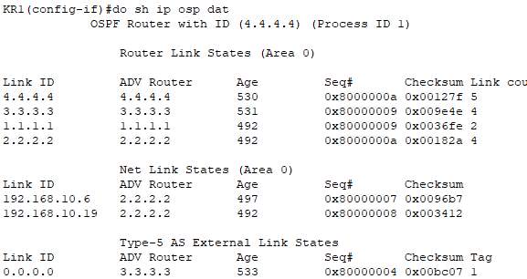
OSPF protocoll
SR1
KR1

Slide 24
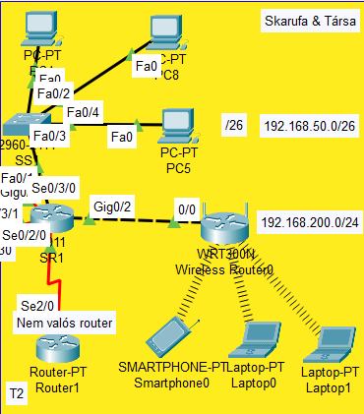
SKARUFA áKOS

Slide 25
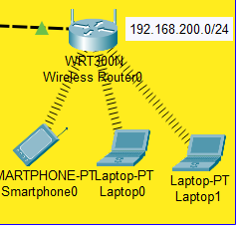
DIVISIONS (DETAILS)
WiFi protocoll:
192.168.200.1 is the main address
You can’t ping into the network, only out
With ACL protocoll, only „Héring és társai” reach the WiFi section (The test can be see later)
Stats:
Network: 192.168.200.0 255.255.255.0
Gateway: 40.40.40.1
DNS Server: 8.8.8.8

Slide 26
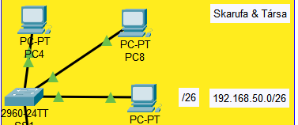
DIVISION (DETAILS)
Default IPv4 DHCP protocoll:
-The pool name is: Skarufa&tarsai
-Config: DR:192.168.50.1
N:192.168.50.0. 255.255.255.192

Slide 27
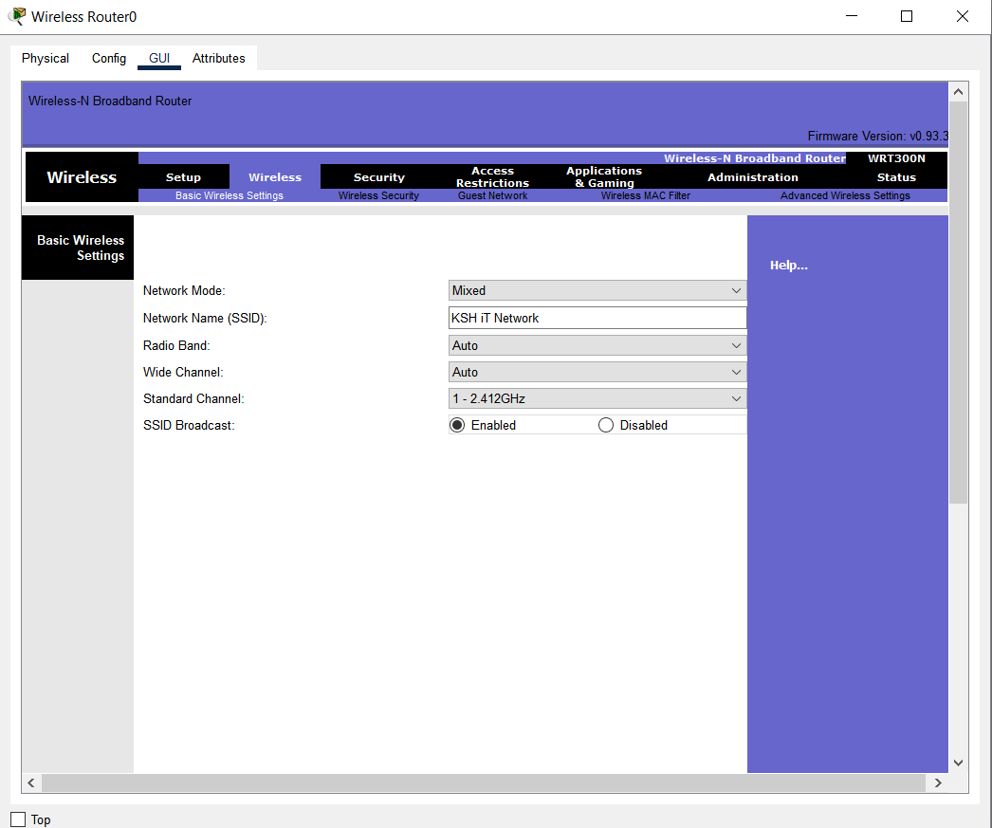
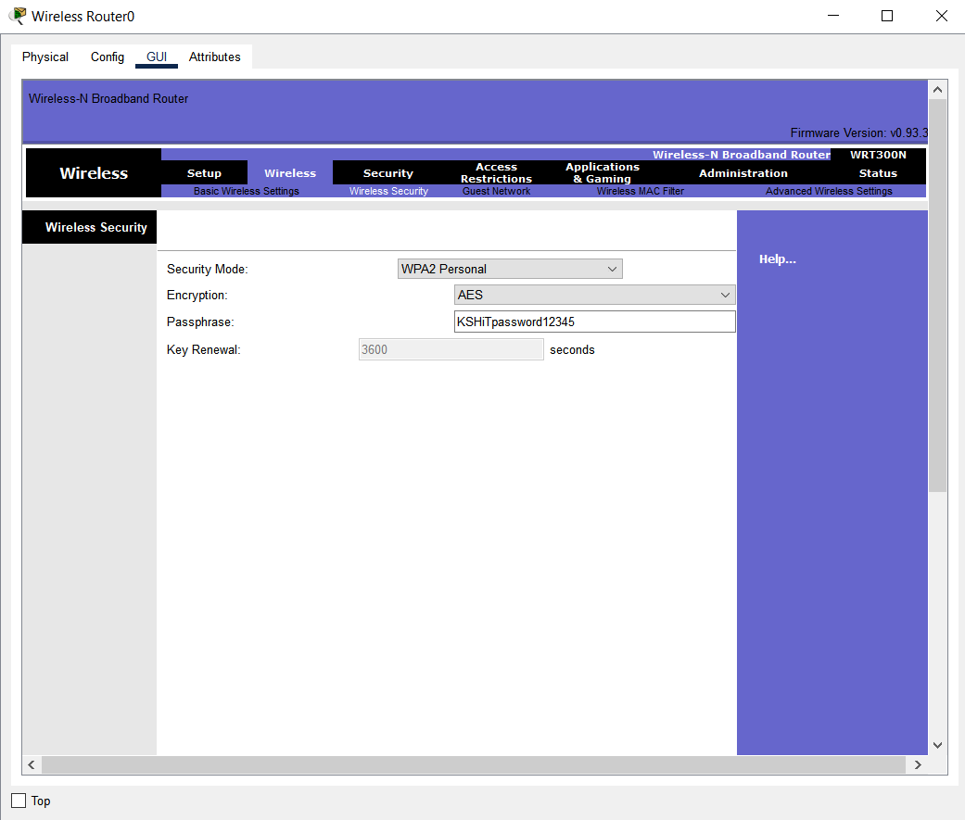
DIVISION(DETAILS)
SSID
Password
„KSH iT Network”
KSHiTpassword12345

Slide 28
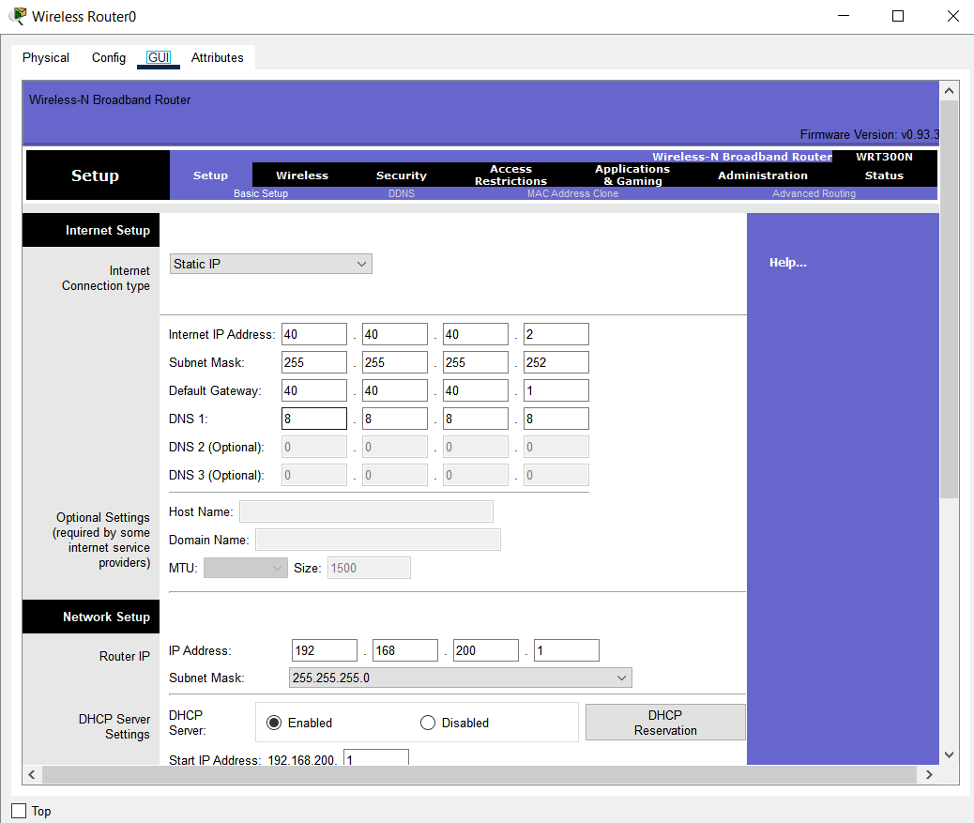
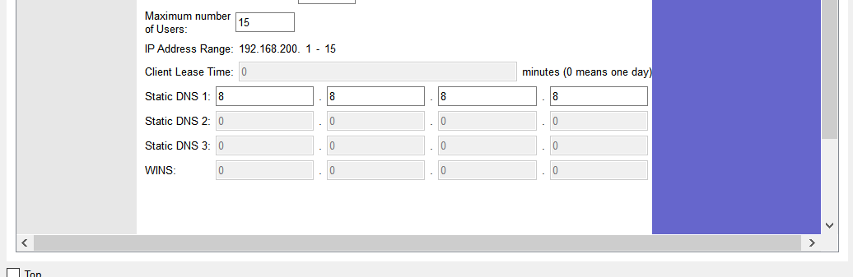
Division(details)
IP-addresses
IP-addresses

Slide 29
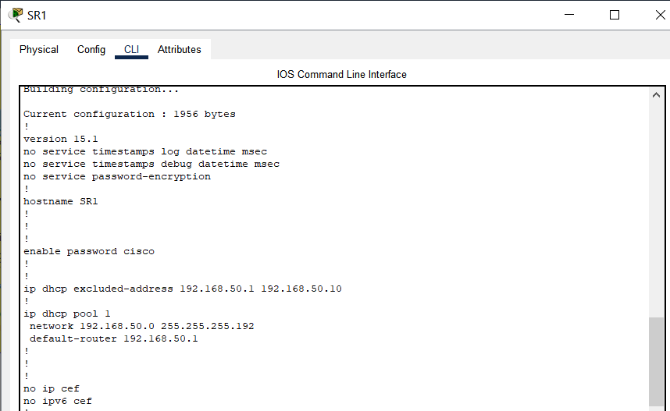
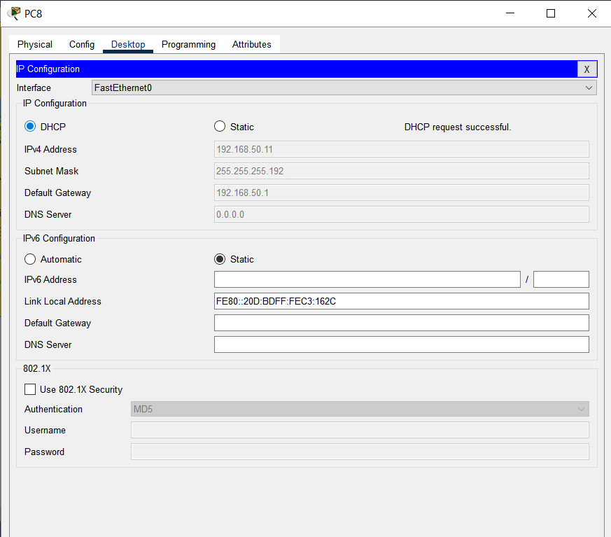
DIVISION(DETAILS)
DHCP-protocoll(Router)
DHCP-protocoll(PC)

Slide 30
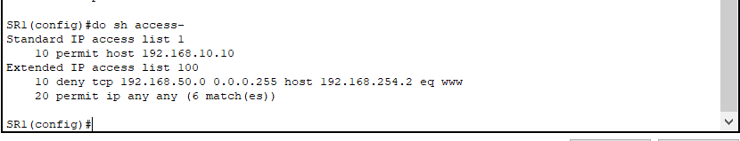


ACL
Only PC2 can connect to SR1thru ssh
192.168.50.0 network cannot reach Server 2 only on HTTPS (secure site)

Slide 31
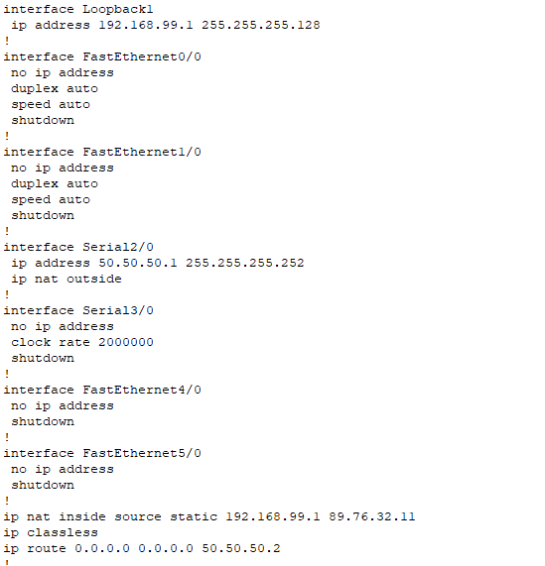
ISP
Loopback 1: 192.168.99.1 / 25
-------------------------------------------------------------------------
Static nat: 192.168.99.1 -> 89.76.32.11

Slide 32
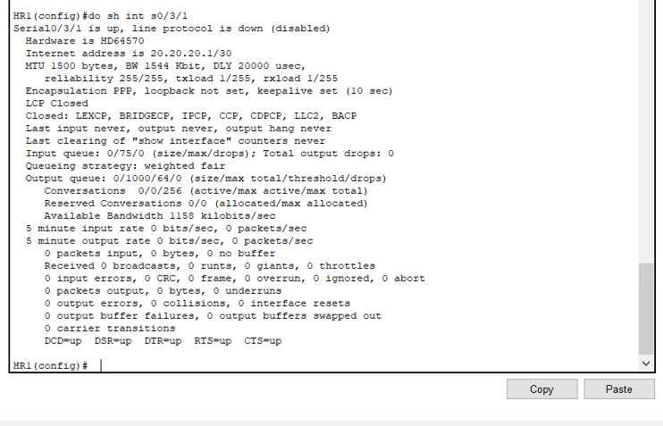
Division(details)
WAN connections with PPP (SR1)

Slide 33
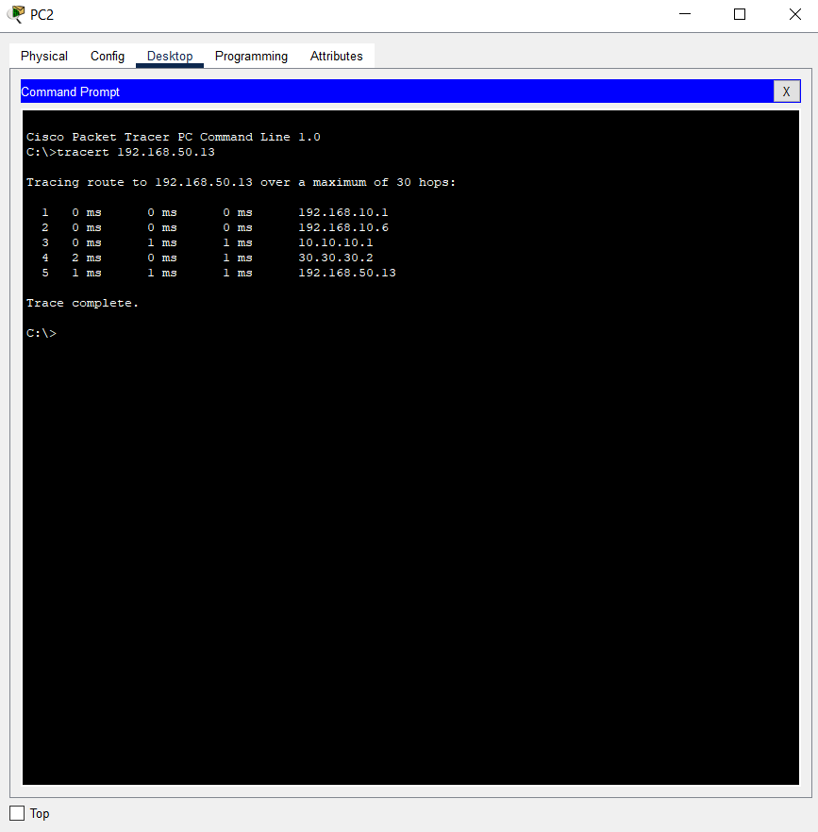
Tracert

Slide 34
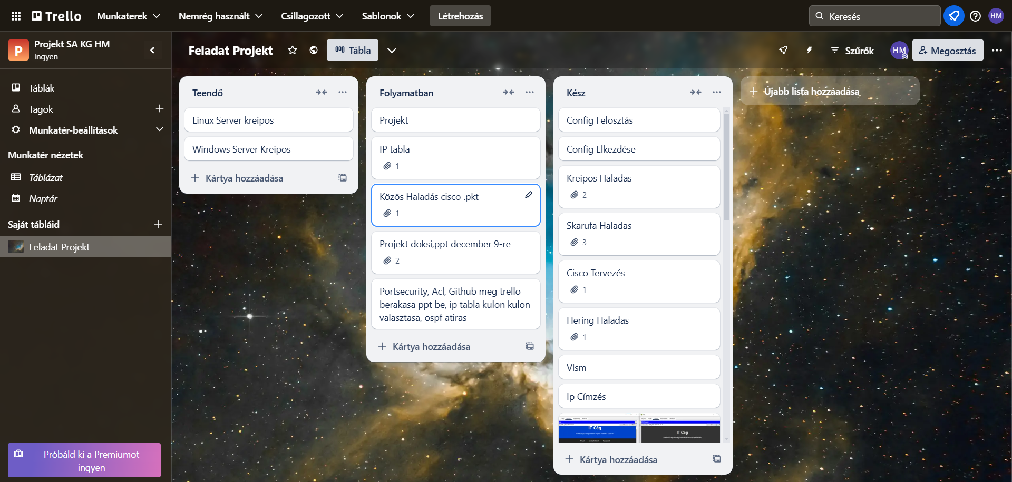
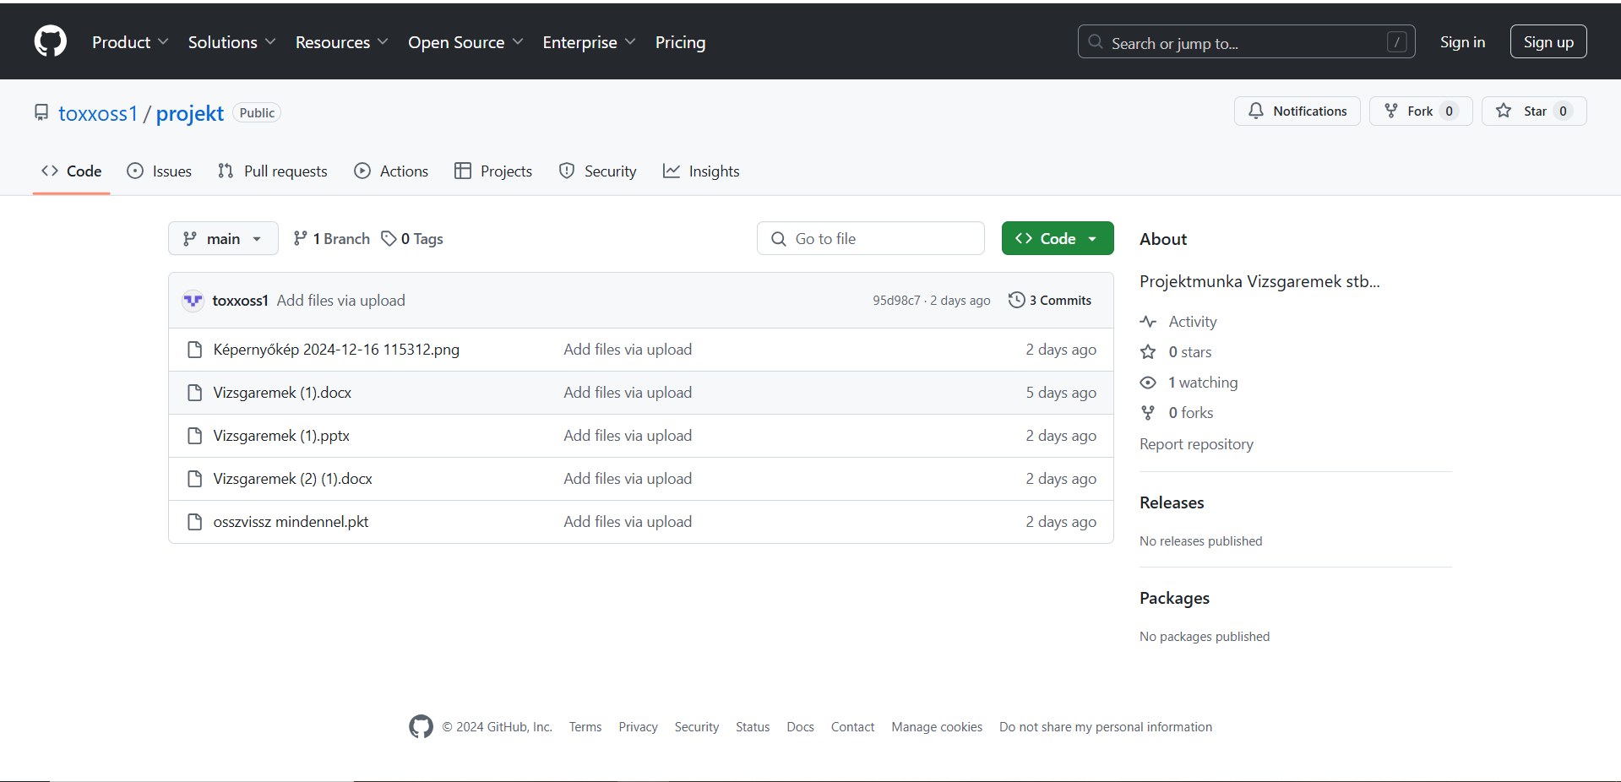
Github/trello

Slide 35
Divisions
Héring | Kreipos | Skarufa
HSRP | Windows Server | WLAN
VLAN | Linux Server | DHCP
Routing | Routing | Routing
OSPF | OSPF | OSPF
Port-Security | Port-Security | Port-Security
ACL | ACL | ACL
Ether-Channel | Word Documentation | ISP
PPT Documentation | Excel Documentation | PPT Documentation
Word Documentation |  | Excel Documentation

Slide 36
The end
Thank you for listening!

