Slide 1

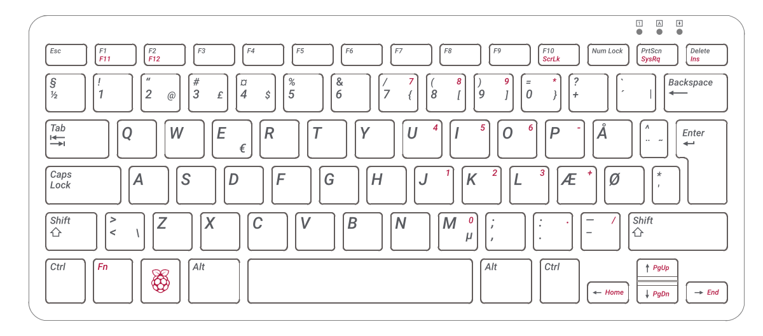
WHIRLWIND ATTACK
LEAP ATTACK
JUMP
HELICOPTER ATTACK
ATTACK
EXIT GAME
OPEN / CLOSE SHOP MENU
SPRINT
MOVE MOUSE TO CONTROL CAMERA
MOVE

