Slide 1
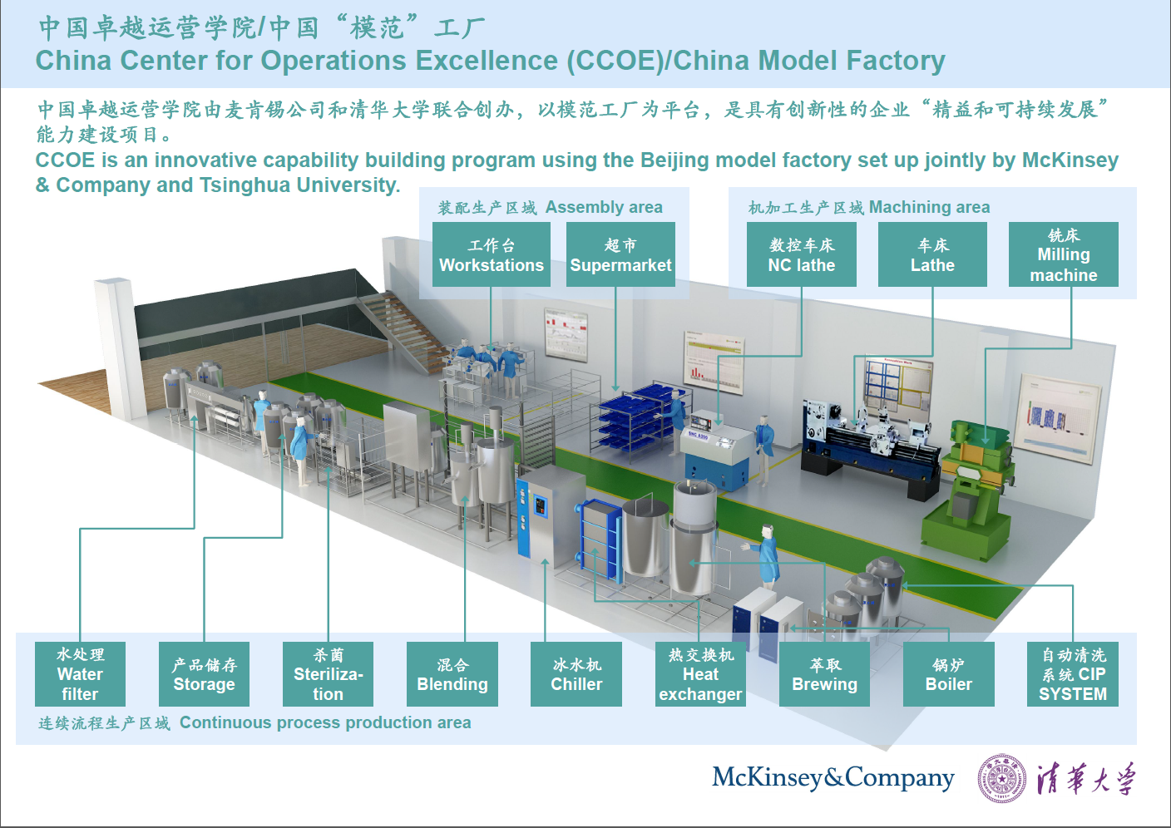
McKinsey-THU China Model Factory

