Slide 1

A Meta-Language for Architecting Complex Systems
Sponsor: The Charles Stark Draper Laboratory, Inc.
Advisor: Prof. Edward F. Crawley
ESD-PhD. Candidate: Benjamin Hsueh-Yung Koo
Graduation Date: June 2004 (expected)

Slide 2
Objective of Research
To articulate a set of generally applicable principles in Complex Engineering System Architecting
By creating a meta-language for system architecting
  Represent the space of architectures in a formal language
  Identify and organize measurable properties within the space of architectural choices
  Establish a preference order for each system metric value according to contextual situations
  Develop methods and tools to generate and select architectures
  Demonstrate on Draper-related applications
Using intellectual resources and industrial experience at MIT and Draper

Slide 3
Architecture of Methodology
Operational
Risk Model
Bi-directional
Influencing
Development
Risk Model
Operational
Risk Assessing
Development
Risk Assessing
Mission
Success
Risk
Enumerate the architectural options using computable primitives
  Using Finite-State Automaton to generate categorized possibilities
Model the dynamics of operational and development activities
  Using Continuous and Discrete events as temporal abstractions
Encode conditional dependencies of interacting variables
  Using Bayesian Belief Network to perform state-space mapping
Examine subsets of architectural options through user interactions
  Using Belief Propagation Algorithm to trigger multi-scale simulation runs to verify and validate architectural decisions

Slide 4
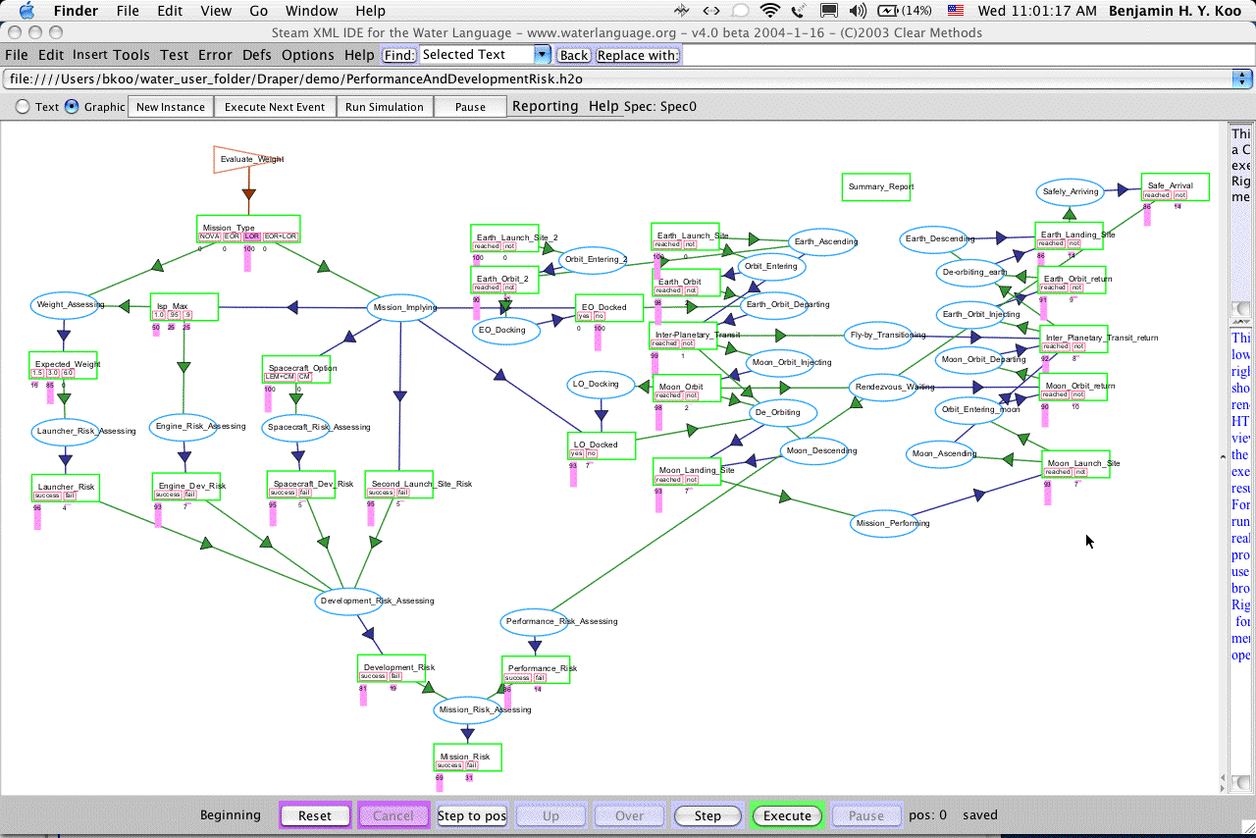
Space of Possible Architectures
Application-Specific Language = Graphical Automaton

Slide 5
Architectures of Modeling Languages
Languages
System
Dynamics
Coloured
Petri-Net
Probabilistic
Network
Categorical
Theory
Object-Process
Methodology
Concepts
Operand
Place
State
Object
Stock
Place + Coloured tokens
v1
v2
Operator
Transition
Process
flow
Pre-condition
Relationship
Embedded in
arrows
P1
T1
P2
Conditional
Probability Tables
Embedded in
Operators
Post-condition
Runtime
Engine
Numerical Integration
Engine
Event Queue Management
Engine
Belief Propagation
Algorithms
S-Expression
Interpreter
λ calculus
Application
Domains
Physical System
Modeling/Decision
Support
Discrete Event
Modeling
Reasoning about
Random
Processes
Mathematical
Reasoning,
Compiler design
System
Description/
Simulation
Temporal
Scale
Infinitesimal Time Steps
Quantized Time Steps
A-Temporal
Graph Abstraction
of multiple scales
Approximation of
multiple scales
Spatial
Metaphors
Continuous Metaphors
Quantized Metaphors
State-space Metaphors
Generic Abstraction
of Metaphors
Symbolized
Metaphors
Notes:
J. Arlen Cooper

Slide 6
Bio and Conference Invitations
Education:
  PhD in Engineering Systems Architecting, MIT, 2004;
  MS in System Design and Management, MIT, 2001;
  MS in Industrial Engineering and Operation Research, U of MN, 1995
  BS in Mechanical Engineering, U of MN, 1993
Work Experience:
  Research Engineer in Integrated Aircraft Power Systems
  Research Associate in Supply Chain and Financial Risk Visualization
  Software Architect in the Information Technology Industry
Recent Invited Conference Presentations:
  International Conference on Complex Systems, May 16-21, 2004
  2nd International Conf. on “A New Kind of Science”, April 23-25, 2004
  Center for Innovation in Product Development, March 12, 2004
  Hanscom Air Force Research Laboratory, February 27, 2004

