Slide 1

A New Kind of Language for Complex Engineering Systems:
Case Study: NASA’s Apollo Program
NKS 2004
Benjamin Koo
Edward F. Crawley
Engineering Systems Division
Department of Aeronautical and Astronautical Engineering

Slide 2
Architecting in Engineering Systems
One Grand Challenge in Engineering Systems:
  Assessing Very Large Scale engineering decisions early enough with meaningful model resolutions and abstraction levels
  Architects face numerous options based on possible combinations and permutations with insufficient computational power
Need to integrate multiple domains of knowledge at meaningful levels of abstraction and resolution
  By applying the Principle of Computational Equivalence to translate between domain models
  Using a generalized version of Wolfram Automata: Object-Process Network (OPN)
Applying NKS to NASA’s Apollo Mission:
  Wolfram’s automata (a simple language) can be mapped onto multiple abstraction levels based on the Principle of Computational Equivalence
  NASA’s Apollo mission is revisited to to show that NKS can help assess critical decisions at multiple technical levels
Notes:
An architecture of memory and processing.

Slide 3
Architecting as Language Manipulation
The Principle of Computational Equivalence states that all physical processes can be mapped onto equivalent “languages”
  Computer scientists often define various kinds of “machines” as “languages” or “automata”
All domain-specific models must be built on a common set of linguistic primitives in order to ensure consistency
  Choice of vocabulary embodied in OBJECTS with their respective range of admissible states define the variability in a system
  Grammatical rules are PROCESSES that capture the relationships between objects (as conditional probability functions) can reduce system complexity
  Vocabulary arranged by Grammatical Rules creates a NETWORK
Notes:
An architecture of memory and processing.

Slide 4
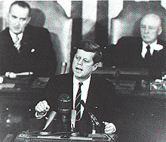
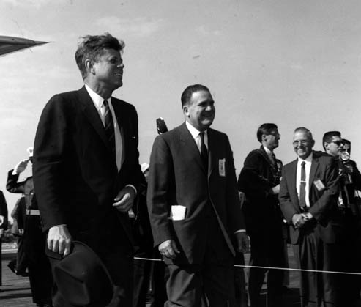
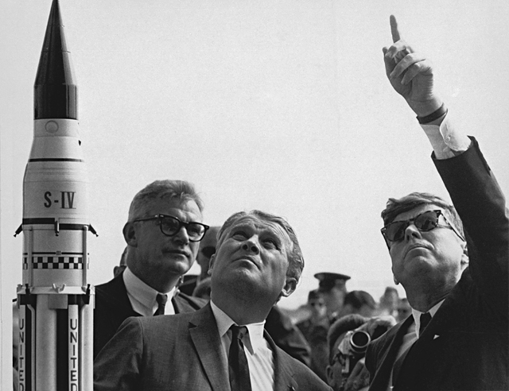
Language: the medium of interactions
Language(s) of
Decision Makers
Program-Level
System
Operational
Assessing
Development
Assessing
Language(s) of
Operators
Operational
System
Bi-directional
Influencing
Development
System
Language(s) of
Technologists
Interactions between subsystems requires translation between domain-specific languages
System architects must share a global language or translate between local/domain-specific languages
All domain-specific models must be built on a common set of linguistic primitives in order to ensure consistency and composability
Notes:
http://www.sonic.net/~cooptown/spaceage/apollo.html
President Kennedy delivered a powerful speech on May 25, 1961 to a joint session of Congress. His challenge to the nation to land men on the moon was answered by overwhelming approval of what was to be one of the costliest projects ever concieved.
Dr. Robert Seamans, Deputy Administrator of NASA; Dr. Wernher von Braun; and President John F. Kennedy at Cape Canaveral, Florida, November 16, 1963. (Photo: NASA)
President John F. Kennedy and NASA Administrator James T. Webb at the Launch Operations Complex (later renamed the Kennedy Space Center) during a tour of NASA facilities on November, 1963. (NASA Photo, available on NASA Image

Slide 5
Languages based on “Simple Programs”
Wolfram Automata
  A series of interactive machines that follow one rule to perform Turing computable tasks
Languages based on a “simple kernel”
  Mathematica
    Multi-Paradigm Programming Language
    Meta-Language that subsumes multiple programming paradigms
  Modelica
    A visual object-oriented language for physical systems based on Mathematica’s runtime engine
Notes:
http://www.stephenwolfram.com/about-sw/interviews/93-dobbs/
An architecture of memory and processing.

Slide 6
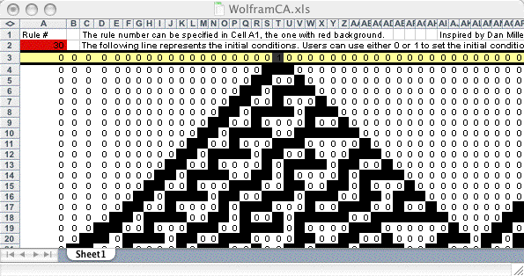
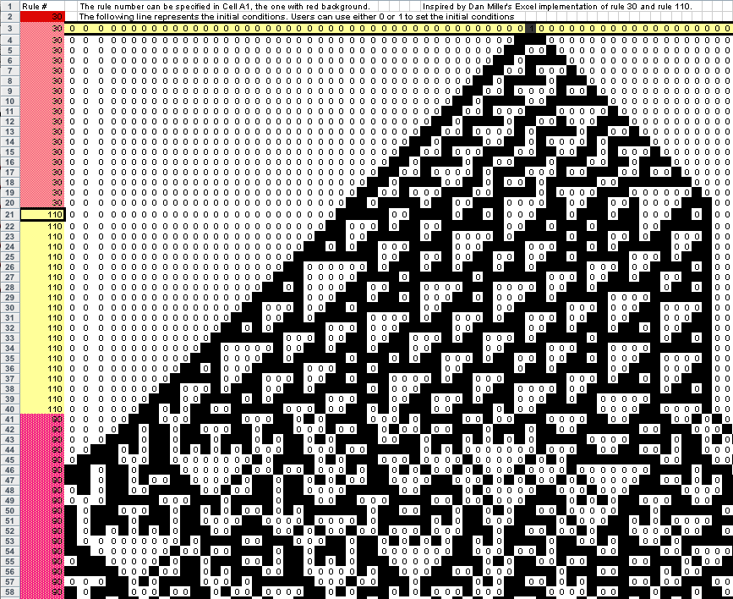
Variability in Cell-State Permutation
Cellular Automata is a visual programming language
<cells, neighboring relations, initial condition, rule number>
Order sensitive: color permutation at initial row
The vertical dimension is time
A common vocabulary and one rule family
p(t=0)
q(t=0)
r(t=0)
Wolfram
Rule
Discrete Space
q(t=1)
Time
Wolfram rules are highly composable
Notes:
This slide shows the example of why the nature of language is an essential element of design practice. Most engineers just force themselves to learn the language that is available. An architect should think about the choice of language to open up the communication channels between component designers.
Signal port approach does not work well when energy needs to be exchanged across component boundaries.
The multi-port approach allows modelers to define more than one parameter to be exchanged bi-directionally.
Formally speaking, the signal port approach is a special case for the multi-port approach.
These types of language subtleties critically influence the cost and time required to create accurate models of the intended systems.
Help decision makers to make decisions in concert by using commonly understandable semantics to build consensus.

Slide 7
Simple Programs in Conditional Probability Tables
Wolfram Rules can also be encoded in Conditional Probability Tables
{ , , , }
{ , , , }
Where:
N: rule number (0..255)
p: left cell
q: middle cell
r: right cell
One generalized function for all 256 rules… (one alternative to NKS p.648)

Slide 8
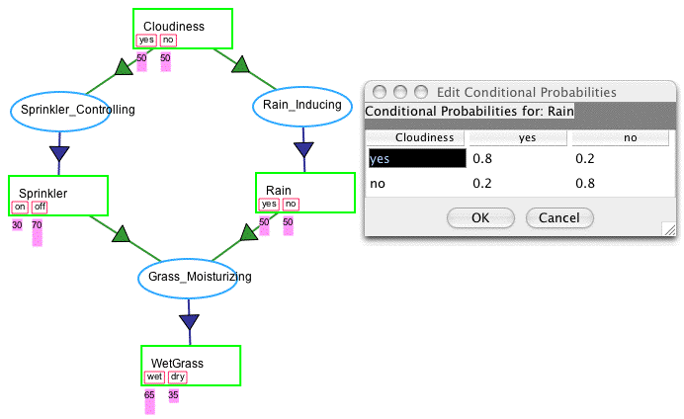
Variability in Cell-State Combination
When time is ignored, a combinatorial problem can be formulated as a graph of conditional probability tables, a.k.a. Bayesian Belief Networks (BBNs)
BBNs can be thought of as probabilistic automata
Exact BBN solution is known to be NP-hard, not suitable for large graphs or dynamic problems
Notes:
Factor Graph and the Sum-Product Algorithm

Slide 9
OPN is a Simple Meta-language
OPN allows non-technical users to construct domain-specific languages
  Domain-specific Vocabulary (Objects)
    Local knowledge confines the space of combinatorial possibility by carefully choosing the inclusion of variables and their admissible value ranges
  Domain-specific Grammar (Processes)
    Local knowledge eliminates unnecessary permutation and combinatorial possibilities
  Domain-specific language (Network)
    Humans and machines can incrementally edit the network structure or the conditional probability table based on local context and runtime experience
Object
v1
v2
Process
Object1
Process
Object2
yes
no
true
false

Slide 10
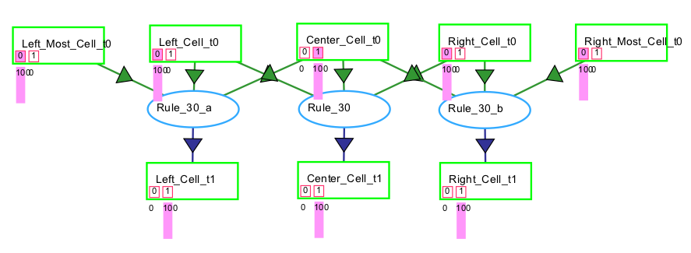
Cellular Automata in Object-Process Network
Object-Process Network (OPN) is an extension from Dori’s (2002) Object-Process Methodology (OPM)
  A general purpose system description language (UML replacer)
Cells as Objects
  Each object can have two or more states
Rules as Functions (Processes)
  Each rule is specified by a unique instance of Conditional Probability Table/Function

Slide 11
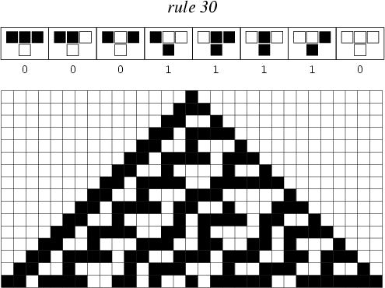
OPN subsumes 4 languages
Languages
System
Dynamics
Coloured
Petri-Net
Probabilistic
Network
Cellular
Automata
Object-Process
Network
Concepts
Operand
Place
State
Object
Stock
Place + Coloured tokens
v1
v2
Operator
Transition
Process
flow
Pre-condition
Direction of
Dependency
Relationship
Embedded in
arrows
P1
T1
P2
Conditional
Probability Tables
Rule number,
Cell Layout
Post-condition
Runtime
Engine
Numerical Integration
Engine
Event Scheduling
Engine
Belief Propagation
Algorithms
Synchronous
Rule Firing
S-Expression
Interpreter
Application
Domains
Physical System
Modeling/Decision
Support
Discrete Event
Modeling
Reasoning about
State-Space
Combination
Natural Science
Pattern Generation
System
Description/
Simulation
Temporal
Scale
Infinitesimal Time Steps
Asynchronous Time Steps
Time-independent
Memory-less
Synchronized
Time Steps
Approximation of
multiple scales
Semantic
Metaphors
Dynamics of Analog Signals
Dynamics of Messages
Causal Structures
Interactive
Systems
Symbolic
Knowledge
Notes:
J. Arlen Cooper

Slide 12
Can one language help reason-through a binary decision in the Apollo Program?
A highly public architectural decision
  Tremendous impact on downstream developmental activities
How did the decision makers reason through the decision with incrementally available knowledge?
launching
or
?
docking
Earth Orbit Rendezvous (EOR)
Lunar Orbit Rendezvous (LOR)
Notes:
http://www.mchinsure.com/apollo/item_houboldlor.html
I included this piece in the art section of the site, because John Houbolt took the time to draw a diagram illustrating his theory on Lunar Orbital Rendezvous. The man thinks so passionately about his theory that he was willing draw it on paper.

Slide 13
Impact of LOR Architectural Decision
LOR decision reached: June 7th, 1962
$160M, 0.82% of total budget $19.4B
Notes:
http://www.hq.nasa.gov/office/pao/History/SP-4214/app2.html
http://www.hq.nasa.gov/office/pao/History/Defining-chron.htm
7 Jun. 1962
At an all-day meeting at the Marshall Space Flight Center, NASA leaders met to hash out differences over the method of going to the Moon with Project Apollo, with the debate getting heated at times. The contention was essentially between Earth-orbit versus lunar-orbit rendezvous. After more than six hours of discussion those in favor of Earth-orbit rendezvous finally gave in to the lunar-orbit rendezvous mode, saying that its advocates had demonstrated adequately its feasibility and that any further contention would jeopardize the president's timetable. This cleared the path for the development of the hardware necessary to accomplish the president's goal.

Slide 14
Science in the LOR vs. EOR Decision:
Sequence and Combination Matters
How to enumerate all possible itineraries?
  Space of trajectories must include sequence info.
How to assess variable interactions over multiple knowledge domains?
  Space of technical options includes a large combination of possibilities
How to inform stakeholders about decisions with comprehensive contextual data?
  The interactions between the two kinds of computational complexity, sequence and combination, must be coherently organized in a unified representational scheme, namely a language

Slide 15
Manual representation and enumeration of trajectory options?
Consider the trip as four planetary encounters (Earth depart, moon arrive, etc)
Each encounter has numerous permutations of objects and processes
Planetary Arrival - 1 craft
Super-orbital
Orbital Entry
De-orbit
Direct Descent
Planetary Arrival - 2 Craft - Joined Initially, Joined Finally
Planetary Arrival - 2 Craft - Joined Initially, Separated Finally
Super-orbital
Orbital Entry
Orbit to Landing
Direct Descent
Super-orbital
Orbital Entry
Orbit to Landing
Direct Descent
Super-orbital
Super-orbital
Orbital Entry
Orbital Entry
Orbit to Landing
Orbit to Landing
Direct Descent
Direct Descent

Slide 16
How to represent and enumerate trajectory options systematically?
Use a finite state automaton to generate all possible mission architectures
  Repeatable Motion Primitives (“Trim” conditions)
    Constant in control setting, configuration
  Finite-Time Motion Primitives (“Maneuvers”)
    Finite time transition between two Repeatable Motions
A “language” for describing all
possible single craft itineraries
Orbit Departing
Orbiting
Transiting
Orbit
De-Orbiting
Direct
Ascent
“Trim
Trajectory”
Orbit Entering
Orbit Attaining
Direct Decent
Surface
Frazzoli 2001
Notes:
P51 of Frazzoli thesis:
Trim Trajectories are defined by the following:
A constant control setting u bar.
A constant configuration g bar.
A constant vector epsilon bar, with eta bar := A d(g bar) (sub) epsilon bar belongs to h.
With the condition that Sigma(g bar, epsilon bar, u bar) = 0. As a consequence, any instance of a given trim trajectory , can be expressed as:
g(t) = h(0) exp(eta bar t) g bar.
P53 of Frazzoli thesis:
A maneuver is defined as a finite time transition between two trim trajectories.
A time duration T
A control signal u: [0, T] -> U
A function psi[0,T] -> Gxg, describing the evolution of the system over the maneuver.

Slide 17
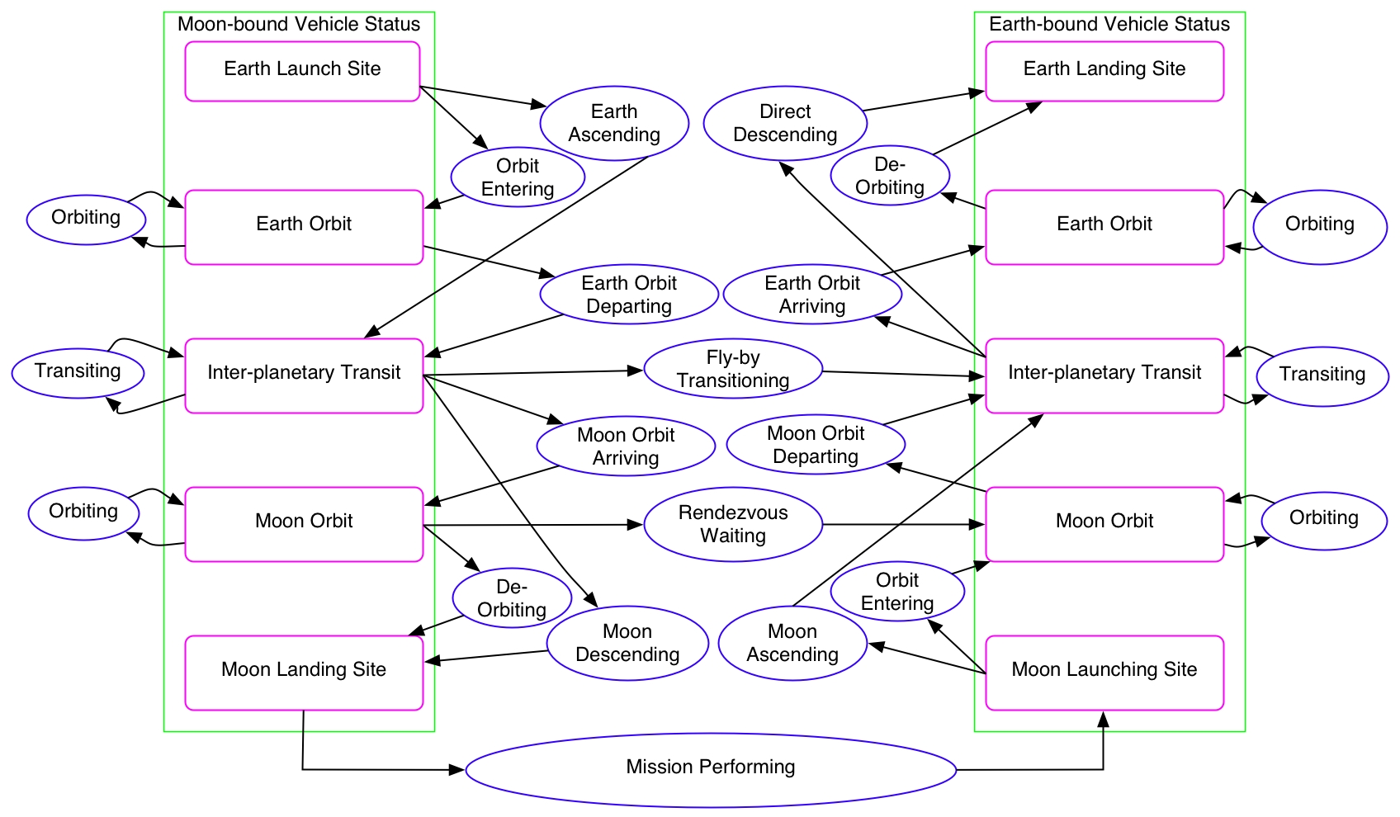
Generator of Mission Architectures
“Trim” conditions
steady state
Maneuvering
steady state
“Trim” conditions

Slide 18
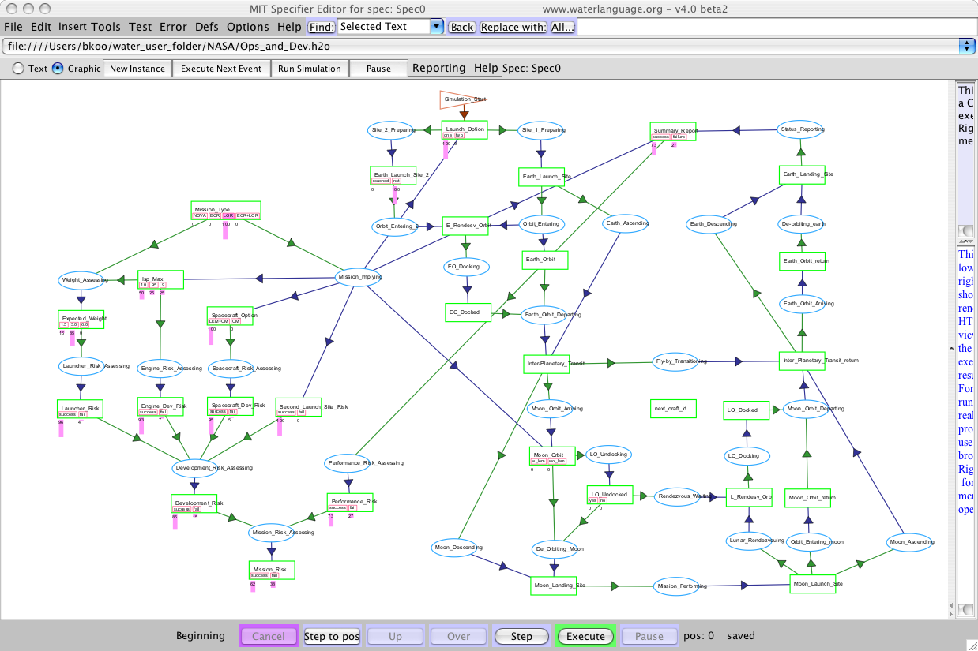
Demo

Slide 19
Summary
Large Scale Engineering Decisions need a New Kind of Language
  As systems become more complex, a simpler yet unifying language is needed to deal with the two essential sources of computational complexity (permutation and combination)
  Existing computable languages can be simplified or emulated using a unifying meta-language, Object-Process Network
Object-Process Network is a user-friendly meta-language that allows a wide range of users to create intuitive, domain-specific, yet efficient languages
  Languages derived from OPN can be composed into a unified computational model to assess the interactive effects of subsystems across many levels of abstraction and model resolutions

Slide 20
Acknowledgements
Dr. Robert Seamans for his generous time and oral history that shed light on Apollo’s landmark decisions
Dr. Raymond Leopold for his insights into the design of Iridium Satellite systems and how simple rule tables can be used to construct very complex interactive systems
Mr. Russ Wertenberg from NASA for his insights into the socio-techno dynamics in Space Programs
Thanks to Christopher Fry at http://www.clearmethods.com for his implementation of the OPN runtime engine using the Water Programming Language
Mr. Qiu Yilin for his original concepts in evolvable software systems
Prof. Paul Carlile for his contribution in using boundary objects as a common currency for socio-technical system interactions
Dr. Geilson Loureiro, Karen Marais, A-P Hurd for their respective intellectual contribution and technical reviews of this presentation.

