Slide 1
FINAL PROJECT
By : Ayyub Jose

Slide 2
The Ask
Looking into three Algorithms in predictive modelling
Analyzing Illness dataset and predicting if tumor is benign of malignant
Analyzing algorithms and comparing results
Understanding which algorithm yielded best results
Identifying insights gained from findings
Recommendation and Justification on which model should be selected

Slide 3
The Methodology
Three different algorithm will be tested against the data set
Support Vector Machines
Naïve Bayes
Decision Tree

Slide 4
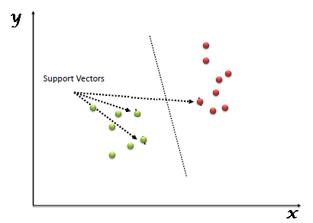
SVM
Support Vector Machine” (SVM) is a supervised machine learning algorithm which can be used for both classification or regression challenges
Advantages
SVM works relatively well when there is a clear margin of separation between classes.
SVM is more effective in high dimensional spaces.
SVM is effective in cases where the number of dimensions is greater than the number of samples.
SVM is relatively memory efficient

Slide 5
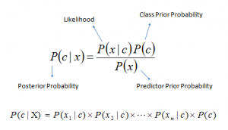
Naive Bayes algorithm
The Naive Bayes classifier assumes that the presence of a particular feature in a class is unrelated to the presence of any other feature.
Advantages
It is simple and easy to implement.
It doesn't require as much training data.
It handles both continuous and discrete data.
It is highly scalable with the number of predictors and data points.

Slide 6

Decision tree algorithm
Decision Tree solves the problem of machine learning by transforming the data into a tree representation. Each internal node of the tree representation denotes an attribute, and each leaf node denotes a class label.
Advantages
Compared to other algorithms decision trees requires less effort for data preparation during pre-processing.
A decision tree does not require normalization of data.
A decision tree does not require scaling of data as well.

Slide 7
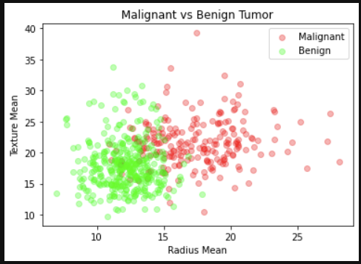
Understanding the dataset
Strong overlap between classes in the central area
Data only contains two data types, floats and categorical data
Strong correlated between some datasets

Slide 8
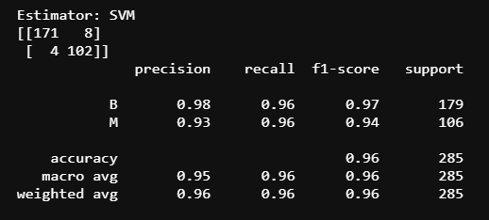
Understanding the Dataset
SVM
This method yielded the most accurate results in the confusion matrix
This model had higher precision when dealing with the benign classification
The Analysis yielded an accuracy of 96%

Slide 9
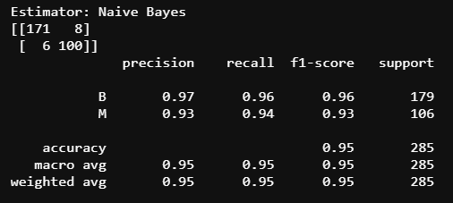
Understanding the Dataset
Niave Bayes
This method yielded accurate results in the confusion matrix
This model had higher precision when dealing with the benign classification
The Analysis yielded an accuracy of 95%

Slide 10
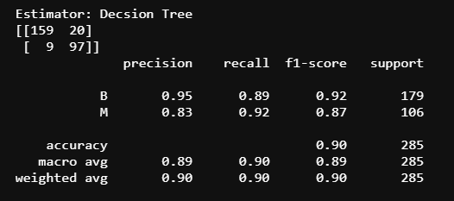
Understanding the Dataset
Decision Tree
This method yielded the least accurate results in the confusion matrix
The worst accuracy when dealing with the Malignant class
The Analysis yielded an accuracy of 90%

Slide 11
Recommendation
The SVM and Naïve Bayes Model yield similar results but SVM model yielding higher accuracy with more data
I would recommend Mr John use SVM use this for his analysis
SVM works relatively well when there is a clear margin of separation between classes. In this dataset we have two clear distinct classes
When the data set size was increased , the SVM maintained its high accuracy while the Naïve Bayes model did not

Slide 12
IMPROVING THE MODEL
Implementing a 'unity-based normalization’ could increase or accuracy. This seeks to turn all the columns to a 0-1 range. This will allow a proper foundation for our prediction model.
More data does not mean more performance, removing some unnecessary data sets can improve our model
Model Can be improved using “Grid Search”
Basically, Grid Search is a process to find the best parameters to our model, making him performs better. This process consists in trying a set of small or big number of parameters to find the best.

