Slide 1
PROPOSAL FOR FEDERAL GOVERNMENT DIGITALIZATION MANDATE
Digital Procurement & Contractor Management Portal
SVP
In alignment with the Federal Government's directive to digitalize all parastatal operations
Sea View Properties Ltd · A Subsidiary of the Nigerian Ports Authority
July 2026

Slide 2
The Problem
Current challenges & the Federal Government's digitalization mandate
📋 Paper-Based Process
🔍 No Audit Trail
Proposals, contracts and approvals are managed on paper — slow, error-prone, and hard to track.
There is no centralised record of who approved what, when, and why — creating compliance risk.
⏳ Approval Bottlenecks
💳 Payment Delays
Multi-stage approvals happen via email and phone calls, causing delays and lost correspondence.
Contractor payments are processed manually with no structured verification or payment tracking.
🔒 No Access Control
Sensitive financial and procurement data is not protected by role-based permissions.

Slide 3
The Solution
A centralised, role-based digital procurement platform
Approval Workflow
Dashboard & Reports
Contractor Onboarding
Audit & Compliance
Sea View Portal
Proposal Submission
Payment Processing
Contract Award & PDF
Notifications & Alerts

Slide 4
End-to-End Procurement Workflow
From contractor registration to payment — fully automated
1
2
3
4
5
6
7
8
Contractor Registers
Submits Proposal
MD Initial Review
Procurement Appraisal
MD Final Approval
Contract Awarded
Completion Report
Audit & Payment
CAC, TIN, banking docs uploaded & verified
Project scope, cost estimate & documents
MD approves or returns for clarification
Officer appraises, Head of Procurement signs off
Managing Director gives final go-ahead
PDF award letter generated & signed digitally
Contractor submits with images & certificates
Audit review → Accounts processes payment

Slide 5
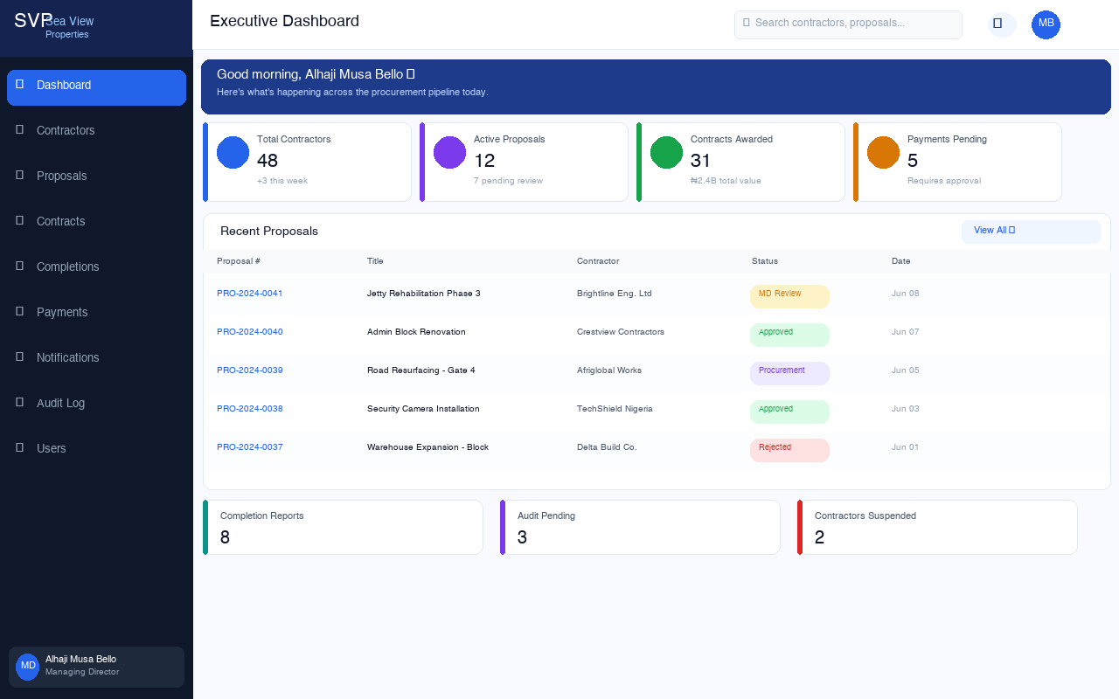
Executive Dashboard
Real-time KPIs, recent proposals, and activity feed — tailored per user role
Sea View Properties · Procurement Portal

Slide 6
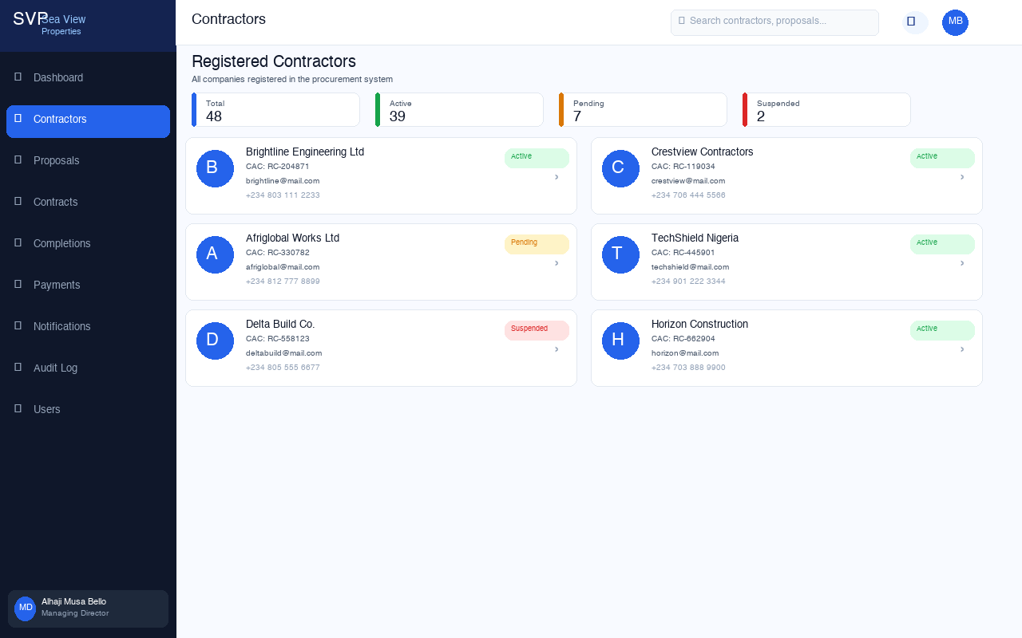
Contractor Registry
All registered contractors with status badges, contact details and quick access
Sea View Properties · Procurement Portal

Slide 7
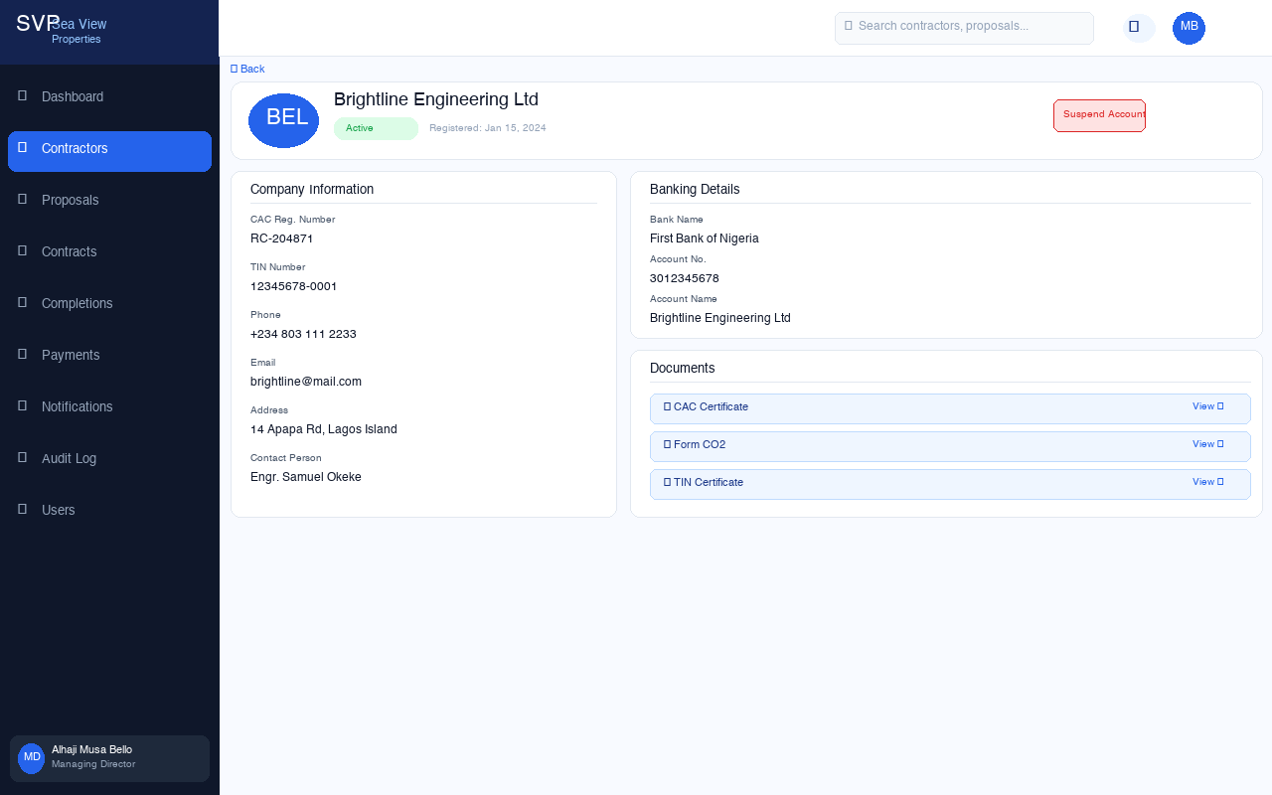
Contractor Profile
Full company info, banking details, documents, and staff action controls
Sea View Properties · Procurement Portal

Slide 8
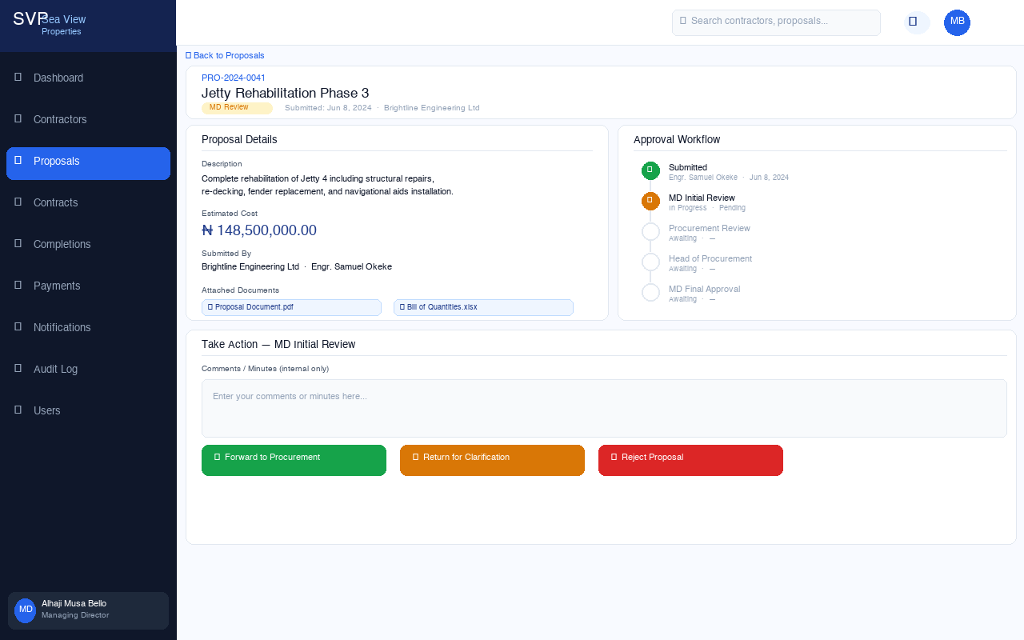
Proposal & Approval Panel
Proposal details, workflow timeline, and role-based action buttons for approvers
Sea View Properties · Procurement Portal

Slide 9
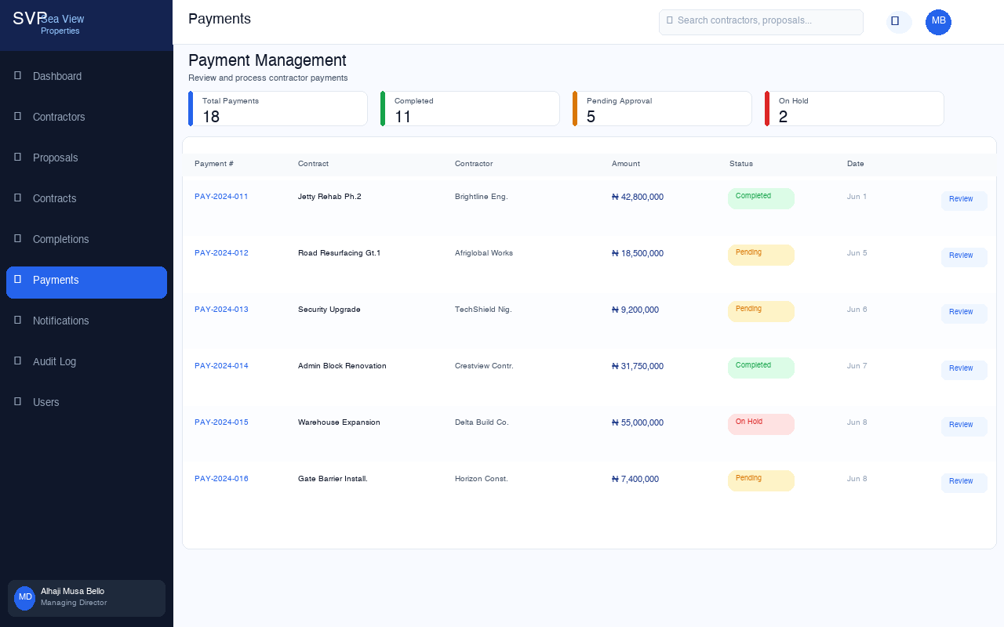
Payment Management
Payment pipeline with amounts, status tracking, and one-click review access
Sea View Properties · Procurement Portal

Slide 10
User Roles & Access Control
Every user sees only what they need — enforced at the database level
Contractor
Managing Director
Register · Submit proposals · Upload completions · Track payments
Initial & final proposal approval · Contractor verification · Dashboard
Procurement Officer
Head of Procurement
Appraise proposals · Forward to Head of Procurement
Final procurement review · Reject or approve for MD sign-off
Head of Audit
Head of Accounts
Review completion reports · Forward to accounts after verification
Process payments · Upload bank transfer evidence · Manage deductions
ICT Administrator
User management · System audit logs · Role assignments

Slide 11
Key Features
Built for compliance, transparency and speed
🔐 Role-Based Access Control
📄 PDF Award Letters
Supabase Row Level Security — data is filtered at the database, not just the UI.
Auto-generated, digitally signed award letters with MD's uploaded signature.
📊 Executive Dashboard
🔔 Real-Time Notifications
Real-time KPIs: proposals pending, contracts active, payments due — all in one view.
Instant alerts for every workflow event — approvals, rejections, awards, payments.
🛡️ Immutable Audit Log
🔎 Universal Search
Every action is time-stamped and actor-attributed. Records cannot be edited or deleted.
Find any contractor, proposal, contract or payment instantly from the top bar.
📱 Mobile Responsive
� Seamless Integrations
Works on phones, tablets and desktops — accessible from anywhere.
Built on open standards — integrates with existing systems, email and document workflows.

Slide 12
Ready to Launch
Contact
The platform is built and production-ready. We need approval to connect it to our Supabase account and go live within 48 hours.
ICT Department
Sea View Properties Ltd
📍 Nigerian Ports Authority
48 hrs
Connect Supabase credentials & go live
Subsidiary
Week 1
Onboard ICT Admin + create staff accounts
🌐 Platform: Ready
⏱ Go-Live: 48 hours
Week 2
Contractor registration & first proposals
Month 1
Full procurement cycle running on the platform
Sea View Properties Ltd · Confidential · July 2026

