Slide 1

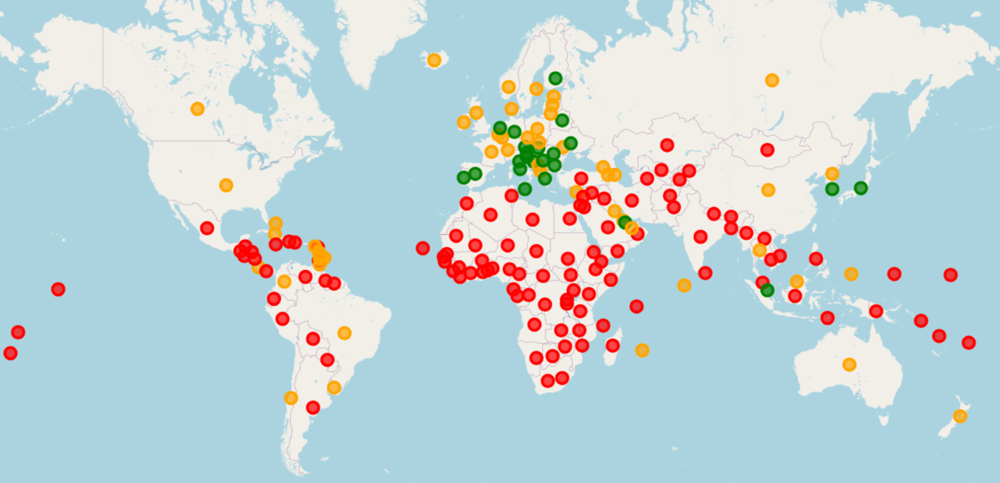
Descriptive Data Mining on World Data
Ang Dorje Sherpa
Cristian C Noriega M
Omotoyosi Ezekiel
Arshdeep Singh

Slide 2
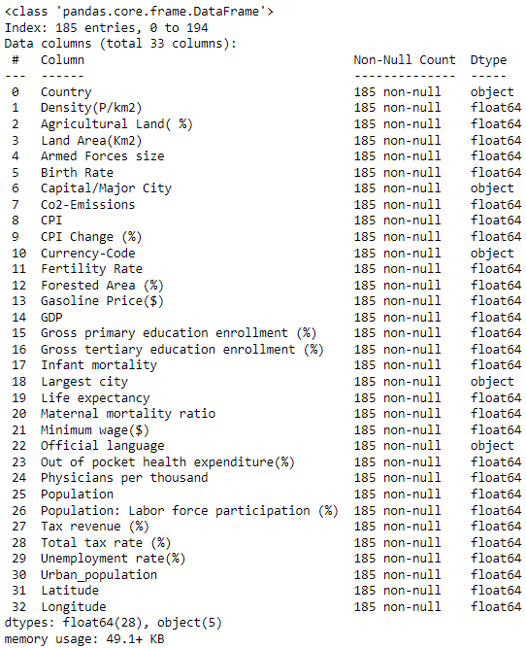
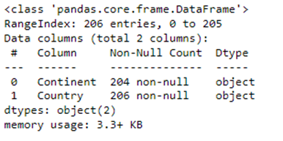
World data & continent data
World Data contains data related population, land area, Birth rate, etc. for 185 countries
World Data and continent data are merged.
Using descriptive data mining, the world data is analyzed to understand relationships between numerical attributes.

Slide 3
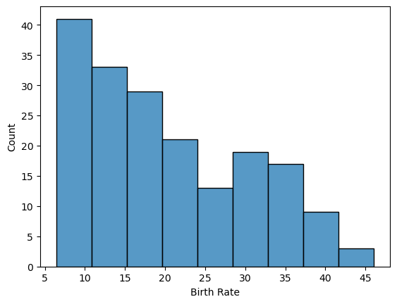
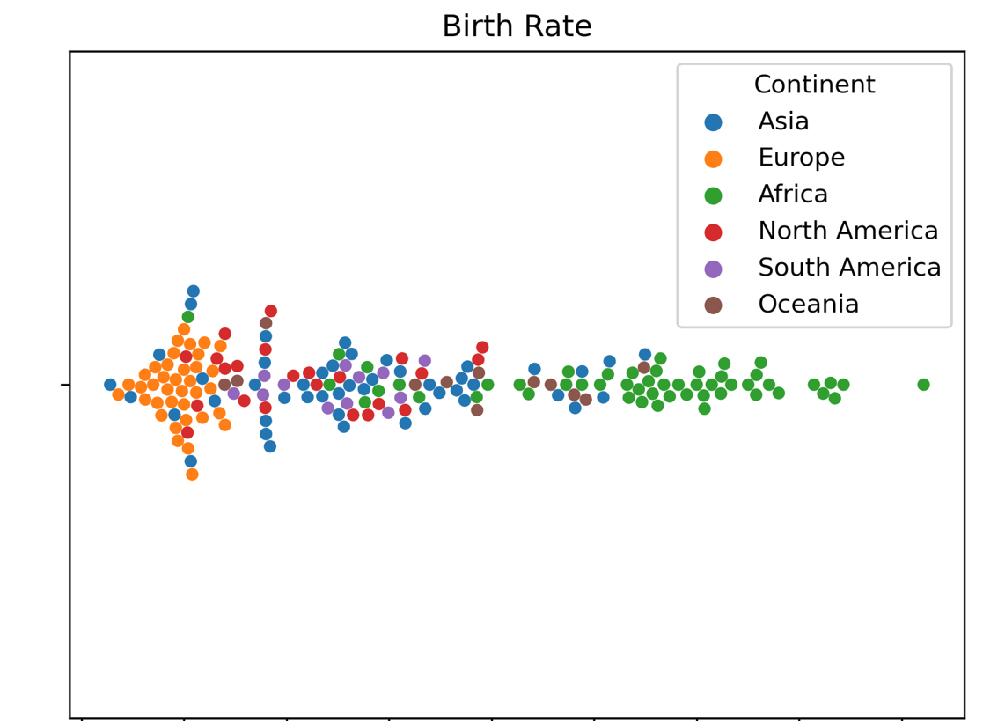
Goals of analysis
Analyze the numerical attributes Birth Rate, Fertility Rate, Infant Mortality, Life Expectancy, Maternal Mortality Ratio, Physician per thousand, Density, Population, Labor Participation, Unemployment Rate, Urban Population
Understand the behavior of the data through cluster analysis, and KMeans

Slide 4
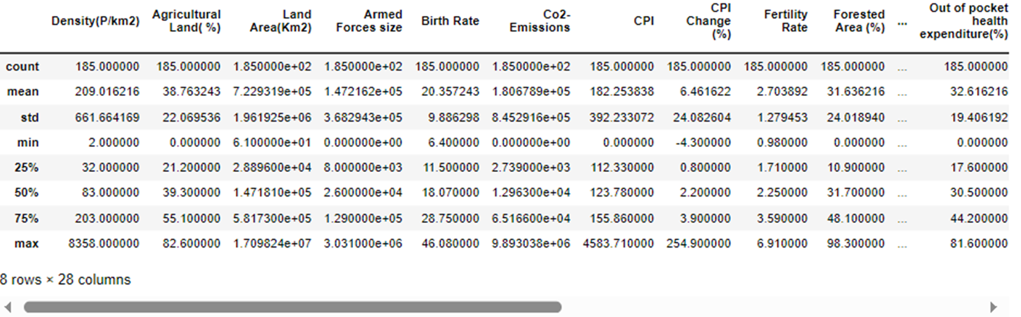
Descriptive Data Summary
Statistical summary of the numeric columns to understand the spread of the data among columns
This shows us that standardization will be useful as a part of the preprocessing procedure

Slide 5
Descriptive Data mining
Association Rule
Sequence Mining
Clustering Analysis

Slide 6
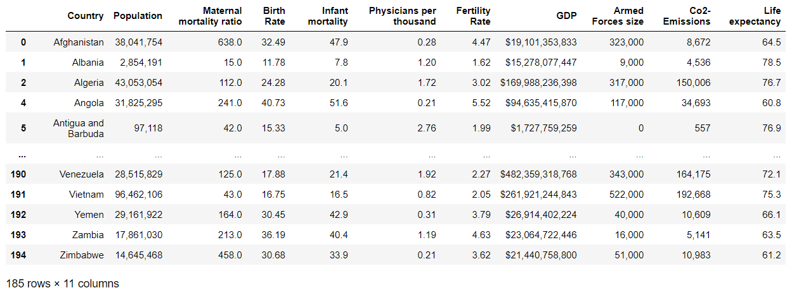
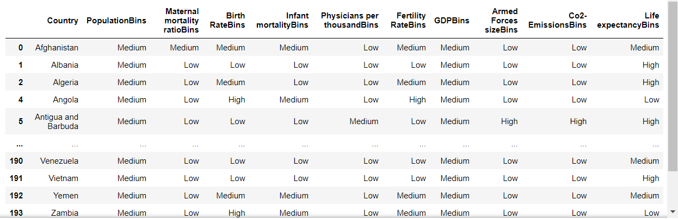
Descriptive Data Mining Method
Association rule
It was not suitable for the World data.

Slide 7
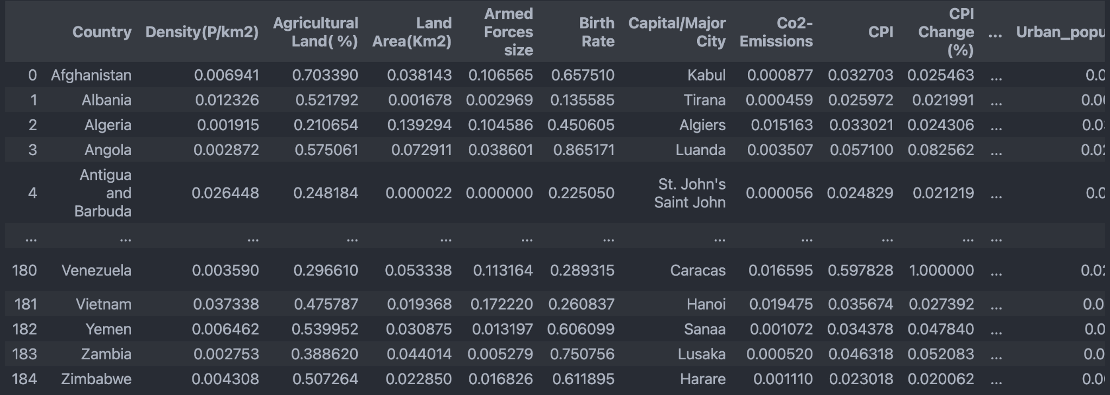
Standardization
Data was scaled using Min Max Scalar to bring it to a consistent scale as some columns were in millions (Armed Forces size) while others were between 0 and 100 (UE Rate). This helps standardization.

Slide 8
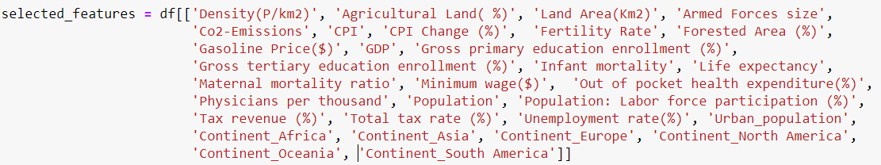
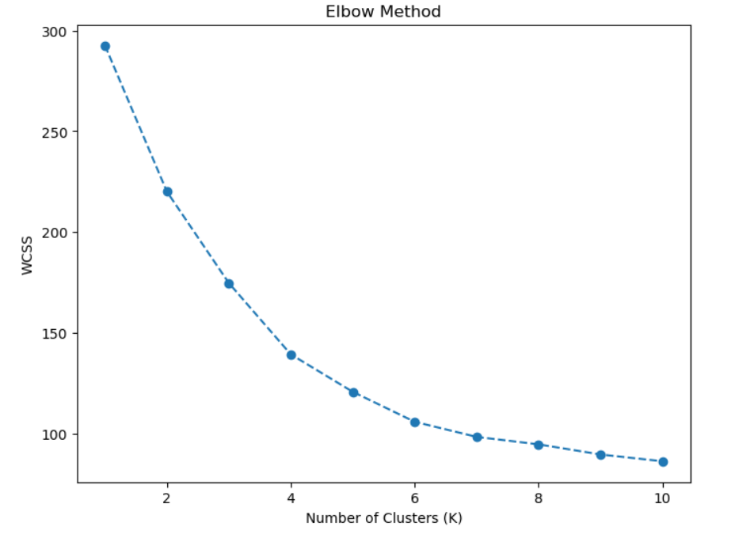
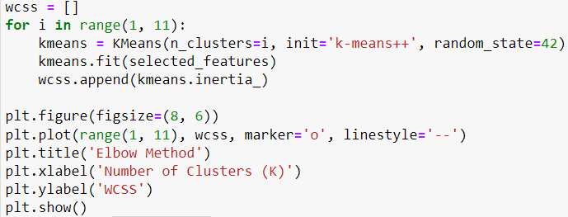
Descriptive Data Mining Method
(Clustering Analysis)
Numeric values were selected, and the Kmeans was method used.
The Elbow Method shows the number of clusters and the WCSS is the sum of squared distances between data points and their assigned cluster centers

Slide 9
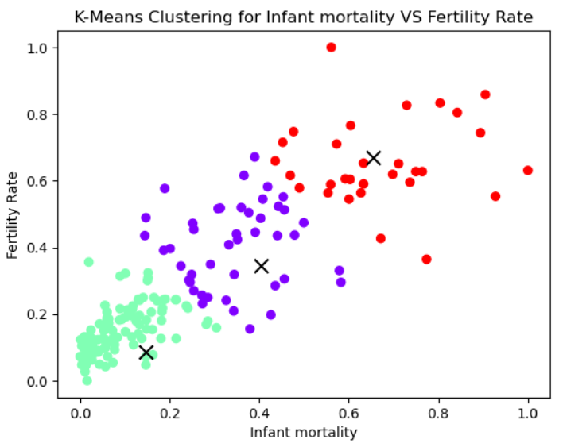
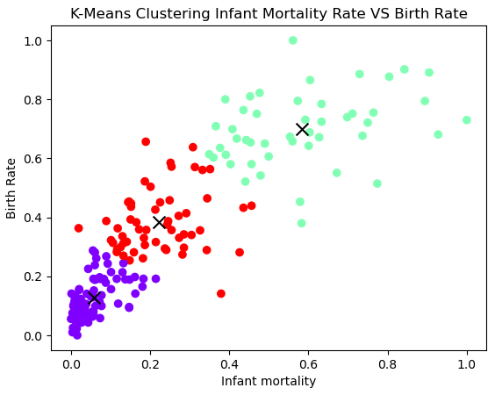
Descriptive Data Mining Method (Clustering Analysis)

Slide 10
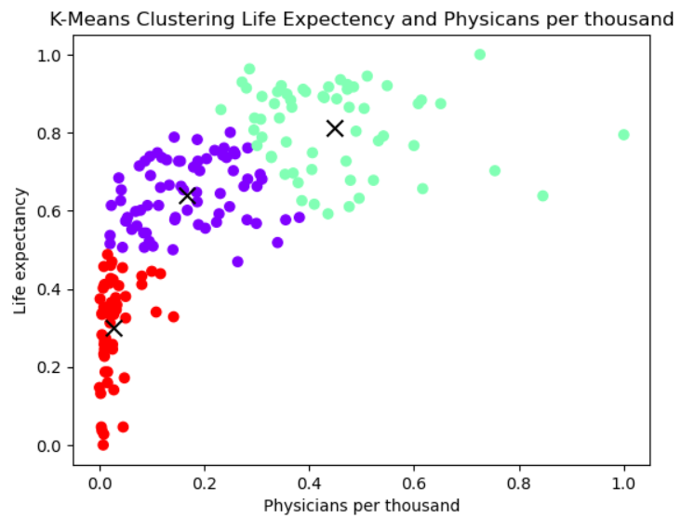
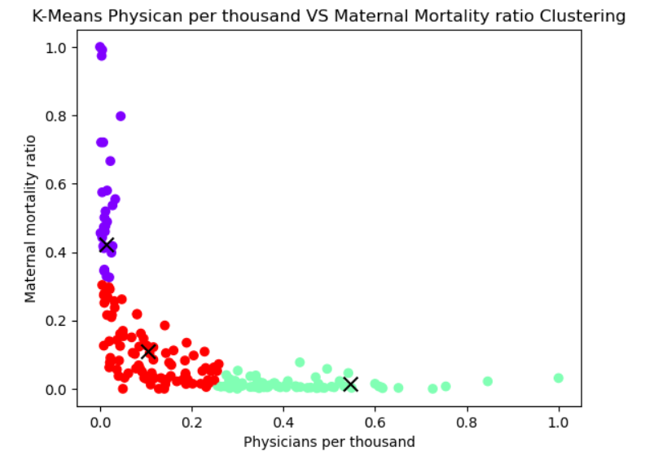
Descriptive Data Mining Method (Clustering Analysis)

Slide 11

Conclusion
The Apriori algorithm applies only to transactional data which is not applicable for the population data.
K-means is an effective algorithm to categorize the data and derive the relationship among the attributes.

Slide 12
References
[1] A. Sss, “Global Country Information Dataset 2023,” Kaggle, https://www.kaggle.com/datasets/nelgiriyewithana/countries-of-the-world-2023 (accessed Oct. 1, 2023).
[2] A. Sss, “Continent list for 2021 Olympics in Tokyo dataset,” Kaggle, https://www.kaggle.com/datasets/arvinthsss/continent-list-for-2021-olympics-in-tokyo-dataset (accessed Oct. 4, 2023).
[3] “Folium#,” Folium - Folium 0.1.dev1+g9ab63f7 documentation, https://python-visualization.github.io/folium/latest/ (accessed Oct. 3, 2023).

