Slide 1

Data Preprocessing on World Data
Ang Dorje Sherpa
Cristian C Noriega M
Omotoyosi Ezekiel
Arshdeep Singh

Slide 2
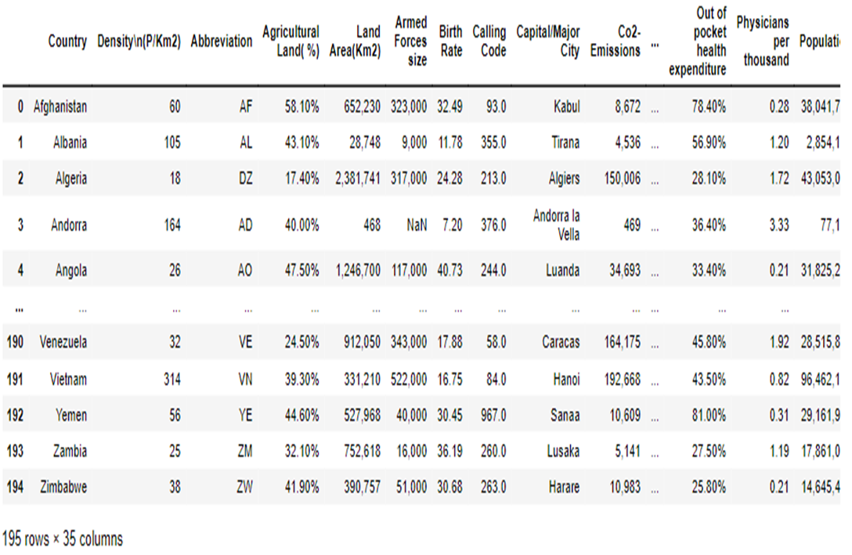
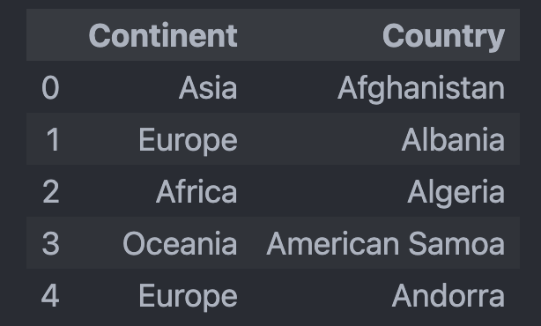
Data Frame ( World Data & Continent)

Slide 3
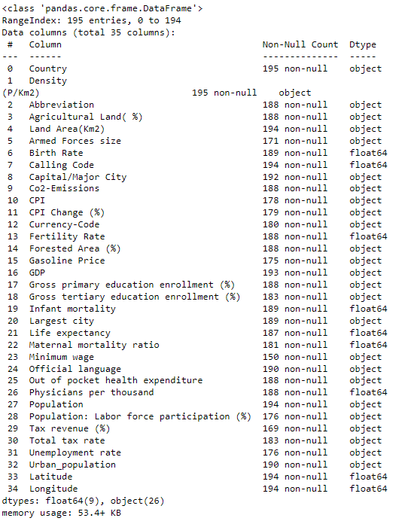
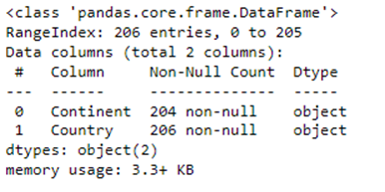
Data Summary
The dataset has 34 columns displaying various attributes of a country
The original dataset has 195 entries, or 195 countries. the number changes as we clean the data
We are interested in predicting Birth Rate for a country and will look to use the other attributes to identify how they relate to Birth Rate

Slide 4
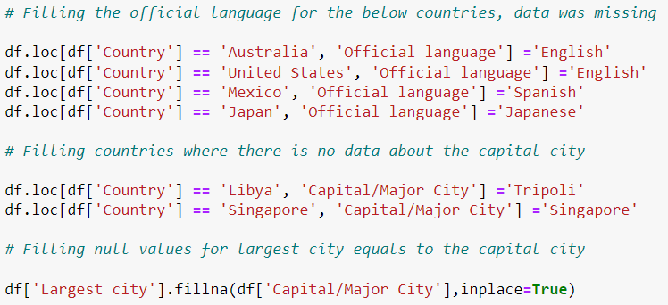
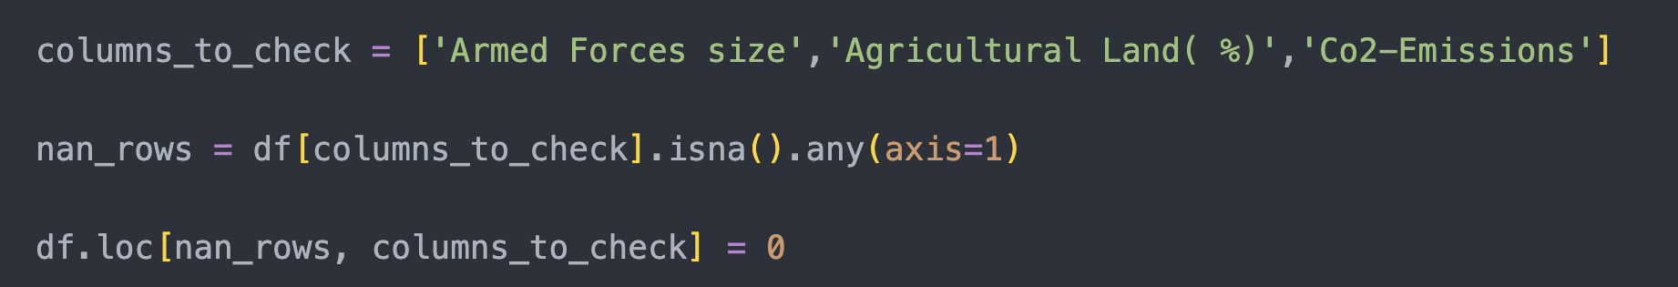
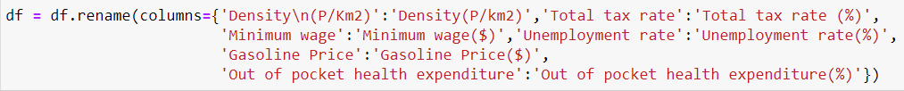
Data: Cleaning & Integration
1
2
3
Identify duplicate, redundant, and irrelevant values within the dataset. We also rename some columns to make them more informative.
We fill and missing values, either manually (‘Official Language’) or many at a time (for example: ‘Armed Forces size’)
We remove duplicate and irrelevant values, such as Abbreviation, and Calling Code

Slide 5
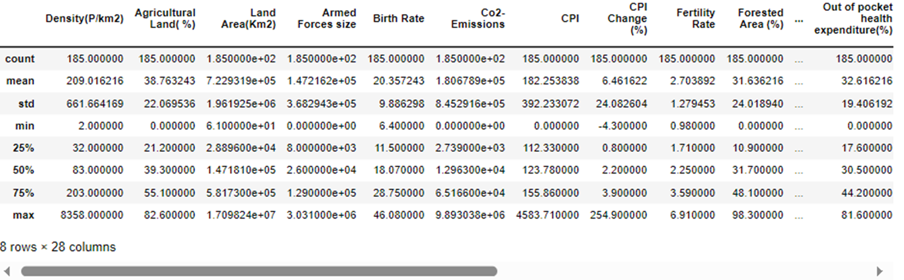
Descriptive Data Summary
We can also obtain a statistical summary of the numeric columns and see that the range of values vary widely between columns
This shows us that standardization will be useful as a part of the preprocessing procedure

Slide 6
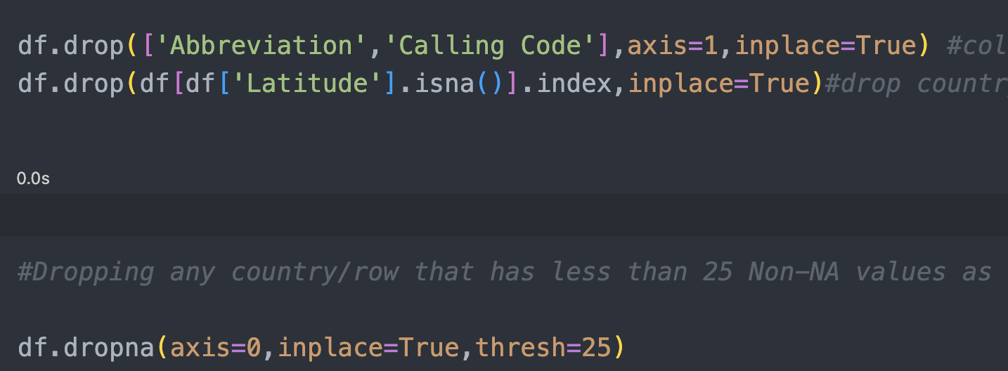
Dimensional Reduction
We remove columns that will not be useful for our evaluation
Also removing rows that have very little data as this will not help in modelling. Data might be because of conflict in the country, lack of a governmental procedure, or a strict censorship
Taking this step will lead to a more complete dataset, that is consistent in its data across rows and columns

Slide 7
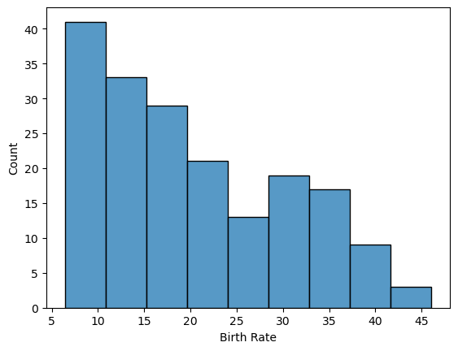
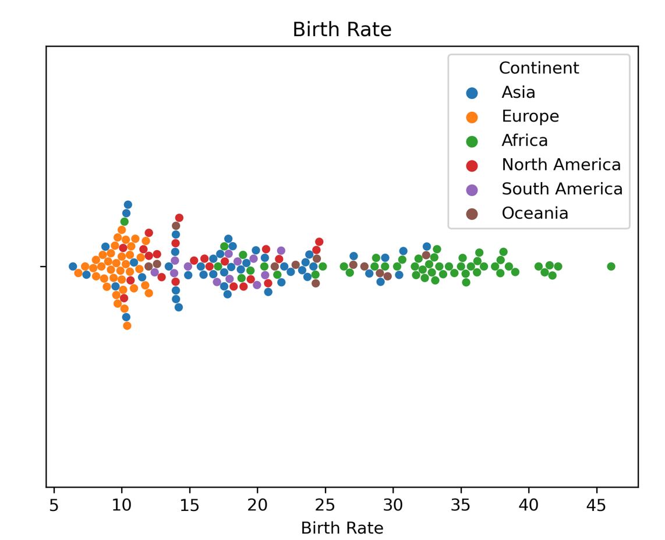
Data Visualization
Map: Birth Rate & Continent
The histogram of Birth Rate is skewed to the right, with no outstanding outliers. Most observations are between 6-25. The swarm plot shows Africa is showing the highest birth rate, while Europe is the opposite.

Slide 8
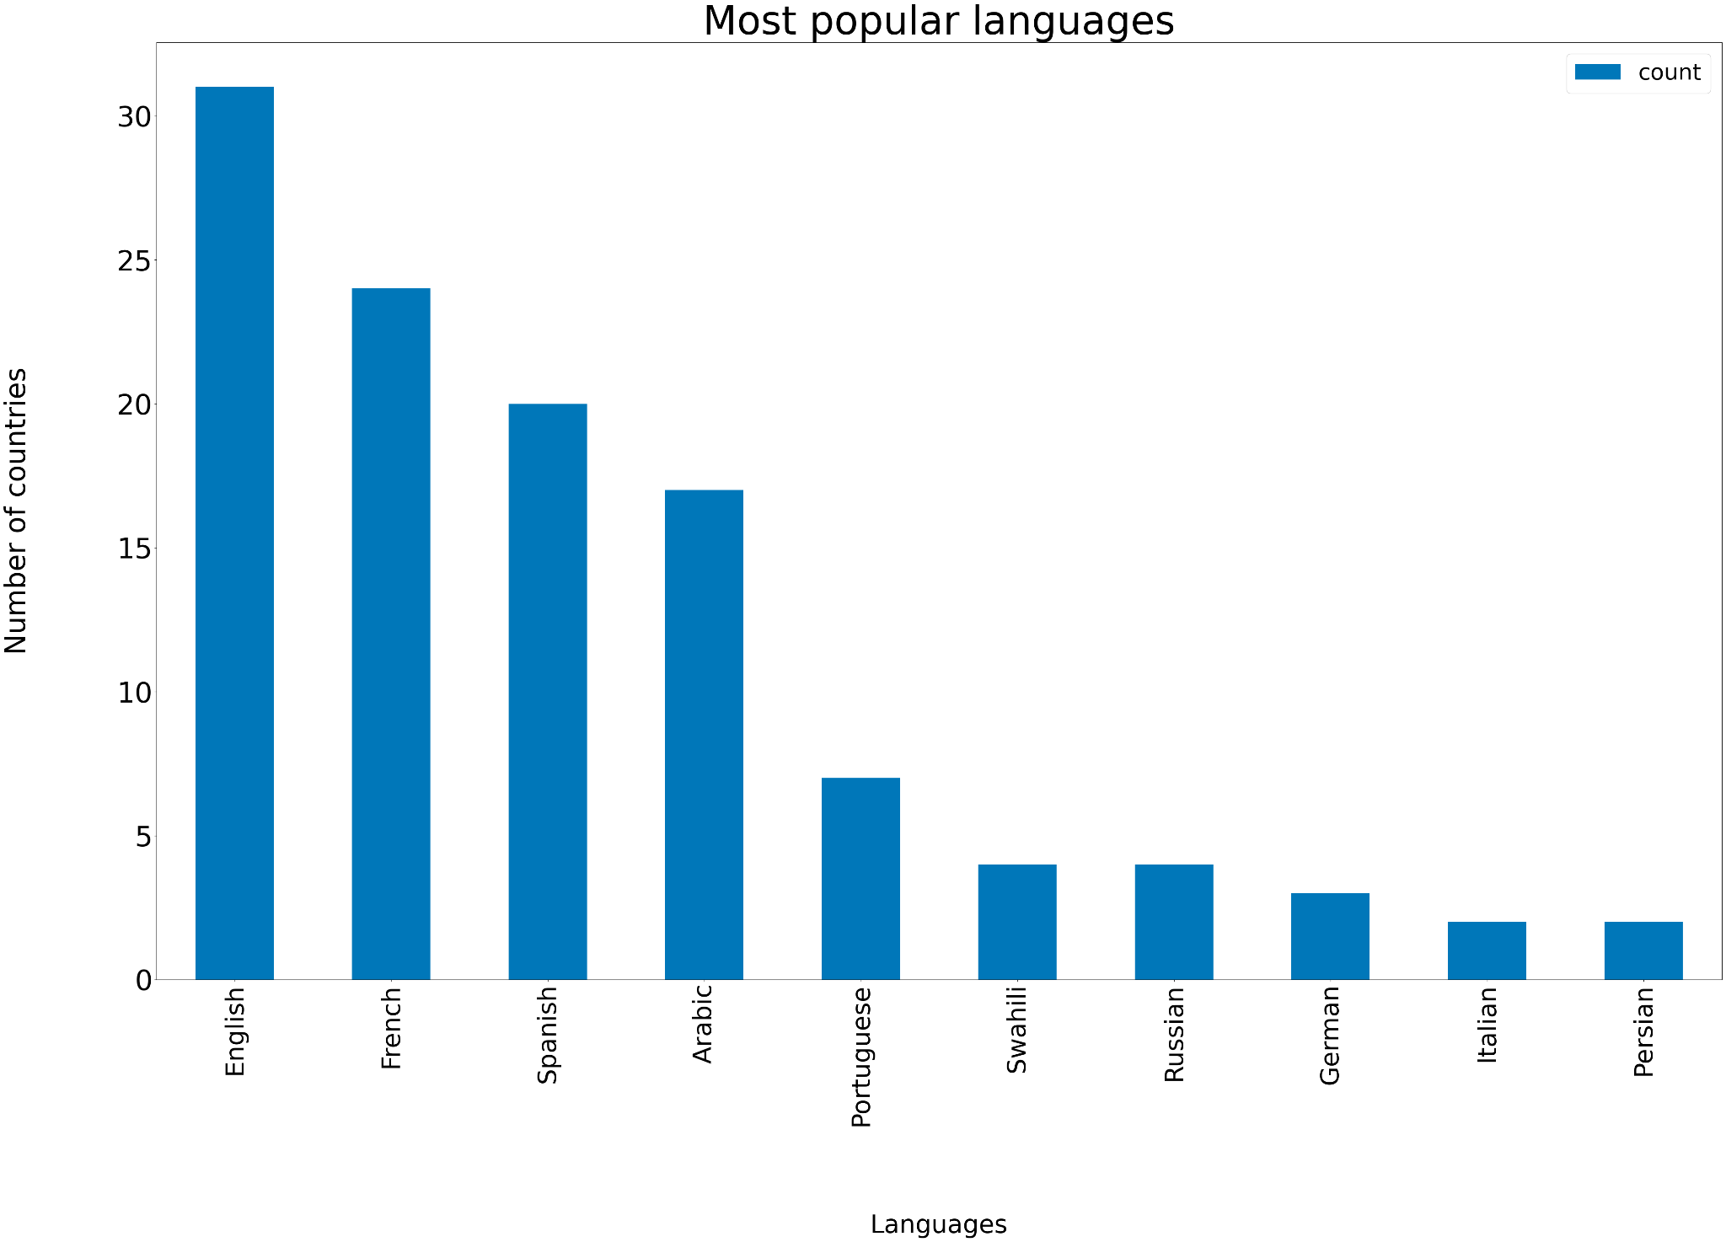
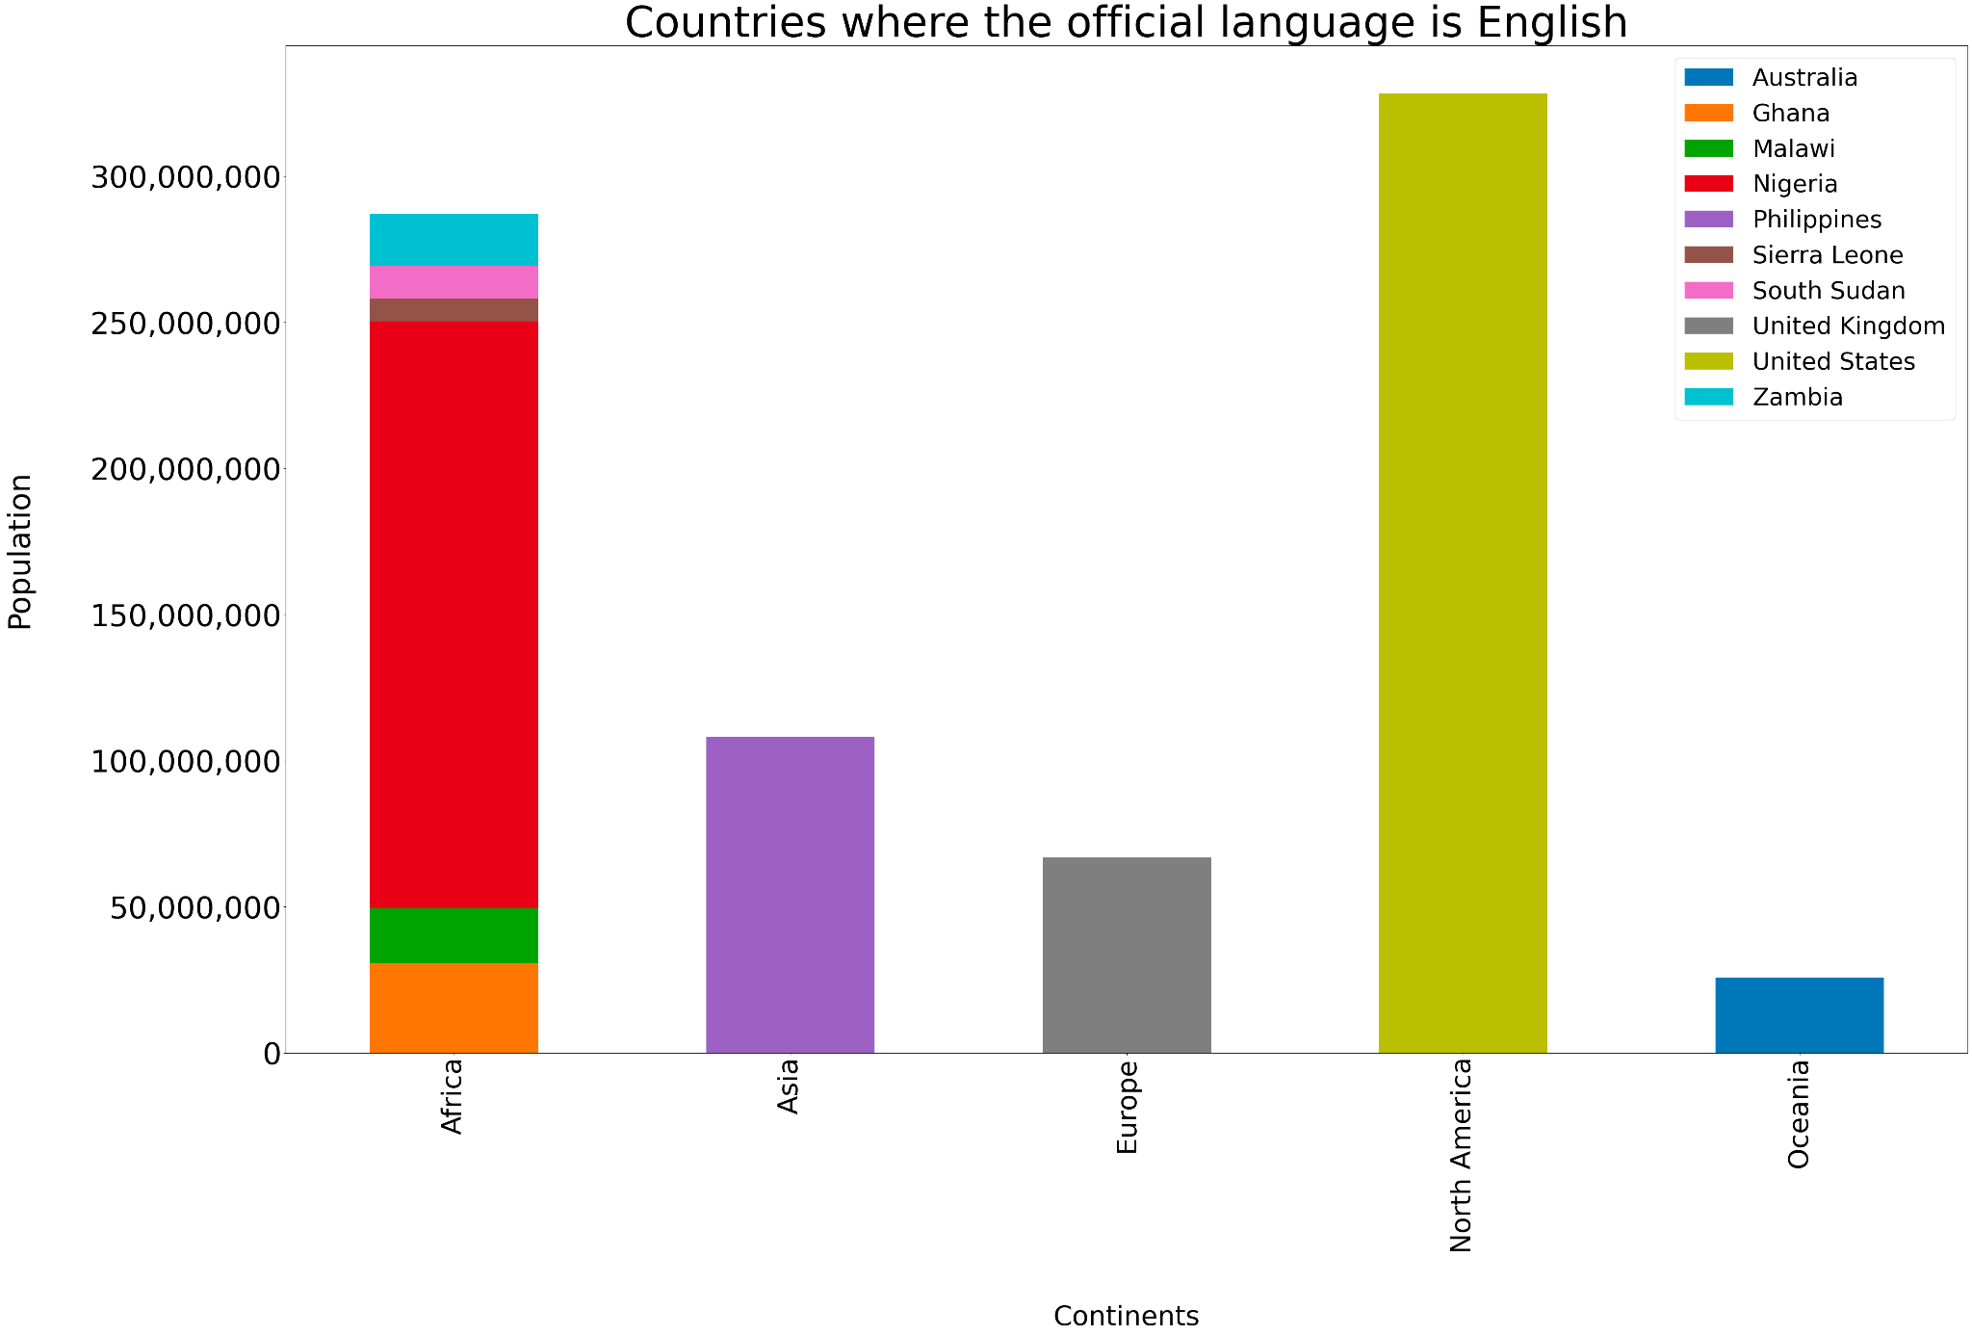
Data Visualization
Map: Languages
10 most popular languages, English is the most spoken language in the world. The majority of English speakers are in North America, followed by Africa. In Africa, the country with the biggest population that speaks English is Nigeria.

Slide 9
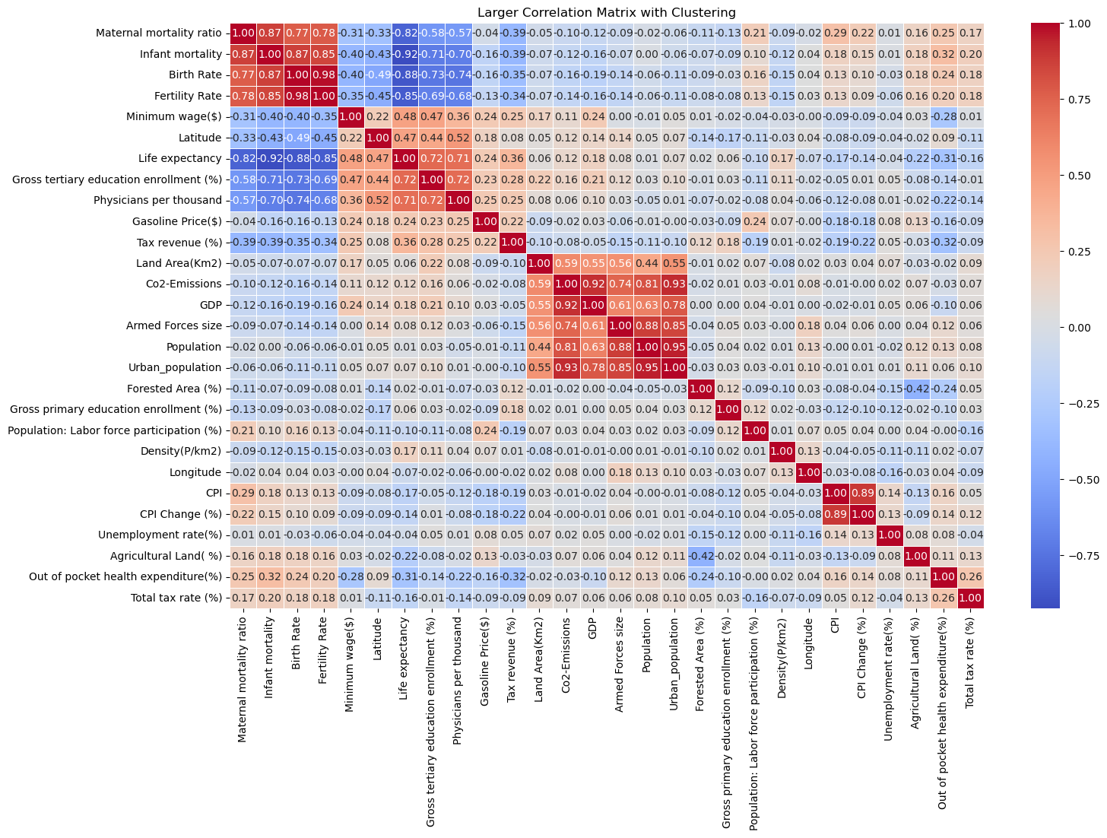
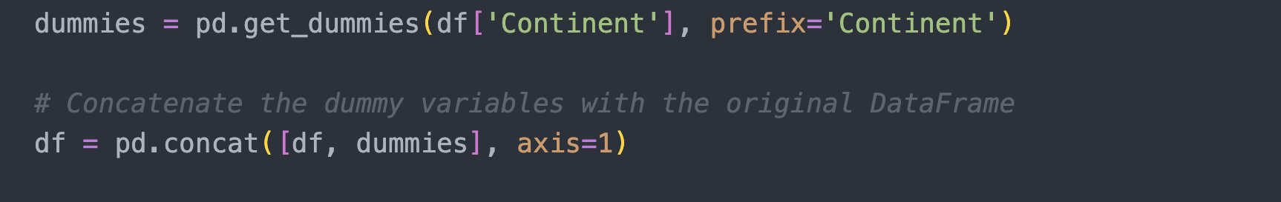
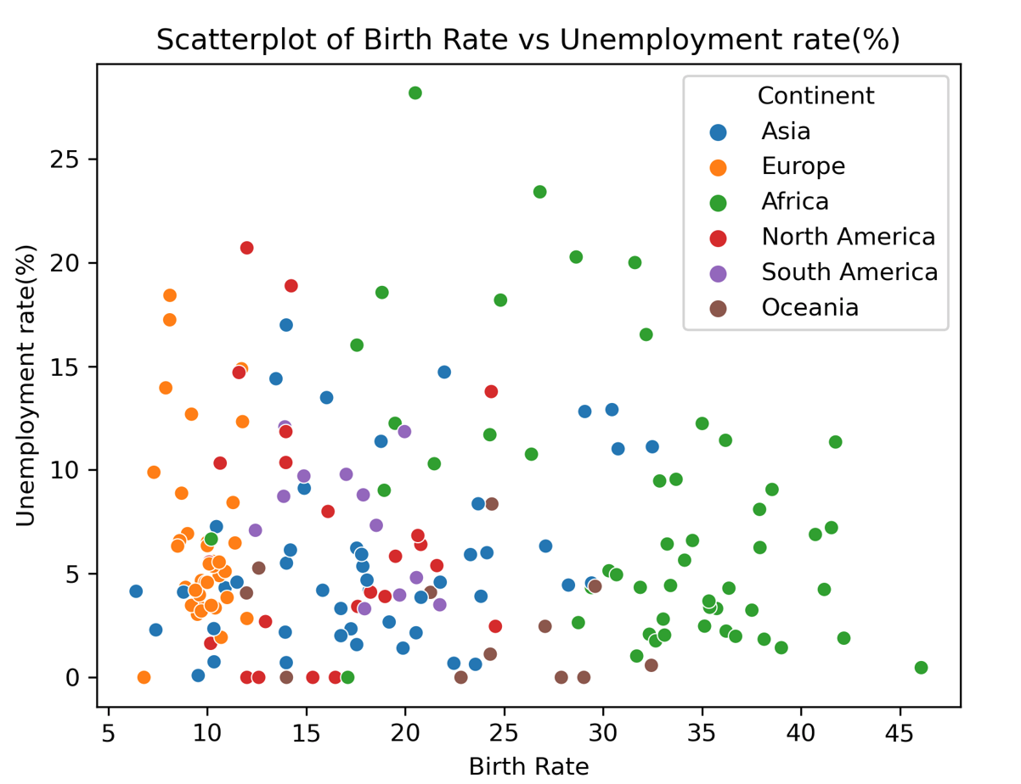
Data Visualization & Transformation
Scatter Plot: Unemployment & Birth Rate
Mortality rates, number of physicians, and life expectancy show signs of correlation with a country’s birth rate. We also created dummies for the Continent attribute to be used later in analysis. This will turn a categorical attribute into a Boolean that can help in regression.

Slide 10
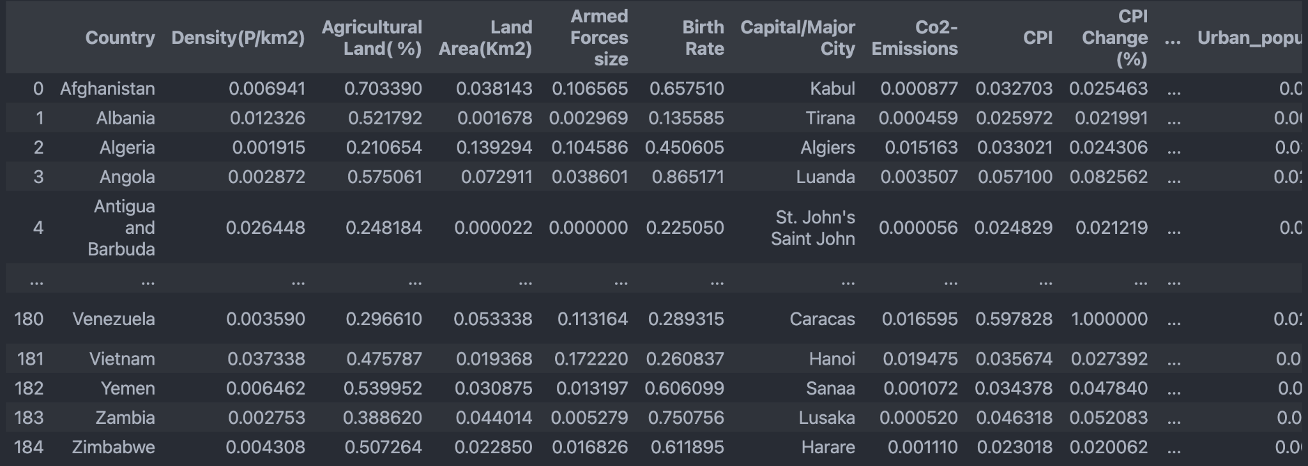
Standardization
We scaled our data using Min Max Scalar to bring it to a consistent scale as some columns were in millions (Armed Forces size) while others were between 0 and 100 (UE Rate). This helps standardization.

Slide 11
References
[1] A. Sss, “Global Country Information Dataset 2023,” Kaggle, https://www.kaggle.com/datasets/nelgiriyewithana/countries-of-the-world-2023 (accessed Oct. 1, 2023).
[2] A. Sss, “Continent list for 2021 Olympics in Tokyo dataset,” Kaggle, https://www.kaggle.com/datasets/arvinthsss/continent-list-for-2021-olympics-in-tokyo-dataset (accessed Oct. 4, 2023).
[3] “Folium#,” Folium - Folium 0.1.dev1+g9ab63f7 documentation, https://python-visualization.github.io/folium/latest/ (accessed Oct. 3, 2023).
[4] “Scipy.cluster.hierarchy.dendrogram#,” scipy.cluster.hierarchy.dendrogram - SciPy v1.11.3 Manual, https://docs.scipy.org/doc/scipy/reference/generated/scipy.cluster.hierarchy.dendrogram.html (accessed Oct. 3, 2023).

