Slide 1

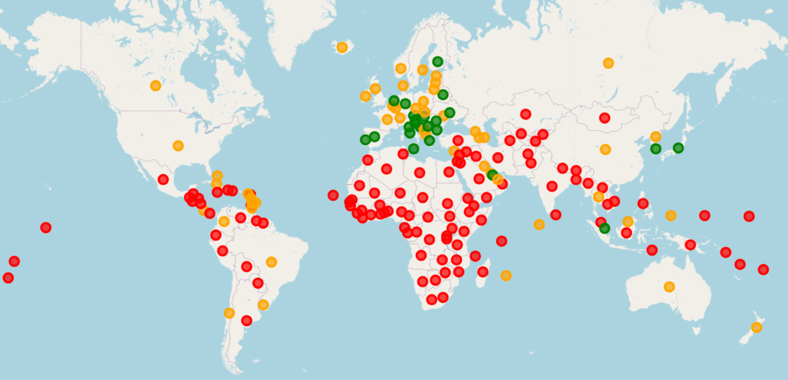
Predictive Data Mining on World Data
Ang Dorje Sherpa
Cristian C Noriega M
Omotoyosi Ezekiel
Arshdeep Singh

Slide 2
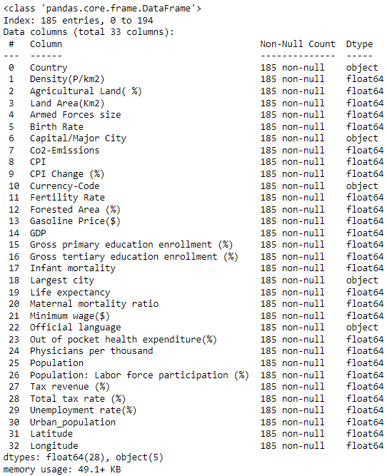
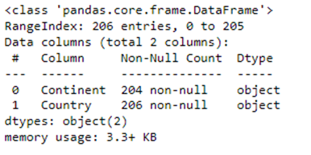
World data & continent data
World Data contains data related population, land area, Birth rate, etc. for 185 countries
World Data and continent data are merged.
Using descriptive data mining, the world data is analyzed to understand relationships between numerical attributes.

Slide 3
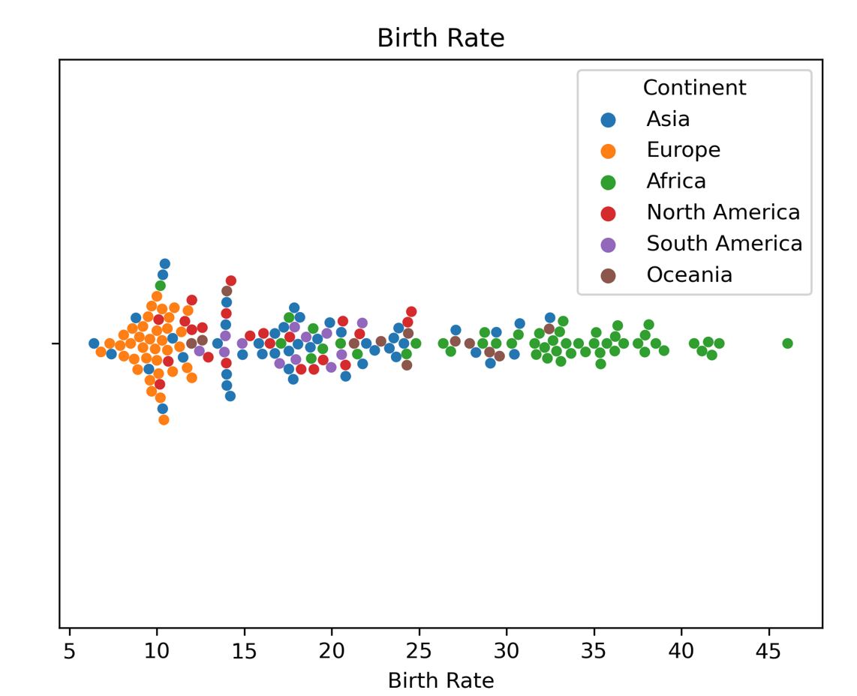
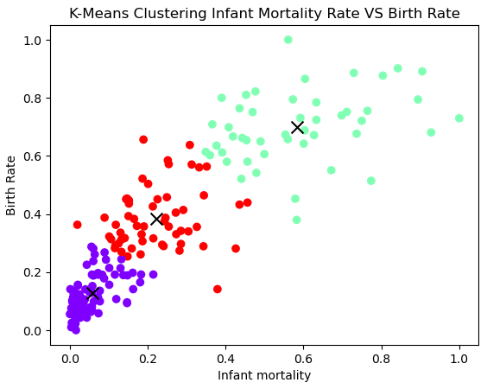
Goals of analysis
Analyze the numerical attributes Birth Rate, Fertility Rate, Infant Mortality, Life Expectancy, Maternal Mortality Ratio, Physician per thousand, Density, Population, Labor Participation, Unemployment Rate, Urban Population
Goals of clasification

Slide 4
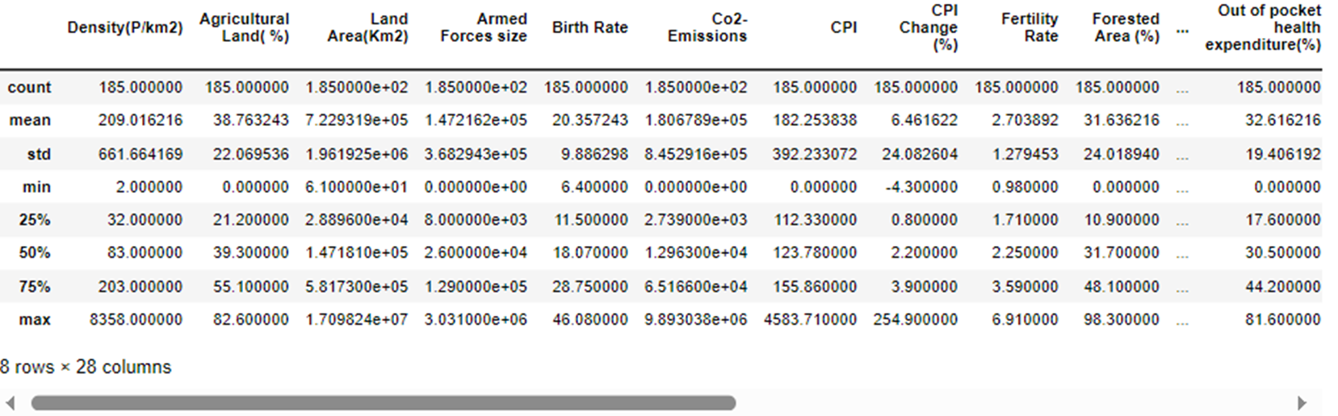
Descriptive Data Summary
Statistical summary of the numeric columns to understand the spread of the data among columns
This shows us that standardization will be useful as a part of the preprocessing procedure

Slide 5
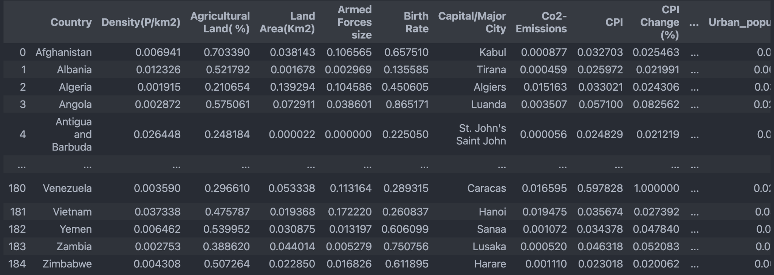
Standardization
Data was scaled using Min Max Scalar to bring it to a consistent scale as some columns were in millions (Armed Forces size) while others were between 0 and 100 (UE Rate). This helps standardization.

Slide 6
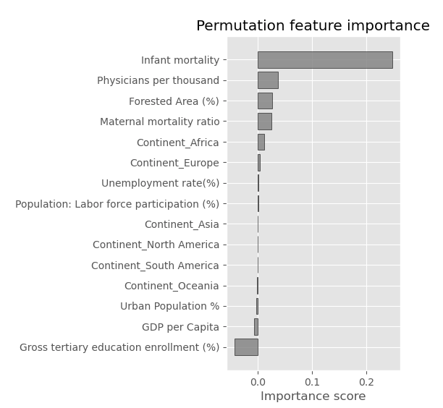
Permutation feature Importance
Based on feature importance, we run a baseline regression model
Ran two classifiers, it would predict the birth rate class

Slide 7
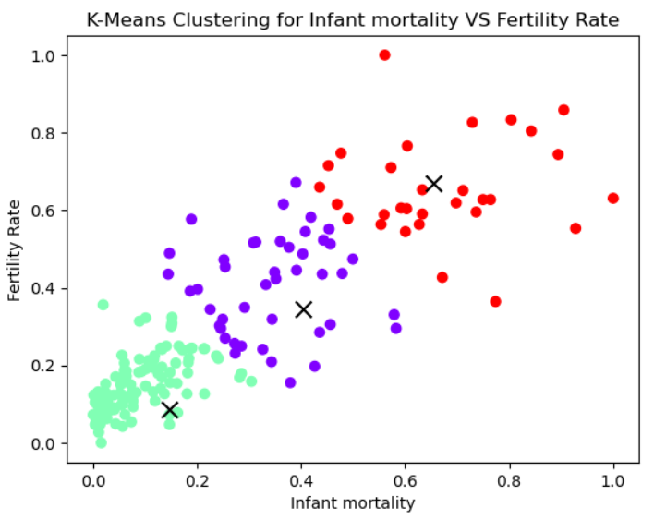
Descriptive Data Mining Method (Clustering Analysis)

Slide 8
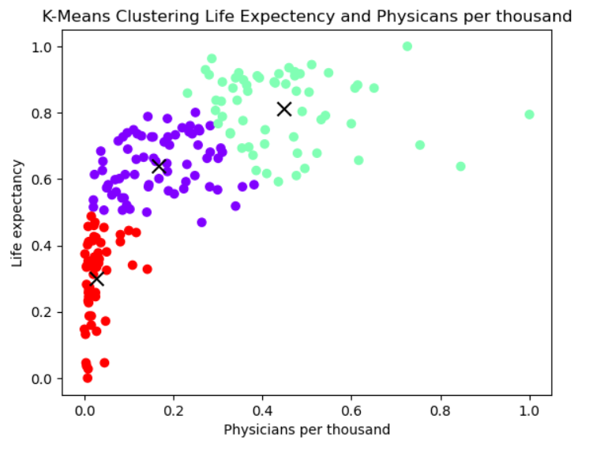
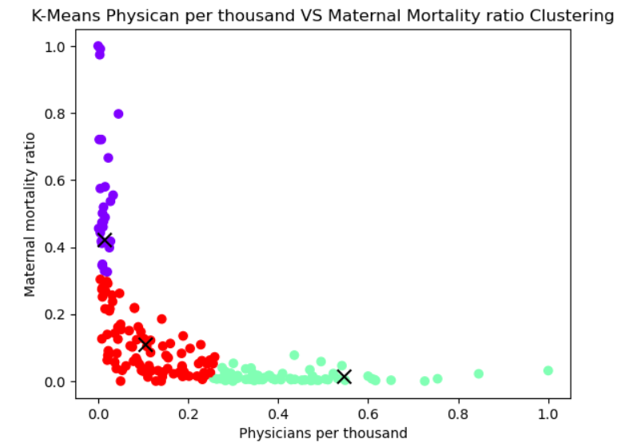
Descriptive Data Mining Method (Clustering Analysis)

Slide 9

Conclusion
Economic -> GDP per capita.
GDP & population
K-means is an effective algorithm to categorize the data and derive the relationship among the attributes.

Slide 10
References
[1] A. Sss, “Global Country Information Dataset 2023,” Kaggle, https://www.kaggle.com/datasets/nelgiriyewithana/countries-of-the-world-2023 (accessed Oct. 1, 2023).
[2] A. Sss, “Continent list for 2021 Olympics in Tokyo dataset,” Kaggle, https://www.kaggle.com/datasets/arvinthsss/continent-list-for-2021-olympics-in-tokyo-dataset (accessed Oct. 4, 2023).
[3] “Folium#,” Folium - Folium 0.1.dev1+g9ab63f7 documentation, https://python-visualization.github.io/folium/latest/ (accessed Oct. 3, 2023).

