Slide 1
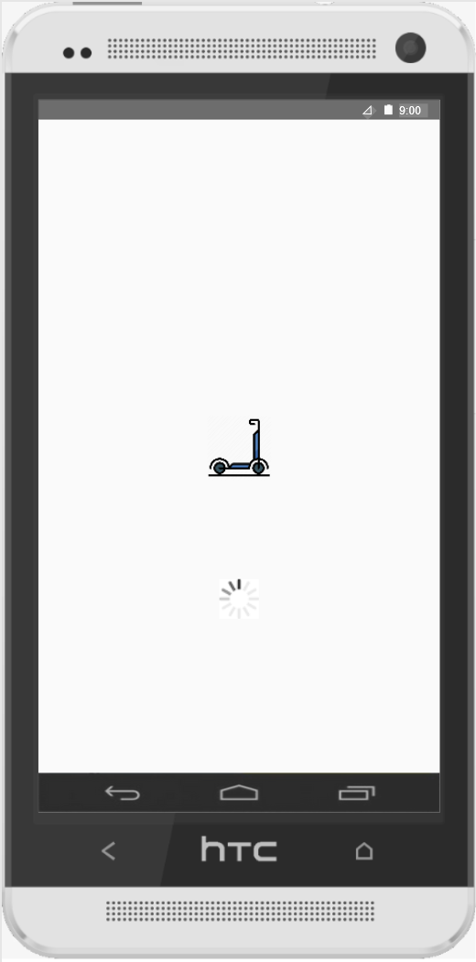
Software Engineering – Analysis Project: E-Scooter Rental Service
Kendra Birringer (1229372)
Nader Cacace (1208115)
Steffen Hanzlik (1207417)
Marco Peluso (1228849)
Svetozar Stojanovic (1262287)

Slide 2
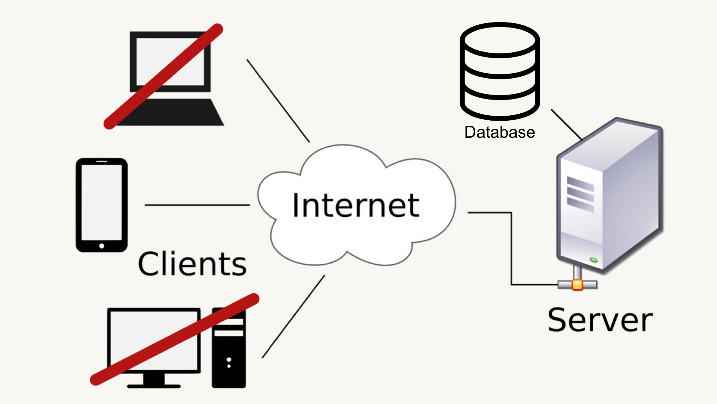
Introduction
High-level System Architecture
Google Sheets
Discord
GitHub
MagicDraw
Axure
LaTeX

Slide 3
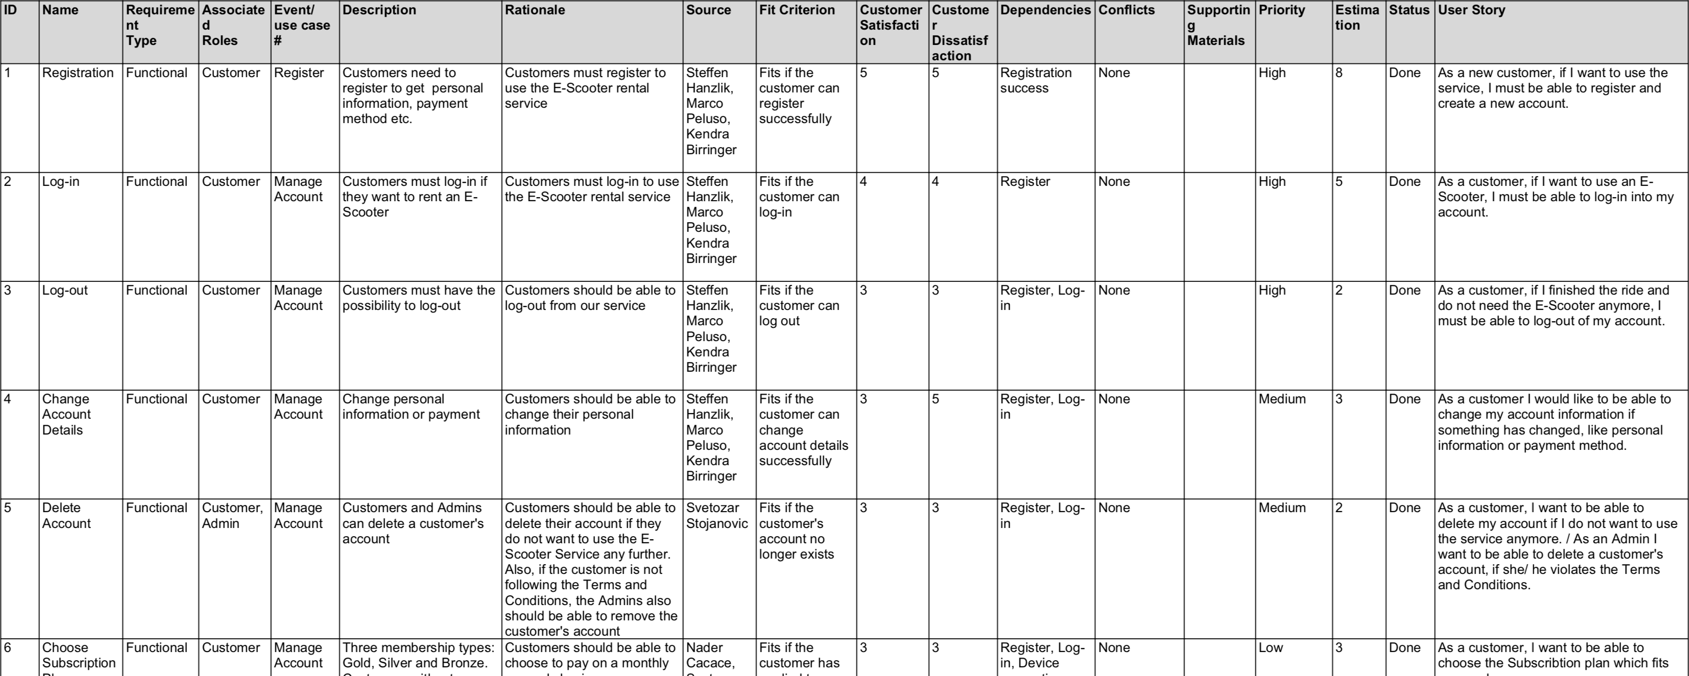
Requirements

Slide 4
Use-Case Diagram

Slide 5
Class Diagram

Slide 6
Activity Diagram

Slide 7
Sequence Diagram

Slide 8
UI Prototypes

Slide 9
Thank You

