Slide 1
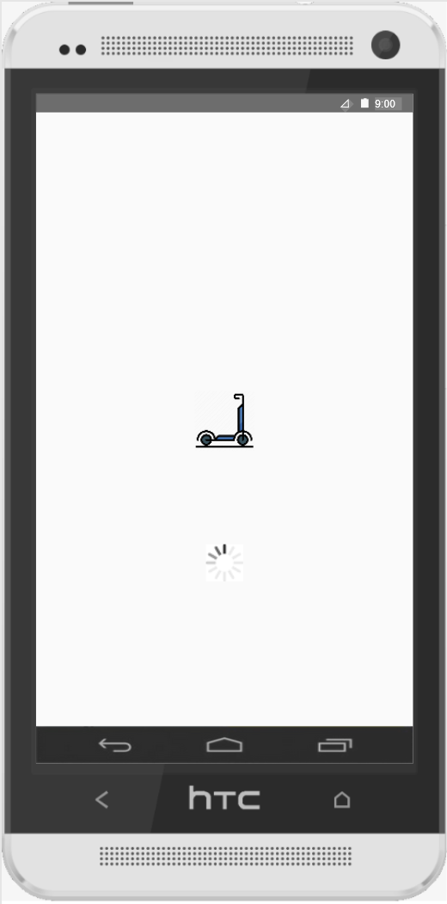
Software Engineering – Analysis Project: E-Scooter Rental Service
Kendra Birringer (1229372)
Nader Cacace (1208115)
Steffen Hanzlik (1207417)
Marco Peluso (1228849)
Svetozar Stojanovic (1262287)
Frankfurt University of Applied Sciences

Slide 2
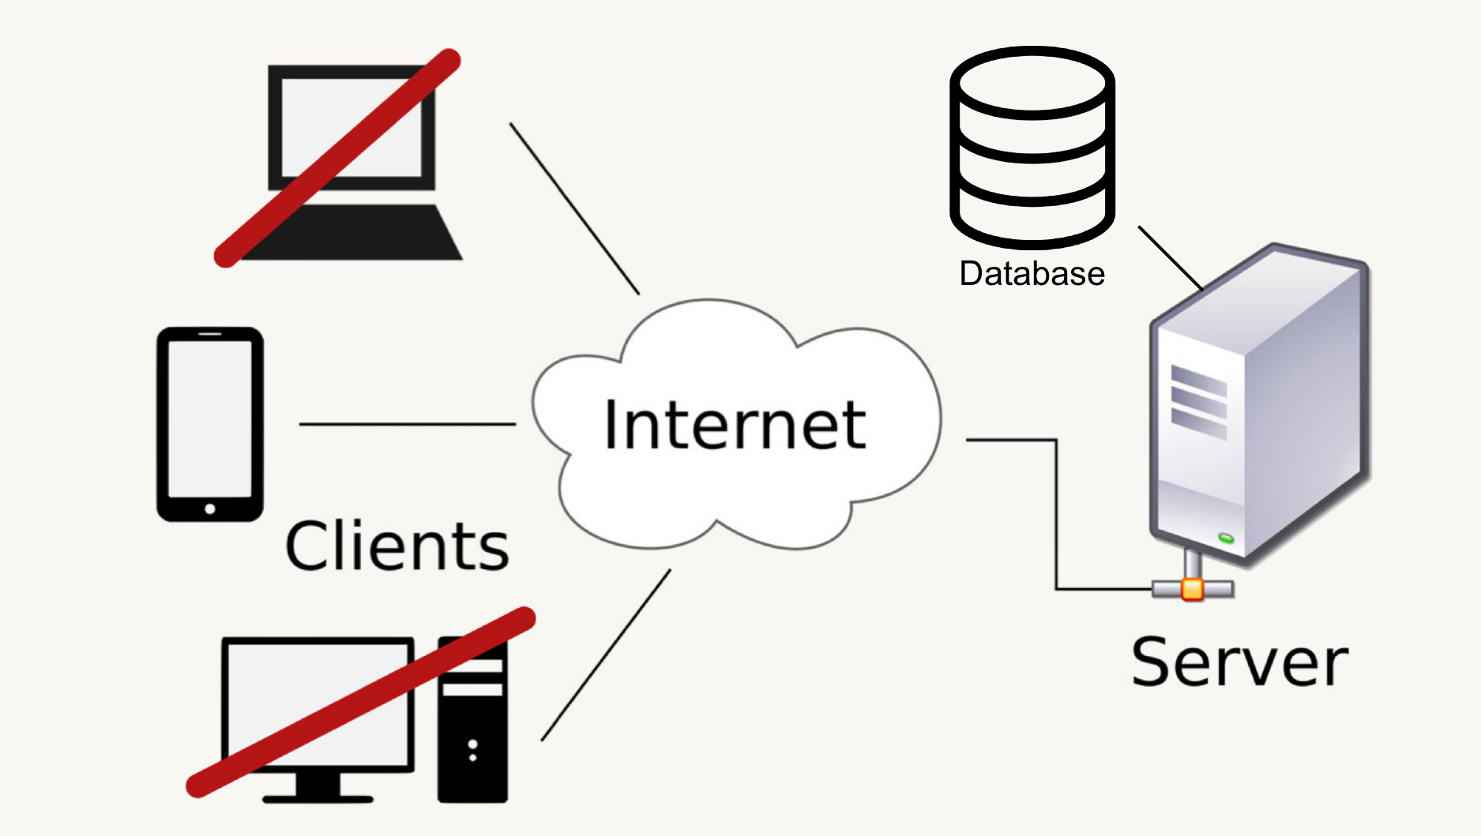
High-level Software Architecture
Source: https://commons.wikimedia.org/wiki/File:Client-server-model.svg
(modified by Kendra Birringer)

Slide 3







Tools
Source: https://discordapp.com/branding
Source: https://de.cleanpng.com/png-8ht5bw/
Google Sheets
Discord
GitHub
MagicDraw
Axure
LaTeX
Source: https://www.lieberlieber.com/embedded-engineer/home-2/magicdraw_logo/
Source: https://github.com/logos
Source: https://de.wikipedia.org/wiki/LaTeX#/media/Datei:LaTeX_logo.svg
Source: https://www.brandeps.com/logo/A/Axure-01

Slide 4
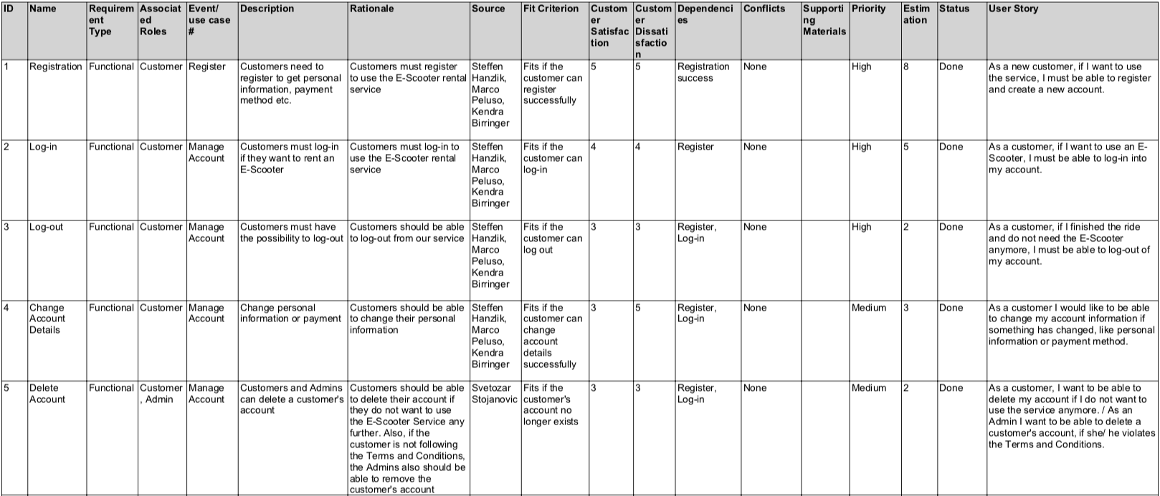
Requirements
Requirements

Slide 5
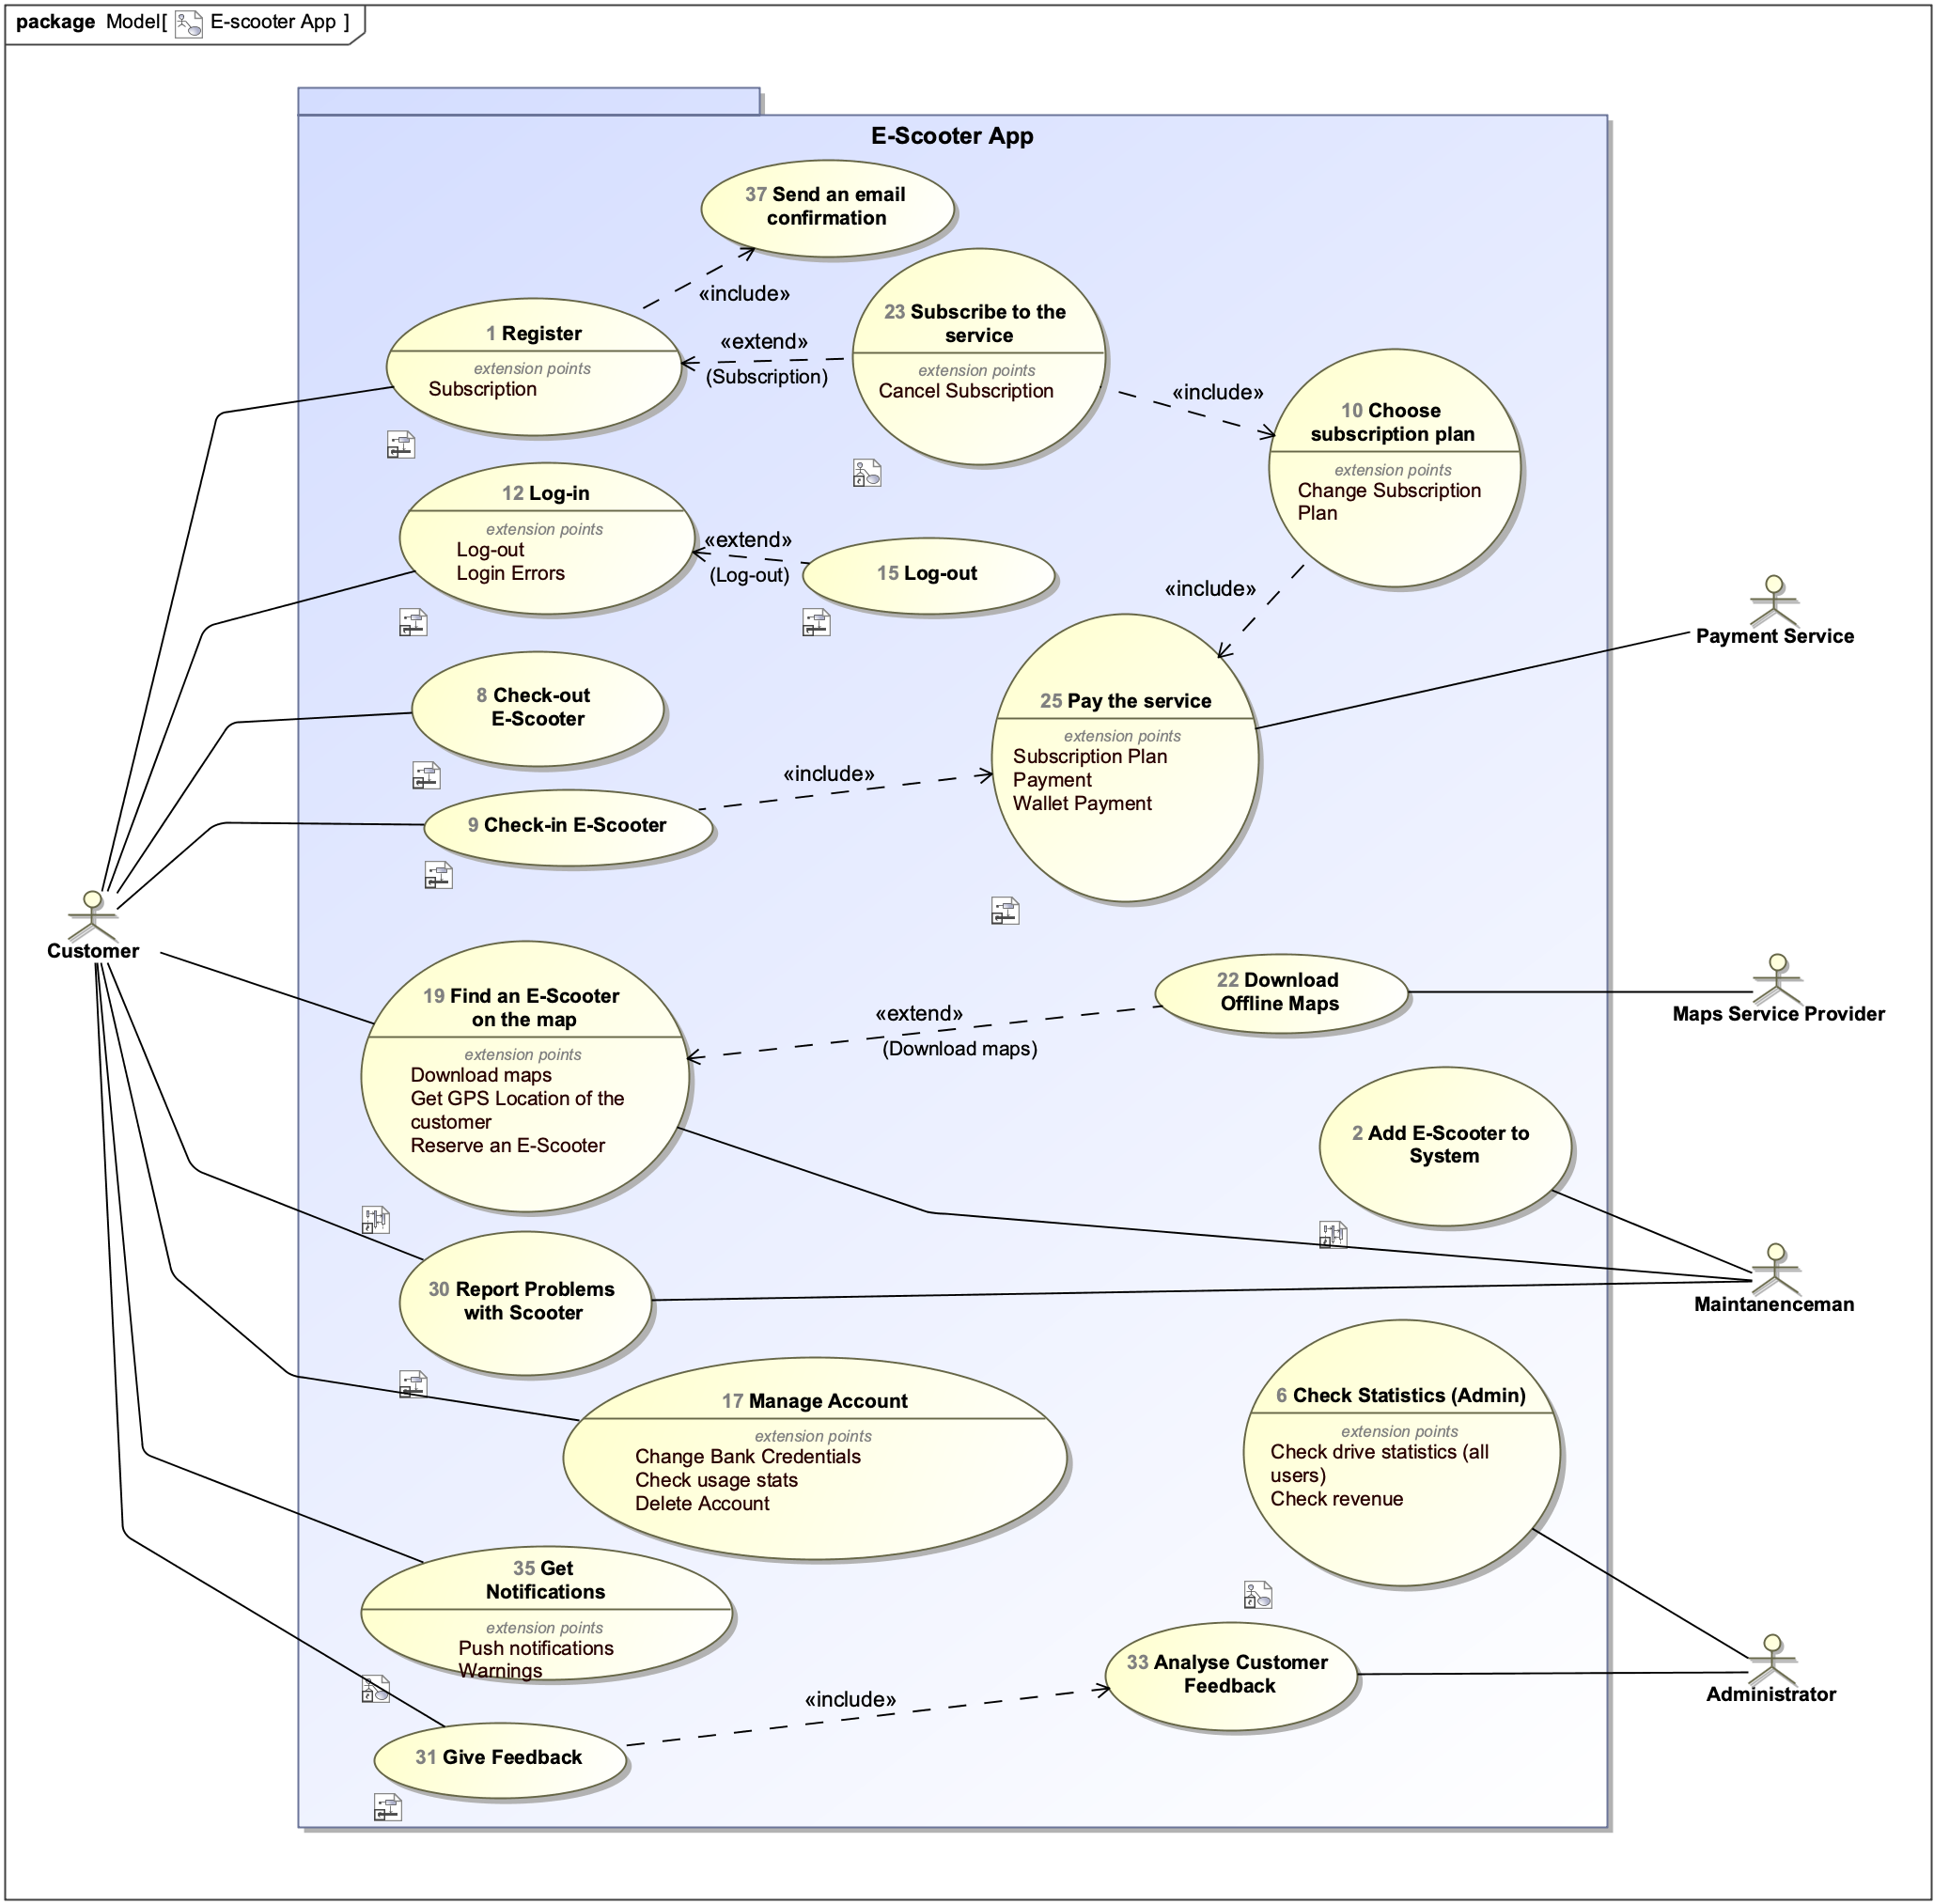
Use Case Diagram

Slide 6
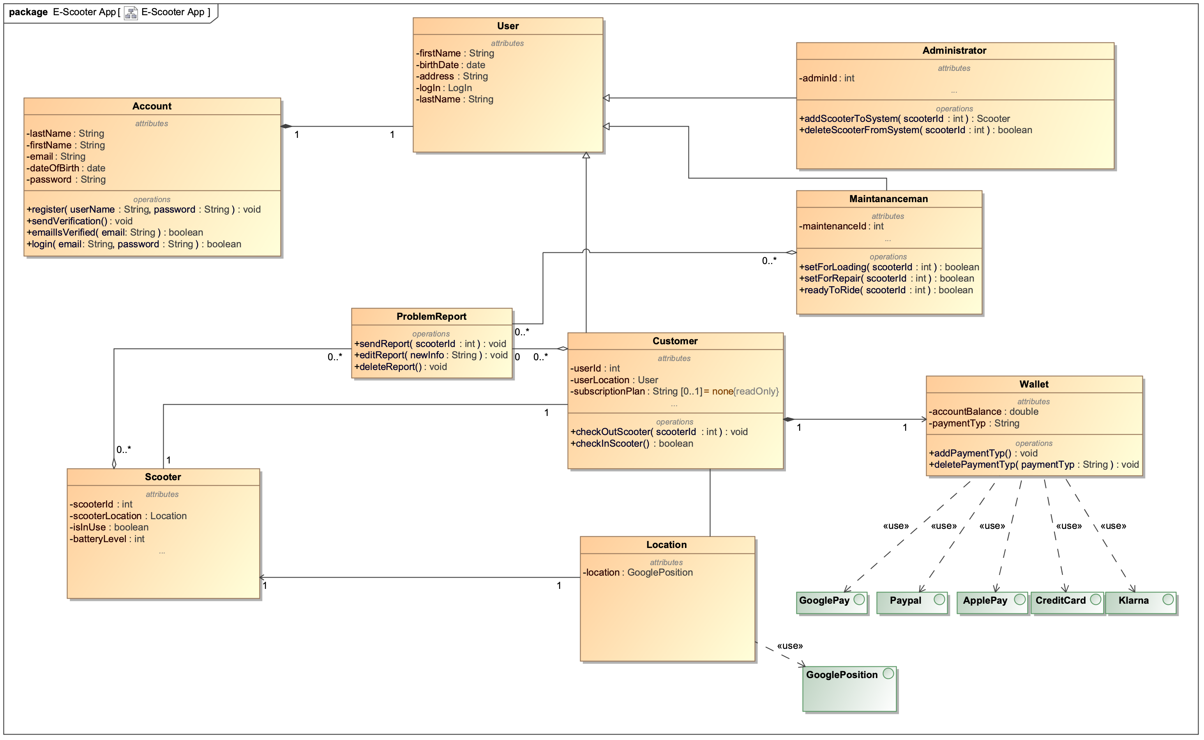
Requirements
Class Diagram

Slide 7
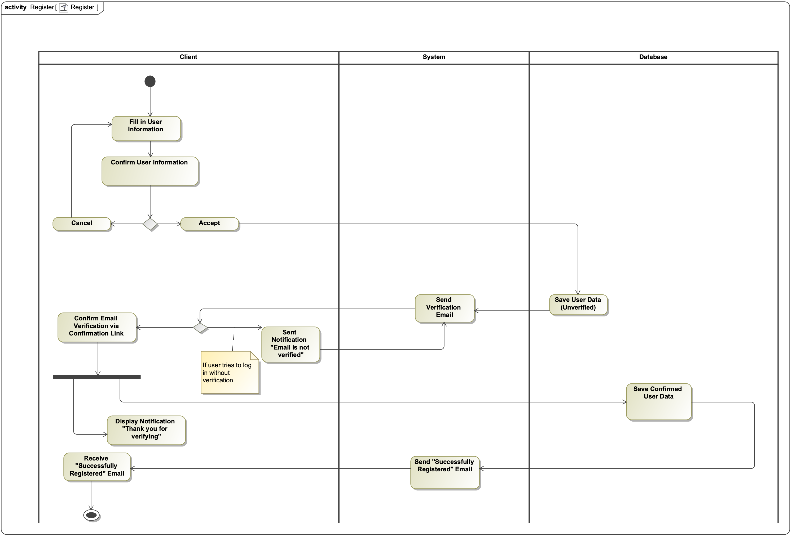
Requirements
Activity Diagram

Slide 8
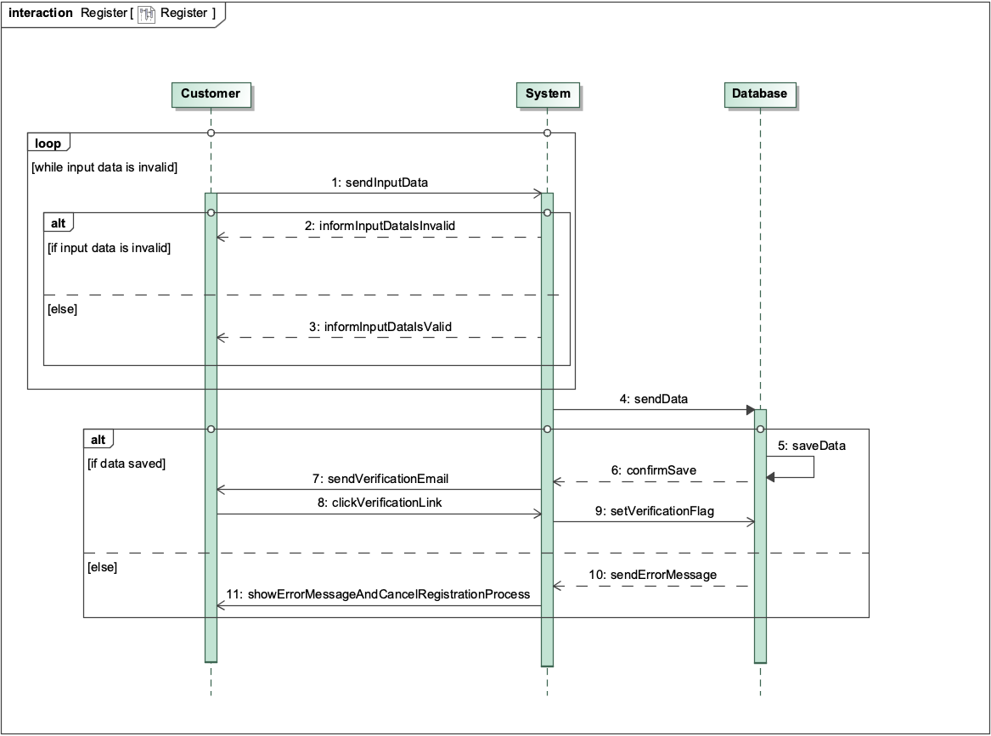
Requirements
Sequence Diagram

Slide 9
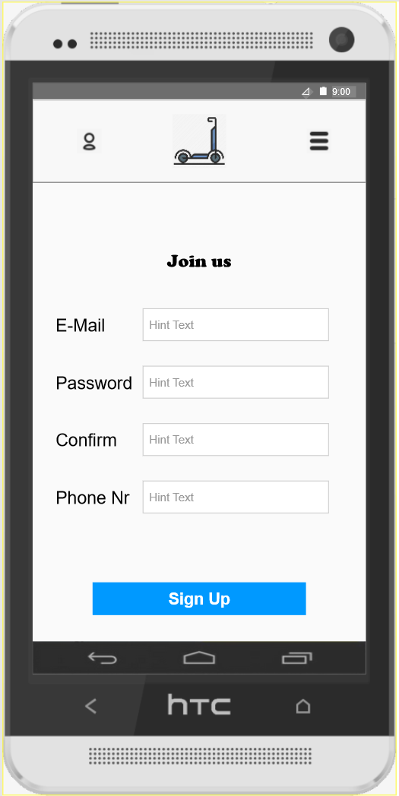
UI Prototype
Axure Experience
Can be animated and used as a web app
Focus on the mobile platform

Slide 10
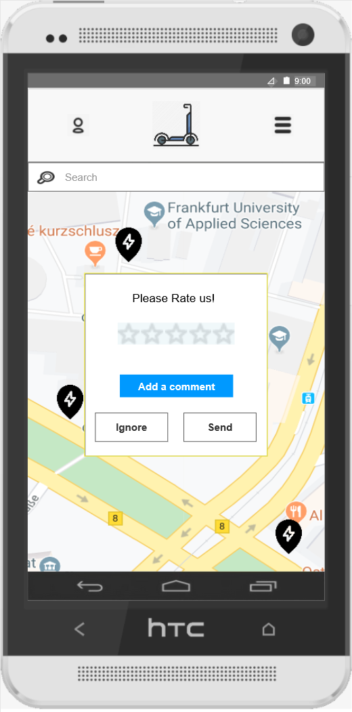
Conclusion
Scrum Experience
Difficulties
Different time schedules for team members

