Slide 1
Early-stage Diabetes Risk Prediction
CECS 456 : Machine Learning
Spring 2023
Group #2:
Carlsean Claricia
Sierra Harris
Sean Iida
Abhay Solanki
Brian Tran
Kenneth Valero
Brian Vu​

Slide 2
Agenda
Introduction
Dataset Overview
Data Analysis
Machine Learning Model
Feature Ranking
Discussion
Conclusion

Slide 3
Introduction
The detection of early stage risk of diabetes can be closely predicted using a machine learning model that identifies if a patient is newly diabetic or would be.
Check dataset for any missing or malformed data and then perform a preliminary test
better understanding of the data such as the number of features, the number of patients, along with those diagnosed with diabetes and those not.
Classifications:
Logistic regression,
Random Forest Classifier
Support Vector Machines
Plot ROC curve of each classification model and calculate the area under the curve (AUC)
Then choose the best classification model to use for a dataset.

Slide 4
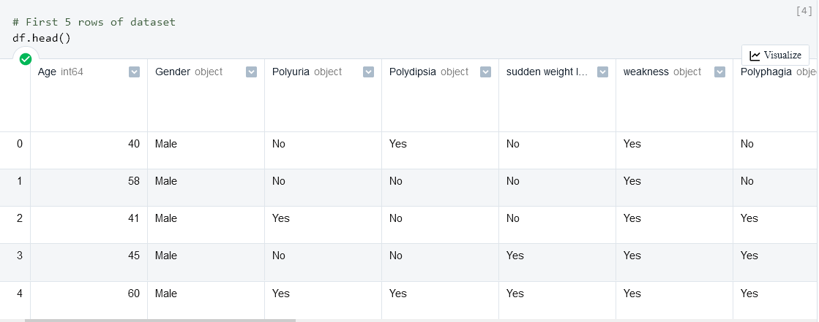
Dataset Overview
Early stage diabetes risk prediction dataset
UCI ML Repository
17 features including classification
Doctor-approved data from 520 patients
All variables except for Age are binary classifications
Notes:
Binary classifications
Male/Female, Yes/No, Positive/Negative

Slide 5
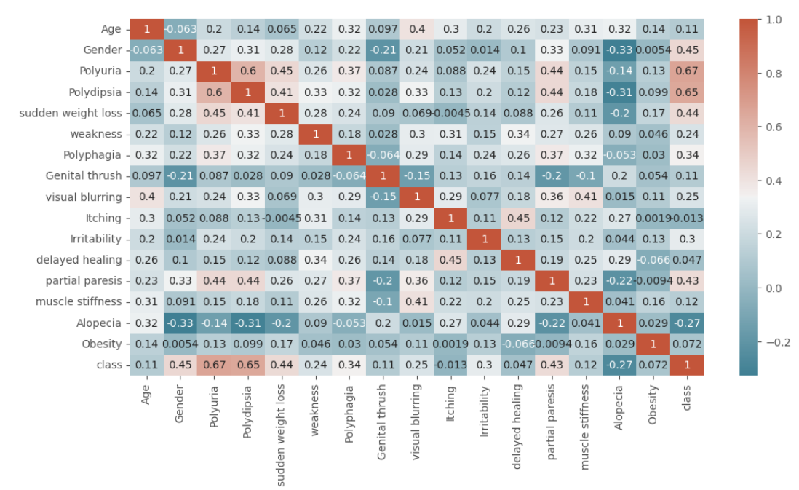
Data Analysis
Converted binary classifications to Integer
Yes, Positive, Female → 1
No, Negative, Male → 0
Generated heatmap to visualize correlations between features
Area of focus is correlation
between a single feature and the classification
Notes:
Notes in order, what to say up to speaker:
Most of the variables are binary classifications that need to be converted to integers.
Yes, Positive, Female are represented as 1 and No, Negative, and Male are represented as 0.
To visualize and better understand data, we do not use scatterplots or boxplots as Age is the only numerical feature.
Heatmap is first generated to quickly show correlations between variables and the diabetes classification
Represents correlation between 2 variables as value between -1 to 1. Greater the number the greater the correlation.
Area of focus for analysis is correlation between single feature and classification as they have the most relation to early stage diabetes in the heatmap

Slide 6
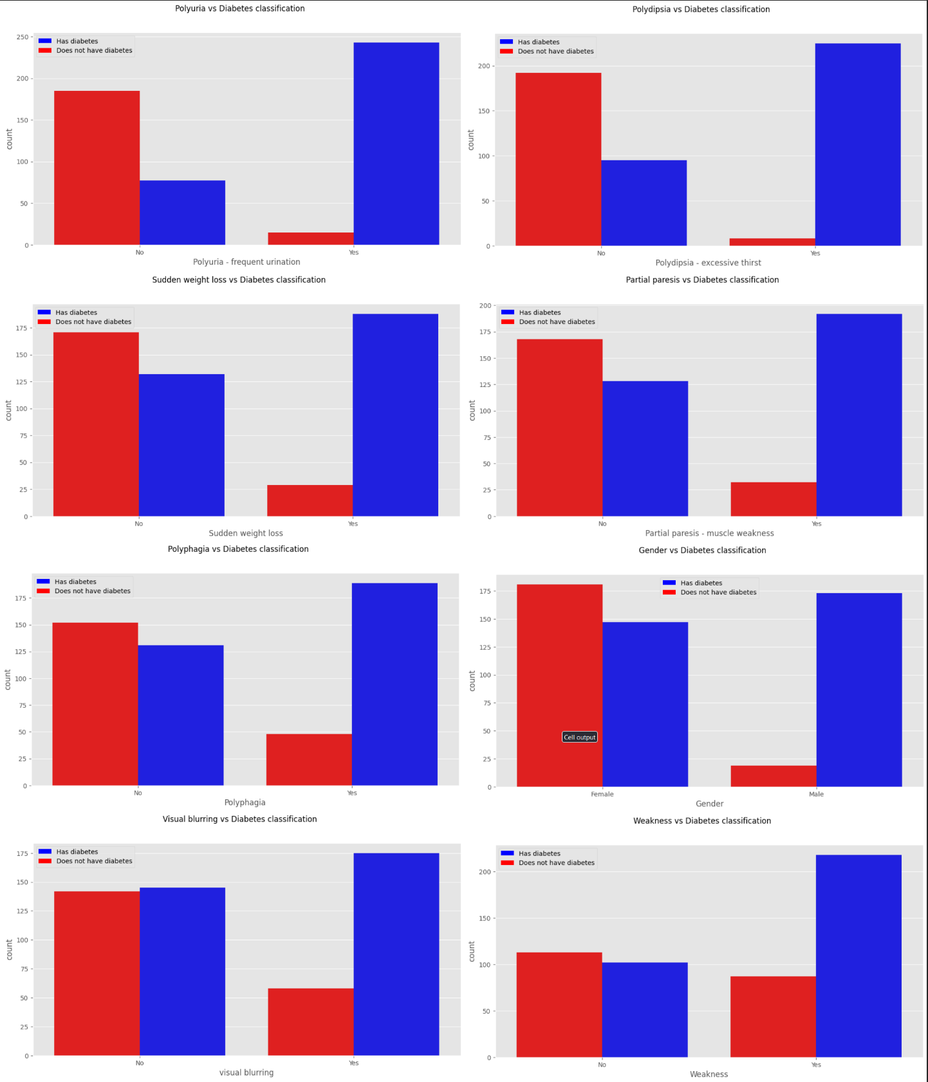
Data Analysis
Men are much more likely to test positive for diabetes
Features displayed have greatest correlation to diabetes within dataset
Features that were present alongside diabetes more often than not had a greater correlation
Based on the analysis, the following features may be the most suitable for classification:
Polyuria, Polydipsia, sudden weight loss, partial paresis, polyphagia, gender, visual blurring, and weakness
Notes:
Notes in order, what to say up to speaker:
In figure, red represents a False classification of diabetes, whereas blue is a positive classification.
The left pair of bars in a graph represents the False classification of the feature or condition and the right pair represents a Positive classification.
Among the dataset, the features found in the the graph displayed the highest correlation to diabetes.
Additionally, features with a low diabetes count, when the condition was not present, have a stronger correlation to diabetes than features with a higher diabetes count.
In other words, some features were present alongside diabetes more often than not.
For example, a feature like Polyuria or Polydipsia had a greater correlation to a patient having diabetes than features, like visual blurring or weakness.

Slide 7

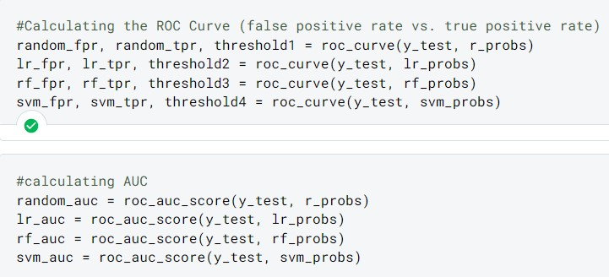
Machine Learning Model
Using the predict_proba function from sk_learn for each model to calculate the probability whether that model will classify each patient as diabetic or not
Calculating probability for a randomized model as reference point
We then use the prediction probabilities to create the ROC curve(false positive rate vs. true positive rate) and calculate the AUC for each

Slide 8
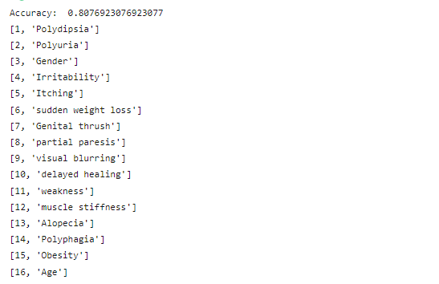
Feature Ranking
To better determine which features hold the most weight in deciding risk factors for diabetes, an algorithm called Recursive Feature Elimination(RFE) is used. This algorithm ranks each feature, from the top being most prominent to the least. In this case, we can see that Polydipsia, or excessive thirst is the highest indicator for diabetes. On the contrary, age holds the least weight when determining risk factors.

Slide 9
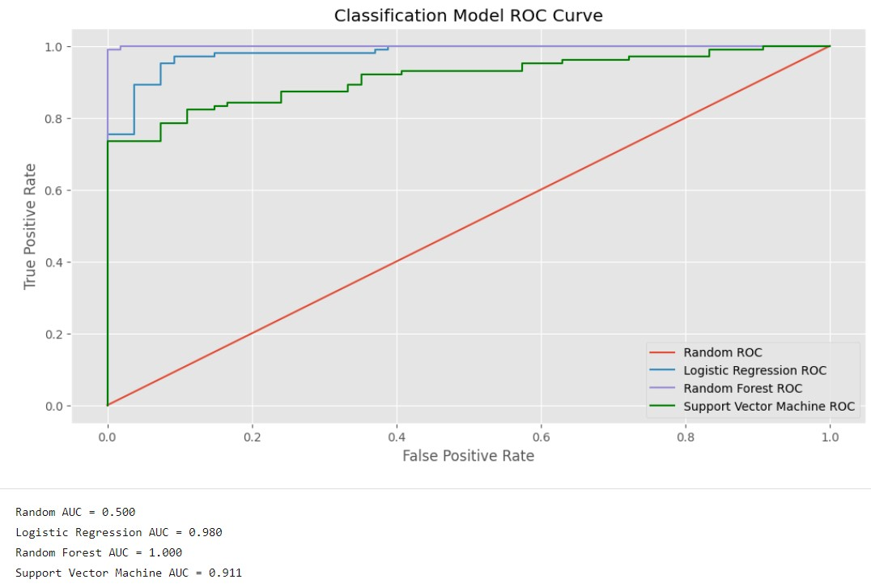
Results
Displaying the graph for the ROC Curve with its associated AUC values
The Random Forest classifier was found to be more effective for classifying patients as diabetic or not than the other two classifier models
Support Vector Machine was the least effective classifier

Slide 10
Discussion
Random Forest classifier model had the highest AUC score which is probably because it is usually more effective with large datasets and the many features it has that affects classification
There are many features that can relate to diabetes which goes well with the Random Forest classifier model
Logistic Regression relies on linear relationships between features and classification, which is not entirely present in this dataset
Support Vector Machine struggles with large datasets and the many important features it has for classification, which leads to poor performance for this dataset

Slide 11
Conclusion
Best classification model to best represent the dataset is the Random Forest Classification.
highest AUC out of the ROC curves plotted.
highest rate of positively classifying patients as either diabetic or not.
Best for larger datasets that contained many important features to consider
such as polyuria, polydipsia, sudden weight loss, partial paresis, polyphagia, gender, visual blurring, and weakness.
Support Vector Machine model was the least effective with this dataset at determining a patient to be diabetic or not.

Slide 12
References
[1] IBM, 2023. What is exploratory data analysis? Retrieved April 19, 2023 from https://www.ibm.com/topics/exploratory-data-analysis#:~:text=The%20main%20purpose%20of%20EDA,interesting%20relations%20among%20the%20variables.

