Slide 1
SMART ELEVATOR CONTROL SYSTEM
Ali Töz

Slide 2
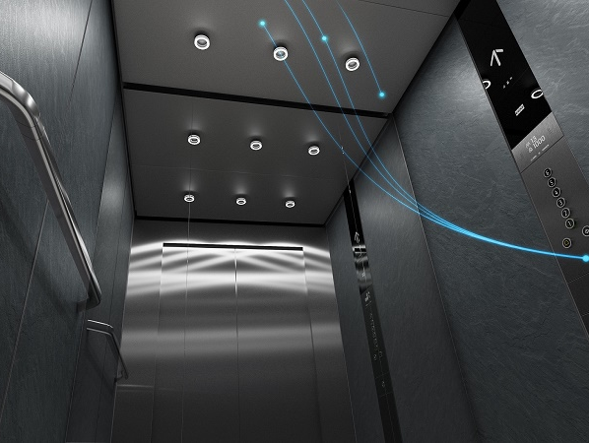
Abstract
The aim of the project is to design a secure, remotely accessible elevator system that can control real-life elevators more easily in daily use. This project idea was conceived for company elevators. It will have additional features to real-life elevators. In the project, data is received from various sensors and this can be displayed to the user. At the same time, when there is a negative situation, the alarm sounds and the elevator is stopped. The elevator can be accessed and controlled remotely via the mobile application.

Slide 3
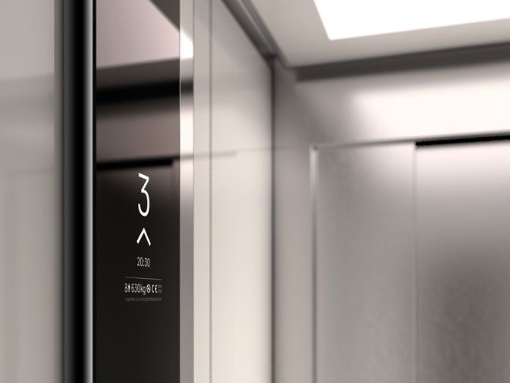
Introduction
First of all, let's get to know the elevator I made. Our company consists of 6 floors, including the ground floor, and our elevator was designed for this company. The data we receive from the sensors inside our elevator cabin is shown to the user. When a negative situation occurs, the alarm sounds and the elevator is stopped according to the data received from the sensors. The motors move according to the direction of the elevator. Depending on the temperature, the heater or cooler works and the movement of the motors can be observed. The control of the entire elevator can be accessed via the mobile application.

Slide 4
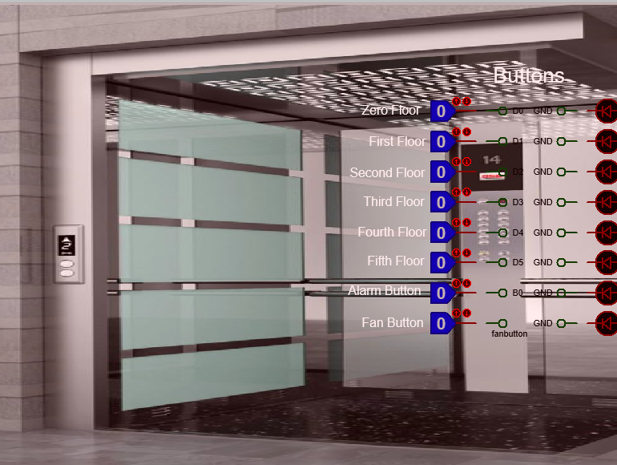
How the system works?
I used logic state buttons for floor buttons, fan buttons and alarm button.

Slide 5
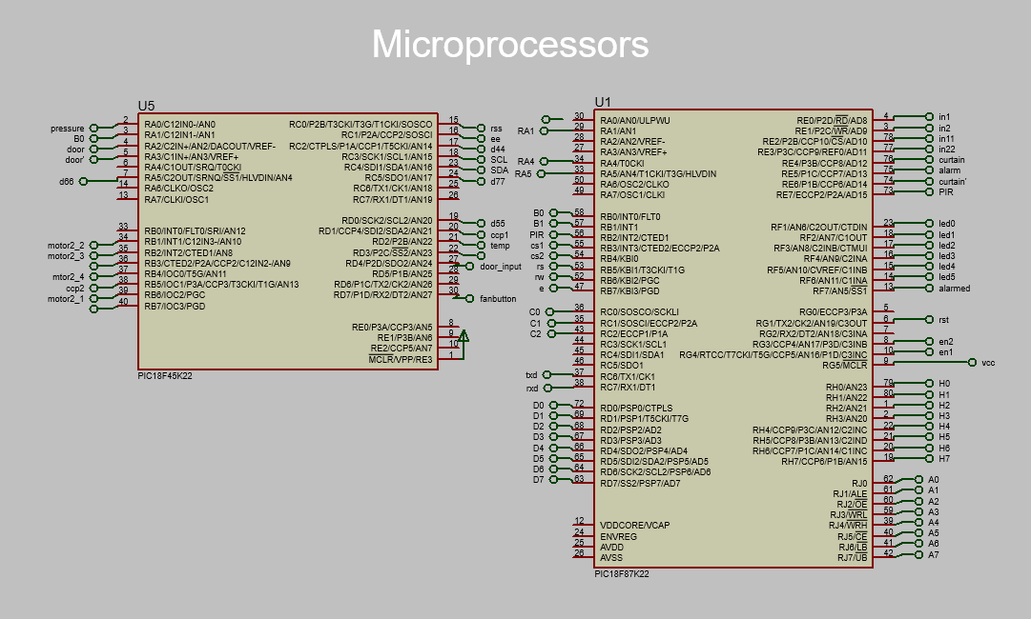
MICROPROCESSORS

Slide 6
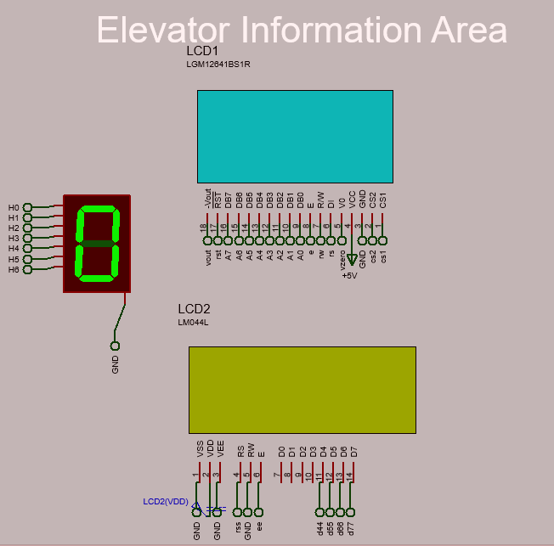
Elevator Information Area
In the elevator information system, one LCD, one GLCD and one seven-segment-display are used. Various information such as information about the elevator, information received from sensors, floor status, date information are displayed here.

Slide 7
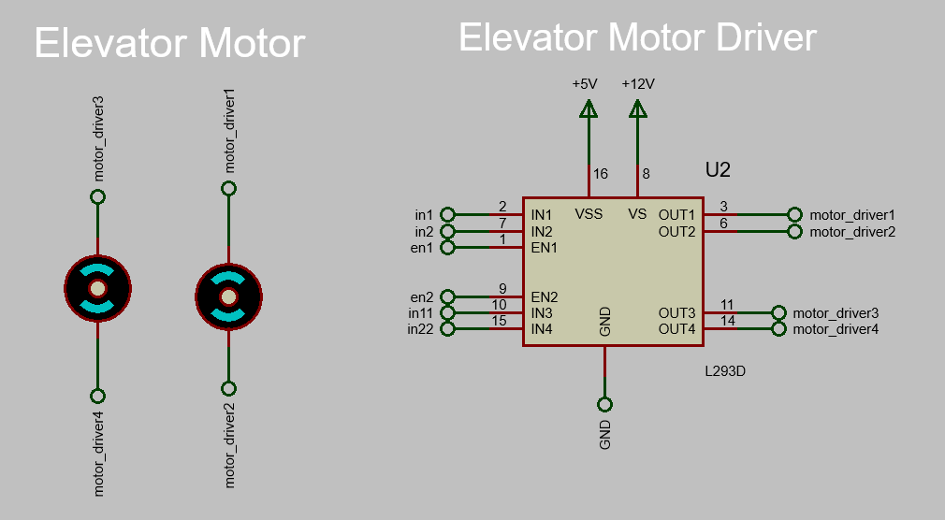
Elevator Motors
I made a system that moves the motors of the elevator according to the current position and the user's choice. I needed a motor driver board for the movement of these motors.

Slide 8
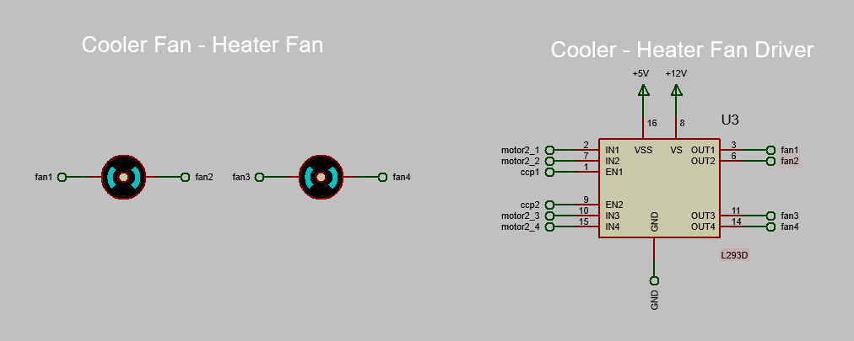
Cooler and Heater System
The elevator heating and cooling system is automatically activated according to the temperature of the elevator. According to the determined reference value, the elevator's heater or cooler works. At the same time, it can be accessed from the buttons inside the cabin or via the mobile application.

Slide 9
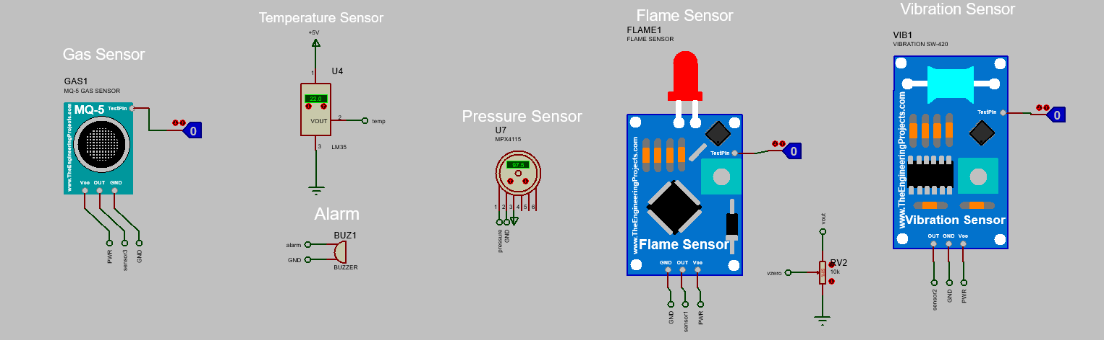
Sensor System
The sensors used are shown here. Information from some sensors is shown to the user inside the elevator cabin. When data comes from sensors such as fire and gas sensors, the alarm sounds and the elevator is stopped.

Slide 10
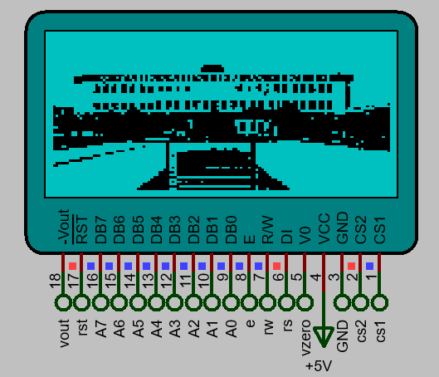
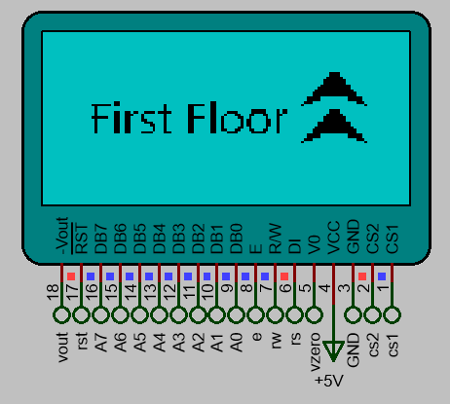
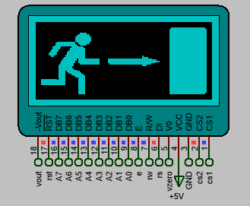
GLCD Animation Sytem

Slide 11
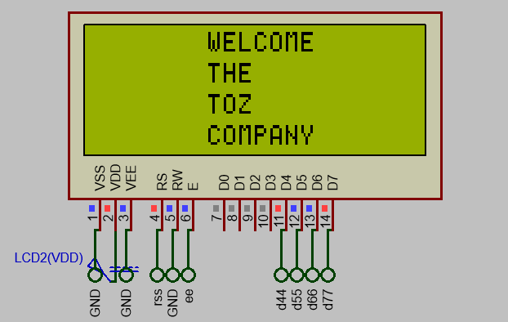
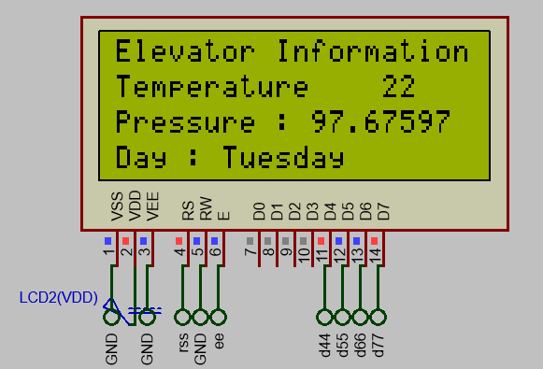
LCD Screen

Slide 12
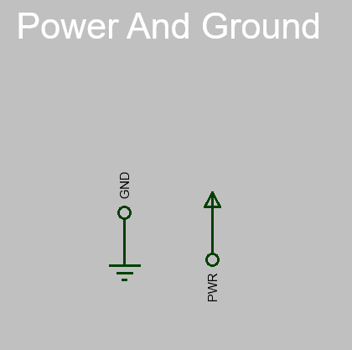
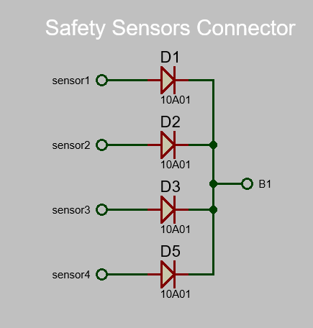
Connectors Power and Ground

Slide 13
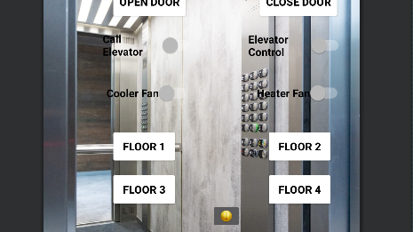
Androıd app AND BLUETOOTH CONNECTION

Slide 14


ANDROID APP
In order to control the elevator through the mobile application, an application has been designed over the android studio. It is connected to the elevator via Bluetooth connection. The elevator control system can be controlled via the designed android application.

Slide 15
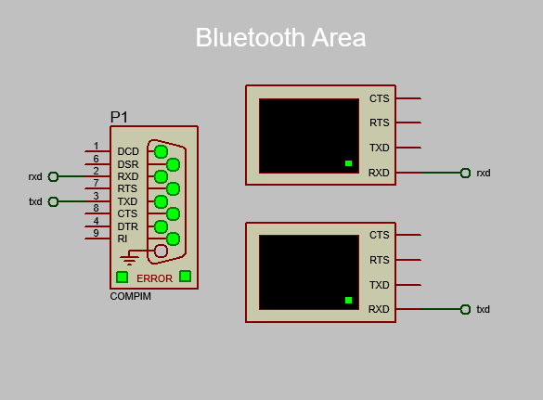
Bluetooth Connection
The Bluetooth connection between the Android application and the elevator control system is provided by the COMPIM module over proteus. Required communication pins are connected between compim and microprocessor and commands sent over bluetooth screens can be seen.

Slide 16
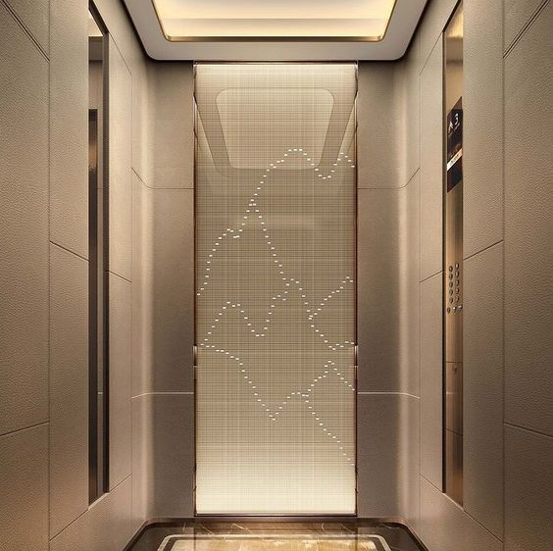
Conclusion
As a result, a comfortable, informative, safe and easy-to-use elevator system has been designed in accordance with today's demands. Information about the daily and the elevator is transmitted to the user via the screens. In unfavorable situations, the alarm sounds and the elevator is stopped. We can also remotely control the elevator system via the Android application.

