Slide 1
Group 104
Sprint 6 Retrospective

Slide 2
How did the Sprint Go?
Negatives
Addressing critical last-minute bugs during testing. This led to increased pressure and cramming our work.
A shared workspace for version control sake and efficient teamwork.
Missing out on frameworks (ie bootstrap).
Positives
Effective communication and coordination with our team and external team (Group 402).
Aligning the development work with the expected prototype.

Slide 3
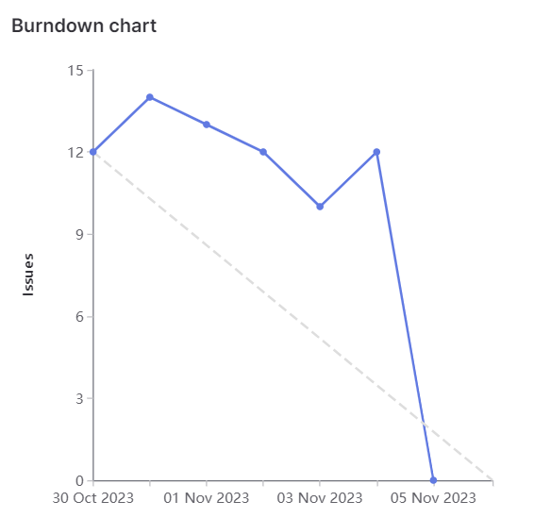
Burndown Chart
Total Issues Weight: 89

Slide 4
Hasen
Team Lead
Weight: 20
Design
Made Web App prototype for the development (F/B end) team to build upon.
Issues
Delegated relevant tasks.
Meetings
Led & scheduled team Meetings, coordinated with team 402 about their API issues.

Slide 5
Riley
Weight:
Something
Company Name, Location
September 20XX - Present
Something
Company Name, Location
September 20XX - August 20XX
Something
Company Name, Location
June 20XX - July 20XX

Slide 6
Thomas
Weight:
Something
Company Name, Location
September 20XX - Present
Something
Company Name, Location
September 20XX - August 20XX
Something
Company Name, Location
June 20XX - July 20XX

Slide 7
Karanvir
Weight: 30
Analyzed the given API documentation from Team 402
Used this information to help the team plan our wrapper API structure & functionality.
Used the Figma design to create the frontend code in HTML/CSS/JS
Buttons with onclick functionality
Input box for entering courses
Table of eligible courses.
Connected frontend to wrapper API
Fetch course info
Generate eligible courses.
Extended frontend functionality
Added table row delete functionality
Added “clear inputted courses” button

Slide 8
Eason
Weight: 23
Something
Company Name, Location
September 20XX - Present
Something
Company Name, Location
September 20XX - August 20XX
Something
Company Name, Location
June 20XX - July 20XX

Slide 9
John
Weight:
Something
Company Name, Location
September 20XX - Present
Something
Company Name, Location
September 20XX - August 20XX
Something
Company Name, Location
June 20XX - July 20XX

Slide 10
Dawoud
Weight: 25
Filtering Courses
Created Dynamic Filtering Options
Allowed for multiple filtering combinations

Slide 11

Start Demo

