Slide 1
Course Admin
EE-uy 4563/EL-GY 6143: Introduction to machine learning
Prof. Sundeep rangan

Slide 2
People
Professor: Sundeep Rangan, srangan@nyu.edu
370 Jay St, 9th floor
Office hours: Wednesdays 16:00 to 17:00 (in my office or on zoom)
Lecture: Tuesdays 11:00-13:30, 370 Jay St, Room 202
All lectures will be on zoom
Attendance (in person or online) is OK. Attendance is not mandatory
Bring your laptop. We will do in class exercises
Course Graders:
Ask for all questions regarding homeworks and labs

Slide 3
Graders for Fall 2025
Grader name | Email | Allocation
Tejdeep Chippa | tejdeep.chippa@nyu.edu | Full
Roshan Nayak | rn2588@nyu.edu | Full
Akshat Singh | akshat.singh@nyu.edu | Full
Aadit Anand Fadia | aaf9407@nyu.edu | Full
Sheetal Prasad | sheetal.prasad@nyu.edu | Half
Raunak Choudhary | rc5553@nyu.edu | Half
Graders will grade all labs, homeworks, and exams
Please contact them if there are any questions
Full graders will each have one hour of office hours per week

Slide 4
Course Learning Objectives
Formulate a task as a machine learning problem
Identify learning objectives, source of data, models, …
Load, pre-process and extract features from common data sources
images, text, audio, …
Mathematically describe simple models of the data
Fit the models to data and use models for prediction and estimation
Use common tools
Evaluate goodness of fit and refine models
Evaluate the performance of methods using statistical techniques

Slide 5
Grad vs Undergrad
Class is simultaneously offered at the graduate and undergraduate level
Undergrad EE-UY/CSE-UY 4563: Intro to Machine Learning
Covers fundamental algorithms and some analysis
In depth coverage of software tools including python, Google Cloud, Tensorflow
Python-based lab exercises + mandatory project
Grad EL-GY 6143: Intro to Machine Learning
More algorithms and more mathematical analysis. Faster paced.
Software tools must be learned at home. Less coverage in class
Python-based lab exercises + optional project
Lecture notes are mostly common with supplementary material for grad students indicated
Many labs are common

Slide 6
Texts and Other Resources
Undergrad: James, Witten, Hastie and Tibshirani, “An Introduction to Statistical Learning”,
http://www-bcf.usc.edu/~gareth/ISL/ISLR%20First%20Printing.pdf
Very clear explanation of concepts.
But examples are in R. And there is no review of probability
Grad: Hastie, Tibshirani, Friedman, “Elements of Statistical Learning”
https://web.stanford.edu/~hastie/Papers/ESLII.pdf
More advanced text with more analysis
Tivandar Danka, Mathematics of Machine Learning
Nice background of all the mathematics you needd
Bishop, “Pattern Recognition and Machine Learning” (more advanced)

Slide 7
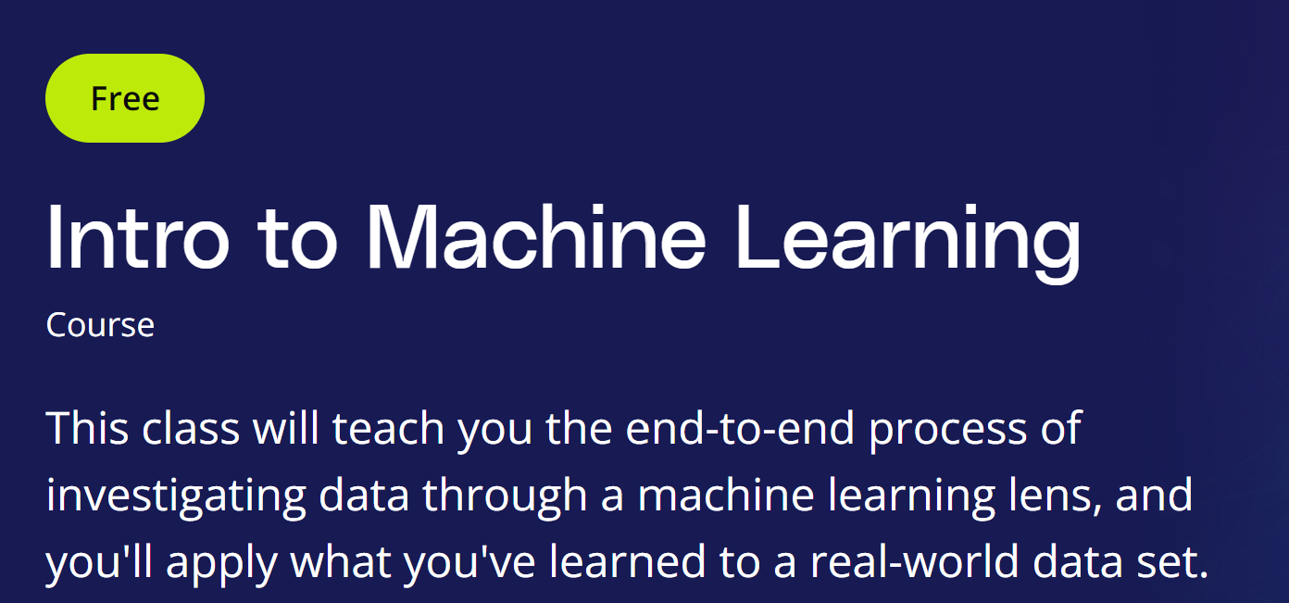
More Resources
Many classes online
Udacity
Cornell CS4780
YouTube videos
Berkeley Deep Learning
Deep learning specifically
Andrew Ng’s machine learning class:
https://www.coursera.org/learn/machine-learning
A little less mathematical than this class
Many, many others online…

Slide 8
Pre-Requisites
Undergrad probability required for both UG and Grad version:
Basics of random variables, densities, Gaussian distributions, correlation, expectation, conditional densities, Bayes’ theorem
Will provide a short review
NYU classes: Data analysis or Intro Probability are sufficient
Undergraduate calculus and linear algebra
Vectors, matrices, partial derivatives, gradients.
Again, we will provide a brief review
No machine learning experience is necessary
If you have ML experience, do NOT take this class.
Take Graduate probability (Fall) then Advanced machine learning (Spring)

Slide 9
Pre-Requisites Programming
Python
All labs are in python, similar to object-oriented MATLAB, but many more libraries.
And free!
What you need to know
You do not need to know python before class. But we will go over it quickly.
You should have experience in some programming language (eg. MATLAB).
You should know or being willing to learn object-oriented programming
Resources:
Installing python and ipython notebook (make sure you install Version 3.12) http://jupyter-notebook-beginner-guide.readthedocs.io/en/latest/index.html
Python tutorial: https://docs.python.org/3/tutorial/
Numpy: http://cs231n.github.io/python-numpy-tutorial/

Slide 10
Grading: Undergraduate
Midterm 1: 25%, Midterm 2: 25%, Labs, HW: 25%, Final project: 25%
Labs: Simple python exercises
Given as jupyter notebook that you complete.
Midterms
Each over approx. 3-4 weeks of material
Closed book with cheat sheet.
Follows homework and quiz problems + some very basic python questions
Final project:
Use machine learning in some interesting way.
Must use data and python analysis.
Provide final report.

Slide 11
Grading: Graduate
Midterm 35%, Final 35%, Labs / HW 30%
Optional project: Up to 20%
Labs: Simple python exercises
Given as jupyter notebook that you complete.
Midterms & final
Each over approx. 6-7 weeks
Open book but no electronic aids.
Follows homework and quiz problems + some very basic python questions
Optional final project:
Use machine learning in some interesting way.
Must use data and python analysis.
Provide final report.

Slide 12
Lecture Sequence
Date | Prior Years |  | Fall 2025
 | Unit | Description | Unit | Description
9/2/2025 | 1, 2 | Course Admin. What is ML? Multiple Linear Regression | 1, 2 | Course Admin. What is ML? Multiple Linear Regression
9/9/2025 | 3 | Model Selection | 3, 4 | Model Selection, Regularization and LASSO
9/16/2025 | 4 | Regularization and LASSO | 5 | Logistic Regression
9/23/2025 | 5 | Logistic Regression | 6 | Nonlinear Optimization
9/30/2025 | 6 | Nonlinear Optimization | 8 | KNN, Kernel methods [New]
10/7/2025 |  | Midterm review | 13 | Decision Trees
10/14/2025 |  | No class: Spring break |  | No class: Spring break
10/21/2025 |  | Midterm |  | Midterm
10/28/2025 | 7 | SVMs | 8 | Neural Networks
11/4/2025 | 8 | Neural Networks | 9 | Convolutional neural networks
11/11/2025 | 9 | Convolutional neural networks | 10 | PCA
11/18/2025 | 10 | PCA | 11 | Word Embeddings and tokenization [New]
11/25/2025 | 11 | Clustering and K-means | 12 | Clustering and K-means [Modified]
12/2/2025 |  | Final Exam Review / Make Up |  | Final Exam Review / Make Up
12/9/2025 |  | Final Exam |  | Final Exam

Slide 13
Machine Learning Project
Perform an interesting machine learning task of your choice
Many possible areas:
Machine vision, brain-computer interfaces, natural language processing, sentiment analysis, …
Anything that interests you
Groups of 2 necessary
Submit all material as that group
Use real data
write code
Place all material in a github repo (including documentation) and submit only github repo

Slide 14
Project Grading
Formulation
How well did you formulate the problem? Was it clear? Was that tied to the right objective?
Approach
Does your approach properly solve your problem? Was that made clear?
Evaluation and Interpretation
Did you comprehensively test the results? How well did you select / create the data?
Did you test against alternative approaches?
Presentation
Were the ideas clear? Were all the details conveyed. Did you highlight the main points?
You can select a number of formats. Whatever makes sense. A github page
Bonus
Given for particularly hard / novel research

Slide 15
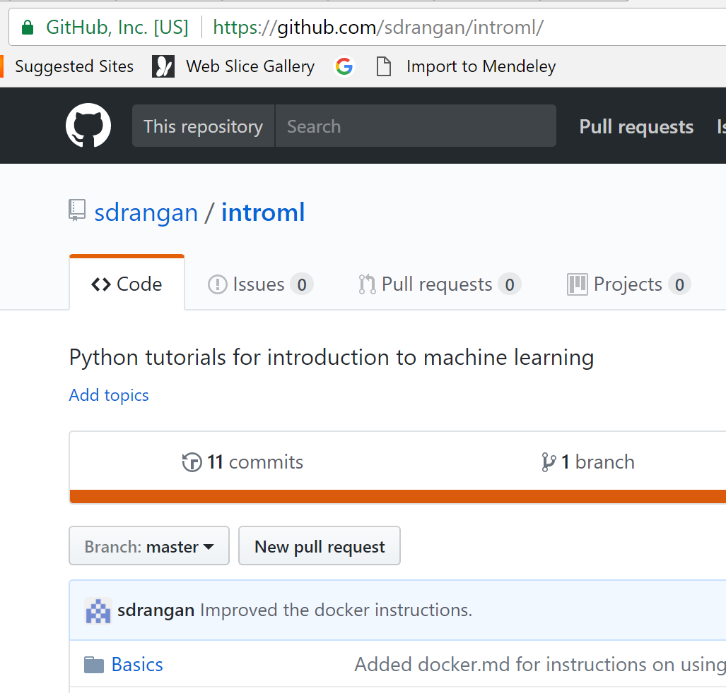
Github
Labs and demo posted on github
https://github.com/sdrangan/introml/
Also includes instruction for installing software
Several tutorials of github on the web.
Available on Windows, Mac and Unix.
But, you can just clone the repo

Slide 16
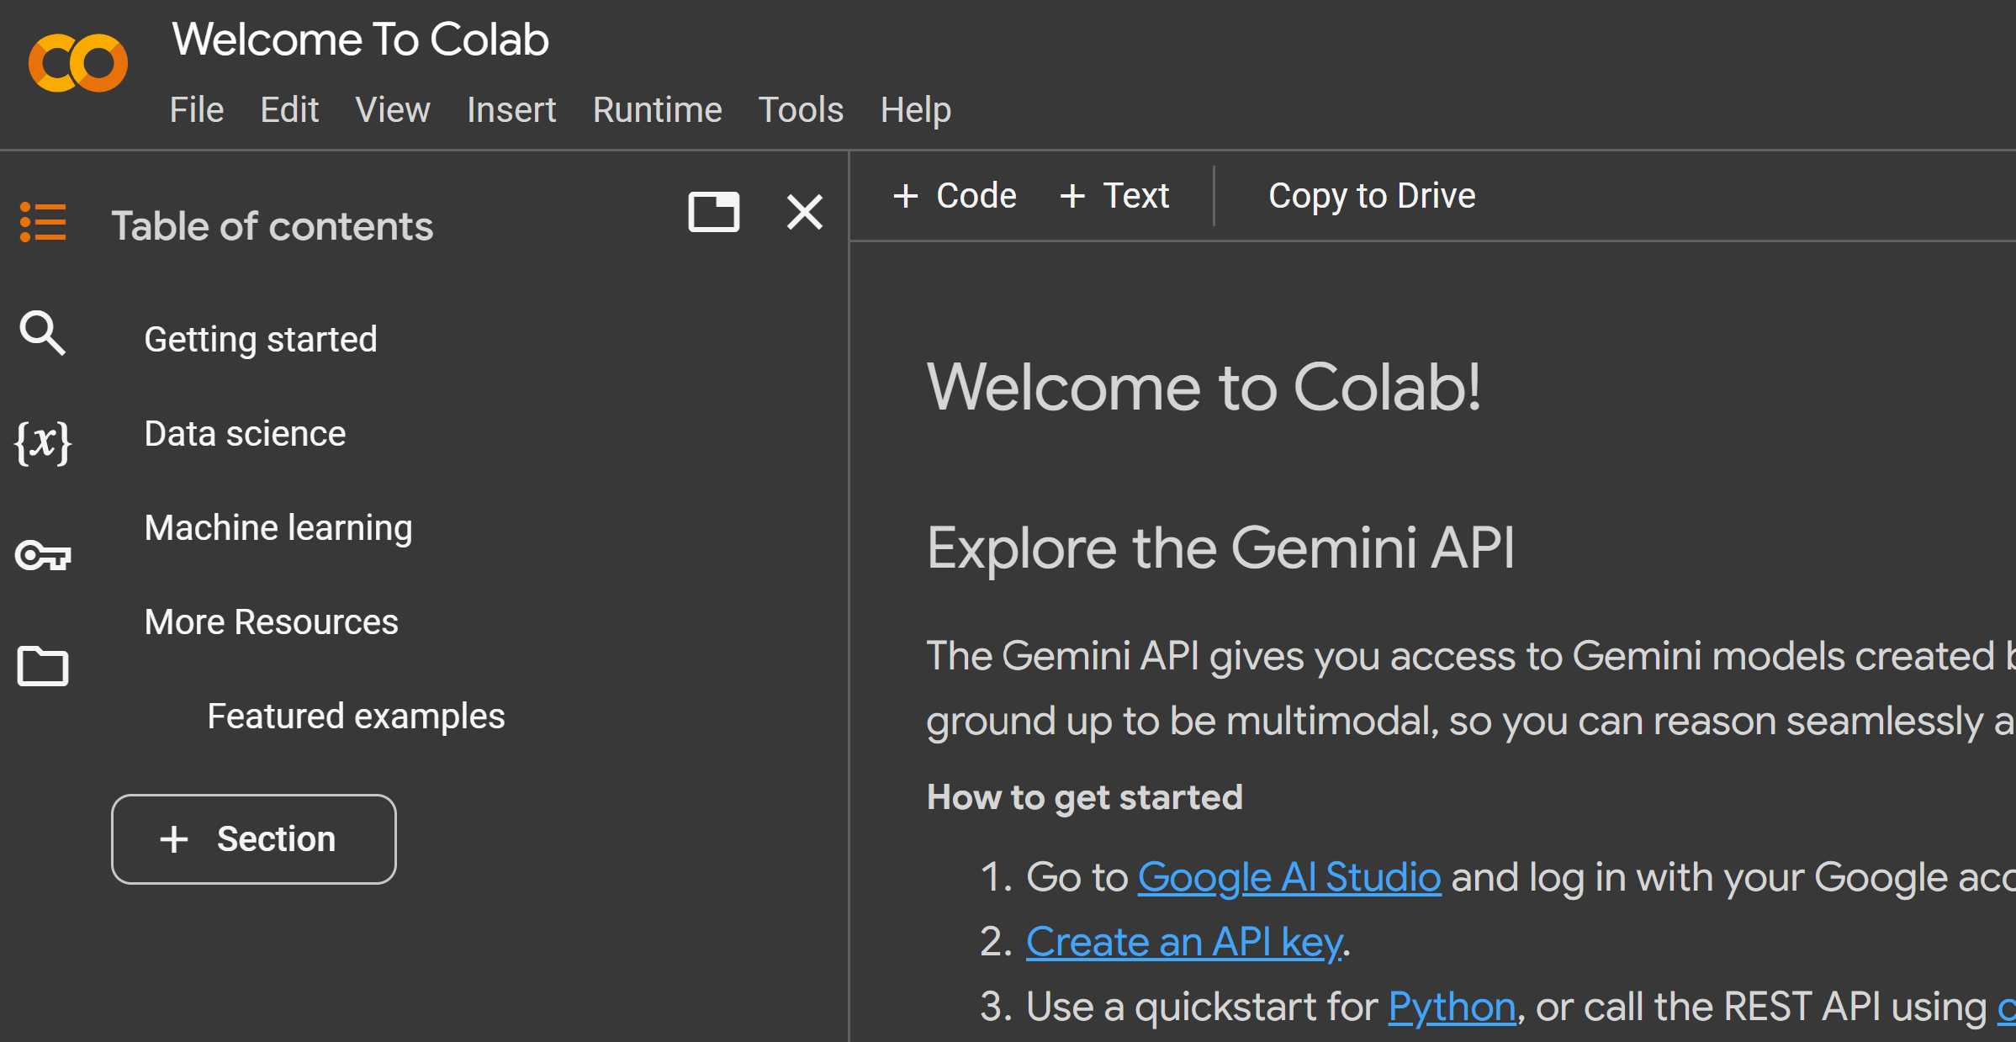
Google Colab
Fully online python environment
Many benefits
Free to use
Will work for all assignments and labs
No machine to set up
But it may be a bit slow
Only matters for larger projects

Slide 17


Software for Local Machine
If you use your local machine, you will need to install several pieces of software:
Python with various packages
Make sure you get 3.12
Anaconda
Jupyter notebook
See notes in NYU Classes
Deep learning package
Either pytorch or Tensorflow
Git hub
Guides: https://guides.github.com/
Available on Windows, Mac or Linux (including GCP instances)
All demos will be available on: https://github.com/sdrangan/introml.git

