Slide 1
Haskell and functional programming
What is it and how does it work?

Slide 2
Objectives
To know what the functional programming paradigm is
To know about functions, domains and codomains
To know about function application and partial application
To know about composition of functions
To know what a first-class object is and what a higher order function is
To know how to build simple functional programs
To know how to construct and work with lists in Haskell
Return the head or tail, prepend, append, test for empty and find length
To be able to use the map, filter and fold functions with lists

Slide 3
1: functions and ghci
Functions, domains, codomains, function application.
Simple statements in Haskell

Slide 4
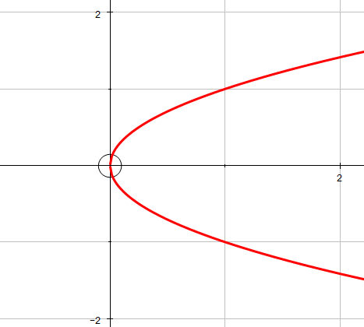
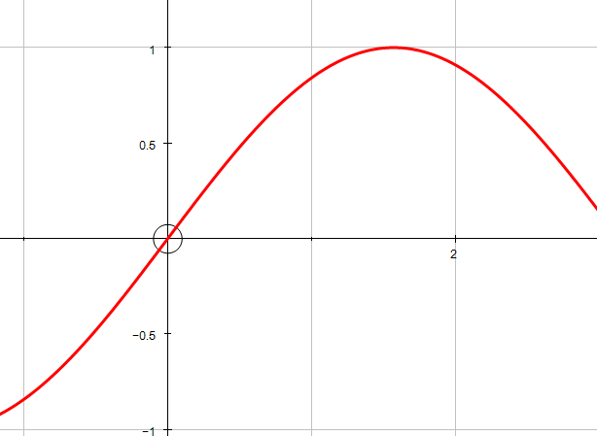
Functions
Input
Function
Output
A function takes a set of inputs and gives a set of outputs
In A-Level maths we work with
“one-to-one” functions like multiplication
“one-to-many” functions like square root
But “to-many” functions have no inverse!
“many-to-one” functions like sine or cosine
A many-many relation is not a function
Functions can be “composed” together
Domain – set of values for input
Codomain – theoretical set of outputs from the function
Range – set of actual outputs given the inputs
The range and codomain will often be the same

Slide 5
What is Functional Programming?
The code entirely comprises functions you define and combine to take various inputs and generate appropriate outputs.
In most of the applications we will look at the program will take a list of data and process it to generate some output: often another list.
Haskell is a very important Functional language and the one we will learn
Lisp is another important language
The backend code for WhatsApp is written in functional code.
The spam filters for Facebook are also written in functional code.
In real-life applications Haskell is used to compile a binary function that is linked into a project in another language like Swift or C++.

Slide 6
Getting Started
Find WinGHCi or GHCi on your computer and start it.
GHCi stands for “Glasgow Haskell Compiler interactive”
It is not Visual Studio, but it is quite good.
The best online tutorial is at: http://learnyouahaskell.com/introduction
I have a lot of videos at: https://www.youtube.com/playlist?list=PLs__YUAXGuHcaA_lstX8yF0jSQLVrV7f-
You can write simple programs into GHCi directly but compilation is better:
We will need to write code in a text editor and then “load” it into GHCi for compilation and running.

Slide 7

Its traditional

Slide 8
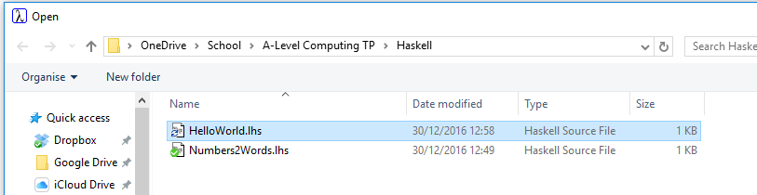
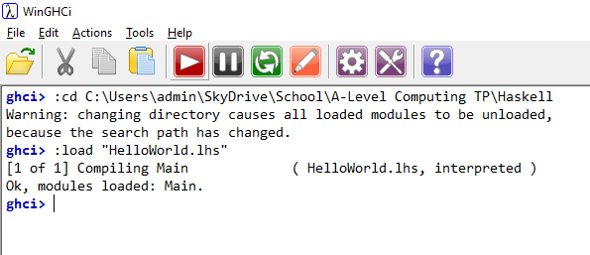
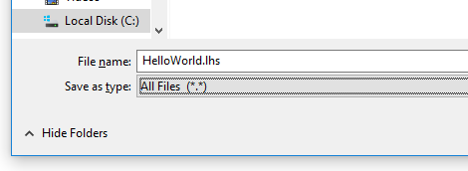
Hello World!
Then in WinGHCi use File -Load
File – Save As
Use type “All Files”
Set the extension as .lhs for “Literate Haskell Script”
Type main <Enter>

Slide 9


Some built-in functions
In GHCi try typing these at the Prelude> prompt:
3+5
3**5
“Dog”==“Cat”
div 92 10
92 `div` 10 be careful to find the correct symbol: ` - not ‘ or “
` ` changes a function from prefix to infix – sometimes this is helpful
mod 92 10
:t (+)
:t div
(+) is defined as a function that takes an object type a and returns a function that takes an object type a and returns an object type a. a is an object of the Num type class:

Slide 10
2. Defining your own functions
What its all about

Slide 11
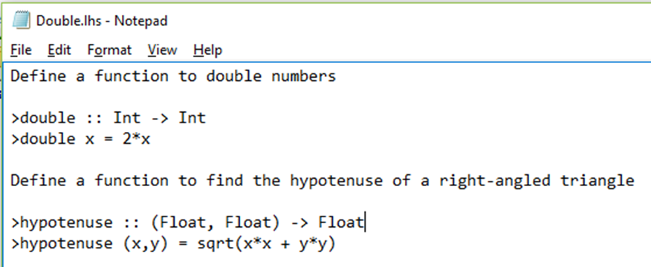
Defining your own functions
Haskell is all about functions so we need to know how to define them.
Declare the function name and the types it receives and returns
Use the name to define the mathematical operations you want
For example, try this code in WinGHCi
This can be read as: “double has type of Int -> Int” that means it takes an Int and returns an Int
On the other hand hypotenuse has type of (Float,Float) -> Float. It takes a tuple of Floats and returns a single float.
It is tempting to say “double takes an Int and returns an Int” but that is a little over simplified.
Strictly we should say to ourselves: “is of a type that takes an Int and returns an Int”
We’ll see why in the next section on Functions of Functions.

Slide 12
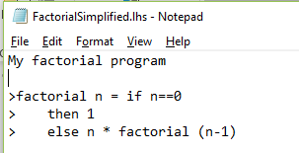
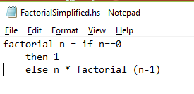
Lhs vs hs?
If you want to write lots of comments (and of course you do!!) you need to create a “Haskell Literate Script” .lhs file
Alternatively you can create a .hs file without comments.

Slide 13
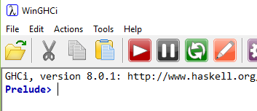
Load into WinGHCi and run it
Load the file
Then you should be able to use Edit and Reload from WinGHCi
It should load, then in WinGHCi type:
double 30
hypotenuse (3,4)

Slide 14
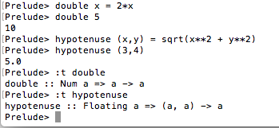
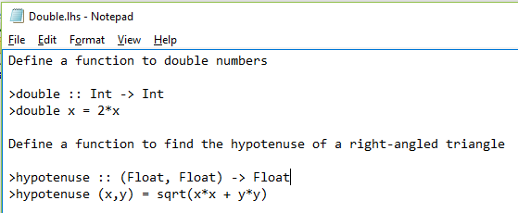
You can be lazy – and sometimes its best!!
When we compiled the program we named the functions explicitly and defined their types.
In fact, if Haskell can deduce the types, you don’t need to explicitly name the functions. However, it is bad form not to. If you want to write self documenting, maintainable code follow the example on the right.

Slide 15

Making decisions in Haskell - 1
You can use If-Then-Else
Now try: doubleSmallNumber 34

Slide 16
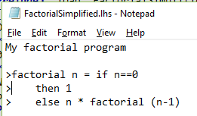
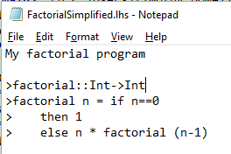
types
Try these two programs
Try the type Integer. It is a clever type that combines Int32 values to any size you like.

Slide 17
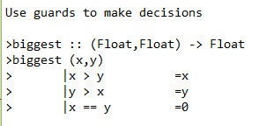
Making decisions in Haskell - 2
Haskell has “guards” – very similar to a Case structure – use a pipe to do this: |
This definition takes a tuple and returns a single value
Write a program that tells you if a number is even or not. You will need the standard functions we started the lesson with.

Slide 18
Now create some more functions of your own
Create a function to find the missing side given a side and the hypotenuse.
Create a function to find the third side of a scalene triangle given two sides and the included angle.
Try cos pi at the prelude prompt

Slide 19
Functions that take or return functions

Slide 20
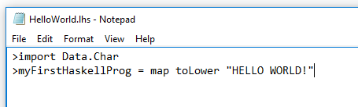
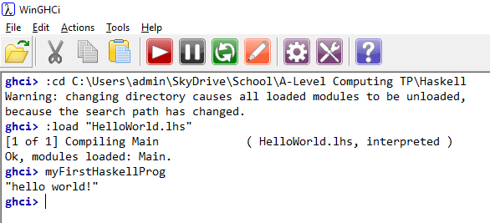
Hello World! - again

Slide 21
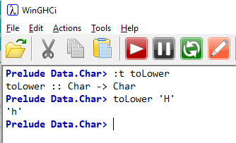
How was that functional??
“toLower” is a built-in function that takes a character and converts it to lower case:
“Map” is a built-in function that
Takes a function and returns a new function that
Takes a list and returns a list !
So, Map took toLower and made a function that takes a list and returns a list in lower case.
It is important to realise that the string “HELLO WORLD!” is not a parameter value of toLower. toLower is a parameter value of Map and the function that is output takes the parameter “HELLO WORLD!” – which is a list of characters.

Slide 22

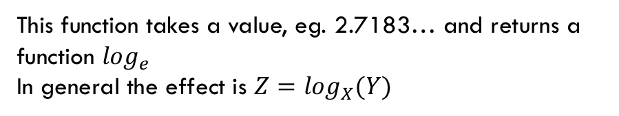
Some interesting concepts
What does this mean?
Roughly speaking it means a function f is of a type that takes a parameter of type X that gives another function that takes type Y and finally gives type Z.
For example
A function that finds the first word of length n in a text would be defined as :
This function takes a value, eg. 2.7183… and returns a function $\log_{e}$
In general the effect is $Z=\log_{X}(Y)$
$$logBase∷Float→Float→Float$$
We could then write in Haskell
Find 4 “Friends, Romans, Countrymen lend me your ears!”
and get the result: “lend”
Then we need to define Find! We won’t because its hard.

Slide 23
Association is “to the right”
“Association” is from “Associativity” – the brackets.
This means that f takes a parameter of type X and returns another function that takes a parameter of type Y and returns a value of type Z.
Bracketing the X,Y means that we get a function f that takes a function (that takes X and gives Y) and returns a value Z. That doesn’t make sense at all.
You can take a function and return another function – like in map.
map is specifically mentioned in the course specification – we will get lots of practice so that you don’t forget it.

Slide 24
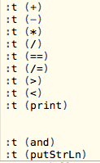
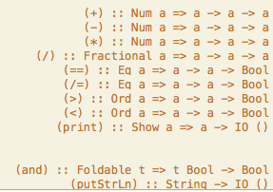
Type classes and type variables
If we are to give functions as parameters of other functions then we need to be able to describe the types involved.
Haskell has type variables: variables whose data type is a data type!
“Num a” declares a as a type variable containing a numerical data type like Int, Float etc.
Fractional is a subclass of Num.
The first line opposite explains that (+) is a function that handles objects whose data types are of the Num class and that it takes an object of type a and returns a function which takes an object of type a and returns an object of type a.
Those objects a could be functions - but they must be of the appropriate type: you can add the output of two functions of Num type, but not Show!

Slide 25

Some practice
Write a program that takes in two values and tells you if the second is a multiple of the first.
Write it “functionally” – ie. use this declaration:
isDivisible :: Int -> Int -> Bool
Now write a program that takes three sides of a triangle and says whether it is geometrically possible or not.
This is not taking a function as a parameter – that’s much more complex and we’ll use Haskell library functions
to do that.
It is tempting to try and write a program to test if a number is prime.
Have a go and see what happens.
We are going to do just this later, but there is an important problem to solve first.

Slide 26
Partial function application
Writing clear code

Slide 27

What is it?
A complex function might take many parameters
This is complex to write and debug and not easy to understand when you read the code
Better practice is to break it down into constituent calculations (parts)
This is know as “partial application” of the function
The intermediate functions might be useful elsewhere anyway
For example, if we were calculating the volume of a cuboid:
Now write a program that uses partial function application to find the value of an investment after a given number of years at a given rate of compound interest.

Slide 28
lists
Haskell’s big thing?

Slide 29
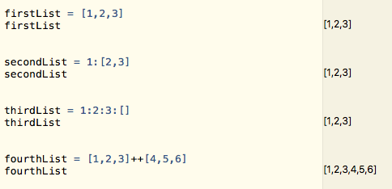
Lists
You can define a list with values
“:” is the constructor for a list – it takes a value and a list and concatenates them. Unlike most of our functions it is infix not prefix.
++ concatenates two or more lists.
“:” is a function that takes a value and returns a function that takes a list and returns a second list (with the value added)

Slide 30
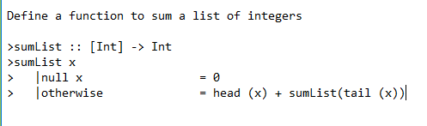
List operations
head :: [a] -> a takes a list and returns the first element
tail::[a] -> [a] takes a list and returns everything but the first element
Notice that our parameter in the function definition is a list but we simply call it x. Haskell knows it is a list from the declaration earlier. It calls itself recursively – another strong point of Haskell.

Slide 31

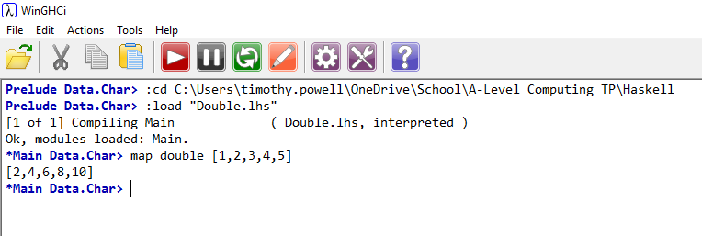
The map function
Map takes a function as a parameter and outputs another function that takes a list and outputs a list. It applies the given function to every element in the input list.

Slide 32
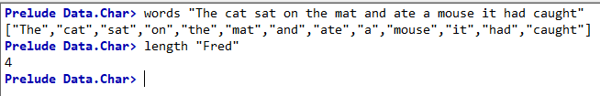
practice
Create a function that takes a piece of text and returns a list of the word lengths. These library functions will help.

Slide 33
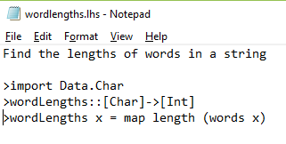
One way to do it

Slide 34
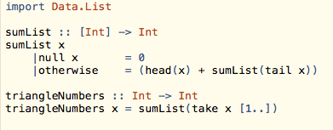
The take function
This takes a programmatically defined part of the front of a list (as opposed to the Head or the Tail).

Slide 35
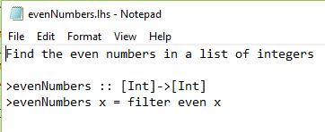
Filter
This function is applied to a list to extract the elements that meet a condition
The condition is described in a predicate function
There are many predicate functions in the Haskell libraries
Practice: Define a function multipleOfThree :: Int -> Bool and filter a list for multiples of three
Now create functions that
Says if a number is a factor of another number
List the proper factors of a number – or returns [] if there are none
List the primes up to a given value

Slide 36
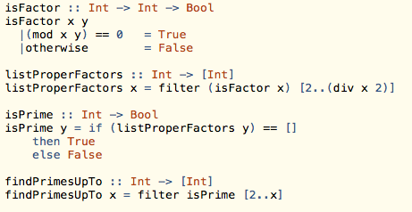
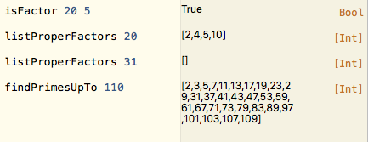
One solution
I used guards here and if-then-else here just for the hell of it. I could have used either in both cases. Although if-then-else is probably a little tidier in this case.
Things to notice: my isFactor function works a strange way round – isFactor 20 5 checks if 5 is a factor of 20.
This is so that when I use it to filter the list of possible factors I give it the dividend and then the set of divisors.
Filter needs a function that returns a Bool to apply to a list. I could not give it the list and then the number to test each member of the list against. Think about that a bit.

Slide 37
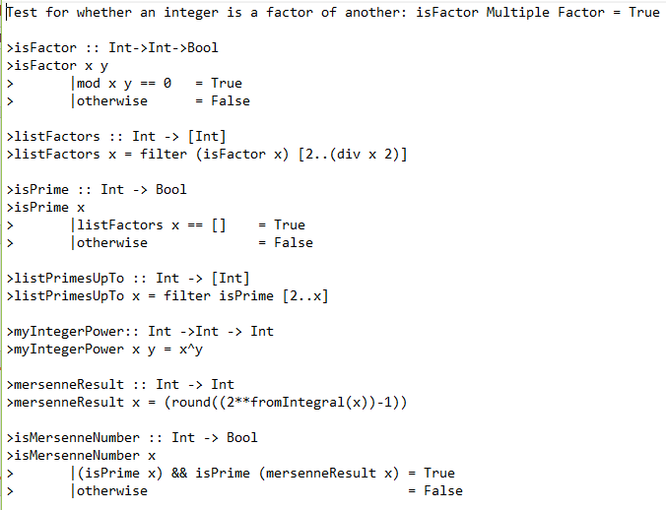
Mersenne primes
There is an issue with types and powers. The function (**) takes and returns Float types. The operation (^) takes and returns Integer types but will only handle relatively small values.
“fromIntegral” converts from our integer x to a Float type and “round” converts the return value back to Integer

Slide 38
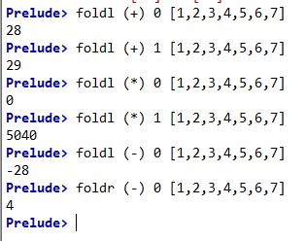
Fold: foldr and foldl
foldr takes the first value from the left of the list and successively applies the function to values in a rightward direction.
foldl takes the final value and moves to the left.
In general foldr is the “normal” one to use. If the function is associative it won’t matter (+) but if not (-) it will matter.
If the list is infinite foldl will never return a value because it will never find the end of the list to start.

Slide 39


span
Span splits a list into the first element if it matches the test value and any adjacent elements that are the same and then the rest of the list:

Slide 40
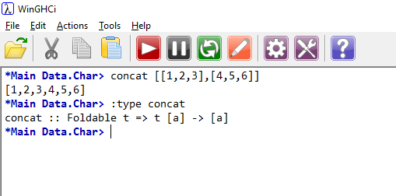
Exercises
The function ‘concat’ concatenates multiple lists
What do these expressions evaluate to?
map double [1,4,4,3]
map (double.double) [1,4,4,3]
map double []
Which of these is true?
sumList.map double = double.sumList
sumList.map sumList = sumList.concat
sumList.sort = sumList

Slide 41
First Class Objects and Higher Order Functions
A first class object is any object that can be passed to or returned by a function
Float, Int, String, words, toLower etc.
A higher order function is one that accepts another function as an argument
map, foldr, foldl, filter etc.
Function Application is the process of providing a function with its inputs
Partial Function Application is the process of partially applying a function to create another function that can then be applied to achieve the end result
Eg:
Add (x,y) = x+y is full function application
PartAdd::Int->(Int->Int)
PartAdd2 = PartAdd 2
PartAdd2 x = x+2 is partial function application

Slide 42
Key Facts for the exam
Haskell is a declarative programming language within the Functional paradigm.
A Haskell program is built from functions with outputs that are predictable and constant – that makes it easy to debug
An error in one part should not result in mysterious behaviour in another part
Terminology:
The type of a function is the combination of inputs and outputs and their data types
Examples
Int->Int is a function which takes an integer and returns an integer
[string]->string is a function that takes a list of strings and returns a single string
Float->(Float->Float) is a function that takes a real number and returns another function that takes a real and gives a real
The domain of a function describes the set from which inputs are drawn. The codomain is the set from which outputs must come. The range is the subset of the codomain comprising the actual outputs.

Slide 43
Task
Write a program that takes an extended piece of text and sorts it into a list of words with the word count.
Break the problem down into functions first
Experiment with sort

Slide 44
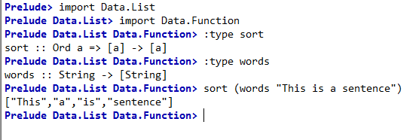
Getting a sorted list of words
The libraries Data.List and Data.Function contain the functions “words” and “sort”:
We can use them to process a piece of text into a list of words in alphabetic

Slide 45
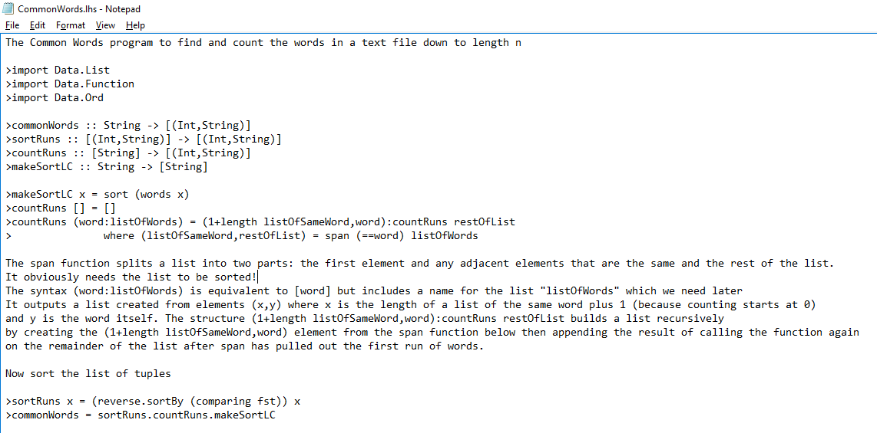

Slide 46
Numbers to Words
We are going to write a program that converts numbers into words

Slide 47
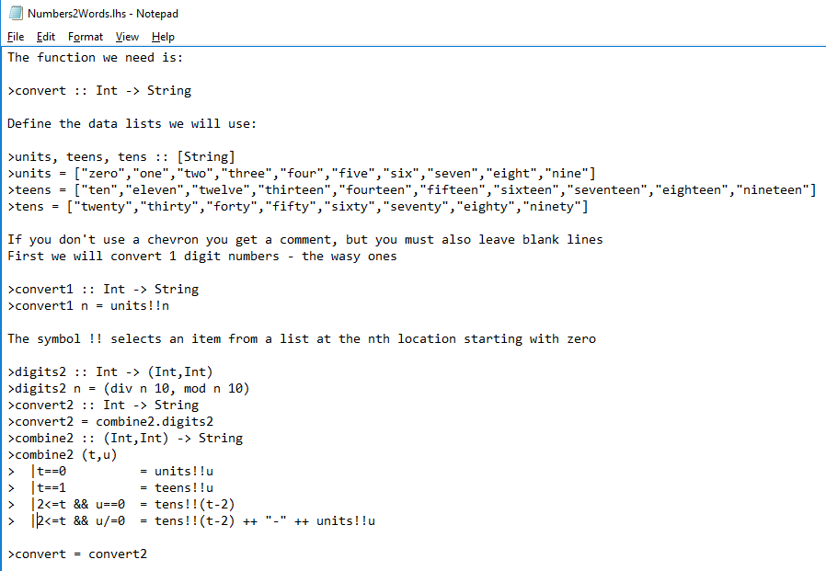
Two digit numbers

Slide 48

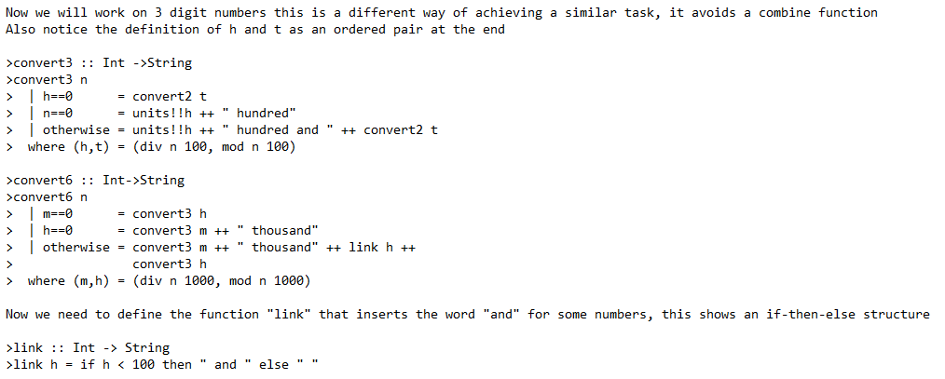
Now for 3 and 6-digit numbers

