Slide 1
Hotels Booking
Tarasenko Dmitry
Lebedev Daniil
Graskov Viktor
Powered by:

Slide 2
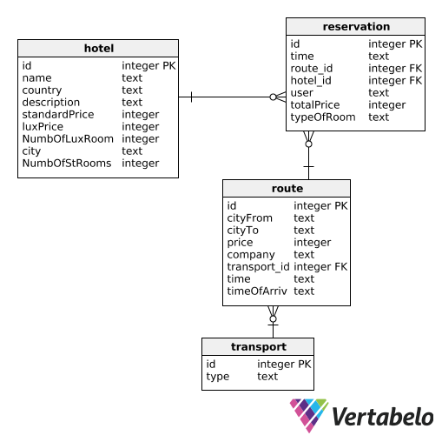
Database structure

Slide 3

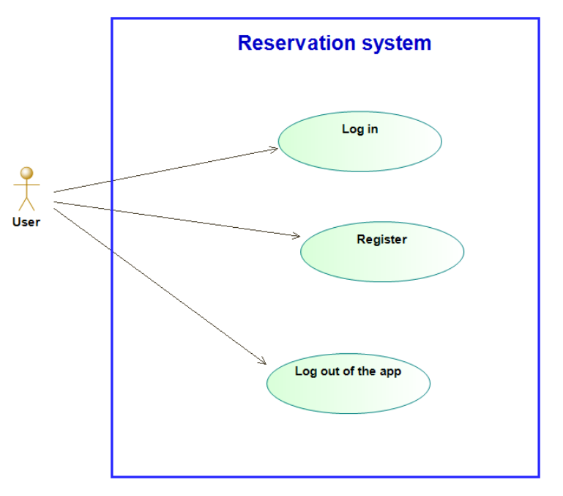
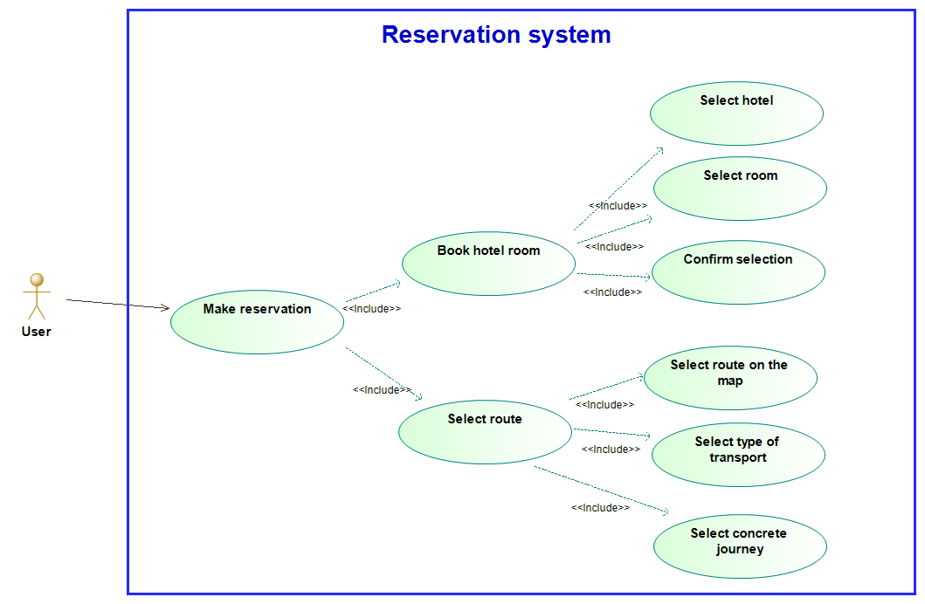
Use case project diagram:

Slide 4
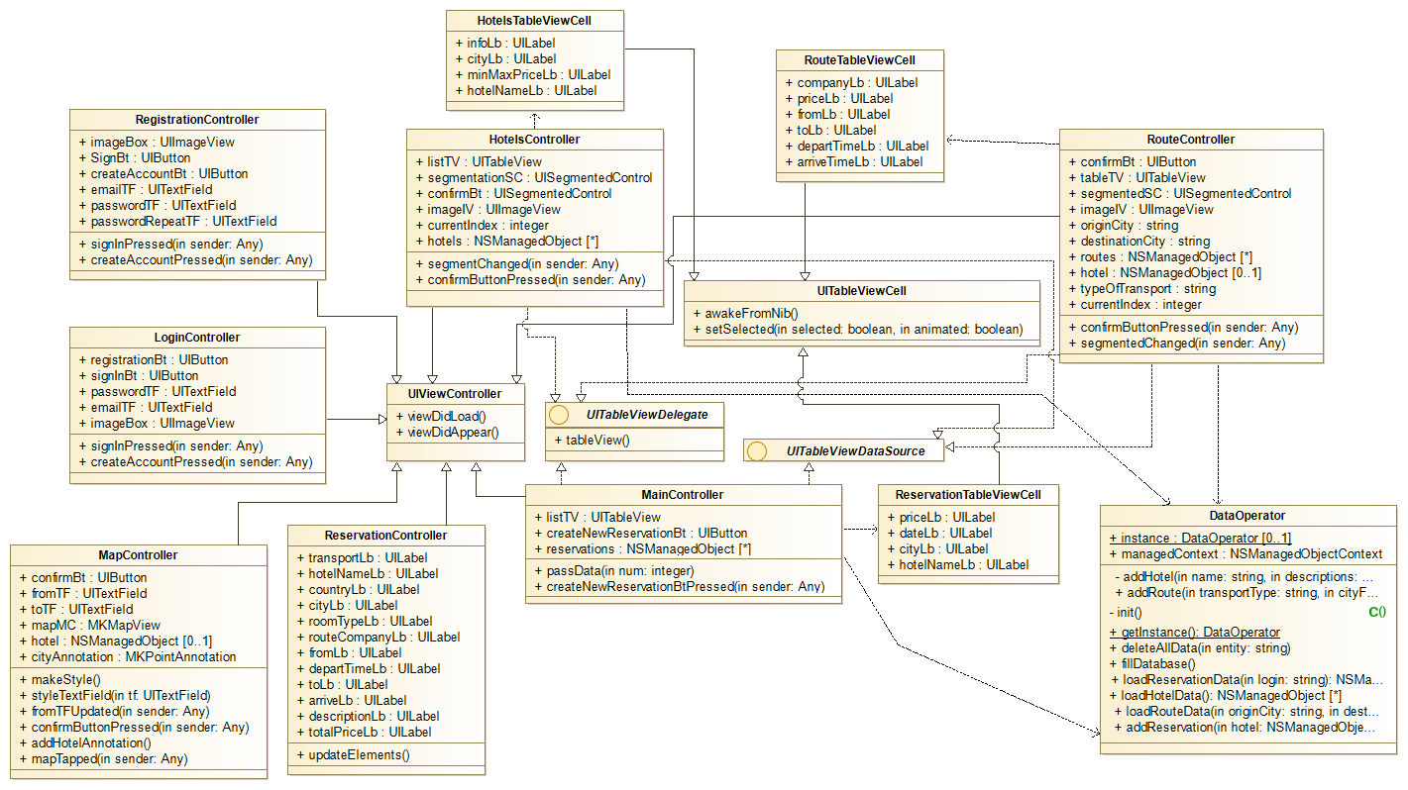
Class diagram:

Slide 5

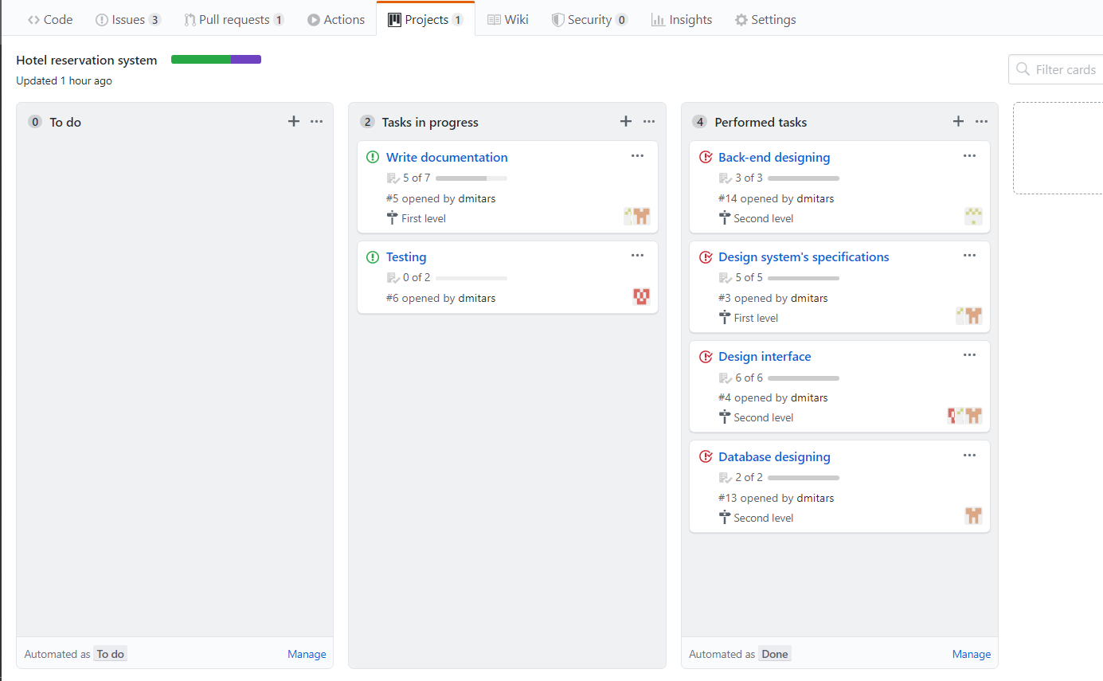
Work in team:
Tarasenko Dmitry:
Project manager
Lebedev Daniil
Developer
Graskov Viktor
Tester
Interface Designer

Slide 6
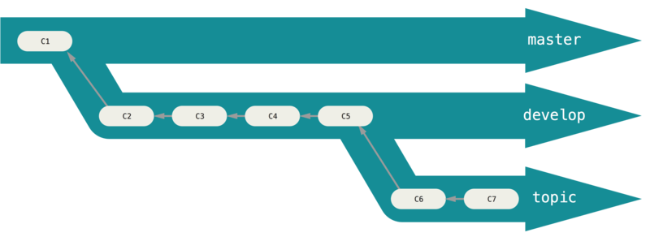
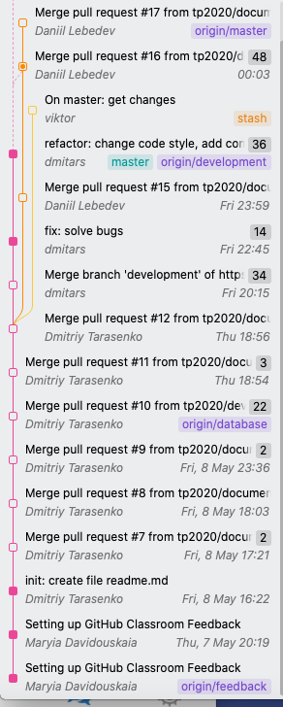
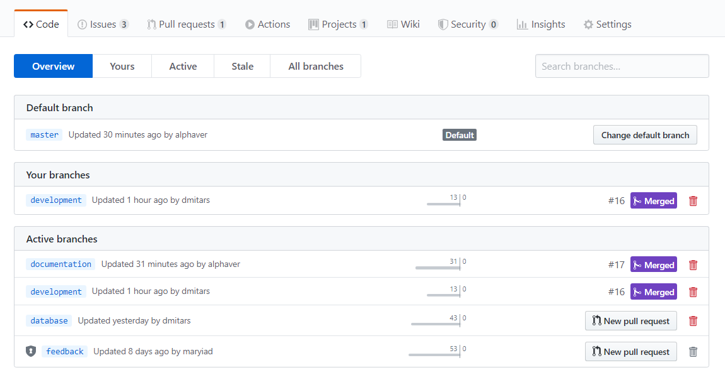
Simple git branching model:

Slide 7
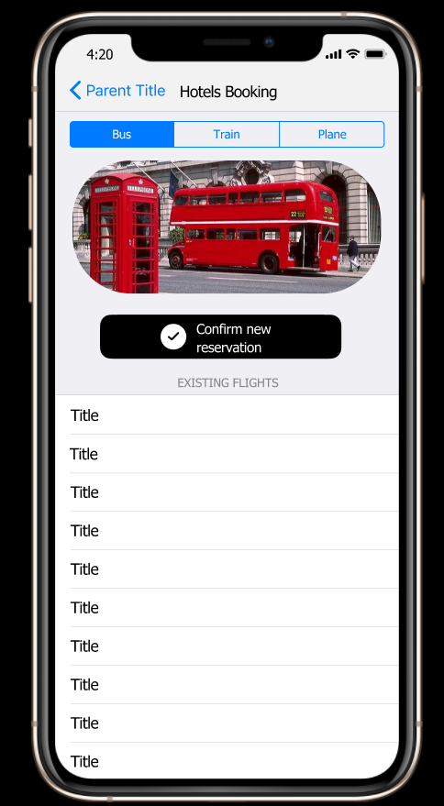
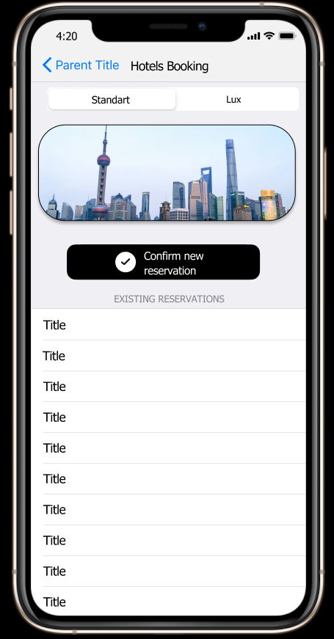

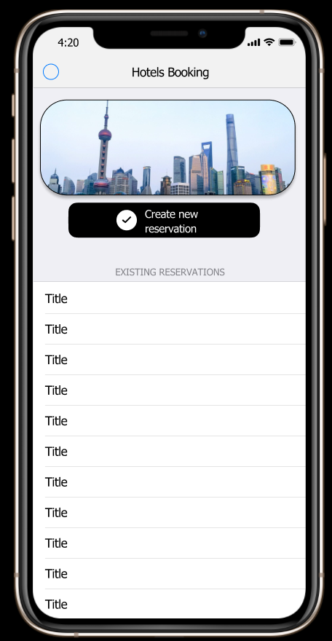
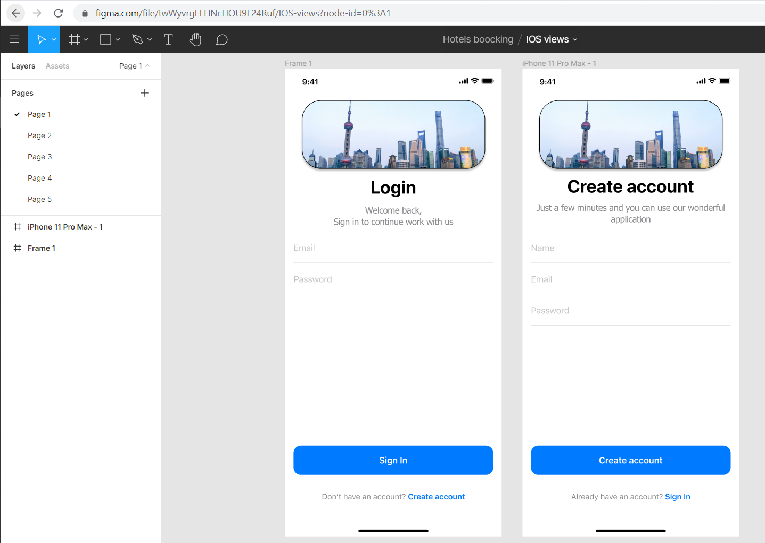
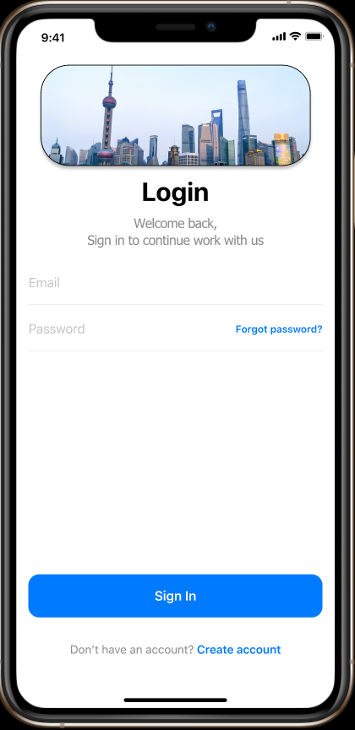
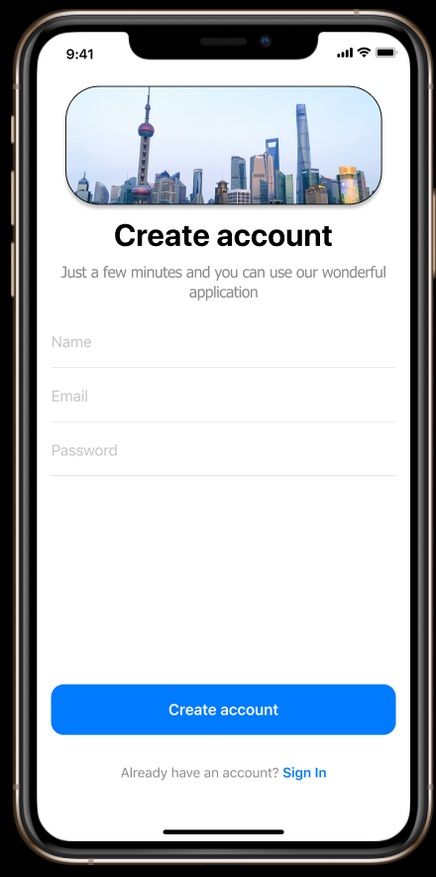
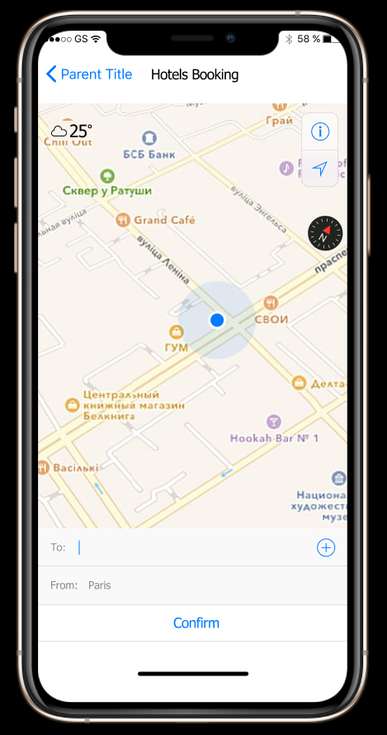
UI Designing :

Slide 8
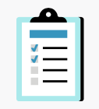
Application requirements:
Project name
Hotel reservation system
Description
It is hotel reservation system, which provides opportunity to select hotel, book room and confirm choosing. Also users can choose type of transport and way to get to it. System keeps user’s data and allows registration and login.
Installation
Download application
Start application
Usage
Authorize or register in the system.
Select a hotel.
Select a room
Confirm your selection
Select route to the hotel
Select type of transport
Confirm reservation
Contributing

Slide 9
Thank you for attention!!!

