Slide 1





Exploring Musical Tunings with Julia
TuningSystems.jl
Thomas Agersten Poulsen
tp2750
2024
Notes:
Let’s talk about music.
Specifically about tunings.
A tuning defines the frequencies of tones.
I’m Thomas Poulsen, and I look forward to telling you about my (not yet registered) package: TuningSystems.
If you want to follow the slides use the QR code on this and the next slide

Slide 2
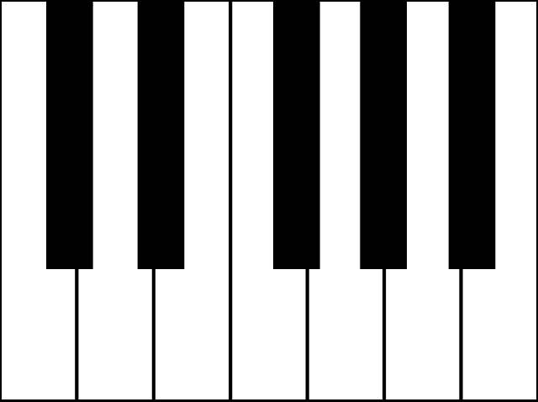
Equal Temperement
julia> 2^(1/12)
1.0594630943592953
julia> ans*440
466.1637615180899
Notes:
On a normal piano, the 12 semi-tones are distributed evenly over the octave:
The frequency ratio between successive semi tones is constant. About 1.06.
The tuning is fixed by setting the frequency of A4 = 440Hz
At 440Hz the distance to the next semitone is about 26 Hz

Slide 3
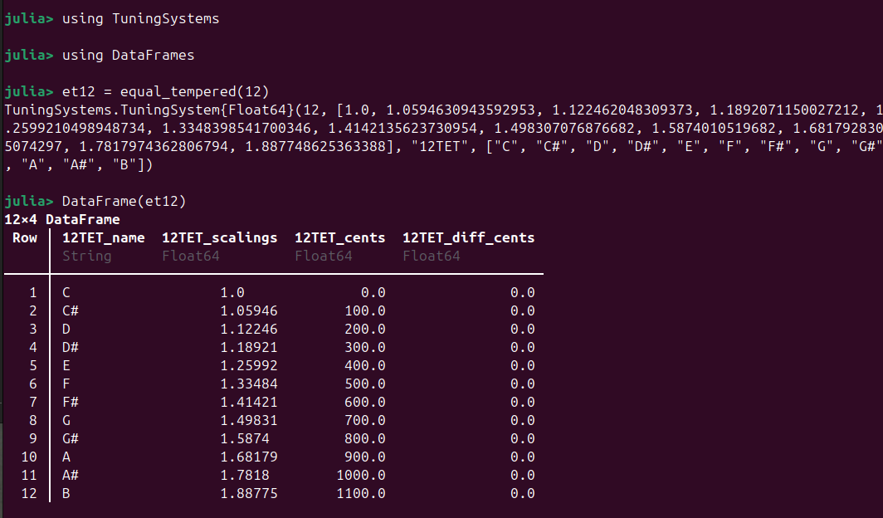
Notes:
TuningSystems has the function equal_tempered to generate an equally tempered scale of a given length.
The equal temperement is no natural.
Why are there any other tunings at all?
But why is ther 12 semi-tones?

Slide 4
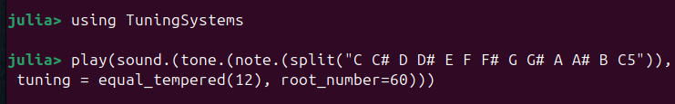
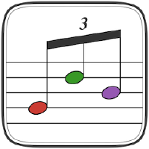
Play it
Notes:
Before we look at that, lets play it.
TuningSystems include simple functions for generating, sampling and playing sounds.

Slide 5
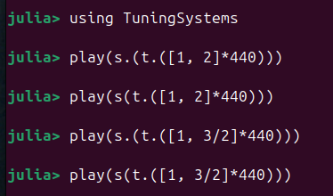
Harmony
Harmonic intervals:
Octave. 2:1
Fifth. 3:2
Notes:
Certain frequency intervals sound particularly harmonic:
2:1 the octave,
3:2 the fifth
They sound nice!

Slide 6
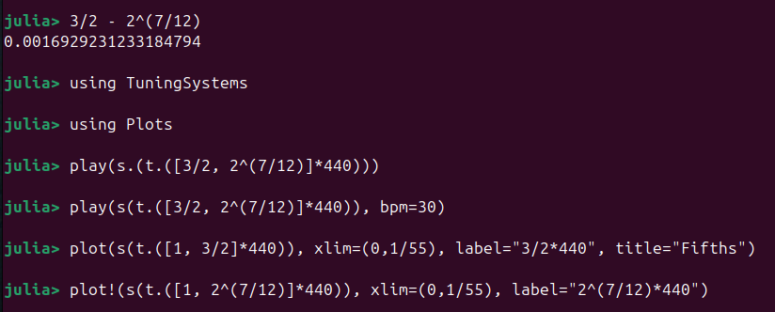

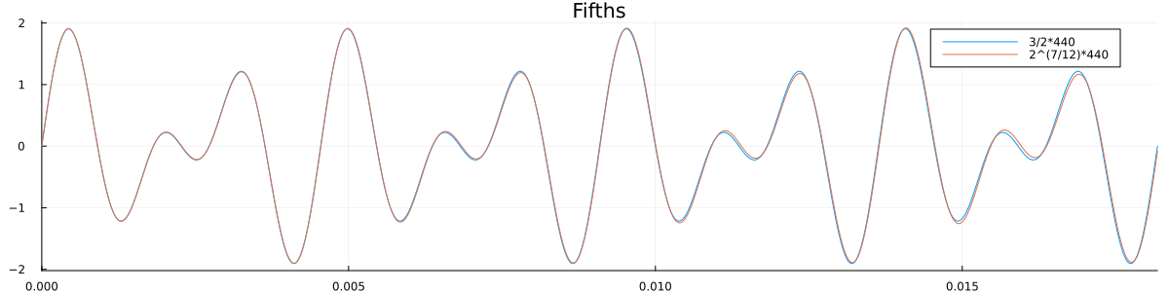
Piano Harmony
Notes:
The octave is on the piano, but how about the fifth?
We can see that the ratio between 3/2 and 2^7/12 is almost 1.
So the fifth on the piano is slightly off, but only by 0.1%
Playing them in succession they are hard to tell apart.
But together, the frequency difference produces a ”beat tone” (see next slide)

Slide 7
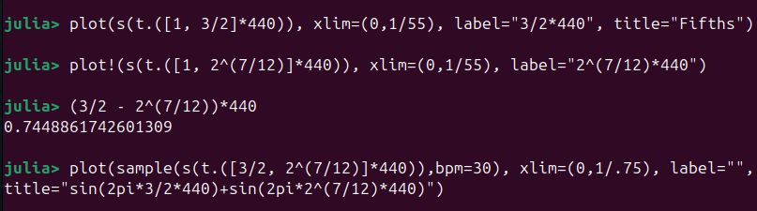
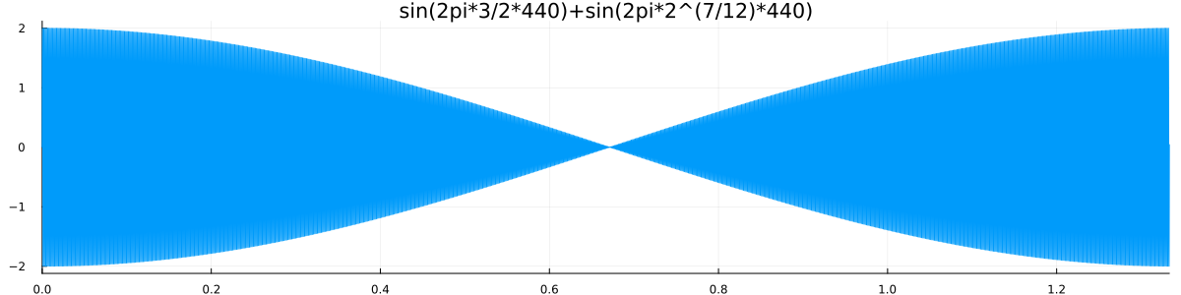
Notes:
Beat tone of about 0.75 Hz between perfect fifth (3/2) and equal tempered fifth (2^(7/12)) at 440Hz.
The beat frequency is the difference in frequencies.

Slide 8
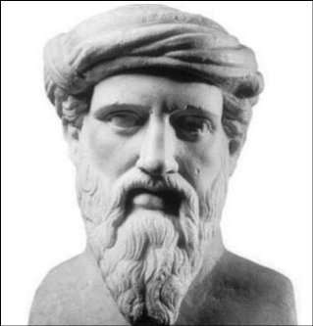

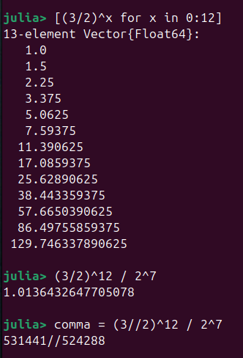
Pythagorean Tuning
By Thierry Dugnolle, CC BY-SA 4.0,
Build on the fifth
Pythagorean comma
Notes:
So maybe the equal temerement is not so natural afterall.
Apparently, Pythagoras also thought about this and observed that going up 12fifths is almost the same as 7 octaves. We can see that at the computation: 128 is 2^7.
This might be the answer to the question about why western music is build on a scale with 12 semi-tones:
Going up 12 fifths is close to 7 full octaves.
Fifths are harmonic, but the “overshoot” after 12 fifths is not so nice. It is called the pythagorean comma and is about 1.4%.

Slide 9
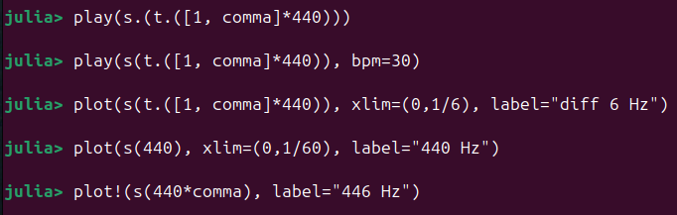
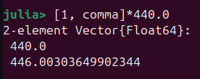
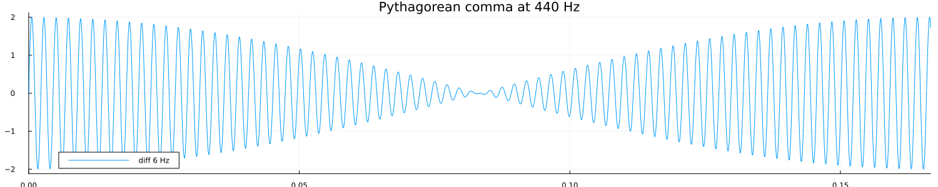
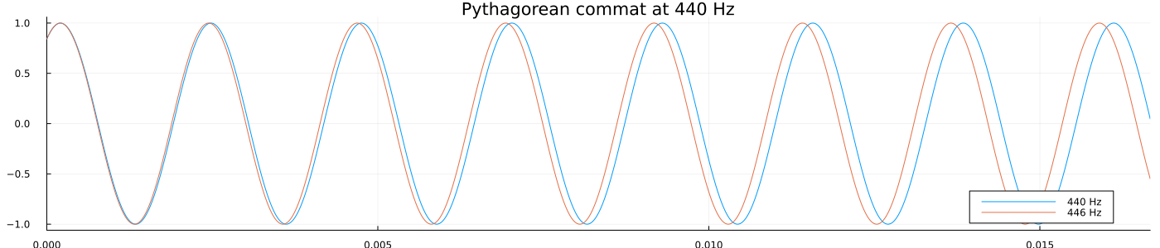
Notes:
We can use the functionalities of TuningSystems.jl to investigate the difference. By plotting the two sinusodials together over 16 ms or the sum of them over 1/6 second.
Let’s hear them together.
The beat frequency is 6 Hz: the difference in frequencies of the pythagorean comma at 440 Hz

Slide 10
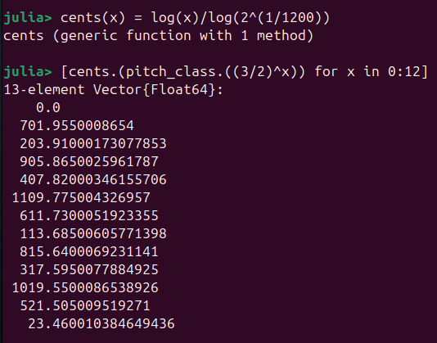
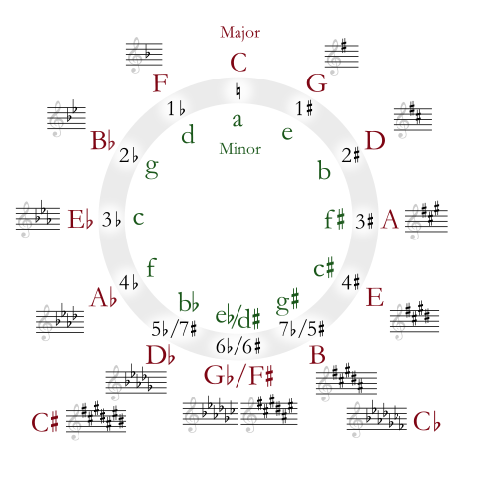
Cents and Pitch Class
Pitch class: Equivalence class modulus octave
Cents: Divide octave in 1200 logarithmically
Obs: ”Circle of fifths” overshoots equal temper by 1.95 cents per step
Pythagorean comma
Notes:
Let’s introduce two concepts:
pitch_class and cents.
As tones that differ by an octave sound “the same” we can consider them equivalence classes. We call them “pitch_classes”: all tones that differ by an intger (opositive or negative) factor of 2. We choose the represenatative in [1;2[.
We saw the cents already in one of the first slides: each tone of the equal tempered octave is separated by 100 cents.
Here we compute the pitch-classes of the “Circle of fifths” in cents. We see that the pythagorean comma is about 23 cents. Circle of fiths: is pitch class of successive fifths.

Slide 11
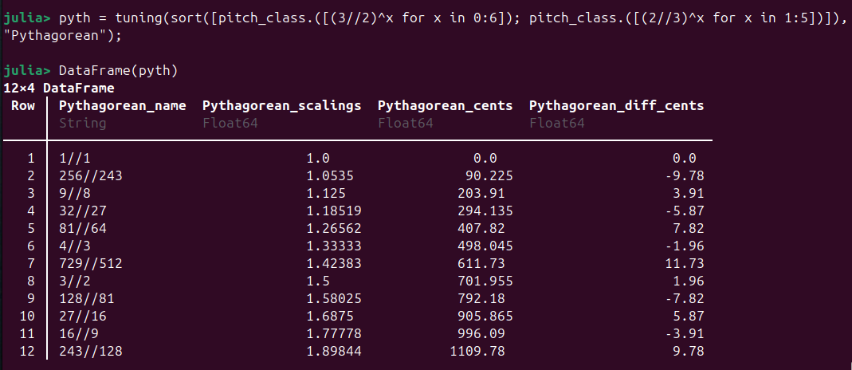
Pythagorean Tuning
Half the error and move it to the tritone (F#) by using 3/2 and 2/3
Notes:
In the actual Pythagorean tuning, we half the error and move it to the tritone (F#) by using 3/2 and 2/3 (fitfh down).
This is ”left” on the circle of fifths.
Max error 11.7 cents.
Note, we go only 5 down (2/3), but 6 up. This is normal practice (ref https://johncarlosbaez.wordpress.com/2023/10/07/pythagorean-tuning/)
F# pun.

Slide 12
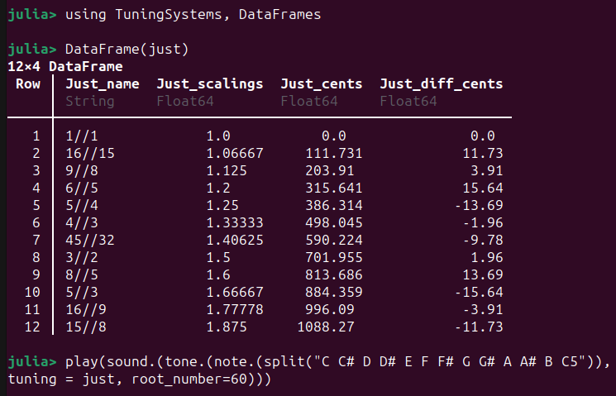
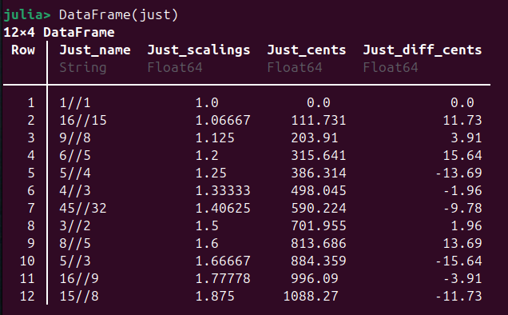
Just Intonation
Notes:
So equal temper is not perfect (fifths are off, thirds are worse, we come to those)
Pythagorean is not perfect: (the octave is off!)
What to do?
Just intonation gives 12 semi-tones all in simple fractions of multipla of 2, 3, and 5 (5-limit tuning).

Slide 13
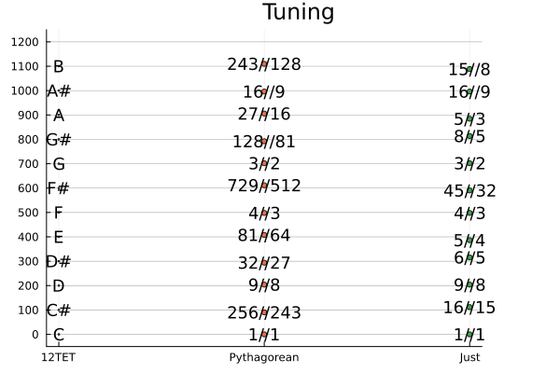
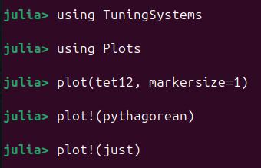
Let’s compare
Notes:
TuningSystems.jl has a function for plotting tunings on a cent axes (log freqency).
We note that both just and pythagorean are not as equally spaced as the equal tempered (obviously), but the “clustering pattern” looks a bit diferent.
Pythagorean uses only fractions of powers of 2 and 3 (3 limit tuning).
Just uses powers of 2, 3, 5 (5 limit tuning)

Slide 14
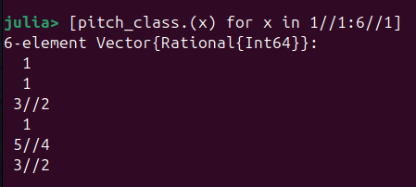

Harmonic Series
By Adjwilley CC BY-SA 3.0
Notes:
Let’s look at the harmonic series.
Strings and wind instruments naturally produce overtones. Here are the first 6.
Overtones are positive integer multipla of the fundamental frequency of the string.
Play it!

Slide 15
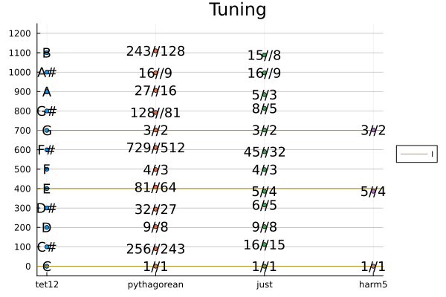
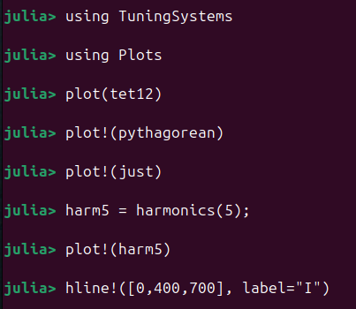
Harmonics and Triad
Notes:
We see that the first 5 overtones form the “major triad” if we look at the pitch classes.
From the plot, we see that
Pythagorean has the fifth, but is off at the thrid.
12 tone equal temper (12TET) is also off at the third, but less so.

Slide 16
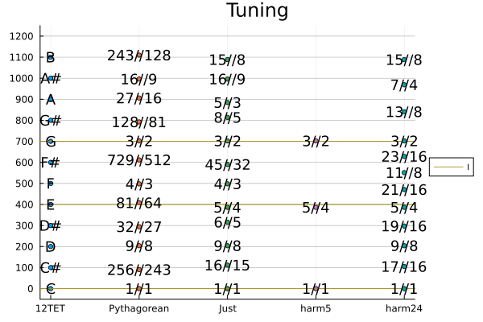
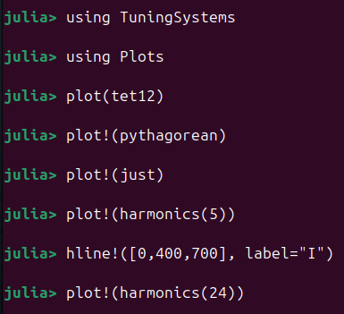
More Harmonics!
24 harmonics
12 different
Not equally spaced
Notes:
Can we make a tuning system out of the pitch-classes of the harmonic series?
The 24 first harmonics gives 12 different tones.
But they are not equally spaced.

Slide 17
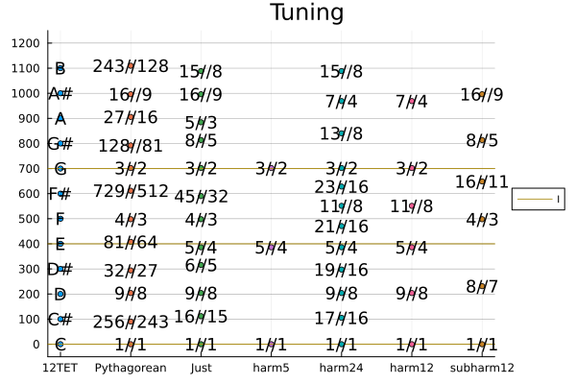
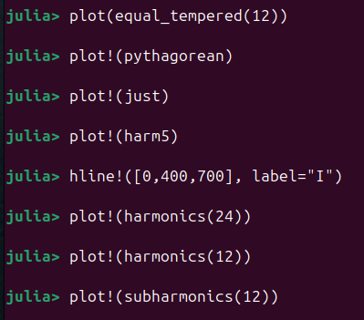
Subharmonics
Notes:
Using sub-harmonics, we can get something that is quite close the the just intonation. But we need the 45th harmonics for F# and we can not ever get the A (5/3). TODO: can we get it using FlexiJoins.jl?
Subharmonics play the same trick as with pythagorean tuning: Invert the fractions.
However,
overtones (intger multipla of fundamental frequency) occur spontaniously
undertones do not occur spontaniously
Note: The harmonics avoid the tritone (F#)

Slide 18
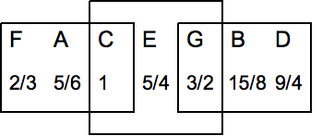
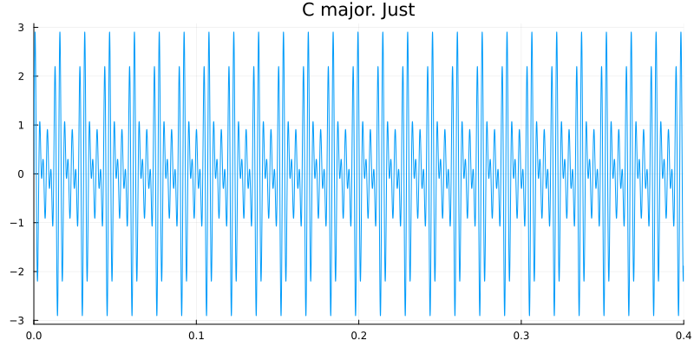
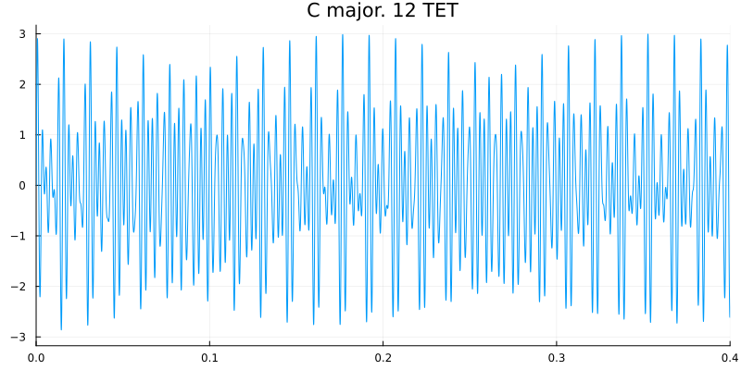
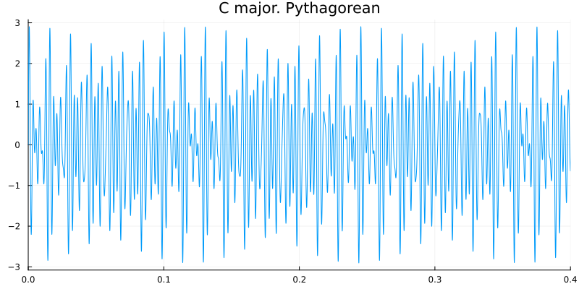
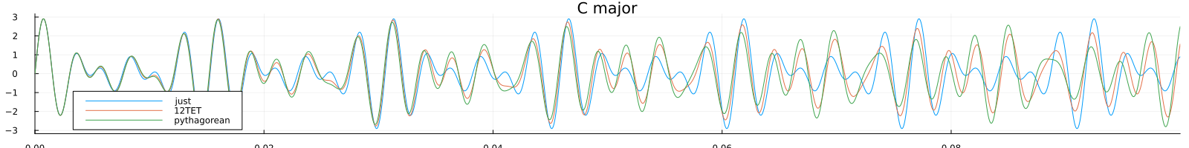
Just intonation and triads
F: (4:5:6) / 6
C: (4:5:6) / 4
G: (12:15:18) / 4 = 3 * (4:5:6) / 4
By Hyacinth at the English Wikipedia, CC BY-SA 3.0
Notes:
The whole notes of the just intonation are defined by requring the major triads of
Tonica
Dominant
Subdominant
are all in ratio 4:5:6
Play them!
So Just intonation has a lot of nice properties. But is doe snot mesh well with modulations or playing in different keys, as equal temperement does. But that is mainly a problem for physical instruments that take a long time to re-tune. A computer instrument can adapt the tuning in real time to changes to key.
I think just intonation is about to have a comback in electronic music, and TuningSystems can help enable this by making it quick and easy to change tuning on the fly.

Slide 19
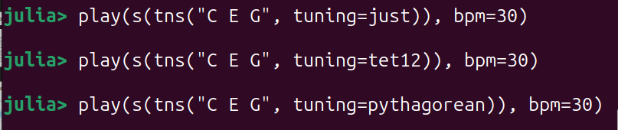
Just intonation and triads
Notes:
The whole notes of the just intonation are defined by requring the major triads of
Tonica
Dominant
Subdominant
are all in ratio 4:5:6
Play them!
So Just intonation has a lot of nice properties. But is doe snot mesh well with modulations or playing in different keys, as equal temperement does. But that is mainly a problem for physical instruments that take a long time to re-tune. A computer instrument can adapt the tuning in real time to changes to key.
I think just intonation is about to have a comback in electronic music, and TuningSystems can help enable this by making it quick and easy to change tuning on the fly.

Slide 20

Thank You!
References
John Carlos Baez:
Well Temperements Part 1
Pythagorean Tuning
Just Intonation Part 1
Perfect fifths in equal tempered scales
Wikipedia
Musical Tuning
Equal Temperement
Pythagorean Tuning
Just Intonation
JuliaMusic/MIDI.jl
dancasimiro/WAV.jl
JuliaMusic/MusicTheory
JuliaAudio/
PortAudio.jl
SampledSignals.jl
https://web.eecs.umich.edu/~fessler/course/100/index.html
tp2750/TuningSystems.jl
Notes:
This work was very much inspired by a series of blog posts by John Baez on different tuning systems. They are worth reading.
Shoutout to JuliaMusic (George Datseris of DrWatson.jl fame)
and WAV.jl by Daniel Casimiro
MusicTheory (by David P. Sanders) came out after I submitted abstract. Does not overlap (much)
Jeffrey A Fessler has a cource at University of Michgan on Music Signal Processing.
He also has a book coming up: https://github.com/JeffFessler/book-la-demo
https://www.cambridge.org/highereducation/books/linear-algebra-for-data-science-machine-learning-and-signal-processing/1D558680AF26ED577DBD9C4B5F1D0FED#overview

