Slide 1



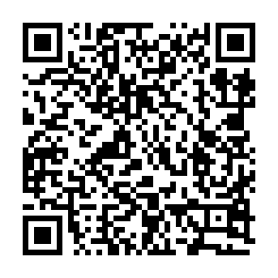

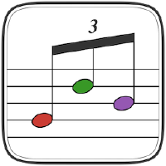
Exploring Musical Tunings with Julia
TuningSystems.jl
Thomas Agersten Poulsen
tp2750
2024
Notes:
Let’s talk about music.
Specifically about tunings.
A tuning defines the frequencies of tones.

Slide 2
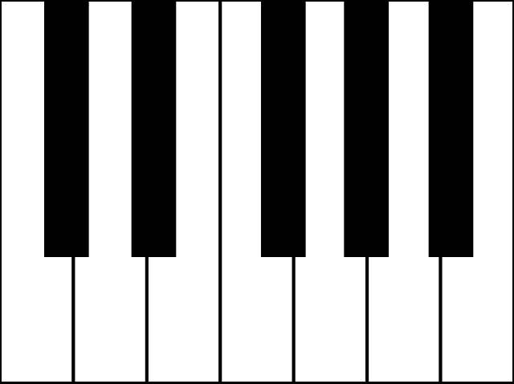
Equal Temperement
julia> 2^(1/12)
1.0594630943592953
julia> ans*440
466.1637615180899
Notes:
On a normal piano, the 12 semi-tones are distributed evenly over the octave:
The frequency ratio between successive semi tones is constant. About 1.06.
The tuning is fixed by setting the frequency of A4 = 440Hz
At 440Hz the distance to the next semitone is about 26 Hz

Slide 3
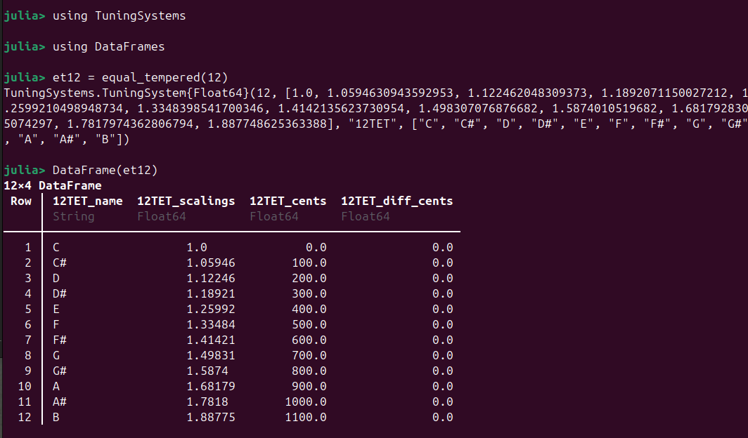
Notes:
TuningSystems has the function equal_tempered to generate an equally tempered scale of a given length.
The equal temperement is no natural.
Why are there any other tunings at all?
But why is ther 12 semi-tones?

Slide 4
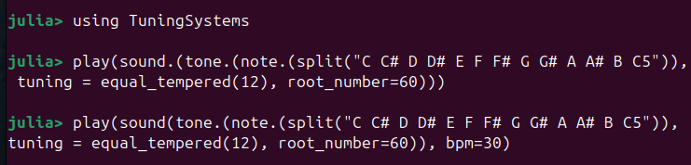
Play it
Notes:
Before we look at that, lets play it.

Slide 5
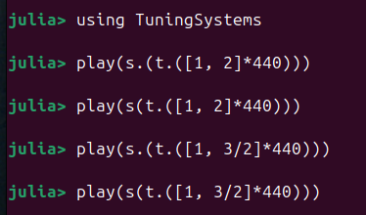
Harmony
Harmonic intervals:
Octave. 2:1
Fifth. 3:2
Notes:
They sound nice!

Slide 6
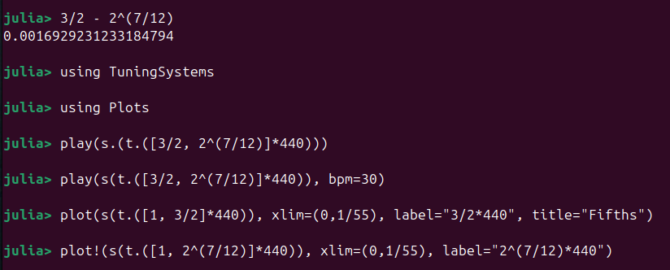

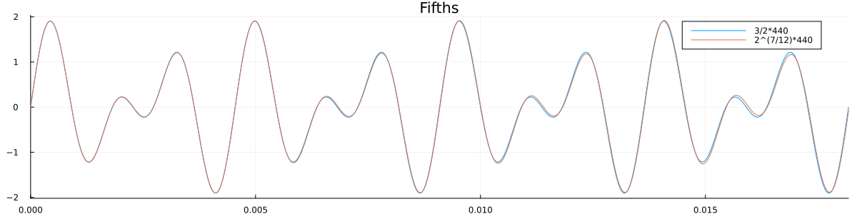
Piano Harmony
Notes:
The octave is on the piano, but how about the fifth?
It is slightly off, but only by 0.1%
Playing them in succession they are hard to tell apart.
But together, the frequency difference produces a ”beat tone” (see next slide)

Slide 7
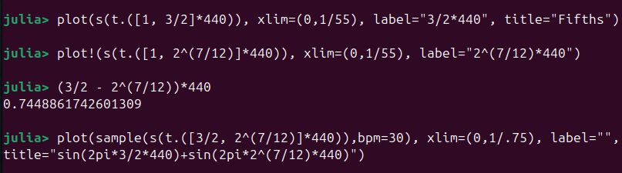
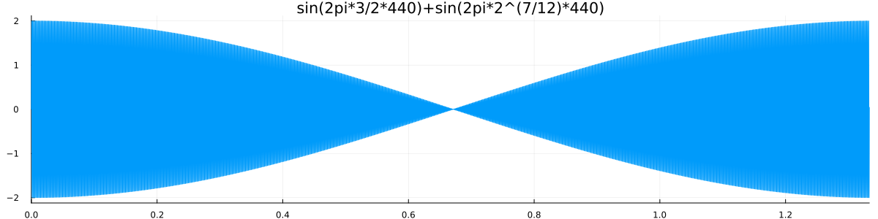
Notes:
Beat tone of about 0.75 Hz between perfect fifth (3/2) and equal tempered fifth (2^(7/12))

Slide 8
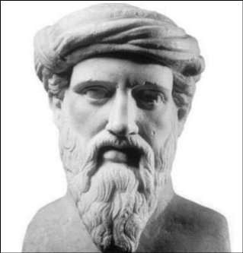
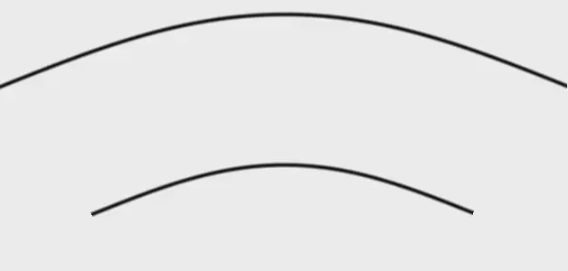
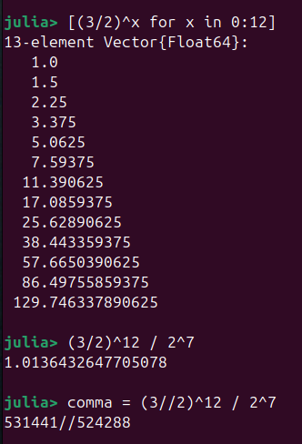
Pythagorean Tuning
By Thierry Dugnolle, CC BY-SA 4.0,
Build on the fifth
Pythagorean comma
Notes:
So maybe the equal temerement is not so natural afterall.
But this might be the answer to the question about 12 semi-tones:
Going up 12 fifths is close to 7 full octaves.
Fifths are harmonic,

Slide 9
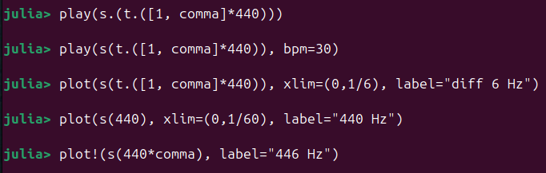
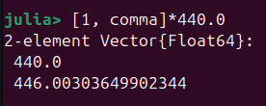
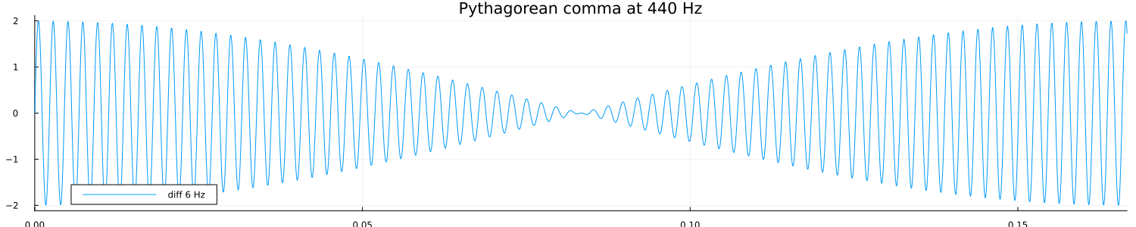
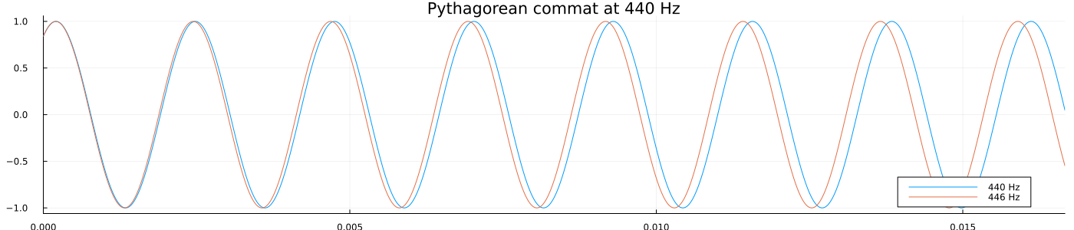
Notes:
Let’s hear them together.
The beat frequency is 6 Hz: the difference in frequencies of the pythagorean comma at 440 Hz

Slide 10
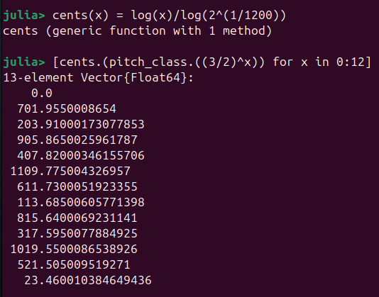
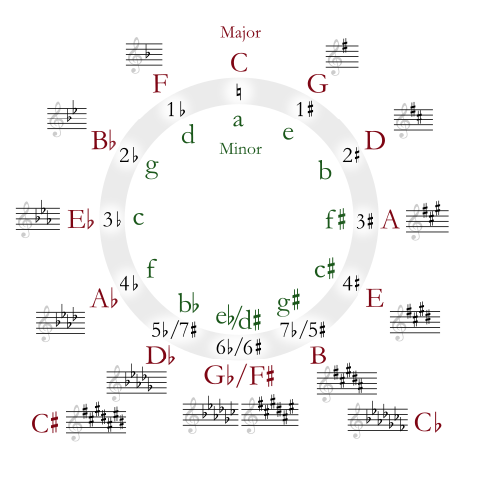
Cents and Pitch Class
Pitch class: Equivalence class modulus octave
Cents: Divide octave in 1200 logarithmically
Obs:
”Circle of fifths” overshoots equal temper by 1.95 cents per step
Pythagorean comma
Notes:
Here we almost have the 12 semi-tones on the piano.
Likely the origin of the 12 semi-tones on the octave used in western music.

Slide 11
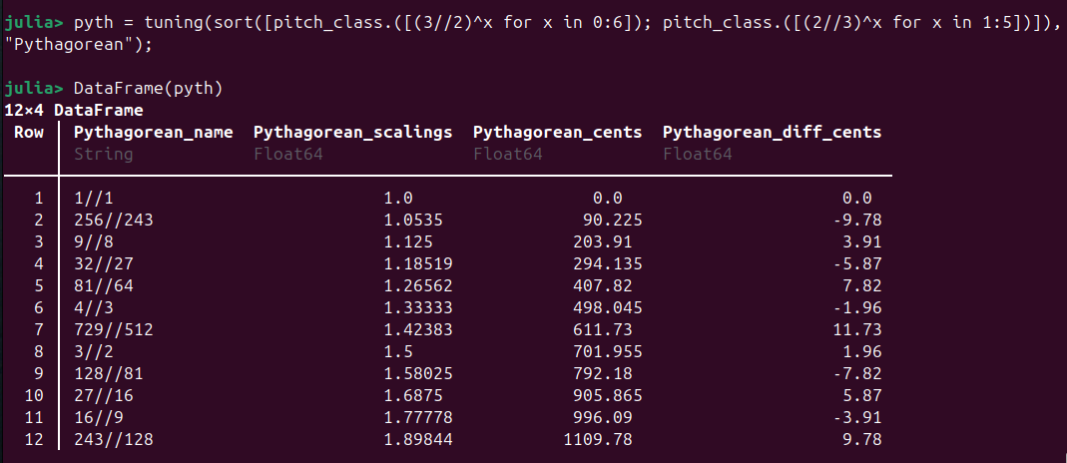
Pythagorean Tuning
Half the error and move it to the tritone (F#) by using 3/2 and 2/3
Notes:
In the actual Pythagorean tuning, we half the error and move it to the tritone (F#) by using 3/2 and 2/3 (fitfh down).
This is ”left” on the circle of fifths.
Max error 11.7 cents.
Note, we do only 5 down (2/3), but 6 up. This is normal practice (ref https://johncarlosbaez.wordpress.com/2023/10/07/pythagorean-tuning/)
F# pun.

Slide 12
TODO Play it
play(s([et12, pyth]))

Slide 13
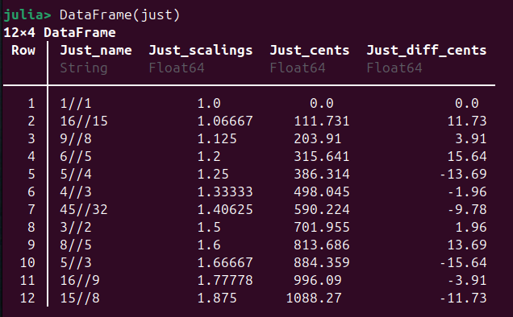
Just Intonation
TODO: play
Notes:
So equal temper is not perfect (fifths are off, thirds are worse, we come to those)
Pythagorean is not perfect: (the octave is off!)
What to do?
Just intonation gives 12 semi-tones all in simple fractions of multipla of 2, 3, and 5 (5-limit tuning).

Slide 14
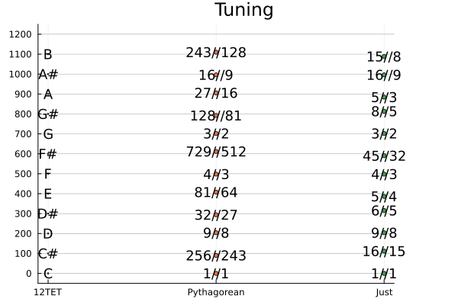
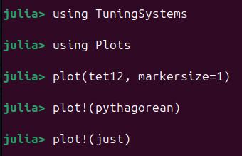
Let’s compare
Notes:
They look very similar.
Pythagorean uses only fractions of powers of 2 and 3 (3 limit tuning).
Just uses powers of 2, 3, 5 (5 limit tuning)

Slide 15
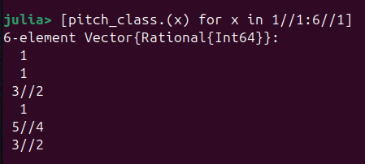

Harmonic Series
By Adjwilley CC BY-SA 3.0
Notes:
Strings and wind instruments naturally produce overtones. Here are the first 6.
Play it!

Slide 16
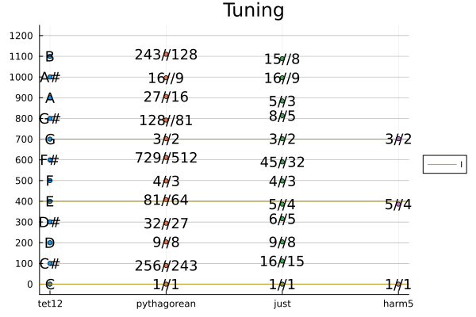
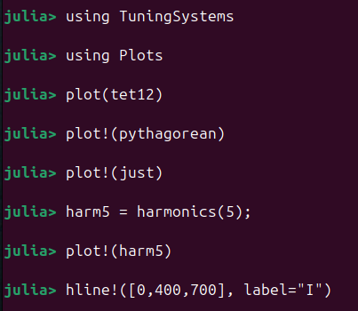
Harmonics and Triad
Notes:
The first 5 overtones include form the major triad!.
Pythagorean has the fifth, but is off at the thrid.
12 tone equal temper (12TET) is also off.

Slide 17
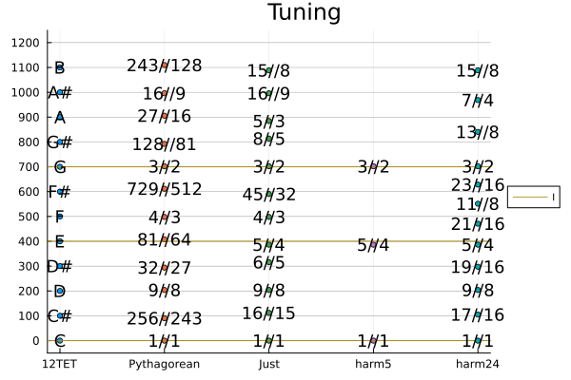
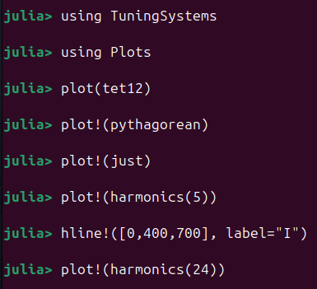
More Harmonics!
24 harmonics
12 different
Not equally spaced
Notes:
The 24 first harmonics gives 12 different tones.
But they are not equally spaced.

Slide 18
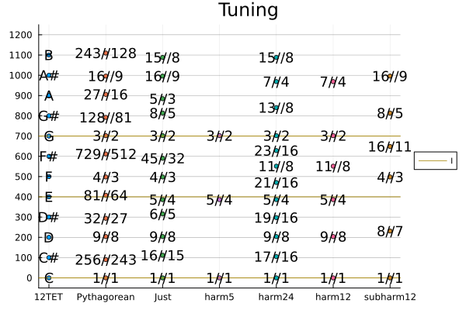
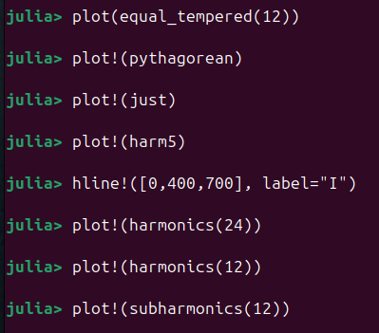
Subharmonics
Notes:
Subharmonics play the same trick as with pythagorean tuning: Invert the fractions.
However,
overtones (intger multipla of fundamental frequency) occur spontaniously
undertones do not occur spontaniously
Note: The harmonics avoid the tritone (F#)

Slide 19
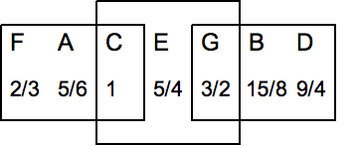
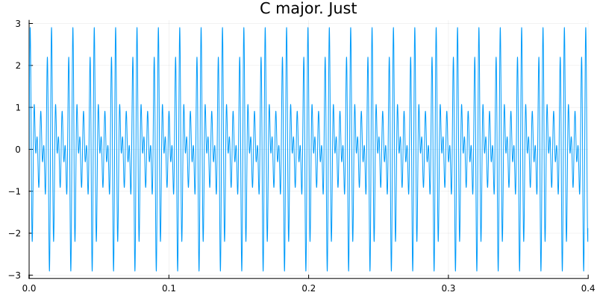
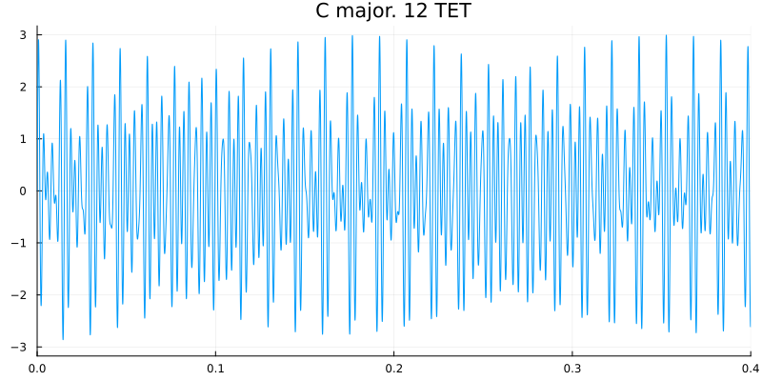
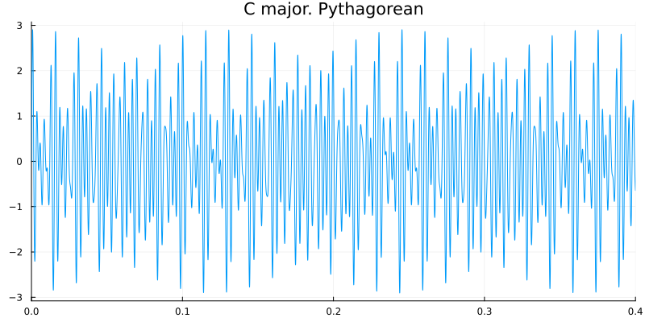
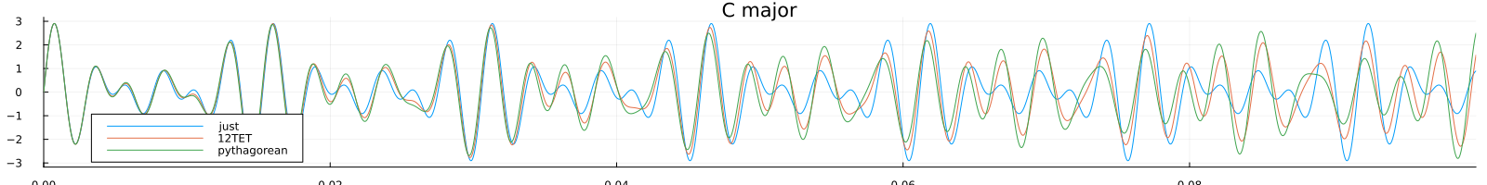
Just intonation and triads
F: (4:5:6) / 6
C: (4:5:6) / 4
G: (12:15:18) / 4 = 3 * (4:5:6) / 4
By Hyacinth at the English Wikipedia, CC BY-SA 3.0
Notes:
The whole notes of the just intonation are defined by requring the major triads of
Tonica
Dominant
Subdominant
are all in ratio 4:5:6
Play them!

Slide 20
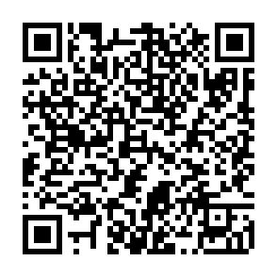
Thank You!
References
John Carlos Baez:
Well Temperements Part 1
Pythagorean Tuning
Just Intonation Part 1
Perfect fifths in equal tempered scales
Wikipedia
Musical Tuning
Equal Temperement
Pythagorean Tuning
Just Intonation
JuliaMusic/MIDI.jl
dancasimiro/WAV.jl
JuliaMusic/MusicTheory
JuliaAudio/
PortAudio.jl
SampledSignals.jl
https://web.eecs.umich.edu/~fessler/course/100/index.html
tp2750/TuningSystems.jl
Notes:
This work was very much inspired by a series of blog posts by John Baez on different tuning systems. They are worth reading.
Shoutout to JuliaMusic (George Datseris of DrWatson.jl fame)
and WAV.jl by Daniel Casimiro
MusicTheory (by David P. Sanders) came out after I submitted abstract. Does not overlap (much)
Jeffrey A Fessler has a cource at University of Michgan on Music Signal Processing.
He also has a book coming up: https://github.com/JeffFessler/book-la-demo
https://www.cambridge.org/highereducation/books/linear-algebra-for-data-science-machine-learning-and-signal-processing/1D558680AF26ED577DBD9C4B5F1D0FED#overview

