Slide 1

Travel Tours Search
Get hotel discount, air fare, explore travel destination.

Slide 2

Explore the world API

Slide 3
Data engineering a step at the time
Meta data discovery
Json format and risk evaluation
Pipeline strategy :
  Structured streaming
  End points evaluation
  RDMS selection

Slide 4
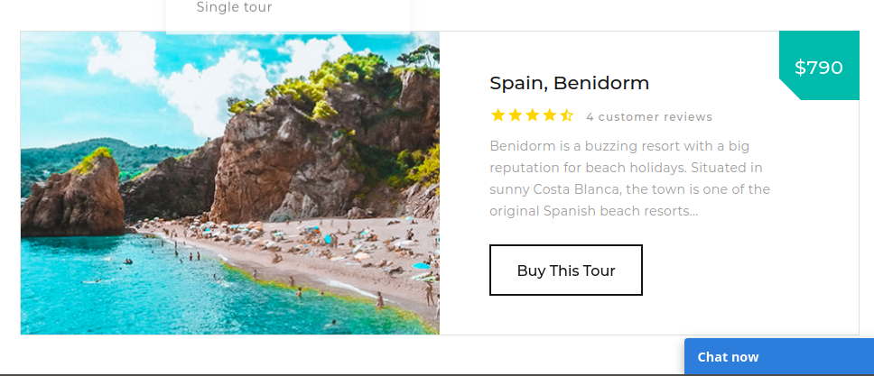
Data wrangling & Travel wonders

Slide 5
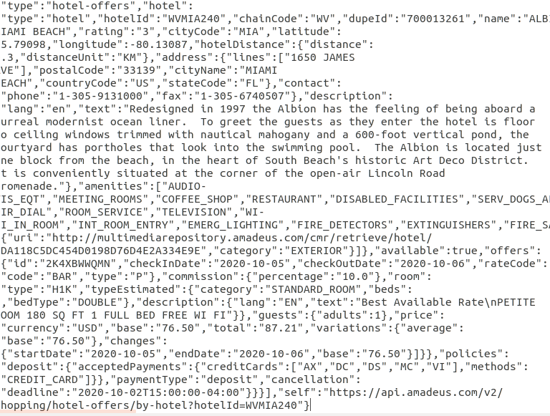
Meta JSON data
Json Format
Complex object
Nested data
Inconsistent Keys

Slide 6
Data Pipeline Step
Travel API
Kafka Producer
PySpark
Consumer
Microsoft
Sql Server
Cache table
PySpark
Json Parser

Slide 7
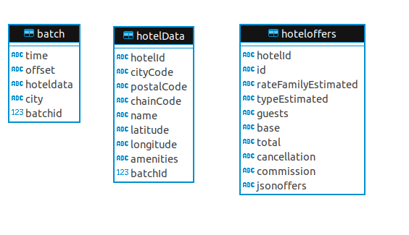
Pipeline RDMS End Points
Relational Data Model
Snowflake Schema
Unique batch id
Persist search keys
Parse JSON to extract hotel data and dimension

Slide 8
SSAS market baskets & Analytics
Query Microsoft server in Spark with Pandas
Pandas describitive statistics and matplotlib
MLib and data wrangling implies indexing elements to numeric type to compile advanced analytics

Slide 9
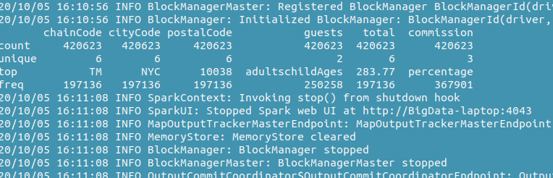
SSAS market baskets & Analytics

Slide 10
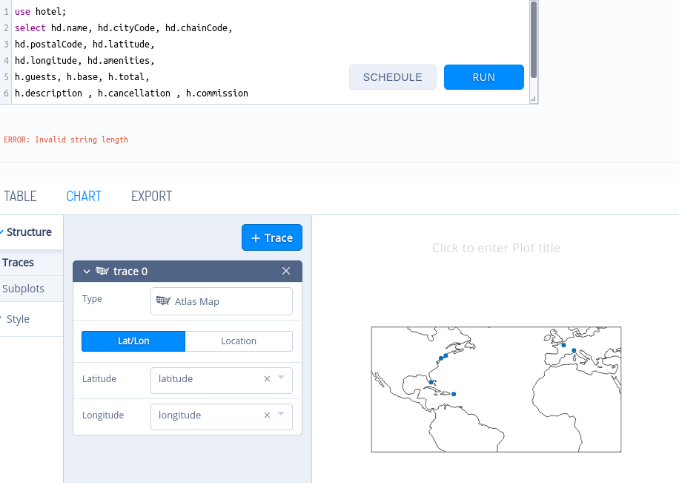
SSAS market baskets & Analytics

Slide 11
Demo Kafka Stuctured Streaming with a Spark client
Get hotel discount, air fare, explore travel destination.

