Slide 1
Linear Models
What they are, what they can tell you, how to use them

Slide 2
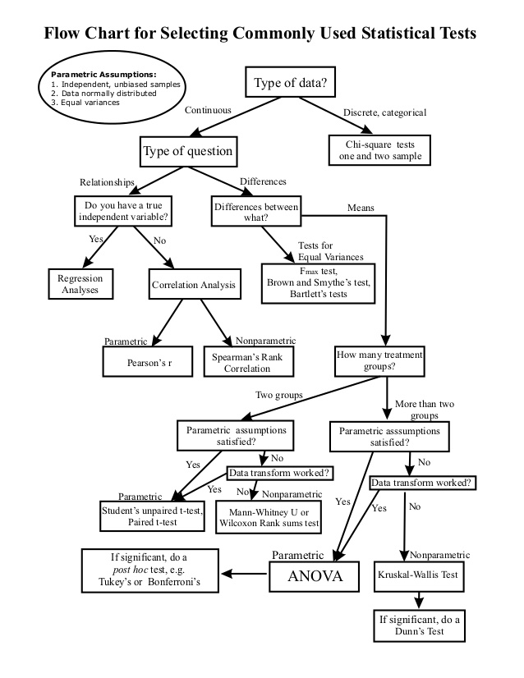
There is a better way

Slide 3
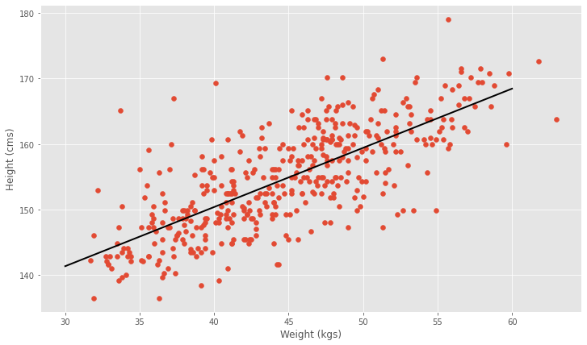
Linear Models
Linear models are a framework for developing statistical models that are tailored to your problem
Many statistical tests can be cast as Linear Models
Only determines associations - NOT CAUSAL

Slide 4
Anatomy of a Linear Model
Dependent variable
Independent variables
Error (noise)
Data
Intercept
Slopes
Parameters

Slide 5
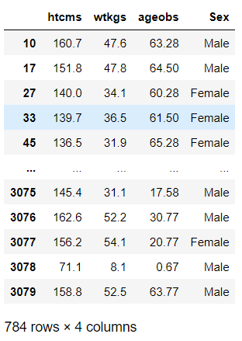


Linear Regression
y
x
!kung data

Slide 6
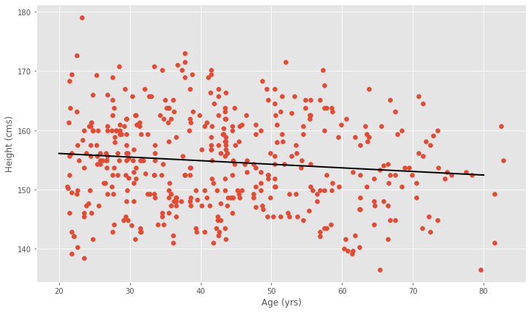
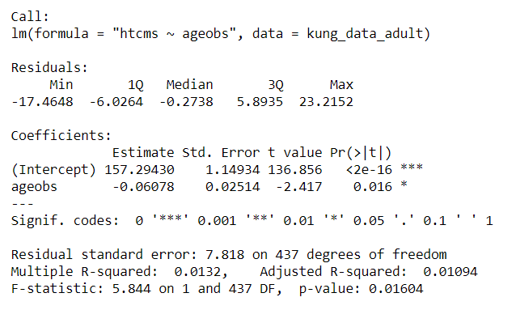
Linear Regression height vs age

Slide 7
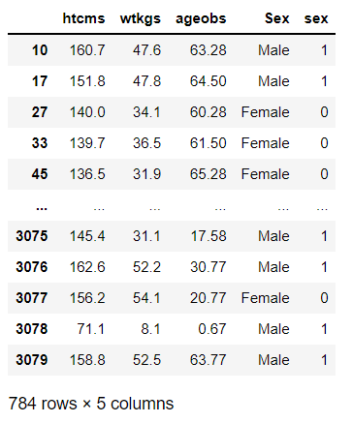

Categorical variables
y
x
M
How to include gender??
Dummy Coding:
  Female: M=0
  Male: M=1

Slide 8
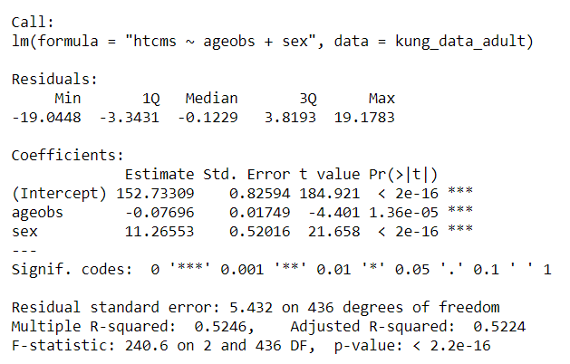
Categorical variables
y
x
M

Slide 9
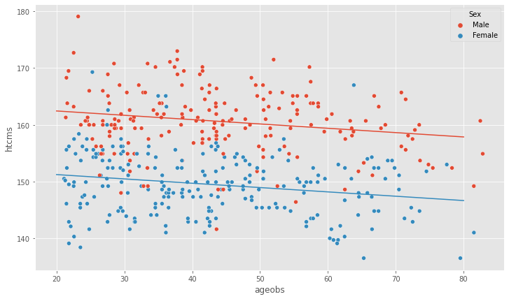
Categorical Variables

Slide 10


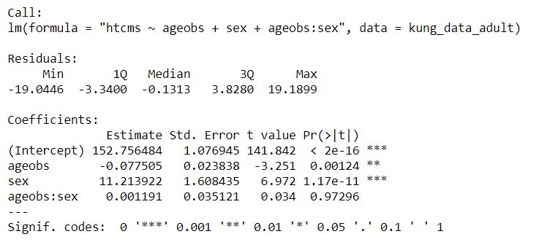
Interactions
Is there a difference in slope between males and females?

Slide 11

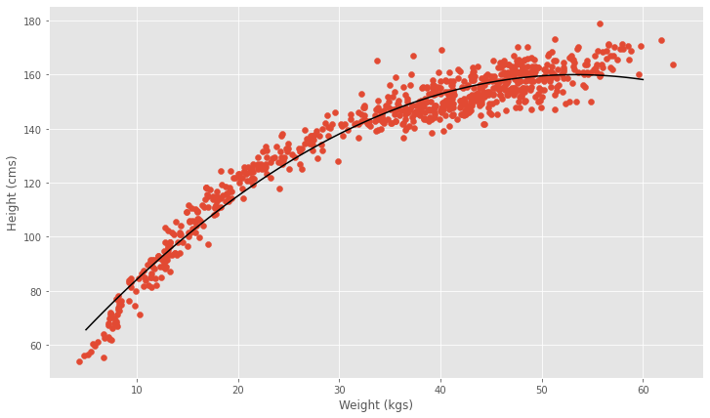
Linear Models are not just about lines!
Polynomial regression
Fourrier series
Splines
…

Slide 12
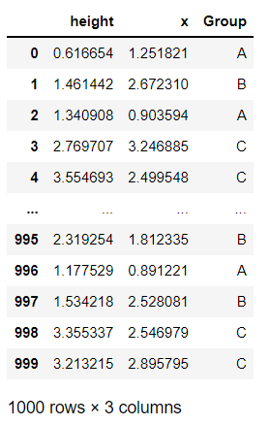
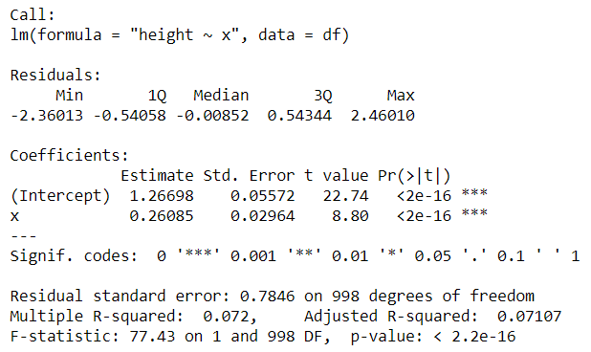
Multi-level categorical variables

Slide 13
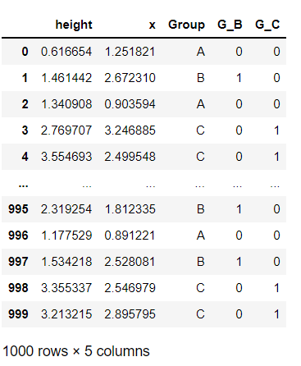
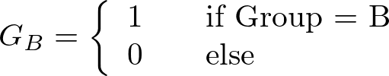
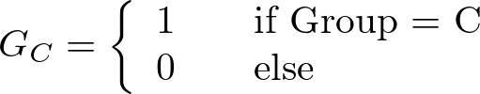

Multi-level categorical variables
Group: A, B and C
  How to encode this?
  Define 2 dummy variables

Slide 14
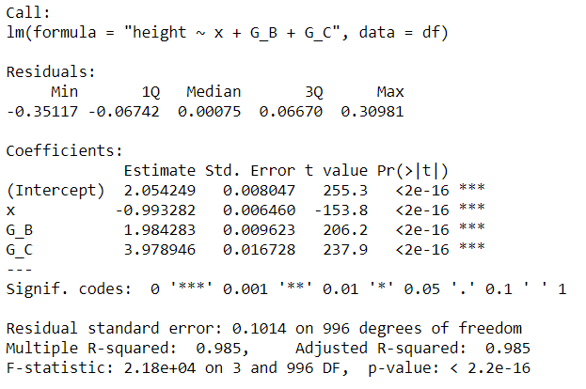
Multi-level categorical variables
?

Slide 15
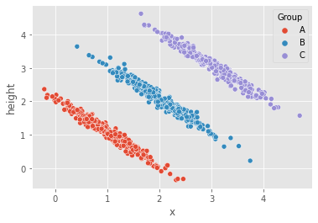

Slide 16
Common Statistical tests as Linear Models

Slide 17
Linear Models
Everything is a linear model
Many statistical tests can be cast as Linear Models
Linear models are a framework for developing statistical models that are tailored to your problem
Only determines associations - NOT CAUSAL
Need to know what are you doing!

Slide 18
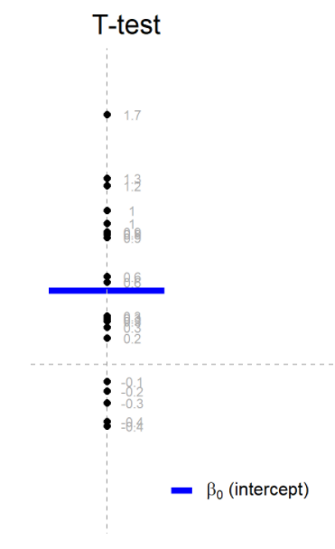

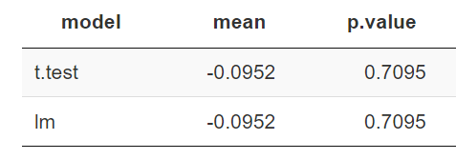
t-test (one sample)
Check if the mean is different from zero

Slide 19
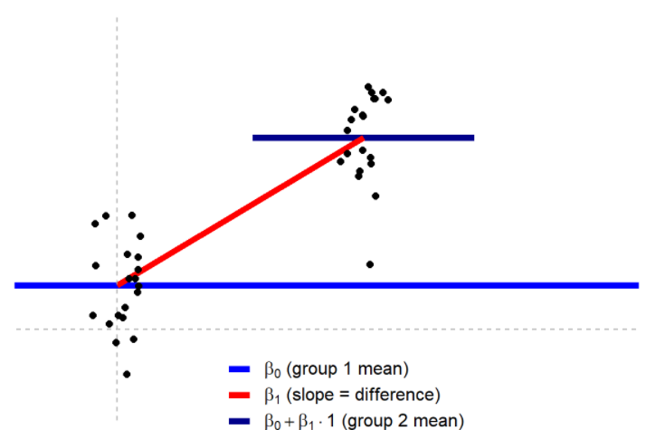

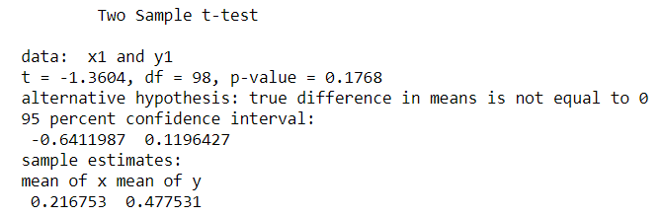
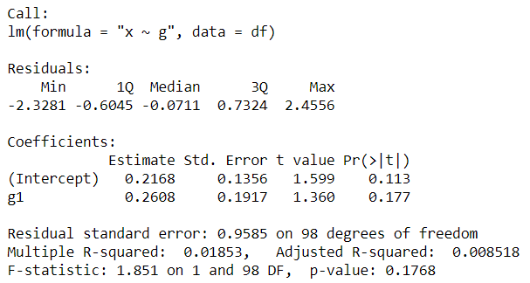
t-test (2 independent samples)
Comparison of the mean of 2 populations

Slide 20
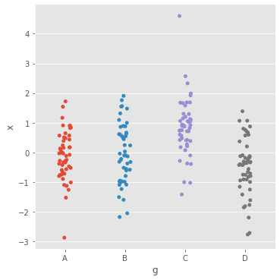
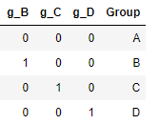

One-way ANOVA
Comparison between several groups

Slide 21
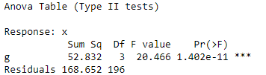
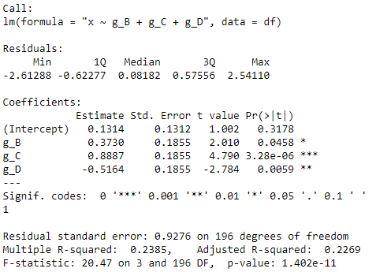
One-way ANOVA
Comparison between several groups

Slide 22
Factorial (two-way) ANOVA
2 categorical factors
  Eg. Strain & Treatment, Replicate & Treatment

Slide 23
Generalized Linear Models

Slide 24

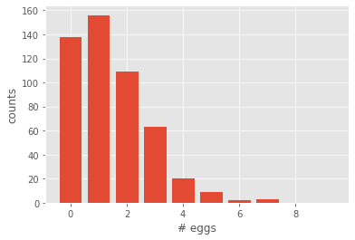
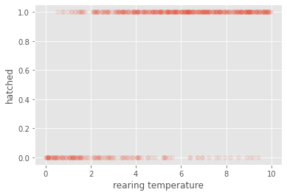
Generalized linear models
Same scale
What if your data (y):
can’t possibly have every value
Is clearly not gaussian

Slide 25
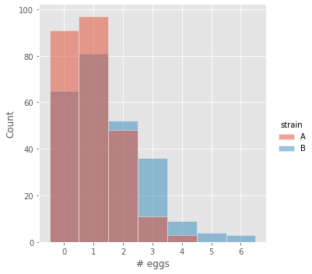

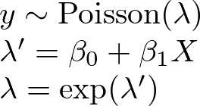
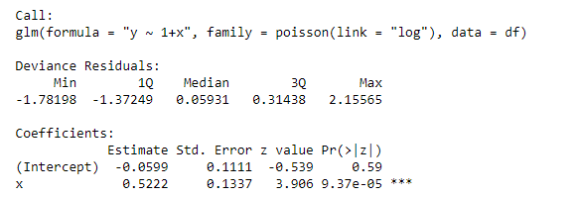
Generalized Linear Models
counts
rate
Inverse Link function

Slide 26
Generalized Linear Models (Poisson)
In link scale!
exp(-0.059) = 0.942
exp(-0.059 + 0.522) = 1.587

Slide 27

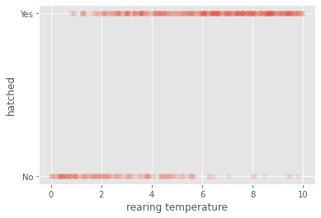
Binomial (logistic) regression

Slide 28
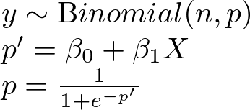
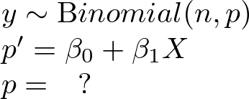
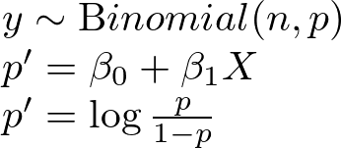

Slide 29
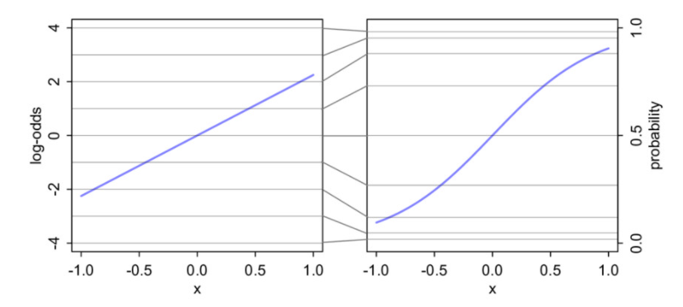
Log-odds

Slide 30
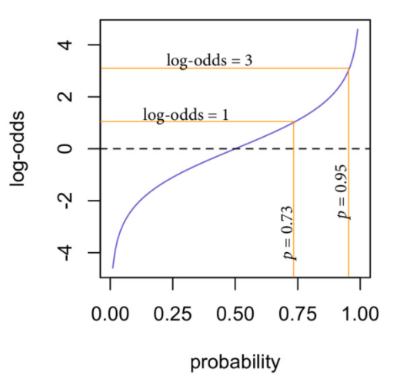
Log-odds

Slide 31
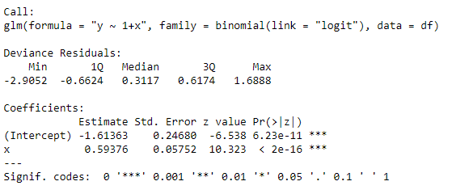
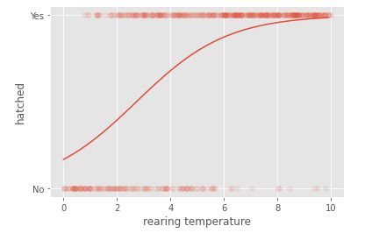
in link scale!

