Slide 1
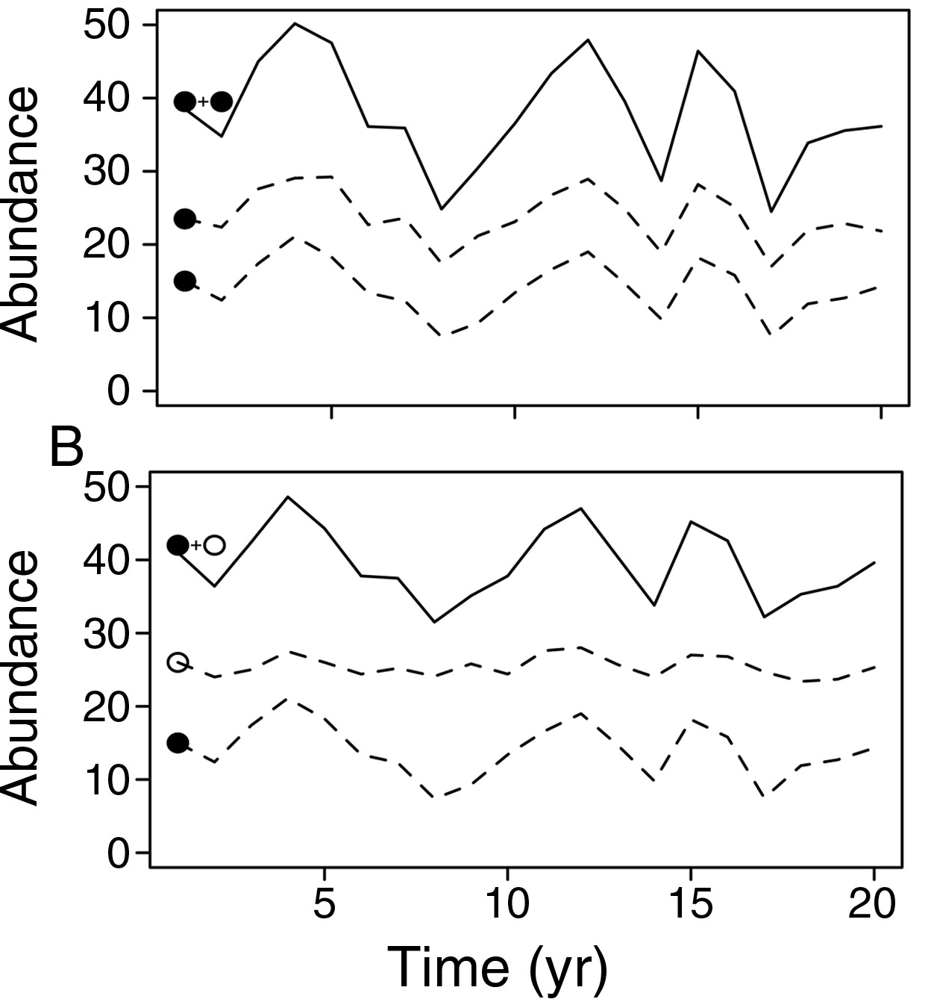
Synchrony and temporal variability
More synchronous temporal fluctuations
Communities are less stable (higher variability)
Less synchronous temporal fluctuations
Communities are more stable (lower variability)
Cadotte et al. 2012

Slide 2
Synchrony and PD
Synchrony
Similar responses to environmental changes between phylogenetically similar species (i.e. low PD)
PD-synchrony relationship should be negative
PD
Synchrony
Phylogenetically similar species compete more
Competition reduces synchrony (due to competitive exclusion)
PD-synchrony relationship is positive
PD

Slide 3
Population and community temporal variability
Tend to be positively correlated
If PD reduces competitive interactions, it might also reduce population variability.
But this might increase synchrony (or make synchrony less negative…)
Cadotte et al. 2012

Slide 4
Non-native species
Tend to be environmental generalists
Less sensitive to competition
This should reduce their species-level temporal variability and increase synchrony…

Slide 5
Questions
How do PD and non-native species affect population and community variability, as well as synchrony?

Slide 6
Data filtering & cleaning
Only used control plots with at least 10 years of data
Excluded non-living and non-vascular plants
>90% species were classified into native/non-native
>90% cover data were classified into native/non-native
Units = each 1-m² plot
Biomass and cover data are available at community levels. But only cover data are available at species levels.

Slide 7
Metrics
Community variability (the inverse of stability)
SD(total abundance across species)/mean(total abundance across species)
Calculated for both living biomass and cover

Slide 8
Metrics
Community variability (the inverse of stability)
SD(total abundance across species)/mean(total abundance across species)
Calculated for both living biomass and cover
Weighted population variability
SD(species abundance)/mean(species abundance)
Weighted by their relative abundance
Cover only

Slide 9
Metrics
Community variability (the inverse of stability)
SD(total abundance across species)/mean(total abundance across species)
Calculated for both living biomass and cover
Weighted population variability
SD(species abundance)/mean(species abundance)
Weighted by their relative abundance
Cover only
Synchrony
Average correlation between abundance of a species & the sum of all other species
E.g., the average of cor(A,B+C), cor(B,A+C), cor(C,A+B)
Further weighted by the relative abundance of each species
Cover only

Slide 10
SEM: exogenous variable
Mean species richness
Mean MPD
Relative native species richness ratio
Mean MNTD
Evenness

Slide 11
SEM: endogenous variable
Mean species richness
Mean MPD
Relative native species richness ratio
Mean MNTD
Evenness
Cover Variability (Species)
Synchrony
Cover Variability
(Community)
Biomass Variability (Community)

Slide 12
SEM: endogenous variable
Mean species richness
Mean MPD
Relative native species richness ratio
Mean MNTD
Evenness
Cover Variability (Species)
Synchrony
Cover Variability
(Community)
Biomass Variability (Community)

Slide 13
SEM: Links
Mean species richness
Mean MPD
Relative native species richness ratio
Mean MNTD
Evenness
Cover Variability (Species)
Synchrony
Cover Variability
(Community)
Biomass Variability (Community)

Slide 14
SEM: Links
Mean species richness
Mean MPD
Relative native species richness ratio
Mean MNTD
Evenness
Cover Variability (Species)
Synchrony
Cover Variability
(Community)
Biomass Variability (Community)

Slide 15
SEM: Full model
Mean species richness
Mean MPD
Relative native species richness ratio
Mean MNTD
Evenness
Synchrony
Cover Variability (Species)
Cover Variability
(Community)
Biomass Variability (Community)

Slide 16
SEM results (N =71)
Mean species richness
Mean MPD
Relative native species richness ratio
Mean MNTD
Evenness
0.41
-0.40
-0.37
0.26
0.36
-0.15
Synchrony
Cover Variability (Species)
-0.28
0.57
0.50
Names | R2m
Synchrony | 0.23
Cover Var (Species) | 0.14
Cover Var (community) | 0.78
Biomass Variability (community) | 0.34
Cover Variability (Community)
0.60
Biomass Variability (Community)

Slide 17
SEM results (N =71)
Mean species richness
Mean MPD
Relative native species richness ratio
Mean MNTD
Evenness
0.41
-0.40
-0.37
0.26
0.36
-0.15
Synchrony
Cover Variability (Species)
-0.28
0.57
0.50
Names | R2m
Synchrony | 0.23
Cover Var (Species) | 0.14
Cover Var (community) | 0.78
Biomass Variability (community) | 0.34
Cover Variability (Community)
0.60
Biomass Variability (Community)

Slide 18
SEM results (N =71)
Mean species richness
Mean MPD
Relative native species richness ratio
Mean MNTD
Evenness
0.41
-0.40
-0.37
0.26
0.36
-0.15
Synchrony
Cover Variability (Species)
-0.28
0.57
0.50
Names | R2m
Synchrony | 0.23
Cover Var (Species) | 0.14
Cover Var (community) | 0.78
Biomass Variability (community) | 0.34
Cover Variability (Community)
0.60
Biomass Variability (Community)

Slide 19
GAMM results –Native species
p=0.04 (GAMM); p =0.049 (LMM)
p=0.005 (GAMM); p = 0.05 (LMM)

Slide 20
GAMM result- Native species
p=0.04 (GAMM); p =0.049 (LMM)
p=0.005 (GAMM); p = 0.05 (LMM)

Slide 21
GAMM results - MNTD
p=0.06 (GAMM); p = 0.046 (LMM)
p=0.12 (GAMM); p = 0.31 (LMM)

Slide 22
How do PD and non-native species affect population and community variability, as well as synchrony?
MNTD increased synchrony. Relaxed competition?

Slide 23
How do PD and non-native species affect population and community variability, as well as synchrony?
More invaded communities tend to be more synchronous – non-native species are ecologically similar/insensitive o competition?

Slide 24
How do PD and non-native species affect population and community variability, as well as synchrony?
Native species exhibited lower variability than non-native species…can be explained by non-natives being fast-growing species?

Slide 25
Future work?
Include treatment plots? (Include all? But the story can become complicated…)
Alternative specification of SEMs?

Slide 26
Effects of native species are non-significant in +NPK plots

Slide 27
Effects of MNTD in +NPK plots..
CONTROL PLOTS
+NPK PLOTS

Slide 28
MPD became significant in +NPK plots…

Slide 29
Mean species richness
Mean MPD
Relative native species richness ratio
Mean MNTD
Evenness
0.39
-0.36
-0.38
0.26
0.38
-0.20
Synchrony
Cover Variability (Species)
-0.30
0.57
0.49
Names | R2m
Synchrony | 0.20
Cover Var (Species) | 0.13
Cover Var (community) | 0.75
Biomass Variability (community) | 0.31
Cover Variability (Community)
0.57
Biomass Variability (Community)

Slide 30
Consequences of invasions?
Relative native species richness ratio
Mean species richness
Mean MPD
Mean MNTD
Evenness

Slide 31
Consequences of invasions?
Relative native species richness ratio
Mean species richness
Mean MPD
Mean MNTD
Evenness
Biotic resistance?
Mean species richness
Mean MPD
Mean MNTD
Evenness
Relative native species richness ratio

Slide 32
Bivariate LMM results (N=77)
 | Biomass variability (Community) | Cover variability (Community) | Cover variability (Species) | Synchrony
MPD | 0 | 0 | 0 | + (R2m=0.11)
MNTD | + (R2m = 0.05) | + (R2m=0.04) | 0 | + (R2m=0.08)
Native sp. Ratio | 0 | - (R2m=0.14) | 0 | 0
Mean species richness | -* (R2m = 0.09) | 0 | 0 | + (R2m=0.10)
Random effect = site name & block name
* indicates marginal results (0.05 < p < 0.1)

Slide 33
Mean species richness
Mean MPD
Relative native species richness ratio
Mean MNTD
Evenness
0.39
-0.36
-0.38
0.26
0.38
-0.20
Synchrony
Cover Variability (Species)
-0.30
0.57
0.49
Names | R2m
Synchrony | 0.20
Cover Var (Species) | 0.13
Cover Var (community) | 0.75
Biomass Variability (community) | 0.31
Cover Variability (Community)
0.57
Biomass Variability (Community)

Slide 34
Mean species richness
Mean MPD
Relative native species richness ratio
Mean MNTD
Evenness
0.39
-0.36
-0.38
0.26
0.38
-0.20
Synchrony
Cover Variability (Species)
-0.30
0.57
0.49
Cover Variability (Community)
0.57
Biomass Variability (Community)

Slide 35
Mean species richness
Mean MPD
Relative native species richness ratio
Mean MNTD
Evenness
0.39
-0.36
-0.38
0.26
0.38
-0.20
Synchrony
Cover Variability (Species)
-0.30
0.57
0.49
Names | R2m
Synchrony | 0.20
Cover Var (Species) | 0.13
Cover Var (community) | 0.75
Biomass Variability (community) | 0.31
Cover Variability (Community)
0.57
Biomass Variability (Community)

Slide 36
Mean species richness
Mean MPD
Relative native species richness ratio
Mean MNTD
Evenness
0.39
-0.36
-0.38
0.26
0.38
-0.20
Synchrony
Cover Variability (Species)
-0.30
Results assumes linearity!
Explore non-linear models?
0.57
0.49
Names | R2m
Synchrony | 0.20
Cover Var (Species) | 0.13
Cover Var (community) | 0.75
Biomass Variability (community) | 0.32
Cover Variability (Community)
0.57
Biomass Variability (Community)

