Slide 1

An Efficient Memory-Mapped Key-Value Store for Flash Storage
Anastasios Papagiannis, Giorgos Saloustros,
Pilar González-Férez, and Angelos Bilas
Institute of Computer Science (ICS)
Foundation for Research and Technology – Hellas (FORTH)
Greece

Slide 2
Saving CPU Cycles In Data Access
Data grows exponentially
Seagate report claims that data grow 2x every 2 years
Need to process more data with same number of servers
Cannot increase number of servers - power, energy limitations
Data access for data serving/analytics incurs high cost
Today key-value stores used broadly for data access
Social networks, data analytics, IoT
Consume a lot of CPU cycles/operation - Optimized for HDDs
Important to reduce CPU cycles in key value stores

Slide 3
Dominant indexing methods
Inserts are important for key-value stores
Reads consist the majority of operations
However, need to handle bursty inserts of variable size items
B-tree optimal for reads
Needs a single I/O per insert as the dataset grows
Main approach: Buffer writes in some manner
… and use single I/O to the device for multiple inserts
Examples: LSM-Tree, B^{ε}-Tree, Fractal Tree
Most popular: LSM-Tree
Used by most key value stores today
Great for HDDs - always perform large sequential I/Os

Slide 4
New Opportunities: From HDDs To Flash
In many applications fast devices (SSDs) dominate
Take advantage of device characteristics to increase serving density in key value stores
Serve same amount data with less cycles
High throughput even for random I/Os at high concurrency

Slide 5
SSDs Performance For Various Request Sizes

Slide 6
User Space Caching Overhead
User space cache: no system calls for hits - explicit I/O for misses
Copies from user to kernel space during I/O
Hits incur overhead in user-space index+data in every traversal

Slide 7
Our Key Value Store: Kreon
In this paper we deal with two main sources of overhead
Aggressive data reorganization (compaction)
User-space caching
We increase I/O randomness for reducing CPU cycles
We use memory-mapped I/O instead of a user-space cache

Slide 8
Outline of this talk
Motivation
Discuss Kreon design and motivate decisions
Indexing data structure
DRAM caching and I/O to devices
Evaluation
Overall Efficiency – Throughput
I/O amplification
Efficiency breakdown
Tail latency

Slide 9
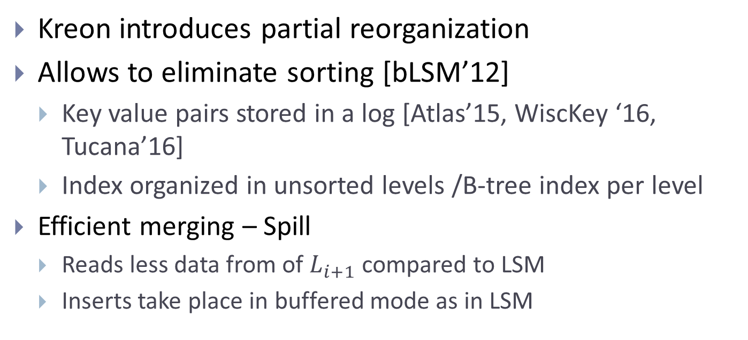
Kreon Persistent Index
Kreon introduces partial reorganization
Allows to eliminate sorting [bLSM’12]
Key value pairs stored in a log [Atlas’15, WiscKey ‘16, Tucana’16]
Index organized in unsorted levels /B-tree index per level
Efficient merging – Spill
Reads less data from of $L_{i+1}$ compared to LSM
Inserts take place in buffered mode as in LSM

Slide 10
Compaction Kreon spill
Memory
Level(i)
Level (i+1)

Slide 11
Compaction Kreon spill
Memory
Level(i)
Level (i+1)

Slide 12
Compaction Kreon spill
Memory
Level(i)
Level (i+1)

Slide 13
Kreon Performs Adaptive Reorganization
With partial reorganization repeated scans are expensive
With repeated scans, it is worth to fully organize data
Kreon reorganizes data during scans
Based on policy (current threshold based)

Slide 14
Reduce caching overheads with memory mapped I/O
Avoid overhead of user-kernel data copies
Lower overhead for hits by using virtual memory mappings
Either served from TLB or page table traversal
Eliminates serialization with common layout in memory and storage
Using memory mapped I/O has two implications
Requires common allocator for memory and device
Linux kernel mmap introduces challenges

Slide 15
Challenges of Common Data Layout
Small random read less overhead with mmap
Log writes large – irrelevant
Index updates could cause 4K random writes to device
Kreon generates large writes by using Copy-on-Write and extent allocation on device
Recovery with common data layout
Requires ordering operations in memory and on device
Kreon does this with CoW and sync
Extent allocation works well with common data layout in key value stores
Spills generate large frees for index
Key value stores usually experience group deletes

Slide 16
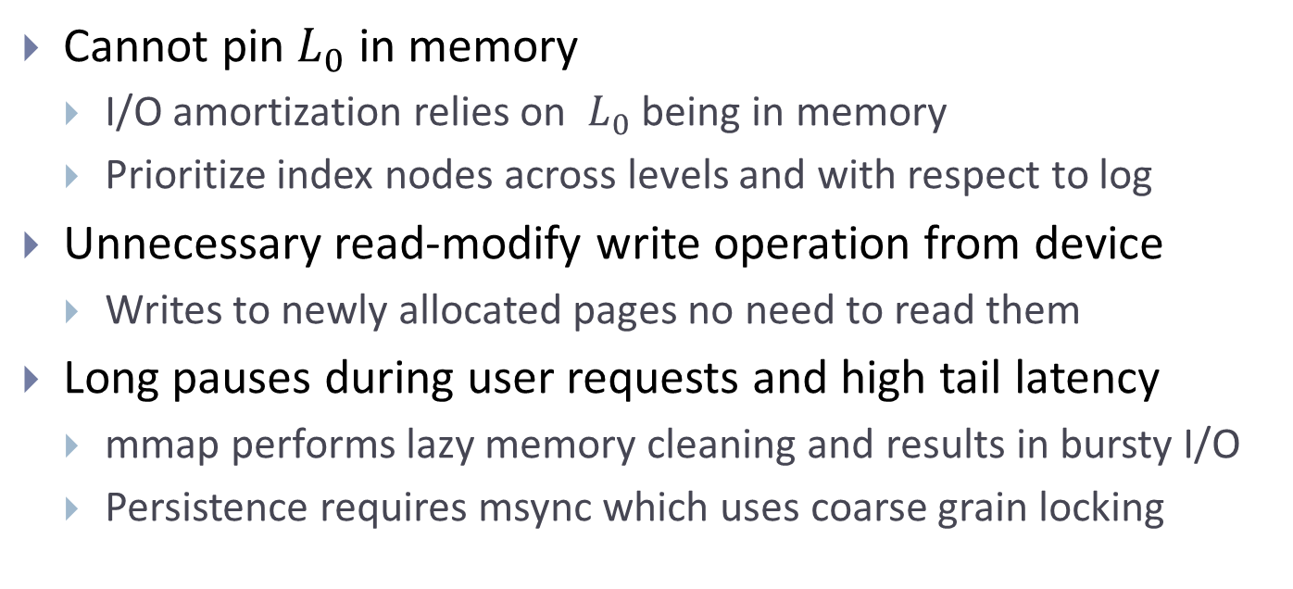
mmap Challenges for Key Value Stores
Cannot pin $L_{0}$ in memory
I/O amortization relies on $L_{0}$ being in memory
Prioritize index nodes across levels and with respect to log
Unnecessary read-modify write operation from device
Writes to newly allocated pages no need to read them
Long pauses during user requests and high tail latency
mmap performs lazy memory cleaning and results in bursty I/O
Persistence requires msync which uses coarse grain locking

Slide 17
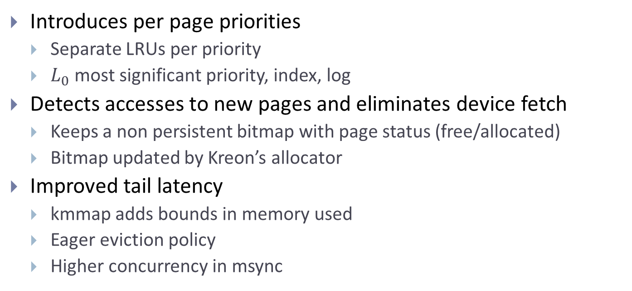
Kreon Implements a custom mmap path
Introduces per page priorities
Separate LRUs per priority
$L_{0}$ most significant priority, index, log
Detects accesses to new pages and eliminates device fetch
Keeps a non persistent bitmap with page status (free/allocated)
Bitmap updated by Kreon’s allocator
Improved tail latency
kmmap adds bounds in memory used
Eager eviction policy
Higher concurrency in msync

Slide 18
Kreon increases concurrency during msync
msync orders writing and persisting pages by blocking
Opportunity in Kreon
Due to CoW the same page is never written/persisted concurrently
Kreon orders by using epochs
msync evicts all pages of previous epoch
Newly modified pages belong to new epoch
Epochs are possible in Kreon due to CoW

Slide 19














kmmap Operation
DRAM
$$L_{0}|{ep}_{1}$$
$$L_{0}|{ep}_{1}$$
$$L_{0}|{ep}_{1}$$
$$L_{0}|{ep}_{1}$$
$$L_{1}|{ep}_{1}$$
$$L_{1}|{ep}_{1}$$
$$L_{1}|{ep}_{1}$$
$$L_{1}|{ep}_{1}$$
$$L_{1}|{ep}_{1}$$
$$L_{1}|{ep}_{1}$$
Log$|{ep}_{1}$
Log$|{ep}_{1}$
Log$|{ep}_{1}$
Log$|{ep}_{1}$
Device

Slide 20







kmmap Operation
DRAM
$$L_{0}|{ep}_{2}$$
$$L_{0}|{ep}_{1}$$
$$L_{0}|{ep}_{1}$$
$$L_{0}|{ep}_{1}$$
$$L_{1}|{ep}_{2}$$
$$L_{1}|{ep}_{1}$$
$$L_{1}|{ep}_{1}$$
$$L_{1}|{ep}_{1}$$
$$L_{1}|{ep}_{1}$$
$$L_{1}|{ep}_{1}$$
Log$|{ep}_{1}$
Log$|{ep}_{2}$
Log$|{ep}_{1}$
Log$|{ep}_{1}$
Device
$$L_{0}|{ep}_{1}$$
$$L_{1}|{ep}_{1}$$
Log$|{ep}_{1}$

Slide 21














kmmap Operation
DRAM
$$L_{0}|{ep}_{2}$$
$$L_{1}|{ep}_{2}$$
Log$|{ep}_{2}$
Device
$$L_{1}|{ep}_{1}$$
$$L_{0}|{ep}_{1}$$
$$L_{0}|{ep}_{1}$$
$$L_{0}|{ep}_{1}$$
$$L_{0}|{ep}_{1}$$
$$L_{1}|{ep}_{1}$$
$$L_{1}|{ep}_{1}$$
$$L_{1}|{ep}_{1}$$
$$L_{1}|{ep}_{1}$$
$$L_{1}|{ep}_{1}$$
Log$|{ep}_{1}$
Log$|{ep}_{1}$
Log$|{ep}_{1}$
Log$|{ep}_{1}$

Slide 22
Outline of this talk
Motivation
Discuss Kreon design and motivate decisions
Indexing data structure
DRAM caching and I/O to devices
Persistence and failure atomicity
Evaluation
Overall efficiency – throughput
I/O amplification
Tail latency
Efficiency breakdown

Slide 23
Experimental Setup
Compare Κreon with RocksDB version 5.6.1
Platform
Two Intel Xeon E5-2630 with 256GB DRAM in total
Six Samsung 850 PRO (256GB) in RAID-0 configuration
YCSB
Insert only, read only, and various mixes
We examine two cases
Dataset contains 100M records resulting in a 120 GB dataset
Two configurations: small uses 192 GB of DRAM large uses 16 GB

Slide 24
Overall Improvement over RocksDB
(b) Throughput (ops/s)
Small up to 5x - average 2.8x,
Large up to 14x - average 4.7x
(a) Efficiency (cycles/op) Small up to 6x - average 2.7x, Large up to 8.3x - average 3.4x
Notes:
Efficiency: Average small 2.7x, Average Large 3.4x
Throughput: Average small 2.8x, Average Large: 4.7x

Slide 25
I/O amplification to devices

Slide 26
Contribution of individual techniques
2.4x
6.3x
2.6x

Slide 27
kmmap impact on tail latency

Slide 28
kmmap impact on tail latency

Slide 29
kmmap impact on tail latency
393x lower 99.99% tail latency than RocksDB
99x lower 99.99% tail latency than Kreon-mmap

Slide 30
Conclusions
Kreon: An efficient key-value store in terms of cycles/op
Trades device randomness for CPU efficiency
CPU most important resource today
Main techniques
LSM → Partially organized levels with full index per level
DRAM caching → via custom memory mapped I/O
Up to 8.3x better efficiency compared to RocksDB
Both index and DRAM caching important

Slide 31
Questions ?
Giorgos Saloustros
Institute of Computer Science, FORTH – Heraklion, Greece
E-mail: gesalous@ics.forth.gr
Web: http://www.ics.forth.gr/carv
Supported by EC under Horizon 2020 Vineyard (GA 687628), ExaNest (GA 671553)
Notes:
This concludes my talk. Thank you for your attention I will be happy to answer any questions

