Slide 1
Introduction To Deep Leaning Neural Networks In Python Using [tensorflow], [keras], [numpy], [pandas] Packages
By Jacob Anderson

Slide 2
What is a Deep Learning Neural Network (DLNN)?
Neural Network
Type of machine learning that’s a simplified model of the way the human brain processes information.
Node based network that ‘learns’ as it receives input
Deep learning
Multiple hidden layers

Slide 3
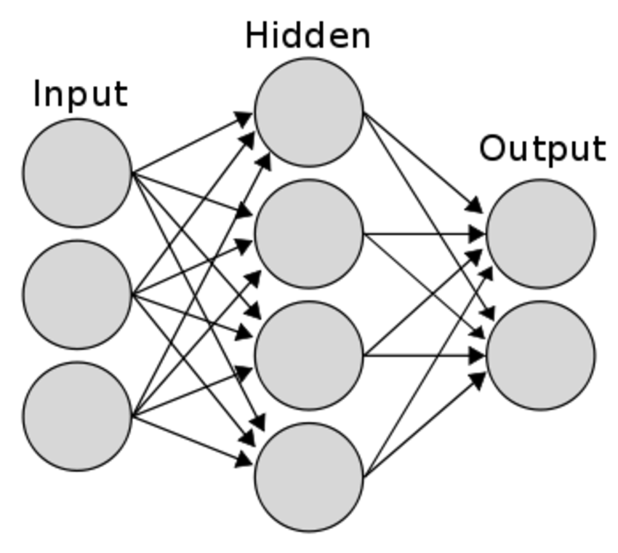
Structure of a Neural Network model
Input Layer
Represents our predictive features (Age, sex, etc.)
Hidden Layer
Anything that is not input or output, (things we don’t have data on, hidden variables)
Output Layer
Predictions of the model
Graff et al. 2014
Notes:
Each line has a weight associated with it that indicates how strongly the input layer affects the hidden layer so on and so forth, this process is called forward propagation

Slide 4
Flow of a Neural Network Model
How it works
Works left to right
Input layer creates hidden layer
Each line is assigned a weight that indicates how strongly the input layer affects the hidden layer.
Σ (input * weight)
Modified from Graff et al. 2014
Notes:
Each line has a weight associated with it that indicates how strongly the input layer affects the hidden layer so on and so forth, this process is called forward propagation

Slide 5
Flow of a Neural Network Model
How it works
Works left to right
hidden layer creates output layer
Each line is assigned a weight that indicates how strongly the hidden layer affects the output layer.
Σ (hidden * weight)
Modified from Graff et al. 2014
Notes:
Each line has a weight associated with it that indicates how strongly the input layer affects the hidden layer so on and so forth, this process is called forward propagation

Slide 6
Flow of a Neural Network Model
That whole process from input to output is called:
Forward Propagation
Works through data one data point (row) at a time
Σ (input * weight)
Σ (hidden * weight)
Modified from Graff et al. 2014
Notes:
Each line has a weight associated with it that indicates how strongly the input layer affects the hidden layer so on and so forth, this process is called forward propagation

Slide 7
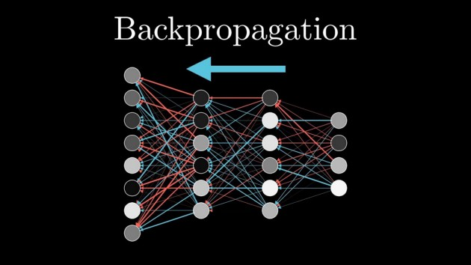
Flow of a Neural Network Model
Backpropagation
Gradient descent
Calculus chain rule
Calculates the slope of the loss function with respect to each weight
Multiply that slope by the learning rate (typically .01), and subtract from the current weights.
Source: https://www.youtube.com/watch?v=Ilg3gGewQ5U

Slide 8
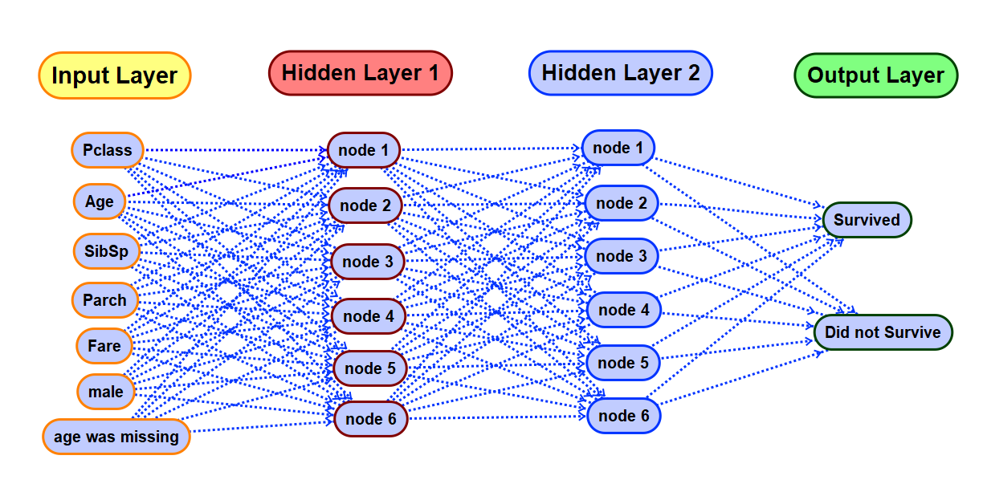
Titanic Example

Slide 9
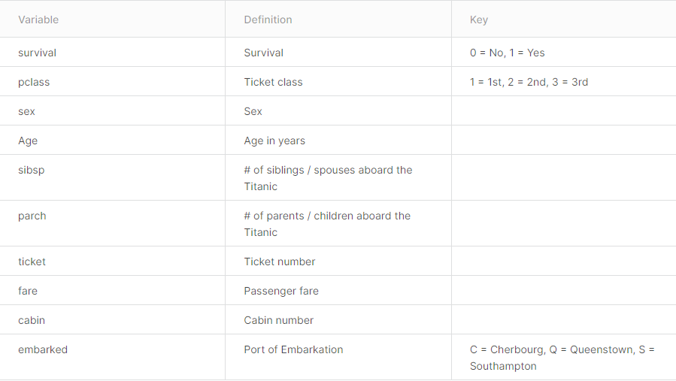
Titanic Dataset
Downloaded from kaggle.com
https://www.kaggle.com/c/titanic/data
train.csv contains 891 observations (rows)
test.csv contains 418 unknown observations (rows) to test
gender_submission.csv contains the true survivorship of the test.csv observations

Slide 10
References
Graff, P., Feroz, F., Hobson, M. P., & Lasenby, A. (2014). SKYNET: an efficient and robust neural network training tool for machine learning in astronomy. Monthly Notices of the Royal Astronomical Society, 441(2), 1741-1759.
Confusion matrix. scikit. (n.d.). Retrieved December 6, 2021, from https://scikit-learn.org/0.18/auto_examples/model_selection/plot_confusion_matrix.html.

