Slide 1
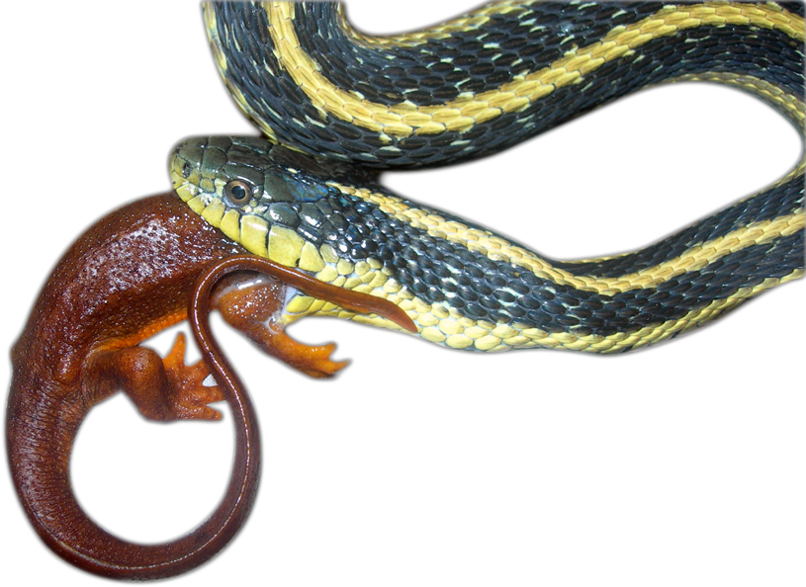
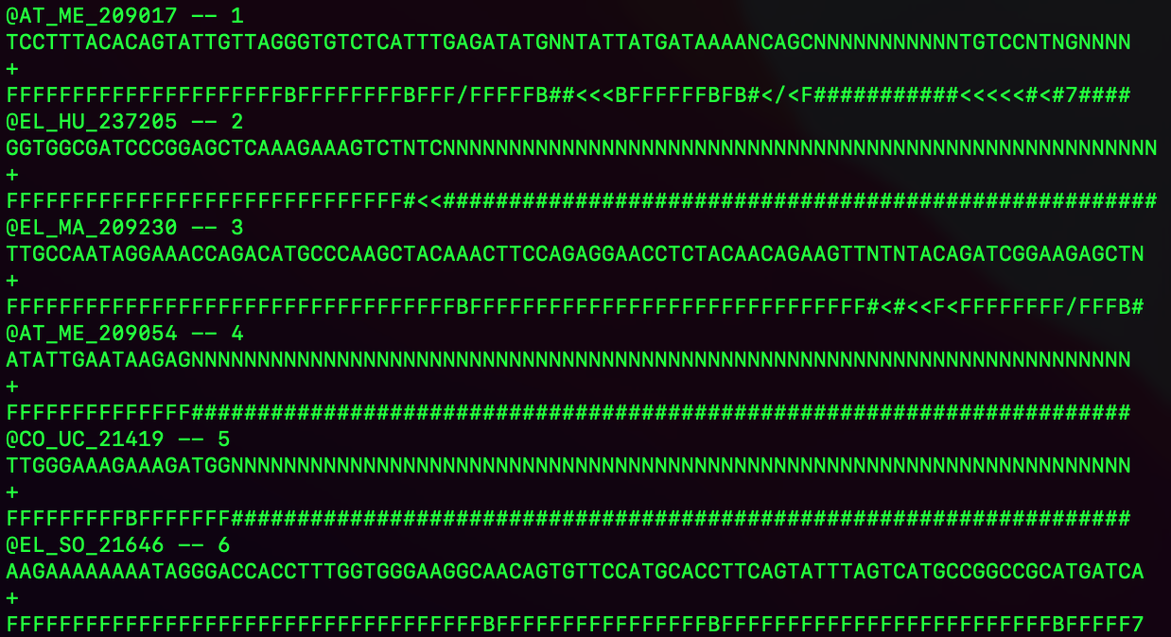
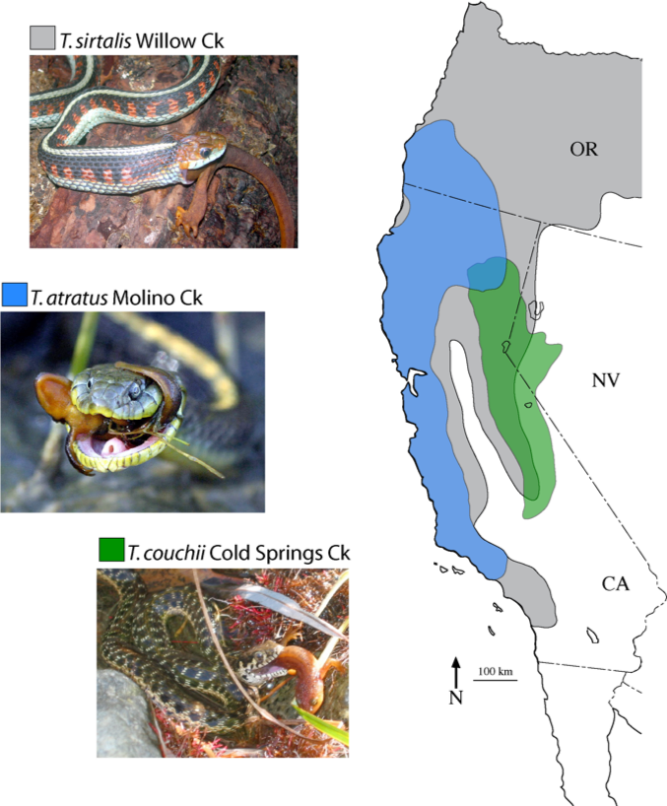
Python: Splitting fastqs

Slide 2
Basic ddRAD filtering workflow
Pipeline
Raw Reads
Remove Contamination
(Human; E. coli; PhiX)
Parse
Barcodes
Spilt
Fastqs
Phylogenetic
Population Genetic
Genomic
Align Reads
(BWA)
Call Variants
(SAMtools/BCFtools)
Filter LOCI
(Depth)
Filtering
VCFtools
Filter IND
(Missing)
Filter LOCI
(Missing)

Slide 3
Basic ddRAD filtering workflow
*
Pipeline
Raw Reads
Remove Contamination
(Human; E. coli; PhiX)
Parse
Barcodes
Spilt
Fastqs
Phylogenetic
Population Genetic
Genomic
Align Reads
(BWA)
Call Variants
(SAMtools/BCFtools)
Filter LOCI
(Depth)
Filtering
VCFtools
Filter IND
(Missing)
Filter LOCI
(Missing)

Slide 4
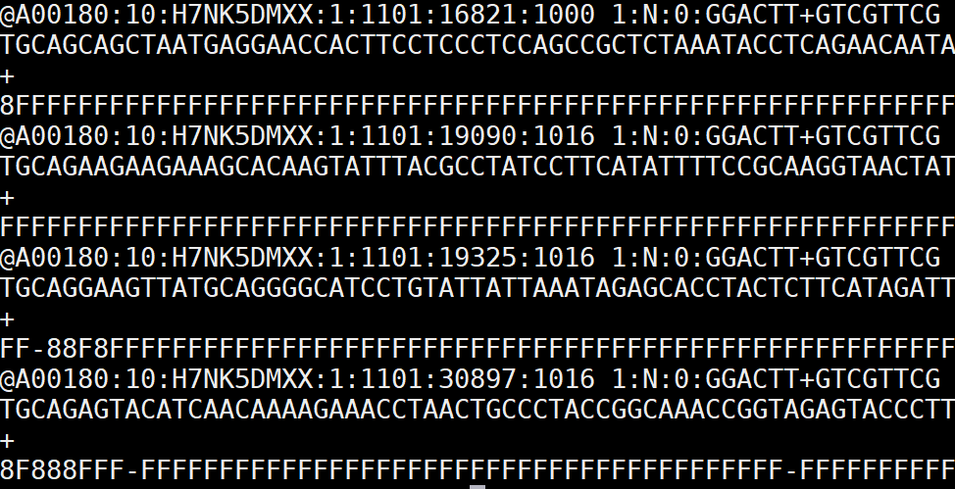
Raw sequence file structure (Parse Barcodes)
Sequencing Information

Slide 5
Fastq file structure
Sequence ID
Sequence
Space / Description
Quality score
Total number of reads across 4 projects = 1,037,450,933 reads
Number of lines 4,149,803,732 lines

Slide 6
Fastq file structure

Slide 7
Fastq file structure

Slide 8
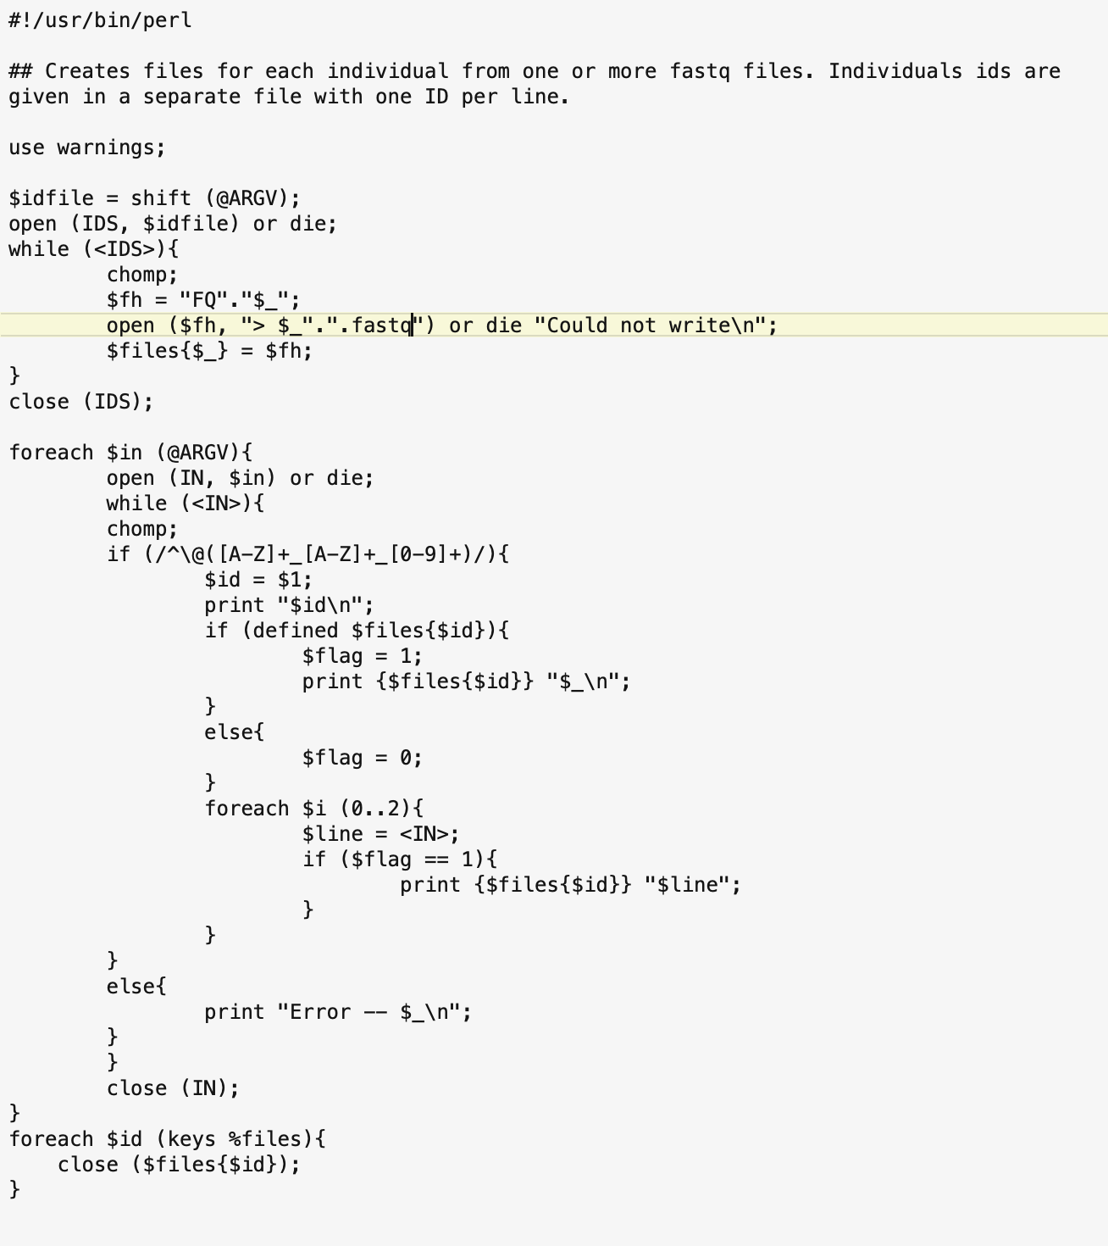
Perl Script:
Opens + reads in
Barcode ID file and creates
New fastq files.
Grabs lines based on ID
Match and writes out to
New fastq file.

Slide 9
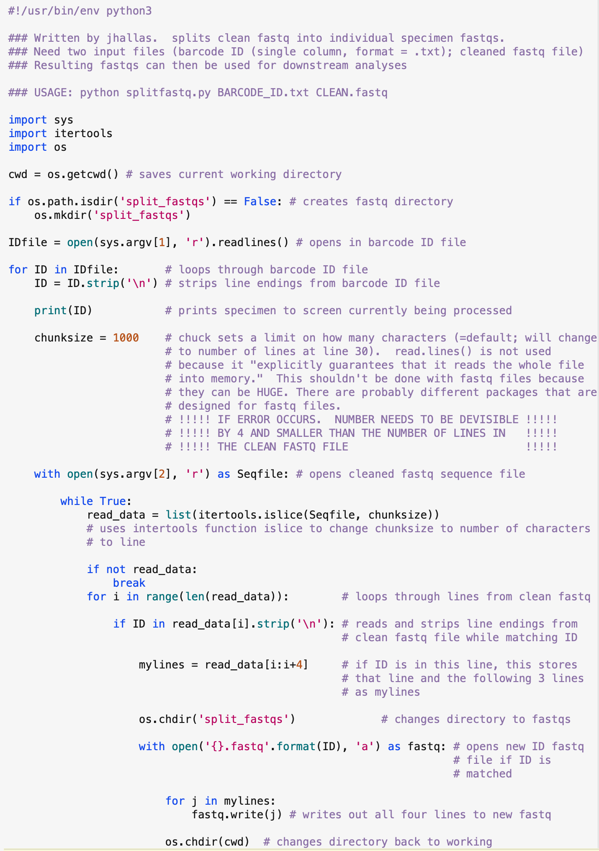
Python Script:

Slide 10
Processes barcode ID file
Grabs sequence data
Writes out to new file

Slide 11
Processes barcode ID file

Slide 12
Processes barcode ID file

Slide 13
Processes barcode ID file

Slide 14
Processes barcode ID file

Slide 15
Grabs sequence data
Writes out to new file

Slide 16
Grabs sequence data
Writes out to new file

Slide 17
Grabs sequence data
Writes out to new file

Slide 18
Grabs sequence data
Writes out to new file

Slide 19
Grabs sequence data
Writes out to new file

Slide 20
Grabs sequence data
Writes out to new file

Slide 21
Grabs sequence data
Writes out to new file

Slide 22
Grabs sequence data
Writes out to new file

Slide 23
Grabs sequence data
Writes out to new file

