Slide 1
Organizing and sharing code and output
Code is written in text, but useful mediums exist to annotate and detail workflows:
Markdown (.md): lightweight markup language that can be used to add formatting elements to plaintext text documents and to annotate code.
R markdown and Jupyter notebooks: Using markdown interspersed with code blocks to annotate code and display output.

Slide 2
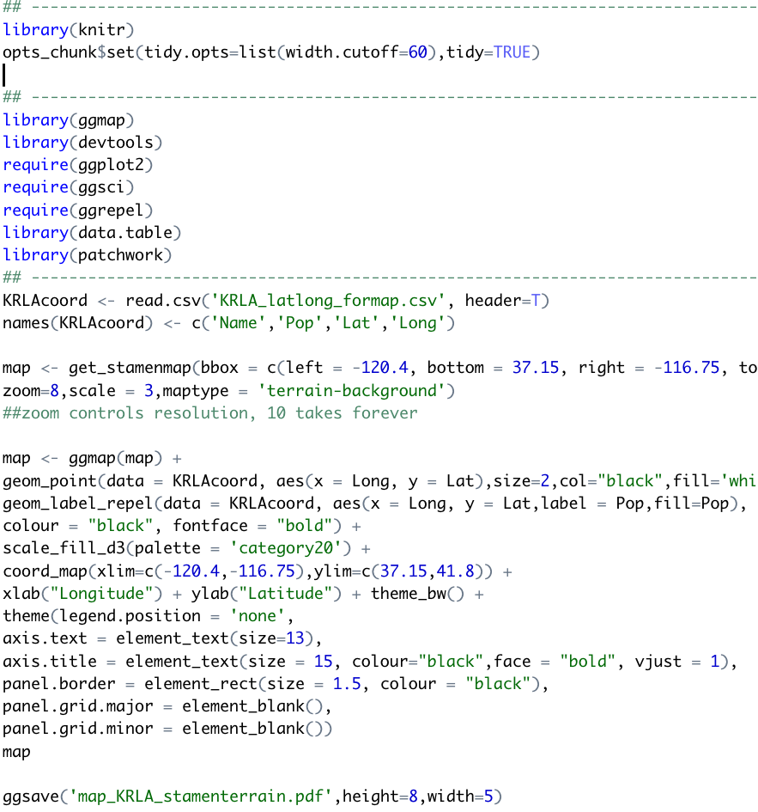
R script:
Code in text, maybe with some lines commented out

Slide 3
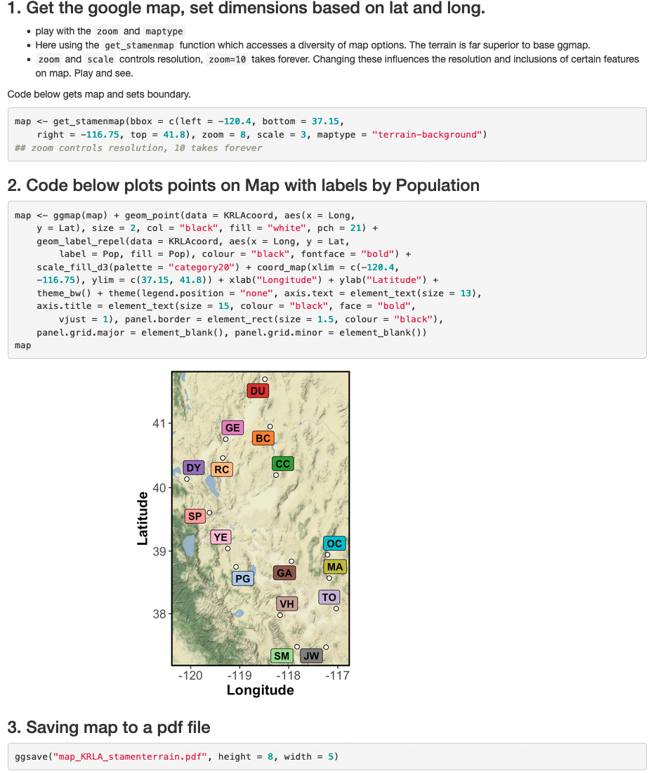
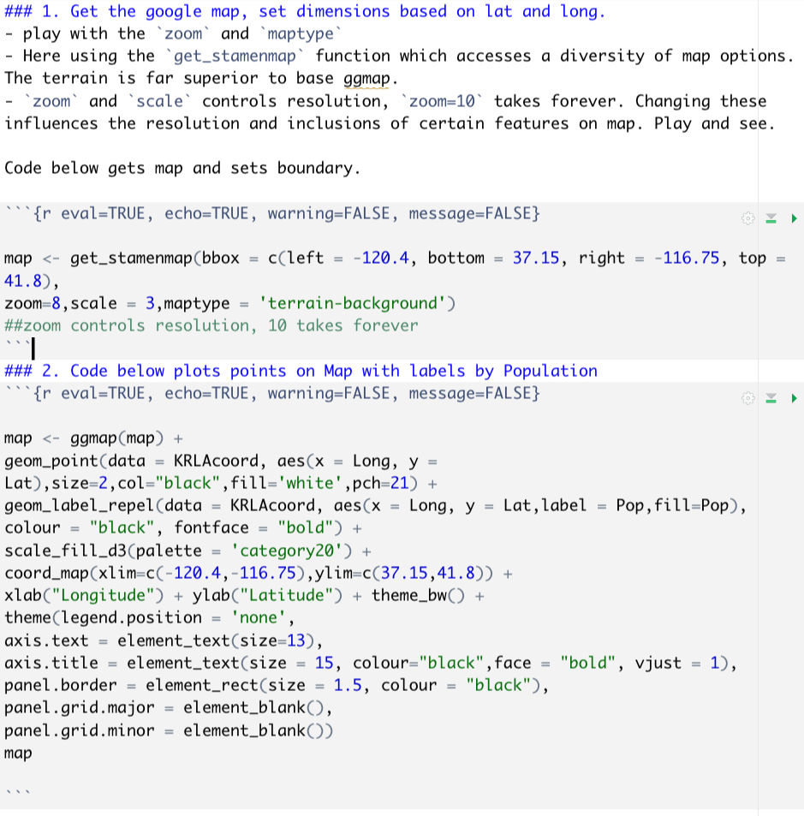
R markdown below
Rendered html

Slide 4
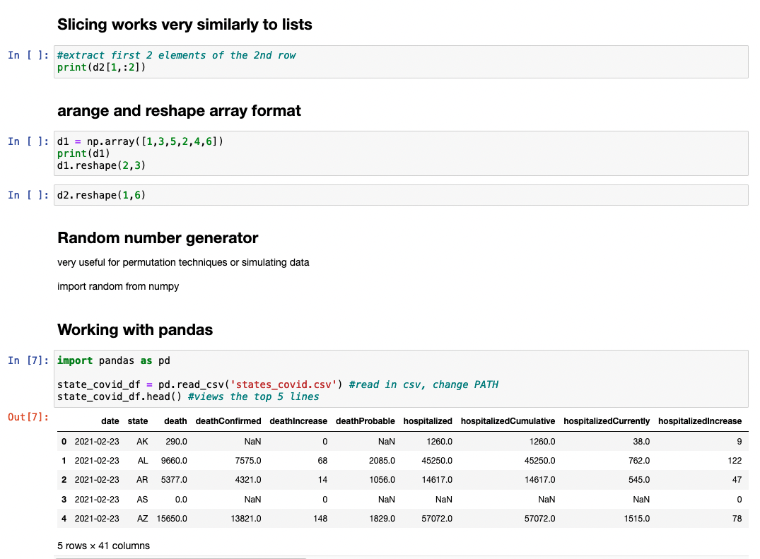
Jupyter
notebooks:
Python code and output with explanations, notes, or annotations written in markdown

Slide 5
R markdown
File format for interleaving markdown text and code blocks
Useful for explaining and displaying both code and its output
Can work with R, python, bash, and latex
Excellent for teaching, sharing, and organizing workflows

Slide 6
Why use R markdown?
Creates clear and easily reproducible record of analyses and results
Excellent for organizing, sharing, and reproducing workflows
Presents code along with output (graphs, tables, etc.) with conventional text to explain it in quality rendered document
E.g., supplemental material for paper submission including all code and output.
day1_Rmd/Rmd examples/Rmd_report_example.html

Slide 7
R markdown: basic elements
Rstudio is a user-friendly GUI (graphical user interface) to run R and to render and view R markdown.
R
- R: https://www.r-project.org/
Rstudio
https://rstudio.com/products/rstudio/download/
It is possible to set up R Jupyter Notebook but RStudio interface is more user friendly

Slide 8
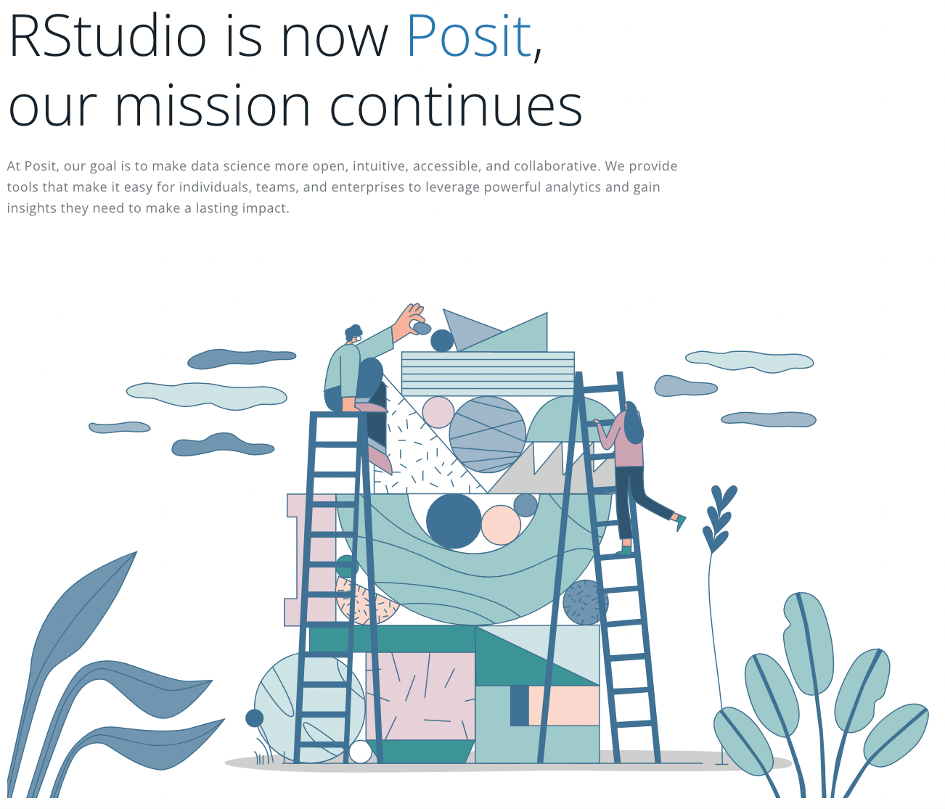
Posit works equally well for R and Python

Slide 9
R markdown: basic elements
.Rmd is common file extension, but these files are just text
Rstudio used to edit .Rmd text and to process/display rendered markdown
Can work with R, python, bash, and latex
Excellent for teaching, sharing, and organizing reproducible workflows.

Slide 10
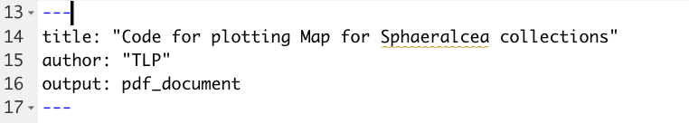
Building an R markdown document
1. YAML header

Slide 11
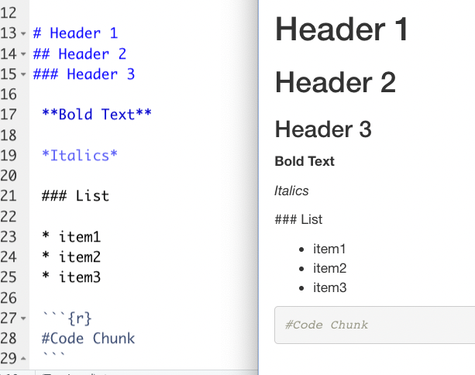
Building an R markdown document
.rmd file
Rendered document
Text written in Markdown syntax
Appears formatted in rendered document (html or pdf)

Slide 12
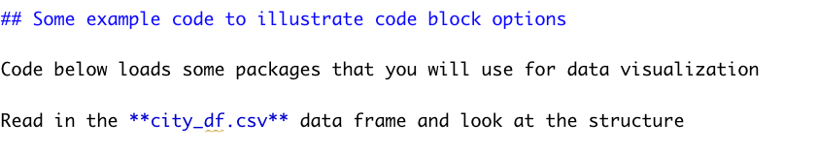
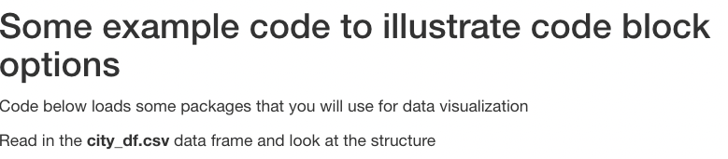
Building an R markdown document
Markdown text example:
Rendered markdown from above will produce below

Slide 13
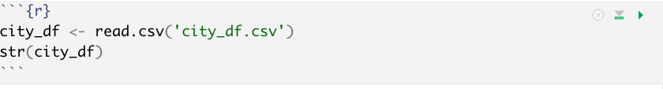
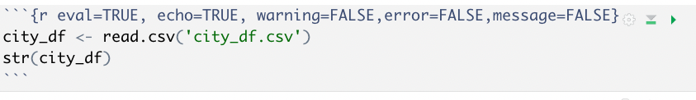
Building an R markdown document
Code (R or python, for example) embedded in code blocks, surrounded by ```{r} ```
With option flags:

Slide 14
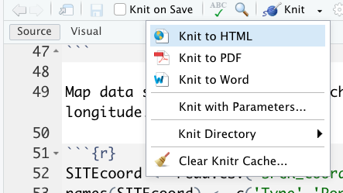
Processing document into html or pdf
Markdown text converted to pdf or html using knitr in R
From prompt:
- rmarkdown::render('knitr_example.Rmd’)
From Rstudio:
- knit dropdown menu

Slide 15
Extract just the R code from R Markdown to R script
Command below will extract just the r code and export to a r script purl.R
knitr::purl("purl.Rmd")

Slide 16

R markdown is not just for R. Handles Python just as easily

Slide 17

Merging R markdown, python, and VS code

Slide 18

R markdown cookbook is free online:
https://bookdown.org/yihui/rmarkdown-cookbook/
Other useful topics:
- embedding latex
- bibliography manager
- tables
- it goes on and on and on

Slide 19
Workshop course page contents for day 1
R markdown tutorial (in `Rmd tutorial` directory)
R markdown examples
- raw markdown documents
- rendered (knitr processed) documents
R markdown cheat sheet

Slide 20
Day 2: Data visualization workshop
Trevor Faske
- Primer, tutorial, and data in day2 directory
- Look over ggplot2 cheat sheet

