Slide 1
Week 6: Getting started in python
I. First script
II. Strings, floats, integers
III. String functions
IV. Interactive mode
V. Float precision
VI. Some practice scripts
For this week:
Haddock and Dunn chapters 7 and 8,
** PythonLesson1_Chapter8.docx for chapter 8 with python3 modifications
pythonI_primer.md,
assignment_python1.md

Slide 2
First python script
#!/usr/bin/env python3
#this is a comment: testing my first program with a simple print statement
print ("I’m ready to learn python, and this is step 1")
From the command line:
$ python first_python.py
OR
$ chmod u+x first_python.py
$ ./first_python.py

Slide 3
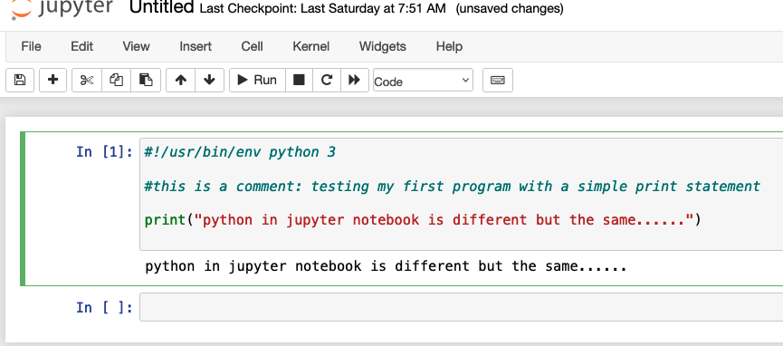

Slide 4
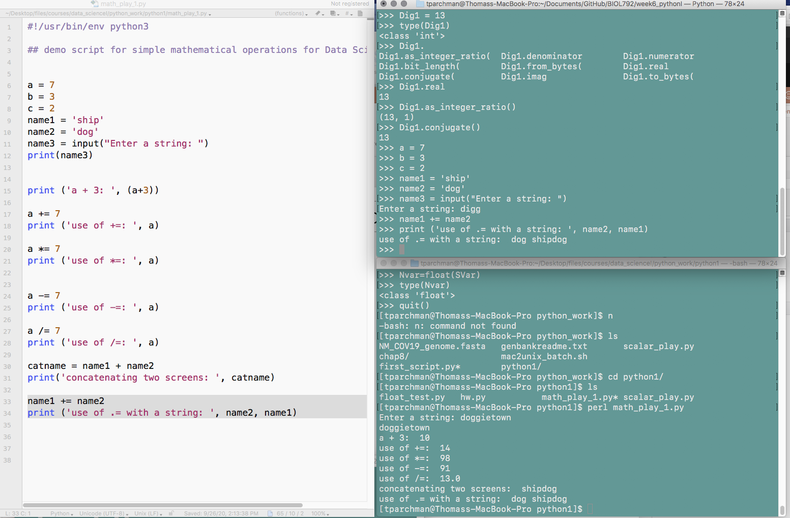
Interactive mode
Enter by simply typing:
$ python3
Amazingly useful for testing code while you are building your scripts

Slide 5
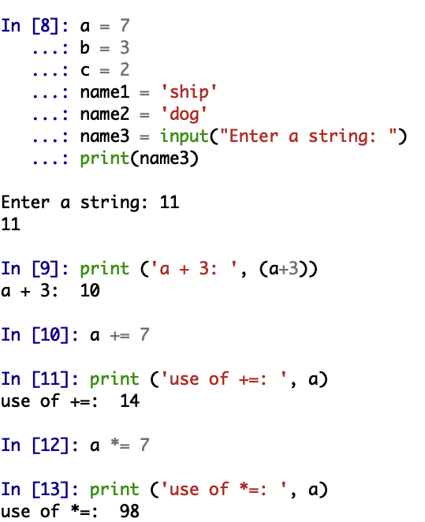
Ipy console
Launch Jupyter Qtconsole from Anaconda navigator
Functions dually as a terminal window and python interactive prompt, tab complete functionality
Amazingly useful for testing code while you are building your scripts

Slide 6
Scalars: strings
Assigning strings to variables (requires single or double quotes):
Team = "lakers"
Seq_one = "actgaaa"
Seq3 = 'atcGGGC' # single or double quotes
Val = '11.2' #something that looks like a float
Sentence = "Joe Burrow is the real deal"

Slide 7
Scalars: built in string functions/methods
StringName.functionname
Team = "lakers" CapTeam = Team.upper() #change lakers to LAKERS
Seq_one = "actgaaa"
NewSeq = Seq_one.replace('a', 't') # replaces a with t
NewSeq = Seq_one.count('A') # returns a count of match

Slide 8
Scalars: built in string functions/methods
StringName.functionname
Team = "lakers" Team.isalpha() #should return ’True’
Seq_one = "actgaaa"
NewSeq = Seq_one.strip(‘aaa') # removes ‘aaa’
NewSeq = Seq_one.upper()
Print(NewSeq) # converts to caps

Slide 9
Scalars: integers and floats
Integers: whole numbers (1, 3, 7, -99)
Dig1 = 13 # no quotes for integers
Dig2 = '111' # quotes make this a string
Floats: ' floating’ decimal point (all is means is there is a decimal)
F1 = 1.3333 # no quotes for floats
F2 = '.111' # quotes make this a string
F3 = float(F2)

Slide 10
% operator:
controlling format of scalars in print statements
%d for an integer, %f for a float, and %s for a string.
%f controls precision of floats printed.
Prod = 2/3
print ("2/3 should equal roughly %.3f" % (Prod))
Temp = 72.3
Seq = "ATCCC"
Num = 23
print("Primer %d, bases %s, melting point %f" % (Num, Seq, Temp))

Slide 11
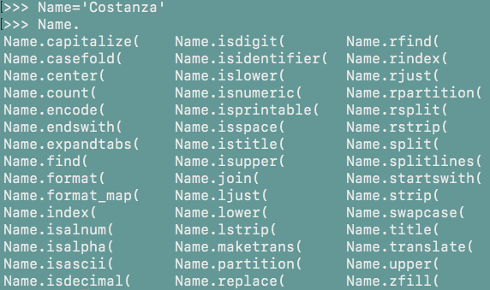
Interactive mode help() and dir()
help(str)
# provides brief description of str functions
Hitting tab after variable name followed by . will list methods available to that variable.

Slide 12
Practice script 3. Write a python script to calculate expected genotype frequencies in a population under Hardy Weinberg Equilibrium based on known allele frequencies at a gene with TWO alleles. As a reminder, a population under Hardy-Weinberg equilibrium has genotype frequencies predictable from allele frequencies (p and q):
p**2 + 2pq + q**2 = 1
So, your script needs to return three values: The AA genotype freq: p**2
The Aa genotype freq.: 2pq
The aa genotype freq.: q**2 = 1)
Points (hints)
The program should use the input() function to prompt for the command line entry of two values from the command line.
If you supply two values, e.g., 0.2 and 0.8, python will want to treat these as strings. So, before doing math you will need to convert them to floats (A = float(Inputvalue))
As part of this exercise, you will need to control the precision of the floats printed (e.g., % %)

Slide 13
Pulling raw input from the command line (input())
In Python:
name3 = input("Enter a string: ")
print(name3)
At command line prompt:
‘Enter a string: ‘ prompt will appear at command line. Type a string
If ‘Burrow’ is typed and Enter hit,
‘Burrow’ should print to screen

Slide 14
This week:
Read through chapter 8 (*note PythonLesson1_Chapter8.docx under week6 is updated to reflect python3).
Write the script specified in the chapter as you go through it
python_1_primer.md, assignment_pyton1.md
Email me script for #3 only.
Next week:
Chapter 9: lists, conditionals, loops

Slide 15
Notes on schedule:
I.1-2 pager independent project description along with python3 assignment next week (by 10/19)
If you don’t have datasets or specific ideas related to your research, other options might include:
Build a jupyter notebook or Rmd tutorial or demo for a specific python module (package) that you have an interest in learning in more detail or applying in your future work (we will cover Jupyter and R markdown in detail during week of Nov. 15, syllabus modifications pending).
Demo a linux based analysis workflow for analyses central to your research focus (example, MetaPhlAl workflow for metagenomic data; https://huttenhower.sph.harvard.edu/metaphlan/).
II. Assignments to have turned in by now: Unix 4 (bash script with for loop), Python1, Python2.

