Slide 1
Week 5
I. Chapter 7: conceptual framework of programming
II. Why Python?
III. Making sure you have python 3 installed
IV. First script
Haddock and Dunn chapter 7, preview chapter 8

Slide 2
From unix_assignment4:
a. Lets work on the yeast_genome.gff file from last week. Use awk to write the 1st, 3rd, and 5th column from that file to another file.
$ awk {'print $1, $3, $5'} yeast_genome.gff
b. The 4th and 5th columns of that file represent the starting and ending location on a chromosome of the annotated sequences represented in this file. Write out the first three columns of this file and the LENGTH of each gene to an output file.
awk {'print $1, $2, $3, $5 - $4'} yeast_genome.gff > info_length_yeast.txt
c. Now, lets say we want to do the same thing as above, but only for sequences that are longer than 400 bases in length. Use awk to extract that information
awk {'if ($5 - $4 > 400) print $1, $2, $3, $5 - $4 '} yeast_genome.gff

Slide 3
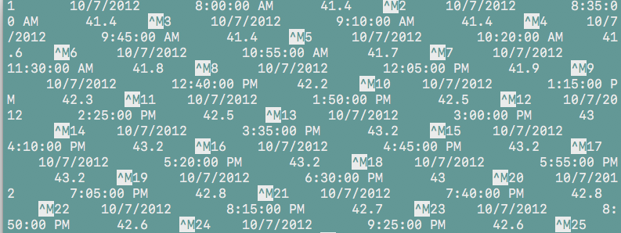

1901302108_H7_D_13.txt.txt
Before changing line endings
unix_1901302108_H7_D_13.txt.txt
After changing line endings

Slide 4
Shell script to change line endings on any number of files
Prints list of arguments, to confirm input is working as planned
#!/bin/bash
echo $@
echo $1
echo $2
for file in $@; do
cat $file | tr '\r' '\n' > unix_$file
done
Prints 1st argument
Prints 2nd argument
Loops through files
Changes line endings, redirects to file. Name of file starts with unix_, and ends with the name of the input argument

Slide 5
Chapter 7: Practical Computing for Biologists
Data structures and workflow control concepts are similar across programming languages
Understanding these elements (without necessarily having to think about syntax) will aid your approach to any programming language
Think about your data as a series of programmable tasks, abstractable as ‘pseudocode’

Slide 6
Overview:
Cover basic concepts of programming to guide your thinking with python and other languages.
Terminology
Variable types
Control structures
Input/Output

Slide 7
Compiled vs. Interpreted Languages
Compiled
- C, C+, Java
- Translated from human readable code (source code) to computer understandable instructions – must be compiled
Interpreted (or scripting languages)
- perl, python, ruby, R
- Processed by an interpreter each time they run – don’t have to compile
- Program itself is the source code, easy to modify and can be run on any machine
- BASH was our interpreter for the shell scripts you wrote

Slide 8
Basic programming terminology
Arguments – values that are sent to programs or functions
$ bash mac2unix.sh *macfiles.txt
Statement – a line of a program or script which can assign a value, do a comparison or perform other operations.
print(“ATCGGGC”)
Parameters – Values that are sent to a function when it is called
No_A = DNAseq.count(A)

Slide 9
Basic programming terminology
Function – a subprogram used to repeatedly to perform the same task
len(DNAseq)
Return – the value created and sent back from a function
SeqLength = len(DNAseq)
Parse – To extract particular data elements from a larger set

Slide 10
How to write a program – four questions
1. What do you want to do?
2. How will you control input and output? And What variables to you want to make/use?
3. What will the workflow be? How will you conduct operations on your variables?
4. What should you return at the end?

Slide 11
Variable types: Scalars
Integer: whole numbers
- 1, 3, 5, 99, etc.
Float: any number, with decimal (“floating point”)
- 11.23, 0.0222, 3 x 10⁻¹⁰, 3e12
String: sequence of text characters
- “ACGGGTTAACCCTTT”
- “Western Conference Finals”
- “3.14159 approximates Pi”
Boolean: True or False

Slide 12
Variables as Containers - lists
One dimensional array (a list)
ColorList = (‘blue’, ‘red’, ‘green’, ‘violet’, ‘orange’ )
NumList = (‘9’, ‘83’, ‘85’, ‘11’, ‘52’ )
Lists are ordered, with 0 as first element
ColorList[0] = ‘blue’; ColorList[4] = ‘orange’;
Multidimensional arrays (e.g., rows of columns, or a 2-d array)
ColorNum[0,2]
Useful, and often used: can ‘loop’ through arrays rapidly, performing the same set of actions on each element

Slide 13
Associative arrays (Dictionary in python, hash in perl)
Unordered sets of key:value pairs
- efficient because they allow more rapid access to paired information
In python, called dictionaries
- key:value pairs, multiple keys can have same value, keys must be unique
HetEst[Loc12] = [0.12]
HetEst[Loc19] = [0.32]
HetEst[Loc15] = [0.12]
Functions in python facilitate work with dictionaries. Like arrays, we can ‘loop’ through dictionaries to perform the same set of code action on each element and or on each key.

Slide 14
Control structures, flow:
if conditional decision making
if-else conditional decision making
for repeating operations in a loop
while open ended loop

Slide 15
if conditional decision making
Input
In python:
other statements
if Num > 0:
print("negative”)
if
false
true: do something
Rest of code

Slide 16
if-else conditional decision making
Input
In python:
other statements
if Num < 0:
print("negative”)
elif Num > 0:
print ("positive”)
if
false
true
else
do something
Rest of code

Slide 17
for iterative loop
Input
In python:
for Num in range(10):
print(Num *10)
for Name in Nlist:
print(Name)
for Base in ‘ACTGCCC’:
print(Base)
other statements
For each item
Do something
(exit loop when nothing left to do)

Slide 18
while iterative loop
Input
In python:
while X < 100:
X = X + 2
print(X)
other statements
while
(condition is true)
Do something
(exit loop when nothing left to do)

Slide 19
Input/Output
- Nearly always, your programs will process information from files you specify
- Nearly always, your programs will write information to files you specify
- Sometimes this will involve one file at a time; often it will involve many (which can be just as easy)

Slide 20
Input/Output in Python
Input example:
FileName = “file_from_working_directory.txt”
InFile = open(FileName, ‘r’)
for Line in InFile:
print (Line)
Output example:
OutFileName = “output_to_working_directory.txt”
OutFile = open(OutFileName, ‘w’)
OutFile.write(Line)

Slide 21
Why Python?
- It is one of the most common languages used in biology and other sciences. Thus, you will find a lot of documentation and examples online.
- Excellent for text manipulation, well suited to bioinformatics and data science.
- It uses consistent syntax, which makes learning specific code relatively easy.
- Many built-in libraries/functions to facilitate common tasks
- Widely used, across science and industry.

Slide 22
Before next week:
Go through short week5_primer.md
Read Chapter 7, Preview Chapter 8
3. Go through jupyter_getting_started.md (under jupyter_start)
4. Converse about independent project ideas if needed

Slide 23
1. Make sure you have python 3 installed (follow week5_primer.md)
2. Write your first, and simplest possible, python program (follow week5_primer.md)
3. Note: updated versions of book chapters corrected for python 3 will be available with other weekly materials on GitHub, starting with chapter 8.

Slide 24
Useful resources to explore and keep nearby
Python documentation:
(https://www.python.org/doc/)
Python for Biologists online materials:
(https://pythonforbiologists.com/introduction)
Learn Python Interactive
(https://www.learnpython.org/)
- This has a built in interpreter, so you can test code or play with code under the tutorial examples. Excellent resource.
Python guru
(https://thepythonguru.com/)
- This also has a built in interpretter, so you can test code or play with code under the tutorial examples. Excellent resource.

Slide 25
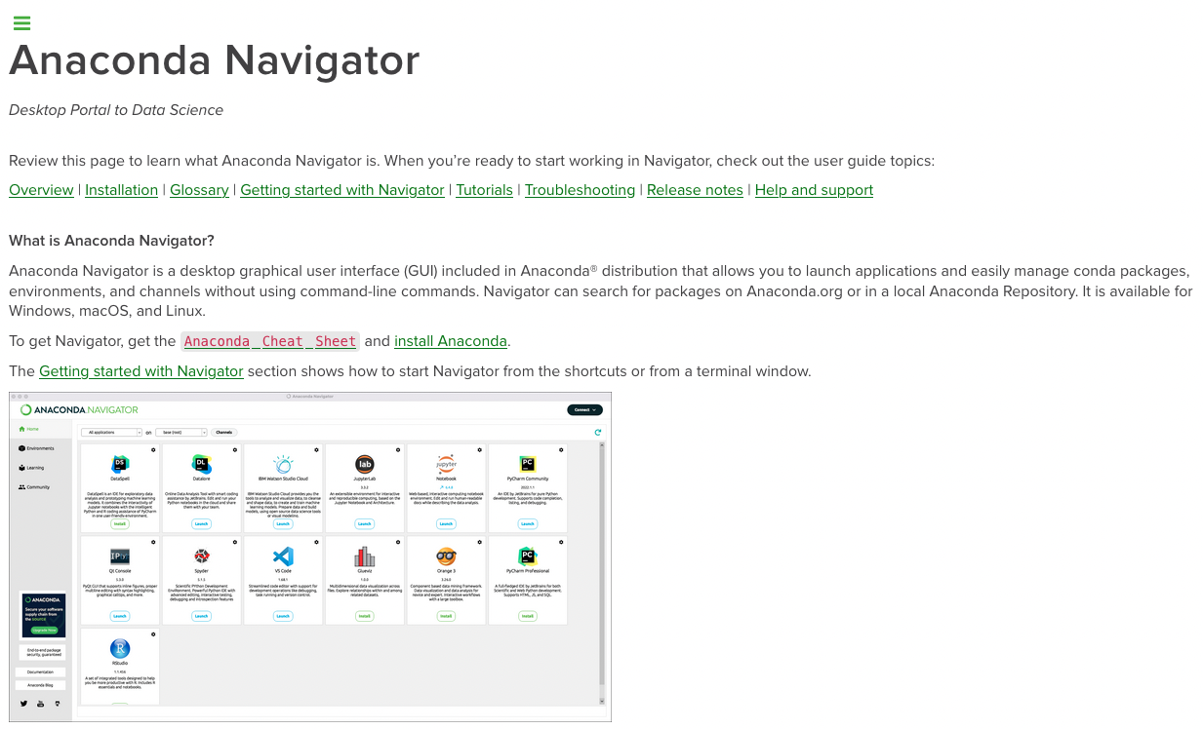
https://docs.anaconda.com/anaconda/navigator/

