Slide 1
Task 1: Week 11, Python 6
IN = open(sys.argv[1], 'r')
OUT = open("listout.txt", 'w')
ID_Seq={}
ID_Len={}
for Line in IN:
ID = Line.strip('\n')
Seq = IN.readline()
Seq = Seq.strip('\n’)
SeqLen = len(Seq)
ID_Seq[ID]=Seq
ID_Len[ID]=SeqLen
for thing in sorted(ID_Len.keys()):
OUT.write("ID: %s, Length %s \n" % (thing, ID_Len[thing]))

Slide 2
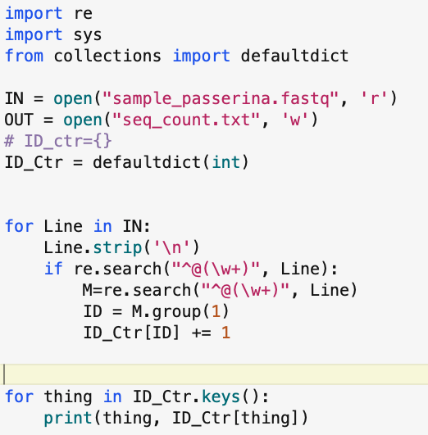
Task 2 (extra): Week 11, Python 6

Slide 3
BIOL792 Fall 2023 – Week 12, python 7
Useful data science libraries for python
primer_python7_numpy_pandas_partI.ipynb
- numpy introduction
- pandas introduction
III. Optional assignment_6_python.md & answers (for week 12)

Slide 4
Ways to write python
Interactive through terminal
Scripting using text editor
IDE (Integrated Development Environment)
- PyCharm
- Spyder
- Rstudio (now posit.co)
Anaconda / miniconda
- Jupyter notebooks
- Environments and repositories

Slide 5
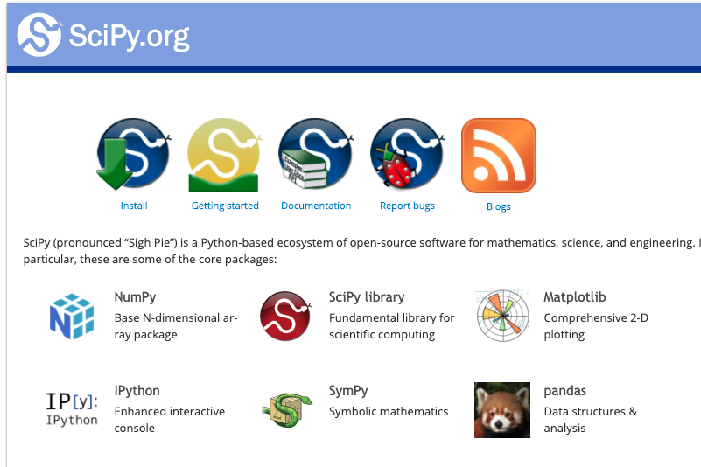
Python libraries
(137,000 estimated)

Slide 6
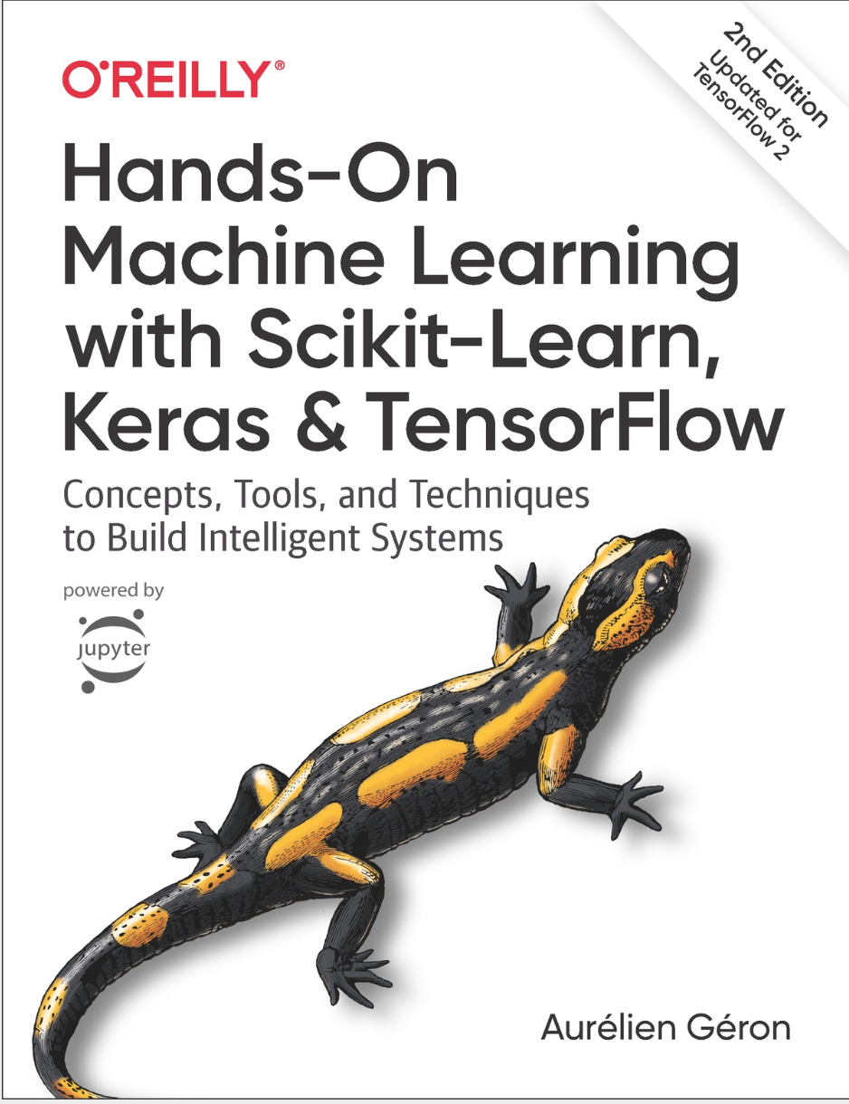
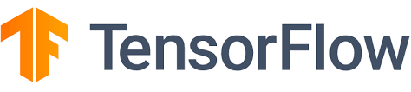
Machine Learning
Tensor Flow
Keras
Scikit-learn

Slide 7
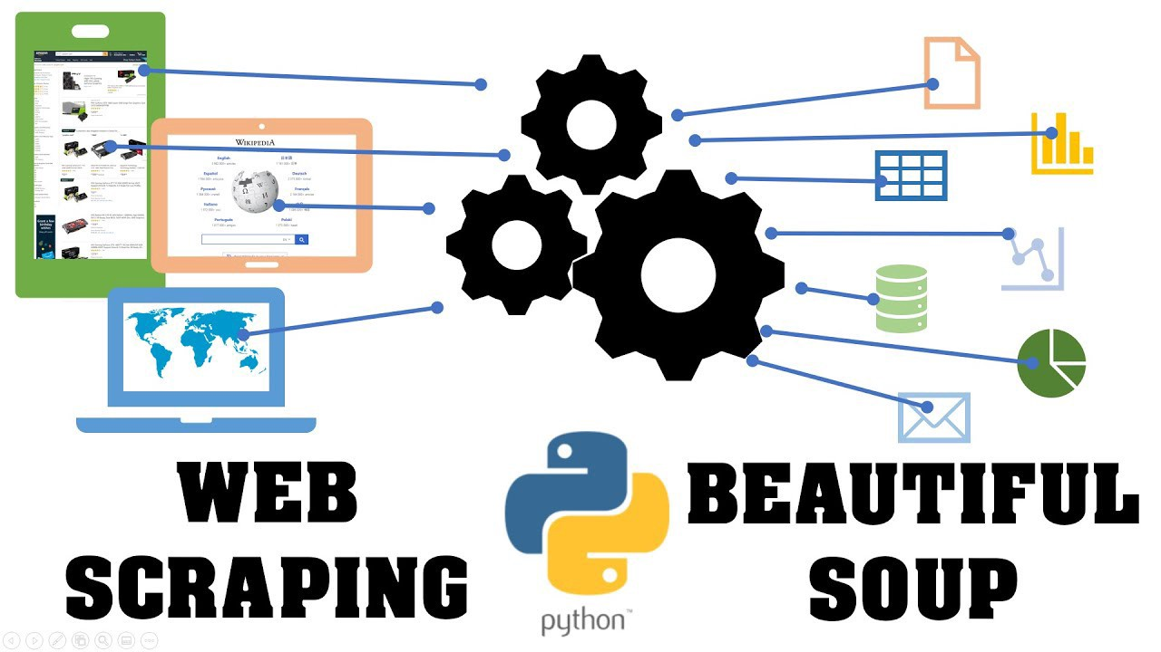

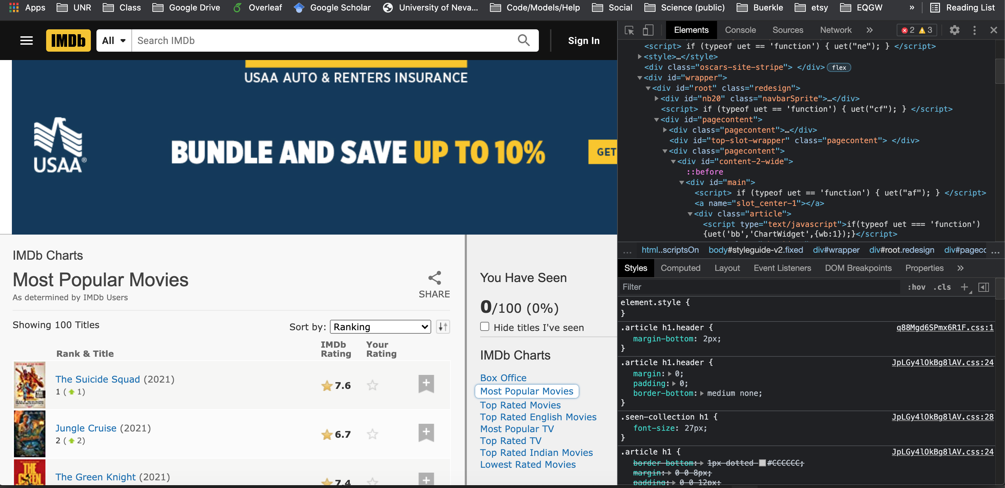
Web data scraping

Slide 8
Common Data Science libraries for python: NumPy
a widely used python library that supports working with large, multi-dimensional arrays and matrices.
has a diversity of mathematical functions to operate on these arrays or matrices.
Array and matrix notation/syntax similar to R
pandas was built from numpy, so requires or resembles much of its functionality.

Slide 9
Common Data Science libraries for python: pandas
- Supports 2-d data cleaning, merging, and joining.
- Easy handling of missing data (represented as NaN)
- Powerful group by functionality for performing split-apply-combine operations on data sets (similar to R)
- pandas requires numpy for many operations. Both are core components of SciPy

Slide 10
Installing python numpy and panda libraries
From the command line:
$ pip3 install package_name
$ pip3 install numpy
$ pip3 install pandas
$ pip3 install matplotlib
If you get a permissions error:
$ pip3 install --user package_name

Slide 11
Importing libraries
Top of script in python
import os,re,sys (import multiple libraries in single line)
import numpy as np (import package as alias)
from numpy import DataFrame (import only specific function)
Aliases commonly used
import numpy as np
import pandas as pd
import matplotlib.pyplot as plt

Slide 12
NumPy basics
- NumPy aims to provide an array object that is up to 50x faster than traditional Python lists (ndarray is the data object)
- Supporting functions make working with ndarray easy and fast – math, iterating, reshaping, searching, etc.
1 dimensional array assignment:
d1 = np.array([1,3,5,2,4,6])
2 dimensional array assignment:
d2 = np.array([[1,3,5],[2,4,6]])

Slide 13
NumPy basics
Accessing elements of a 1-d array:
d1 = np.array([1,3,5,2,4,6])
d1[1] # returns array element “3”
Accessing elements of a 2-d array:
d2 = np.array([[1,3,5],[2,4,6]])
d2[0,2] # returns first row, 3rd col.
d2[1,:2]# first 2 elements of 2nd row
Getting shape of array:
d2.shape # returns dimensions (2,3)

Slide 14
NumPy basics
Mathematical operations:
x2 = random.randint(1000,size=10)#10 random integers between 0 and 1000
print(np.divide(x2, 2))
print(np.power(x2, 2))
print(np.sqrt(x2))
#works with 1 or multidimensional arrays

Slide 15
NumPy basics
Iterating:
arr = np.array([[1, 2, 3], [4, 100, 150]])
for x in arr: # doesn’t matter if array is 1d or 2d
print(x)
Iterating over 1 column in a 2d array:
for x in arr[0:,2]:
print(x)

Slide 16
NumPy basics
Reading from files into ndarray format:
x2d = np.loadtxt("muricata_pops_lat_long.csv", delimiter=",")
print(x2d)
np.genfromtext can be used for files with missing data; will treat missing as defined
Writing numpy formatted arrays to files:
arr = np.array([[1, 2, 3], [4, 100, 150]])
np.savetxt("np_savetxt_test.txt", arr)

Slide 17
Pandas DataFrame
- Two-dimensional data structure - tabular fashion in rows and columns.
- Components: the data, rows, and columns
Reading file as data frame:
import pandas as pd df = pd.read_csv('data.csv') print(df)

Slide 18
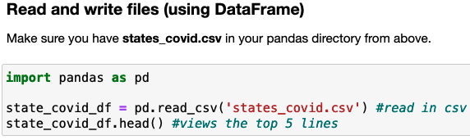
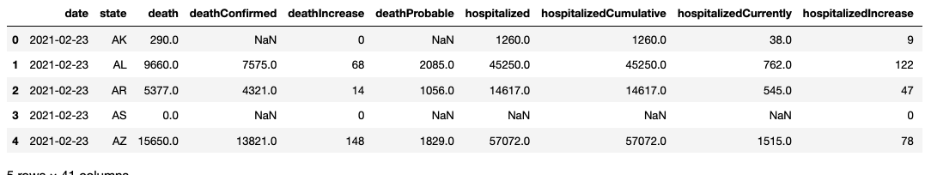

Slide 19
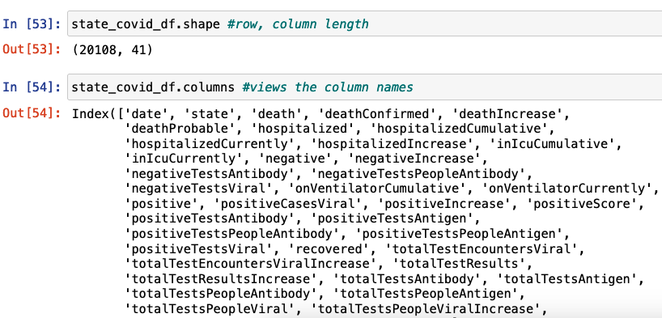

Slide 20
This week
primer_python6_numpy_pandasI.ipynb
We will continue with pandas, including more in depth demo and optional assignment after Thanksgiving holiday
Progress on on independent projects

