Slide 1
Week 2
more Unix commands and command line arguments, man pages
Using .zshrc, .bashrc, or .bash_profile to control terminal behavior for protection and efficiency
Viewing and editing text files (less or TextWrangler or nano)
File compression, decompression
Using Unix tools to work with some DNA sequencing data

Slide 2
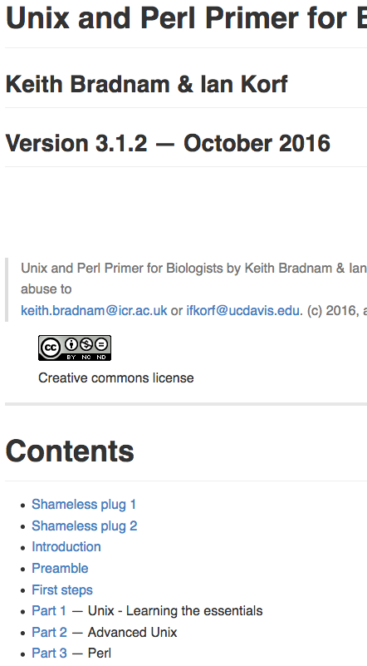
- For this week, focus on U10-U27
- Go through all of Unix Part 1 and be prepared for Unix Part 2 to be very helpful.
http://korflab.ucdavis.edu/Unix_and_Perl/current.html

Slide 3
Changing command names with aliases is useful, but risky
$ alias ls = “ls –l”
Changes the default behavior of ls, looks useful
$ alias mv = “cp”
Potentially bad
**Store carefully thought-out aliases in .bash_profile, .zshrc, or similar profile files in your home directory

Slide 4
Removing files or directories (can be dangerous)
$ rm file.txt
Will remove file. PERMANENTLY. FOREVER.
Use the –i option as protection
$ rm –i file.txt
remove file.txt?
Recommended: alter your bash or zsh to always call rm –i when typing rm at the command prompt, using an alias

Slide 5
.zshrc or .bash_profile
- Contains specifications that control the way the terminal works
- Aliases allow you to create a customized name for a command, or a set of commands with specified options
- Aliases can be set in .bash_profile or .zshrc (depending on terminal used by your system) to improve efficiency and safeguard against bad consequences.
- As most of you are using new apple mac computers, you will be using the zsh terminal and hence this file will be called .zshrc

Slide 6
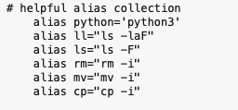
.zshrc:
This file resides in your home directory. It is a “hidden” file. The “.” in front of such a file prevents it from being normally listed with ls
$ less .zshrc
We want to add alias commands to this file in order to make your shell safer and perhaps more useful.
-for e.g., rm is dangerous with its default behavior

Slide 7
.zshrc (or .bash_profile)
Go to the profile section of unixII_primer.md, follow closely to understand and alter .zshrc, .bash_profile, .bashrc or whatever your system call for.
If this file doesn’t exist, the simply make it in your home directory and name it .zshrc.
Alternatively, you can download the simple example .zshrc file from under week2_unixII or unix_resources on the course page.
To activate, restart terminal application

Slide 8
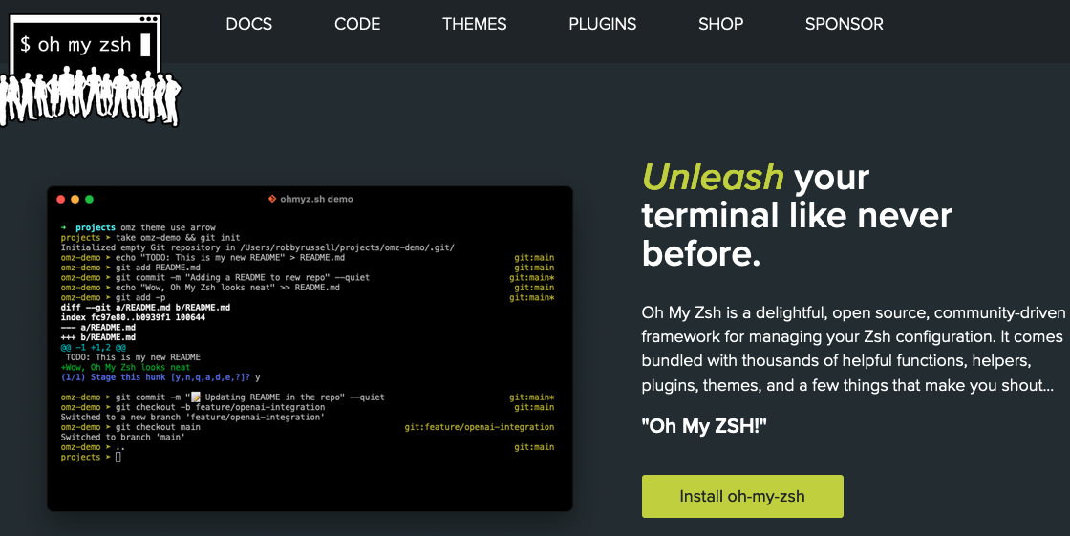
An open source, community-driven framework for managing your zsh configuration
$ sh -c "$(curl -fsSL https://raw.githubusercontent.com/ohmyzsh/ohmyzsh/master/tools/install.sh)"

Slide 9
Unix tools to get a good handle on this week:
wc
grep
less
ps
history
cat
gzip
gunzip
top
kill
cut
paste
grep
&
*
>
|
**everything related to moving, copying or syncing files:
cp, mv, mkdir, rmdir, rm
rsync
This one is important: read man page, and try out on some test directories before next week

Slide 10
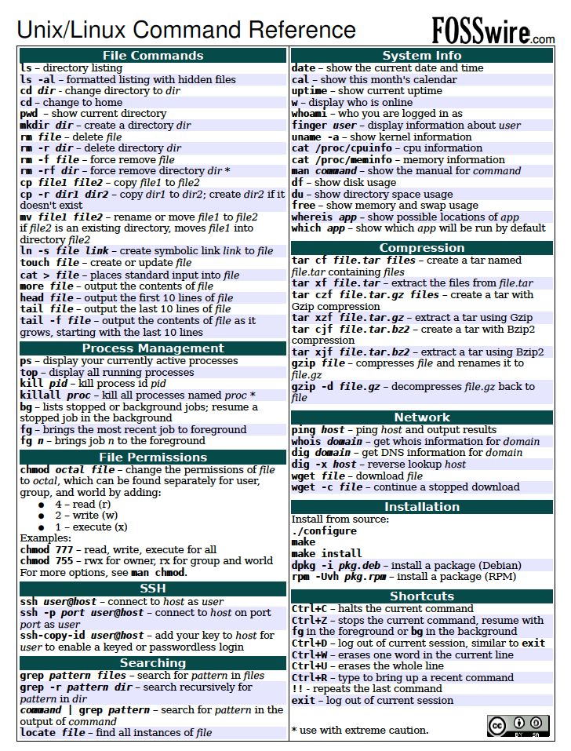
Unix cheat sheet on course webpage under “unix_resources”
I suggest keeping his on hand for now, but being comfortable with most of these commands before working on any computing clusters
There is a similar python cheat sheet in the same location

Slide 11
When to use a text viewer rather than editor:
You might not know which program your computer would ‘automatically’ use to open that file
You don’t know the size of the file. Big data will typically be too big to open with one of your text editing programs.
Sometimes you just want to look, and want to make sure you don’t accidentally edit a file (such as a complicated program)

Slide 12
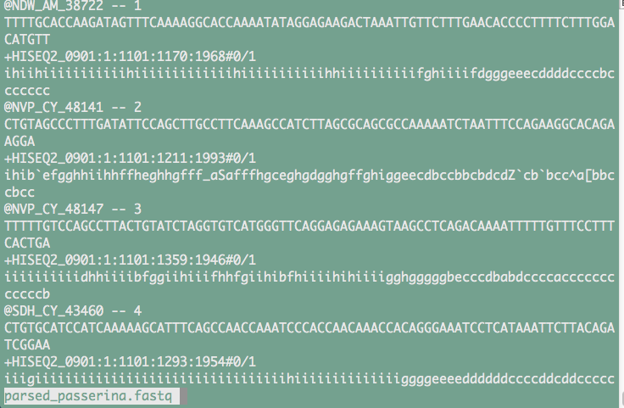
Viewing files (but not editing):
$ less sample_passerina.fastq
q exits, “/” allows you to search for a pattern, space bar scrolls down a page, b goes up a page. See $ man less

Slide 13
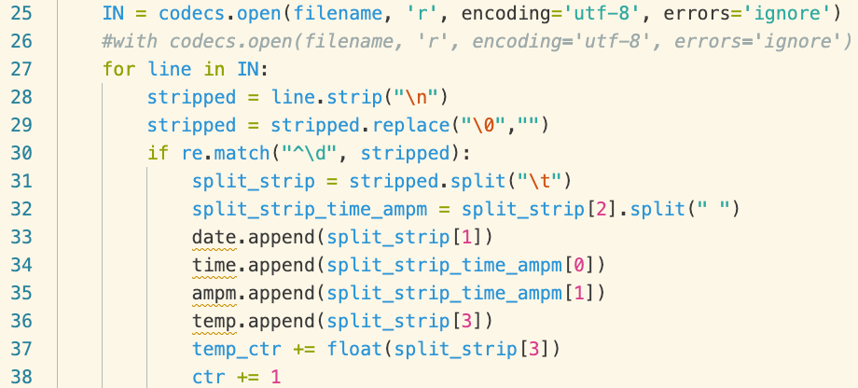
Editing text files outside of the terminal
Text Editors (bbedit, VIM, VScode): good for working on code because they have syntax recognition.
$ open logger.py OR $ open –a TextWrangler simple.sh
I suggest setting whichever text editor you choose as the default for opening .txt files on your machine

Slide 14
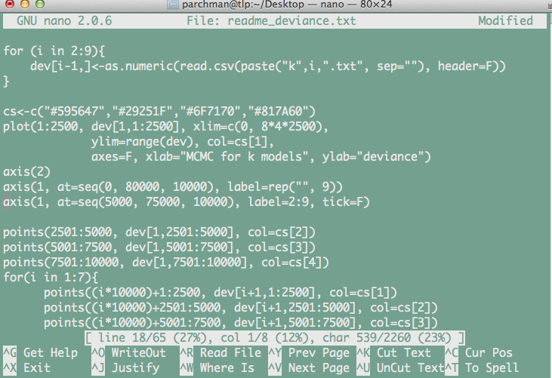
Editing text inside the terminal
Sometimes it will be easier to edit text files from within the terminal (e.g., when you are connected to a remote server or HPC system)
nano: A simple unix text editing program. Learn the basics.

Slide 15
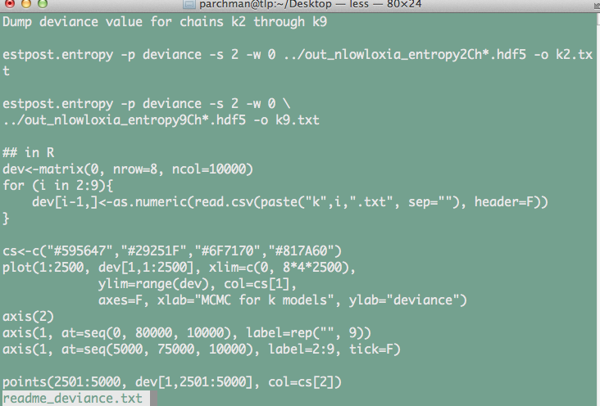
A word on line endings:
While working in Unix and Python you will quickly realize that line endings are themselves characters, although they are hidden
You nearly always want to use UNIX line endings.
Text file with Unix line endings, viewed with less

Slide 16
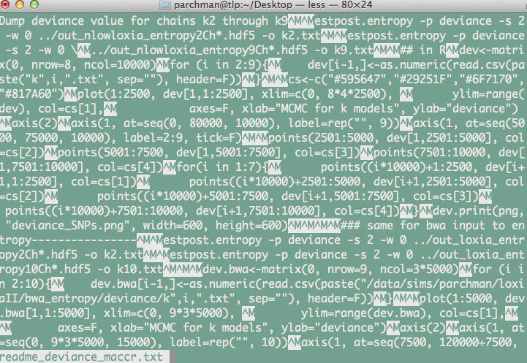
Same file with but with Mac line endings, viewed with less

Slide 17
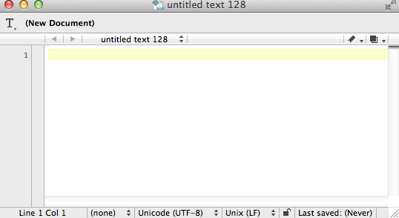
You can change line endings simply in Text Wrangler/BBedit.
- Later we will write a shell script to do this automatically

Slide 18
File compression/decompression
$ gzip sample_passerina.fastq
This will compress sample_passerina.fastq and rename it sample_passerina.fastq.gz
$ gunzip sample_passerina.fastq.gz
This will decompress sample_passerina.fastq.gz

Slide 19
What is STDOUT?
When you execute a unix command, this is what prints to the terminal.
For example:
$ ls
-STDOUT is the printout of directory contents
$ tail file.txt
-STDOUT will be the last part of that file
We will often want to “redirect” (>,>>) that output to another file or “pipe” (|) it into another program

Slide 20
Redirection (>,>>)
$ ls > directory_contents.txt
$ cat *data.txt > loggerdata_alldays.txt
$ cat newdata.txt >> loggerdata_alldays.txt

Slide 21
Other tools for working with text files:
$ cat sample_passerina.fastq #prints entire contents to shell
$ cat sample_passerina.fastq | less #pipes output to less (so you see 1 page at a time)
$ head –n 1000 sample_passerina.fastq #prints first 1000 lines to shell
$ head –n 1000 sample_passerina.fastq > 10000lines.fastq
#writes the first 1000 lines to a new file

Slide 22
grep: regular expression engine, text extraction
- Among the most widely used Unix commands in data science
Works one line at a time for a given file, fast
Returns lines containing pattern matches
The pattern can be an exact pattern, or a flexible regular expression, which we will learn about A LOT more when we start learning python
File contents of fruitlist:
applesauce
apple fritters
peach ice cream
Squash is not a fruit
banana
scrapple
strawberry
Apple festival
$ grep apple fruitlist.txt
Will return all lines containing the pattern match

Slide 23
$ grep [options] <pattern> <file>
$ grep apple fruitlist.txt > applelines.txt
#Will write the lines containing the pattern match to the file “applelines.txt”
$ grep –c apple fruitlist.txt
#Will return the COUNT of the number of lines containing the pattern match
$ grep –V apple fruitlist.txt
#Will return the lines that DON’T match the pattern

Slide 24
Before next week
Make sure you have at least looked at, if not gone through all of the examples in the Bradnam and Korf primer through U27 (http://korflab.ucdavis.edu/Unix_and_Perl/current.html#part1).
2. Feel solid about chapters 4 and 5 in Haddock and Dunn,
have a peek at Chapter 16.
3. Go thoroughly through unixII_primer.md, and
unix_assignment_2.md.
**Note, I won’t ask you to turn anything in this week but may starting next week.

Slide 25
Independent project idea discussion?
Could be as simple as writing python scripts for everyone in the class to have for really simple things
OR
As complex as genome assembly pipeline.

