Slide 1
Week 10
I. Chapter 9/Chapter 10/Chapter 11
II. Working with large numbers of files: input/output
III. More on lists, loops, regular expressions
IV. A real data management problem
python_5_primer.md, assignment_python5.md

Slide 2
Practice script from assignment_python4.md #1
##Initialize variables here, not shown
IN = open(sys.argv[1])
for Line in IN:
Line = Line.strip("\n")
if re.search("^>", Line):
SeqNo += 1
elif re.search("[ATCGN]", Line):
Eco = len(re.findall("GAATTC", Line))
Mse = len(re.findall("TTAA", Line))
Hin = len(re.findall("AAGCTT", Line))
TEco += Eco
TMse += Mse
THin += Hin
print("Total Number of Sequences: %d, EcoRI cut sites: %d, MseI cut sites: %d, HindIII cut sites: %d" % (SeqNo, TEco, TMse, THin))
IN.close()

Slide 3
Practice script from assignment_python3.md #2
IN = open(sys.argv[1])
OUT = open("SSR_out.txt", 'w')
for Line in IN:
Line = Line.strip("\n")
Fasta = Line
Seq = IN.readline()
Seq = Seq.strip("\n")
SeqNo += 1
if re.search("AT{6,}", Seq) or re.search("ATC{6,} ", Seq) or re.search("GA{6,}", Seq):
OUT.write("%s Contains SSR: \n %s \n" % (Fasta, Seq))
AT = len(re.findall("AT{6,}", Seq))
ATC = len(re.findall("ATC{6,}", Seq))
GA = len(re.findall("GA{6,}", Seq))
TAT += AT
TATC += ATC
TGA += GA
print("File has %d AT SSRs, %d ATC SSRs and, and %d GA SSRs \n" % (TAT, TATC, TGA))
IN.close()
OUT.close()

Slide 4
Initializing variables
Variables that need to exist outside and within loops need to be initialized outside of the loop
SeqNo = 0
TAT = 0
For Line in IN:
List = Line.split(“,“)
TAT += List[1]
SeqNo += 1
Created new each time through loop
Initialized outside, grows each time through
Variables assigned within the loop live and die within the loop

Slide 5
I. Input/Output: many files at once
It is often necessary or useful to have the same code executed for many files at once
sys.argv[] is a list of what comes from the command line when you execute your code
$ python3 logger.py file1.txt file2.txt file3.txt .. file100.txt
sys.argv[0]
sys.argv[1]
sys.argv[2]
sys.argv[3]
sys.argv[100]

Slide 6
I. Input/Output: many files at once
sys.argv[1-100] would be a list of 100 file arguments. This can more flexibly be written as sys.argv[1:], which would mean a list from the 1 element to the last element
$ python3 logger.py file1.txt file2.txt file3.txt
import sys
for file in sys.argv[1:]:
print(file)
Should print: file1.txt file2.txt file3.txt

Slide 7
I. Input/Output: many files at once
import sys
for file in sys.argv[1:]:
IN=open(file, 'r')
for Line in IN:
Line=Line.strip("\n")
print(Line)
IN.close()

Slide 8
I. Input/Output: many files at once
Jupyter notebook solution – glob module
import glob
FileList = glob.glob("*.txt")
for file in FileList:
IN=open(file, 'r')
for Data in IN:
Data=Data.strip("\n")
print(Data)
IN.close()
Each file in current directory ending in .txt will go into a list, FileList

Slide 9
READ many files, WRITE many files
Looping through sys.argv, from 1 to end
for file in sys.argv[1:]:
IN=open(file, 'r')
OUT=open("out"+ file, 'w')
for Line in IN:
Line=Line.strip("\n")
OUT.write(Line + "\n")
IN.close()
OUT.close()
Open to read
Open to write, naming files. Done w/in for loop processing files.
Close IN each time through loop
Close OUT each time through loop

Slide 10
READ many files, WRITE to one file
List[]
OUT=open("out.txt", 'w')
for file in sys.argv[1:]:
IN=open(file, 'r')
for Line in IN:
Line=Line.strip("\n")
List.append(Line)
IN.close()
OUT.write(List + ("\n"))
OUT.close()
Open to write, above for loop
Looping through sys.argv, from 1 to end
Building a list, will grow with each line, and with each file
Close IN each time through loop
Close OUT once

Slide 11
This weeks problem
1. Read in 75 files, reformat data, and write to a single outfile
2. Use a loop for sys.argv to read in and work on many many files (one at a time).
- alternatively, you can use the glob (glob.glob) library to process many arguments from within Jupyter notebooks. See primer for this week for a clear demonstration.
3. More work with lists and regular expressions

Slide 12
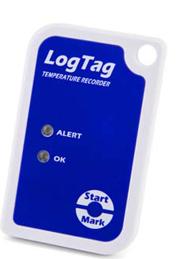
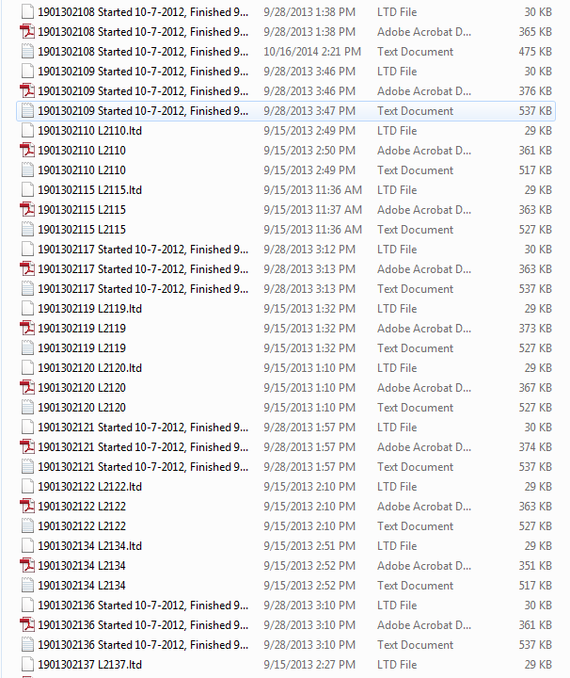
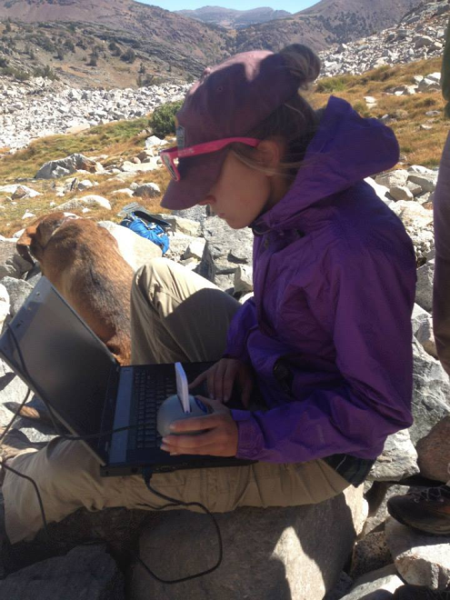
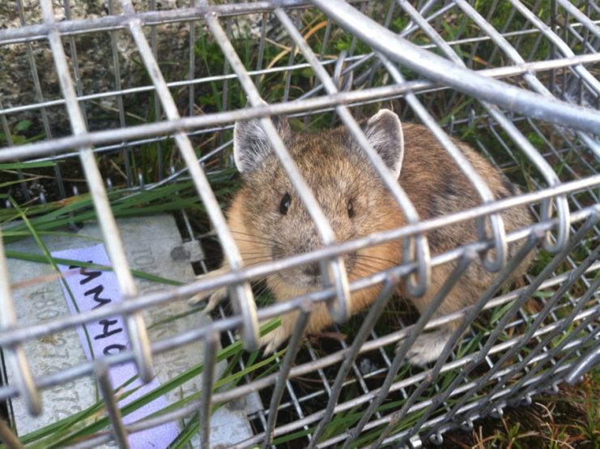
LogTag data
38 Temp Loggers
20 Haypile Locations
2 loggers/ haypile
Measure pika “microclimate”
Record temperature every half hour each year = 13-15,000 readings per year per temp logger
Crashes Excel ---one spreadsheet per logger

Slide 13
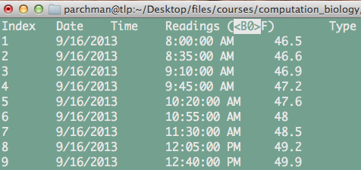
Data and Problem Description
1. 75 files in gzipped directory (logfiles.tgz) can be downloaded from course website.
2. Each file has information in its name that describes the logger information
3. Each file has 4 columns of data that we want to extract. Date, time, AM or PM, and a temperature

Slide 14
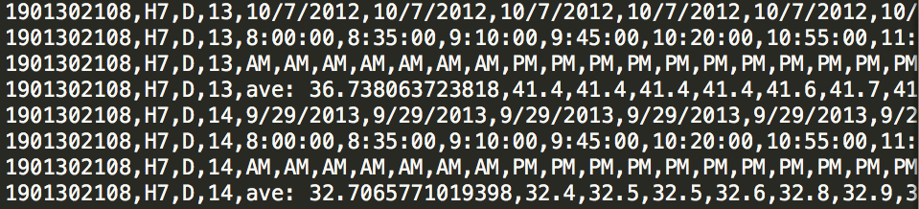
Use regular expression to extract logger information from file name (1901302228_H4_D_13.txt.txt). This could be as simple as:
result = re.sub('.txt.txt', '', Seq)
2. Store data from each of four infile columns into lists for each variable, build those lines each time through a for loop.
3. Write all of the data to a single outfile with 4 rows from each input file, as below
Info from file name
Date
Time
File1
1st 4 lines
AM/PM
Temp
File2
2nd 4 lines

Slide 15
Hints: capturing and storing regular expression matches
Line = "1865878 Colorado"
Match = re.search("(\d+)\s(\w+)", Line)
Digits = Match.group(1)
Letters = Match.group(2)
For a pattern such as “1865878 Colorado”, Match.group(1) would store “1865878” and Match.group(2)would store “Colorado”

Slide 16
Hints: dealing with sinister characters
The data stored from some these loggers has some strange special characters that need to be removed and guarded against. Two things will help.
1. Use a safer option for reading text from these files, with the codecs library
import codecs
for file in sys.argv[1:]:
IN = codecs.open(file, 'r', encoding='utf-8', errors='ignore')
for Line in IN:

Slide 17
Hints: dealing with sinister characters
The data stored from these loggers has some strange special characters that need to be removed and guarded against. Two things will help.
2. There are some problematic special characters in *some* of these files. To guard against them, a line of code as below will work for cleaning these things out of each line in each file.
stripped = stripped.replace("\0","")

Slide 18
For this week
Catch up from last week if needed
II. python_5_primer.md
III. assignment_python5.md
IV. Turn in data management script

Slide 19
Semester through November
Week of 10/29, 10/31 Reading many files at one, data management problem
Week of 11/5, 11/7 Dictionaries
Week of 11/12, 11/14 Numpy and Pandas: Data Science modules
Week of 11/19, 11/21 TBD (git?)
Week of 11/28 independent project work (Tuesday before Thanksgiving).

