Slide 1
Project Materials and Presentations:
Slides
Code
White paper covering goals, what was accomplished, what is still to be done (could all be in a jupyter notebook or R markdown)

Slide 2
Week 13
Pandas: a fast, powerful, flexible and easy to use open source data analysis and manipulation tool
Matplotlib (and seaborn and plotly): plotting and graphics
primer/tutorial on course Github page for week 13
No required assignment (but see assignment_6_python.ipynb)
This week and next: as much time as you need on independent project

Slide 3
Data Science libraries for python: pandas
- Supports 2-d data cleaning, merging, and joining.
- Easy handling of missing data (represented as NaN)
- Powerful group by functionality for performing split-apply-combine operations on data sets (similar to R)
- pandas requires numpy for many operations. Both are core components of SciPy

Slide 4
Installing python numpy and panda libraries
From the command line:
$ pip3 install package_name
$ pip3 install numpy
$ pip3 install pandas
$ pip3 install matplotlib
$ pip3 install seaborn
$ pip3 install plotly
If you get a permissions error:
$ pip3 install --user package_name

Slide 5
Importing libraries
Top of script in python
import os,re,sys (import multiple libraries in single line)
import numpy as np (import package as alias)
from numpy import DataFrame (import only specific function)
Aliases commonly used
import numpy as np
import pandas as pd
import matplotlib.pyplot as plt

Slide 6
Pandas DataFrame
- Two-dimensional data structure - tabular fashion in rows and columns.
- Components: the data, rows, and columns
- easily manipulated, sorted, merged, etc.
- feels similar to dataframe operations in R, but fast for big data

Slide 7
Basic or common pandas operations:
- Reading file to dataframe, writing dataframe to file
- column operations: sub-setting, mathematical operations, extracting
- sorting dataframes
- grouping, aggregating, summary statistics, etc.

Slide 8
Reading file as dataframe:
import pandas as pd df = pd.read_csv('data.csv') print(df)
Writing dataframe to file:
# saving the dataframe
df.to_csv('file1.csv')

Slide 9
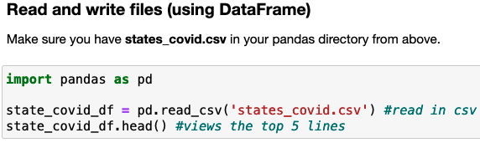
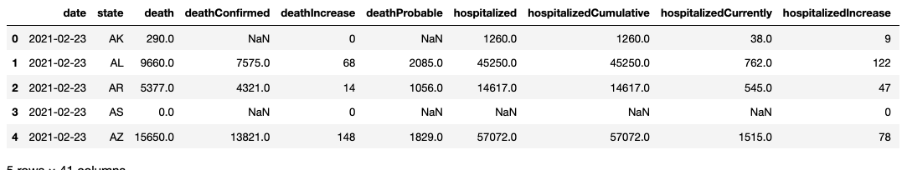

Slide 10
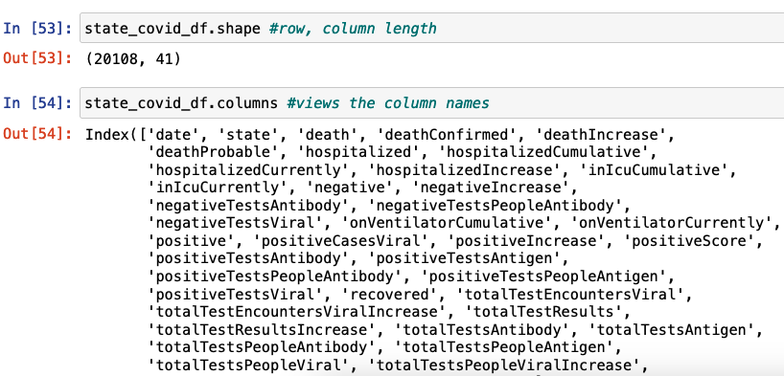

Slide 11
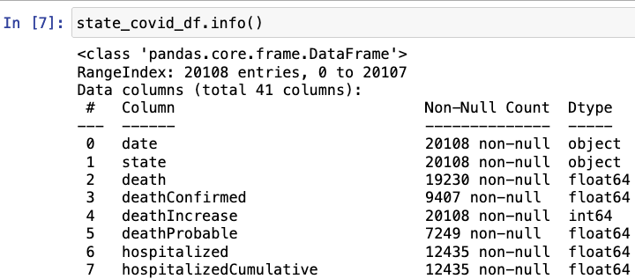
.info() function displays the information on each variable (column).
A useful quality control step to see how variables are being treated on default after creating a dataframe.

Slide 12
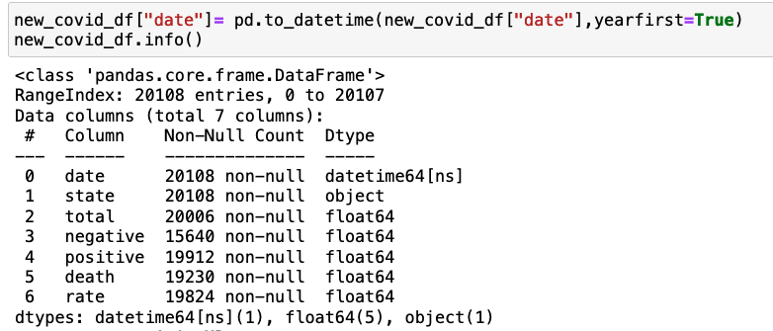
pandas allows manipulation or conversion of dates to more consistent formats. Below is one example of how to convert dates to different formats, and to see how dates are treated
Converting month/day to day of year

Slide 13
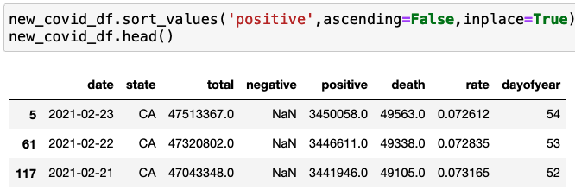
Summarizing data frames
.sort_values(), .unique(), .groupby(), .agg[]

Slide 14

Summarizing data frames
.sort_values(), .unique(), .groupby(), .agg[]

Slide 15
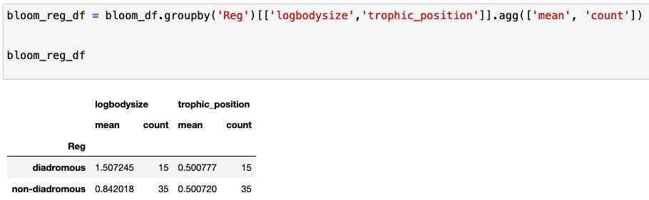
Summarizing data frames
.sort_values(), .unique(), .groupby(), .agg()

Slide 16
Data visualization
- primer_python8_pandas_matplotlibdemo.ipynb covers some examples of data visualization, using states_covid.csv
- Three libraries to give a try:
matplotlib
seaborn
plotly.express

Slide 17
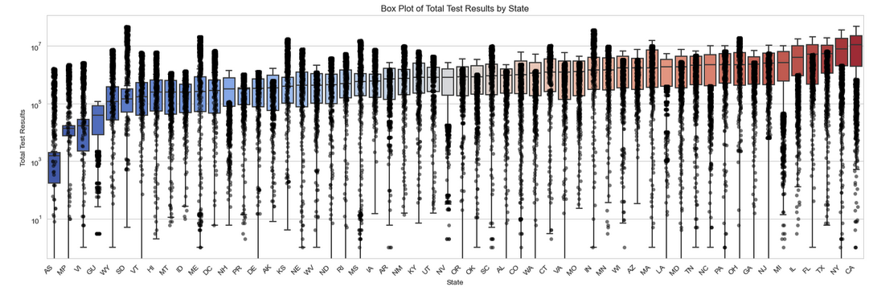

Slide 18
This week
primer_python8_pandas_matplotlib.ipynb
Progress on on independent projects (more important?)
** Presentations start next Thursday (with one early go on Tuesday)

