Slide 1
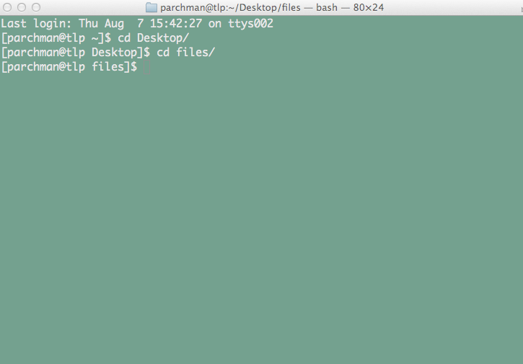
Introduction to Linux
Moving around directories, making files and directories, moving files around, etc.
Work through introductory tutorials

Slide 2
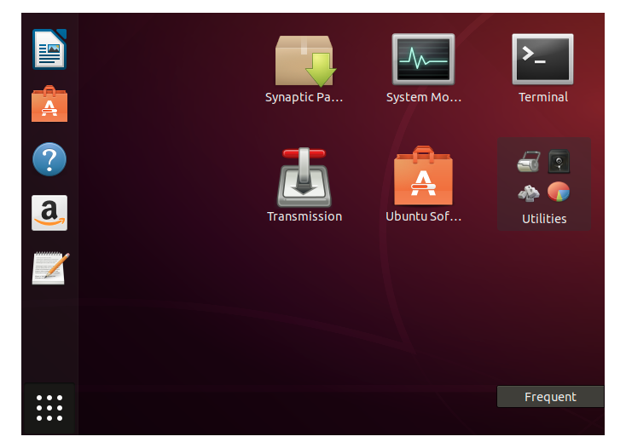
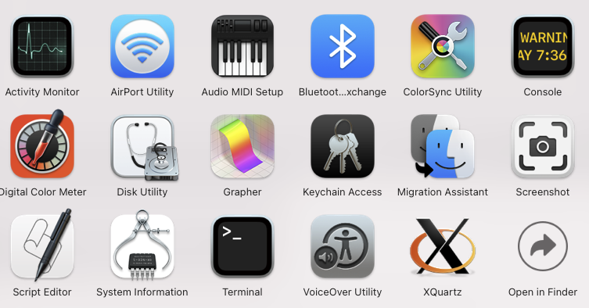
Introduction to the Unix terminal
Applications -> Utilities
Ubuntu Application list
Put a link somewhere to make opening this quick, as you will use it for everything in this course (add it to dock on a mac)

Slide 3
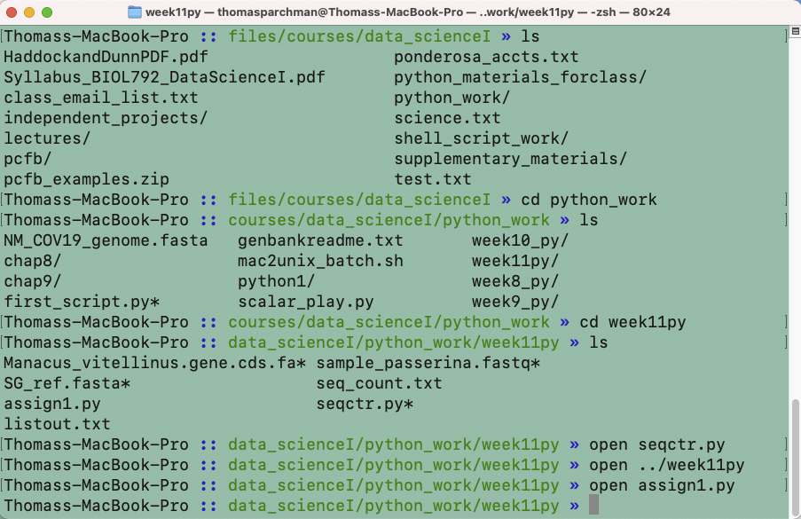
- make the text larger/smaller (hold down ‘command’ and either ‘+’ or ‘–’)
- have multiple terminal windows on screen (see the ‘Terminal’ menu)
- have multiple tabs open within each window (again see the ‘Terminal’ menu)
- Command ‘N’ to open additional windows

Slide 4
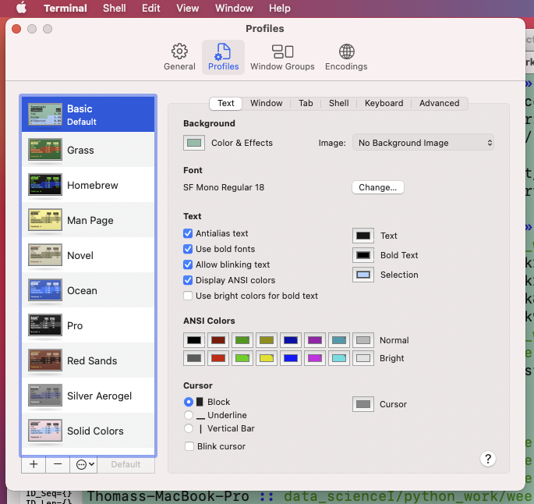
Customize Terminal
Background color,
text size, font, color, etc.

Slide 5
Unix terminal can be used for nearly everything
Moving, copying, removing, organizing and analyzing data
Running programs (we will run Python scripts from the terminal)
Connecting to other computers and networks.
Virtually anything else you can imagine.
** All Linux commands work from the prompt
There are tens of thousands of commands, depending on the system you are using.

Slide 6
By the end of the next 3-4 weeks you should be comfortable with:
Navigating throughout the directory structure.
Copying, moving, removing, and syncing files and directories between locations on your computer, and on external drives (connecting to remote locations will come later).
Using basic Linux commands to manipulate data.
- pattern matching, extracting information from large files, splitting files, concatenating files, and many other useful applications.
4. Use Linux to observe and control processes.
5. Write bash scripts to automate useful Linux (programs made up of Linux commands).

Slide 7
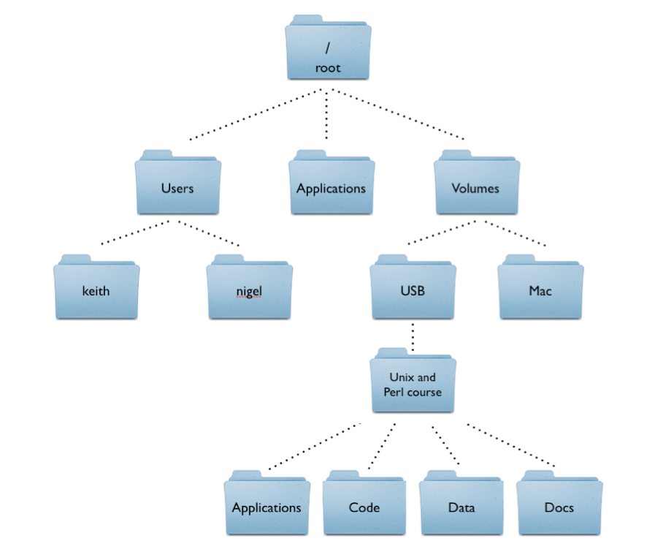
Unix directory structure
Root: indicated with a forward slash
/Users
/Users/keith

Slide 8
Introduction to Unix commands:
Listing the content of directories
“$” refers to the terminal prompt
$ ls
Lists directory contents
$ pwd
This will tell you the path to the directory you are in.
“print working directory”
As you learn Unix you will frequently type commands that don’t work. Commonly, this will be because you are in the wrong directory. You will use the pwd command a lot.

Slide 9
Unix Commands
Unix commands are short: less typing
Unix commands have command line options, or arguments
$ ls –l
will list directory contents along with other information
For example:
-rwxr--r--@ 1 parchman staff 5680 May 19 11:40 filter.sh*
drwxr-xr-x 7 parchman staff 238 Jun 2 13:10 lgc/
drwxr-xr-x 4 parchman staff 136 Jul 2 10:01 new_citations/
-rw-r--r--@ 1 parchman staff 413 Jun 11 14:54 queue.txt
-rw-r--r--@ 1 parchman staff 2260 Jun 30 13:45 readme_deviance.txt
drwxr-xr-x 22 parchman staff 748 Jul 8 10:21 ship/
drwxr-xr-x 11 parchman staff 374 Jun 9 20:41 xbill_BWA/

Slide 10
Introduction to Unix commands:
Change directory (cd) $ cd directory_name
$ cd ../
moves up one level
$ cd ../../../
moves up three levels
$ cd ~/Desktop/files/courses
move to courses directory
$ cd ~
moves from anywhere to home directory
$ cd /
move from anywhere to root
$ cd .
“.” means current directory.

Slide 11
Introduction to Unix commands:
Making, renaming, copying, moving files
$ touch filename.txt
creates a file
$ cp file destination (e.g., $ cp filename.txt ~/BIOL792/)
Copies a file to the directory specified
$ mv file destination (e.g., $ mv filename.txt ~/BIOL792/)
Moves a file to the directory specified

Slide 12
Introduction to Unix commands:
Making, renaming, copying, moving directories
$ mkdir directory_name
creates a directory
$ rmdir directory_name
Removes the directory specified. **** DANGER
$ mv directory destination
Moves a directory to the directory specified

Slide 13
Unix_cheat_sheet.pdf
Under unix_resources on course github page

Slide 14
A word on typing less:
Tab complete will save you most of the typing time at the terminal. Once a directory, file, or program name has been typed to the point of being unique, hitting tab will complete the text. THUS, you do not need to type out things all of the way.
Tab complete will save you time AND will prevent you from mis-typing commands, directory and file names incorrectly
*Play around with this immediately while working through the tutorial and worksheets this week

Slide 15
Shortcuts for moving faster from the command line
(Your mouse is useless).
Up and Down arrows will allow you to scroll through previous commands that have been typed from the terminal. This will be very useful..
You can not use your mouse to move the terminal cursor.
- “control a” will move the cursor to the start of what you have typed.
- “control e” will move the cursor to the end of what you have typed.
- “control l” will clear the window
Try these as you work through the tutorial today

Slide 16
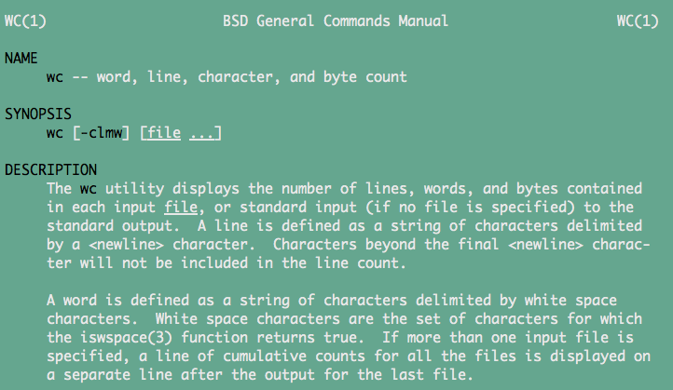
Manual (man) pages exist for every Unix command
List of command line options, and a synopsis of how the program works
- “man” is the unix command for opening the manual page
$ man wc
Opens the manual page for wc using the Unix text viewer less

Slide 17
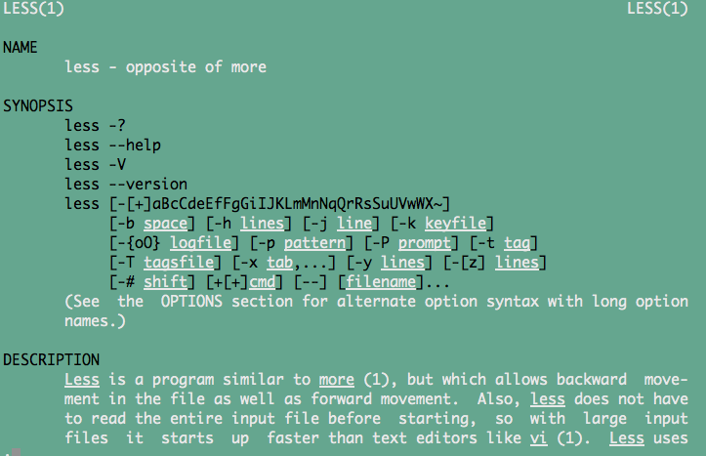
man (manual) pages
$ man less
Manual for less, a unix program for looking into files

Slide 18
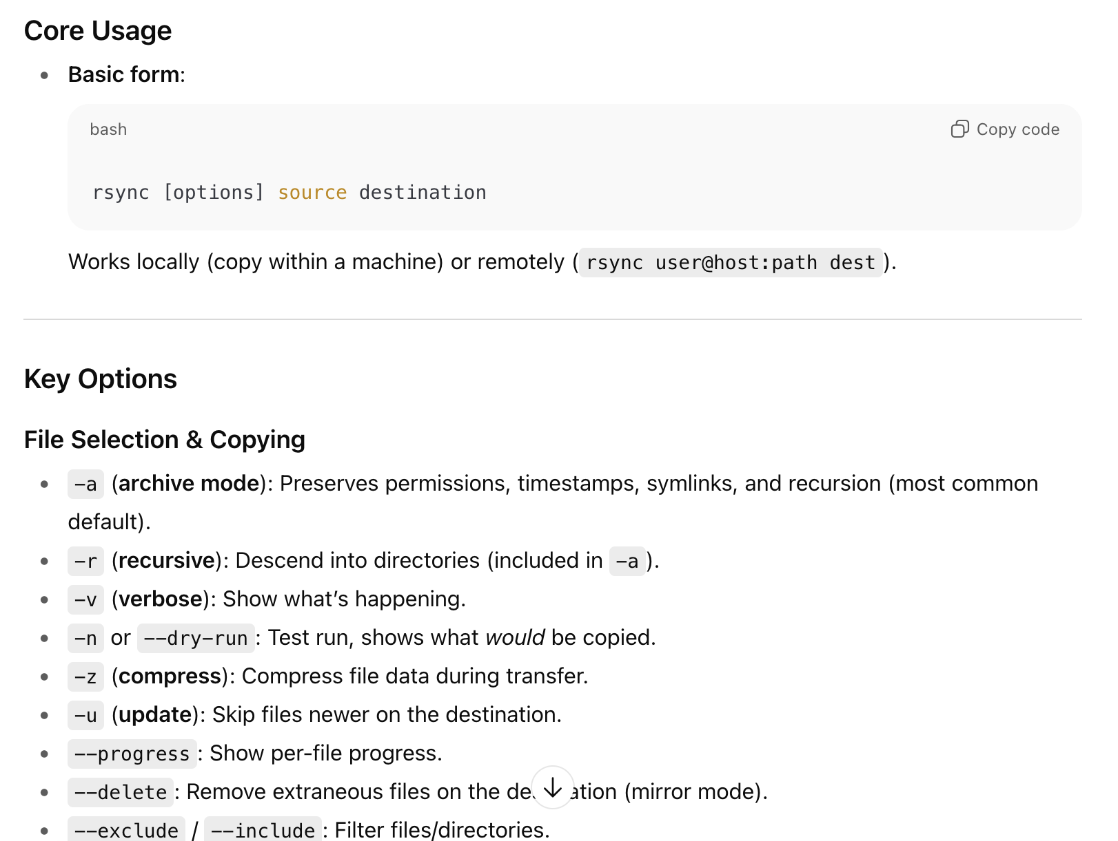
Online manual pages, and ChatGPT in particular, provide very useful summaries of these man pages.

Slide 19
In class today:
Review unixI_primer.md under week1_unixI
Work through unix_assignment1.md, follow links to tutorials at end..
-For the unix_assignment1.md tutorial, you will want to download sample_passerina.fastq and science.txt from the the course github page, under week1.
Before next Tuesday:
Be sure to 1. have Linux set up in a way that works for you 2., download a text editor, 3. explore resources in primers – find what will be most useful for you.
- Work through primer, start getting comfortable with navigation and file operations, look ahead at week2 materials.

Slide 20
Other useful resources for getting started
- Unix cheat sheets, and guides under “unix_resources” on course site
- Useful primer from "Unix and Perl to the Rescue", by Bradnam and Korf. For this course (http://korflab.ucdavis.edu/Unix_and_Perl/current.html) is hard to beat.
- Also, please have a look at the excellent tutorial from software carpentry (http://swcarpentry.github.io/shell-novice/).For this week and next, follow steps 1 through 3.

Slide 21
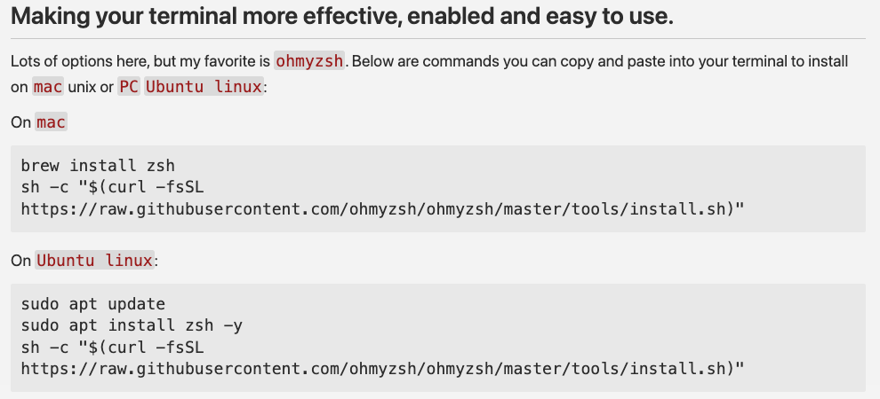
See portion of primer on terminal customization/improvement

