Slide 1
Week 13
I. Dictionaries (see python for biologist’s dictionary tutorial)
II. More on arrays, loops, regular expressions
III. A few scripts using dictionaries
primer_dictionaries.ipynb, dictionary_week_assignment.ipynb

Slide 2
Dictionaries: fast storage and retrieval of paired data
Data structures that store pairs of objects. Each item in a dictionary contains a key : value pair.
Items are unordered, values are looked up by their keys
Accessing information in dictionaries is MUCH faster than accessing information in lists.

Slide 3
Building Dictionaries
Key : value pairs are listed within curly brackets. Can be any types of scalar (string, digit, float)
book = {'Ken':'25998','Mick':'3544', 'Jen':'9875'}
For text within curly brackets, python’s indentation rules are relaxed. Below is much easier to read.
book = {
'Ken':'25998’,
'Mick':'3544’,
'Jen':'9875’
}

Slide 4
Accessing values from keys
book = {
'Ken':'25998’,
'Mick':'3544’,
'Jen':'9875’
}
Name of dictionary, followed by key in square brackets returns the value associated with that key
Ken_value = book['Ken'] # assigns 25998 to Ken_value
print (book['Ken']) # prints 25998

Slide 5
Dictionary methods
.keys() returns a list of keys
.pop() removes a value for a specified key.
.get() gets a value, similar to Dictname[keyname]
.values() returns a list of values
.items() returns items (key value pairs)

Slide 6
Dictionary methods
Klist=Ctemp.keys() # returns a list of keys
for K in Klist:
print(K) ## prints keys
Vlist=Ctemp.values() # returns a list of values
for V in Vlist:
print(V) ## prints values
print(Ctemp.pop(key)) # removes value and specified key from dictionary, and returns

Slide 7
Building Dictionaries with real data
>scaffold_99995
TCAGAATCTTGCTACTCATGAACGTATGTTGGGGATCCTTCTATGACCCTATGGCTGAGGTAGAG
>scaffold_99996
AAAGCAAGAATGAAGAGGTAGGGGCTGGAGAGTTCTTTTACTATAACAGTCAGACCAAAAAAA
>scaffold_99998
TGTAATACTTCAGGCCAATTTCTACAGTAAATTGAGCGCATTCAGCACAACCAAGTGCAGCCAGC
Data format in hypothetical .fasta file
ID_Seq={} # initializing the ID_seq dictionary
for Line in IN:
ID = Line.strip('\n’)
Seq = IN.readline()
Seq = Seq.strip('\n’)
ID_Seq[ID]=Seq # building the ID_seq dictionary
#WORK ON DICTIONARY OUTSIDE OF LOOP

Slide 8
Iterating through dictionaries
Loop through by key
for thing in ID_Seq.keys():
print(thing)
print(ID_Seq[thing])
Each iteration through the loop above, "thing" is assigned a key. Hence, the code will print each key followed by its value on the following line.
Each key assigned to ‘thing’ within loop
The value associated with each key

Slide 9
Iterating through dictionaries, sorted by key
Loop through by sorted keys
for thing in sorted(ID_Seq.keys()):
print(thing)
print(ID_Seq[thing])
Each iteration through the loop above, "thing" is assigned a key. Hence, the code will print to screen each key followed by its value on the following line.
Each key assigned to ‘thing’ within loop
The value associated with each key

Slide 10
Iterating through dictionaries, by item
Loop through dictionary
for key, value in ID_Seq.items():
print(key)
print(value)
Each iteration through the loop above, "thing" is assigned a key. Hence, the code will print to screen each key followed by its value on the following line.
Each key assigned to ‘thing’ within loop
The value associated with each key, variable name assigned in for statement

Slide 11
Nested Dictionaries: Dictionaries of dictionaries
Bengals = {'Offense': {9: 'Burrow', 1: "Chase", 83: "Boyd", 75: "Brown", 5: "Higgins"},
'Defense': {29: 'Taylor-Britt', 55: "Wilson", 20: "Turner", 21: "Hilton", 33: "Scott"}}
# Accessing element using key
print("Offense dict: ", Bengals['Offense'])
print("Offense, number 1: ", Bengals['Offense'][1])
print("Defense, number 29: ", Bengals['Defense'][29])

Slide 12
Why Dictionaries are useful in Bioinformatics
Genomic data is often inherently ”keyed”
Fast lookup of biological entities (genes, transcripts, samples)
Flexible storage for complex annotations and metadata
Human-readable keys that reflect biological meaning
- Natural fit for hierarchical biological data (genome → chromosome → gene → exon)

Slide 13
Common Dictionary Patterns in Bioinformatics
Gene → metadata (coordinates, product, GO terms)
Chromosome → list of features (genes, CDS, repeats)
Transcript → exons (hierarchical relationships)
Sequence ID → sequence (FASTA headers → DNA/protein)
Feature type → count (CDS, intron, ncRNA, TE)
Sample → summary statistics (coverage, read counts, expression)

Slide 14
Counting the number of times a list of things occurs
@NDW_AM_38722 -- 1
TTTTGCACCAAGATAGTTTCAAAAGGCACCAAAATATAGGAGAAGACTAAATTGTTCTTTGAACACCCCTTTTCTTTGGACATGTT
+HISEQ2_0901:1:1101:1170:1968#0/1
ihiihiiiiiiiiiiihiiiiiiiiiiiiihiiiiiiiiiiihhiiiiiiiiiifghiiiifdgggeeecddddccccbccccccc
@NVP_CY_48141 -- 2
CTGTAGCCCTTTGATATTCCAGCTTGCCTTCAAAGCCATCTTAGCGCAGCGCCAAAAATCTAATTTCCAGAAGGCACAGAAGGA
+HISEQ2_0901:1:1101:1211:1993#0/1
ihib`efgghhiihhffheghhgfff_aSafffhgceghgdgghgffghiggeecdbccbbcbdcdZ`cb`bcc^a[bbccbcc
@NVP_CY_48147 -- 3
TTTTTGTCCAGCCTTACTGTATCTAGGTGTCATGGGTTCAGGAGAGAAAGTAAGCCTCAGACAAAATTTTTGTTTCCTTTCACTGA
+HISEQ2_0901:1:1101:1359:1946#0/1
Iiiiiiiiiidhhiiiibfggiihiiifhhfgiihibfhiiiihihiiiigghgggggbecccdbabdccccaccccccccccccb
In this file: 192 samples (birds), 25,000,000 DNA sequences
How many sequences are there for each individual bird?

Slide 15
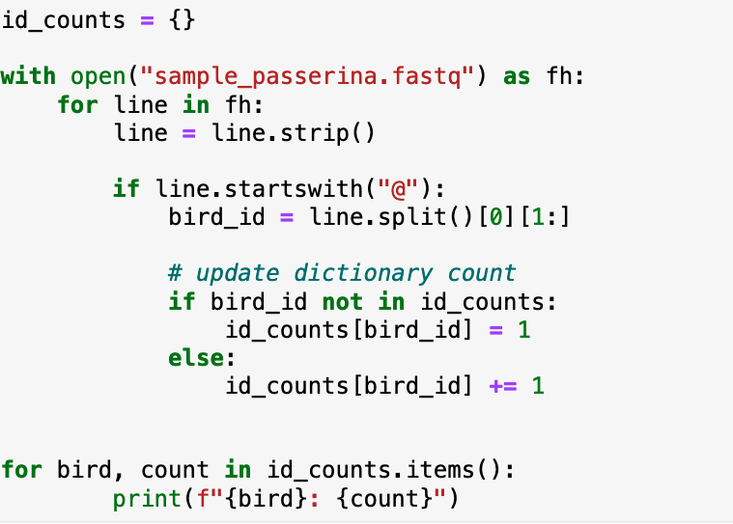
Counting the number of times a list of things occurs

Slide 16
For this week
I. Breathe
II. python_6_primer.ipynb
III. assignment_python6.md
IV. Turn in data management script

Slide 17
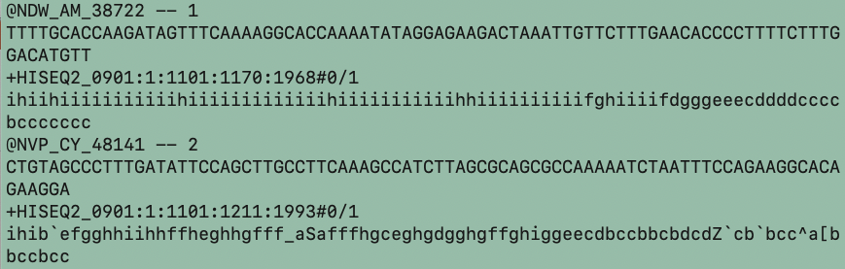
assignment_python6.md
1. Task one: build a dictionary from real data, use some dictionary functions to do stuff. Learn practical usage to apply generally.
2. Bonus: build a dictionary to count the number of sequences for each individual in sample_passerina.fastq. This file has many sequence reads for 192 birds.

Slide 18
Make individual ids as keys in a hash, figure out how to increment values, so that each time you hit the same key, the value goes up by one.
So, once the dictionary is built, you can loop through it and print each unique ID and the number of sequences it has in the file:
for id, count in ID_seq.items():
print(“ID: %s COUNT: %d” % (id, count))

Slide 19
Semester through November
Week of 10/27, 10/29: Reading many files at one, data management problem
Week of 11/5, 11/7 Dictionaries
Week of 11/12, 11/14 Numpy and Pandas: Data Science modules
Week of 11/19, 11/21 more Pandas
Week of 11/26 open day, independent project work

