Slide 1
BIOL792 – Week 11, python 7
Useful data science libraries for python
primer_python7_numpy_pandas_partI.ipynb
- numpy introduction
  - pandas introduction
III. Optional assignment_6_python.md & answers (for week 13)

Slide 2
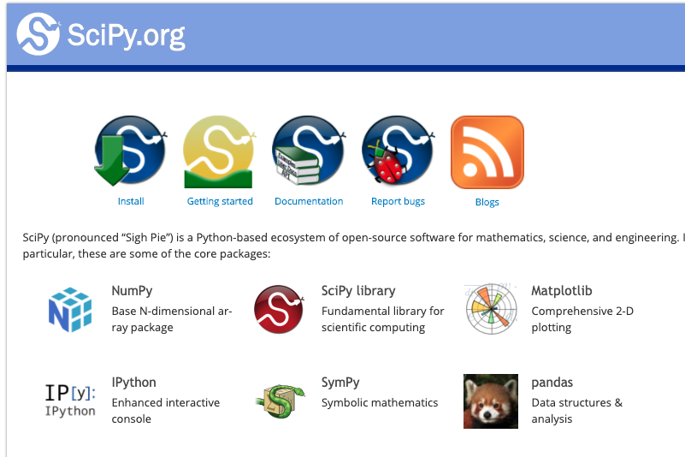
Python libraries
(137,000 estimated)

Slide 3
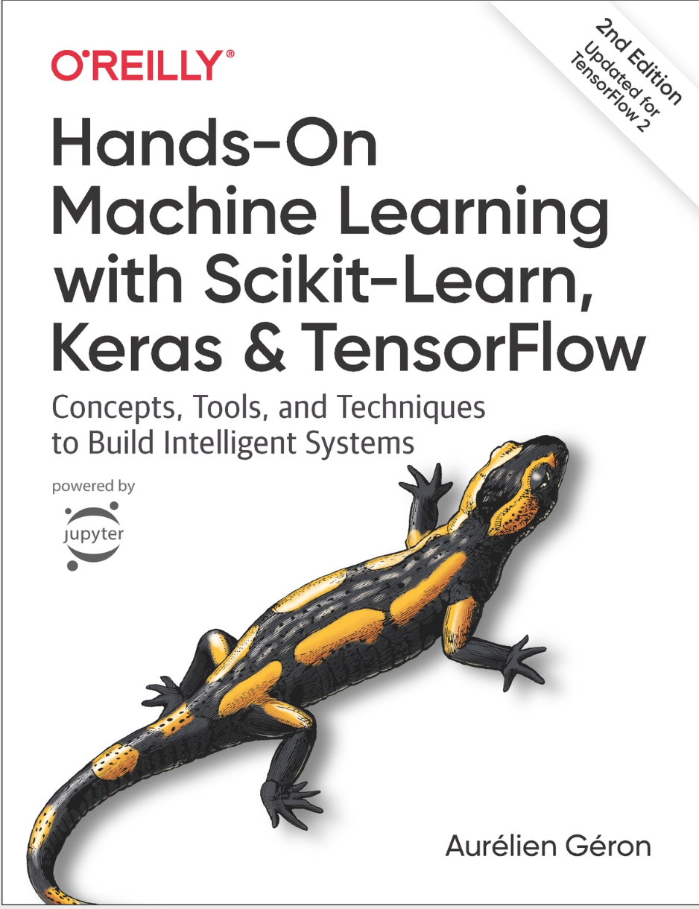

Machine Learning
Tensor Flow
Keras
Scikit-learn

Slide 4
NumPy: Numerical Computing with Python
Fast, efficient operations on arrays of numerical data
- ndarray: a data structure for storing and manipulating multidimensional arrays.
- Arrays can be one-dimensional, two-dimensional (matrices), or higher-dimensional.
- Efficient mathematical operations on arrays without writing explicit loops.
- functions for statistics, random number generation, algebra, and more.
- foundation for other Python libraries, including pandas and SciPy.

Slide 5
pandas: Working with Tabular Data
pandas: Python library designed for working with structured data, particularly tables with rows and columns.
DataFrame: a 2-dimensional data structure similar to a spreadsheet or R data frame.
Built on NumPy and integrates closely with NumPy arrays.
Provides tools for:
  Selecting, filtering, and modifying rows and columns.
  Handling missing data (NaN).
  Summarizing, grouping, and merging datasets.

Slide 6
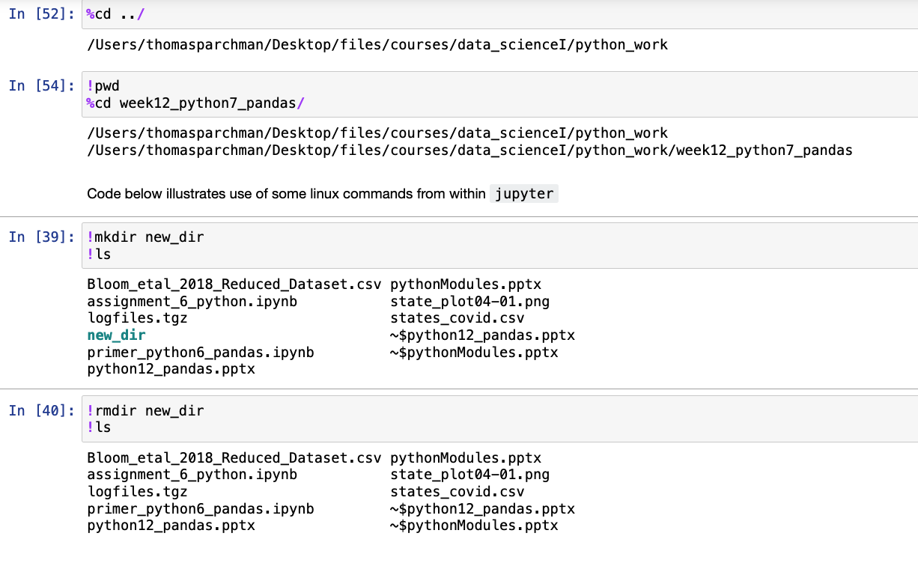
Running Shell Commands in Jupyter Notebooks
Combining Linux commands and Python in one environment
! before most commands
% before some

Slide 7
Installing python numpy and panda libraries
1. Installing with conda (recommended for this course)
conda activate
conda install numpy
conda install pandas
conda install matplotlib
2. Or, install with pip
pip3 install --user package_name

Slide 8
Importing libraries
Import entire libraries:
import os
import re
import sys
import os,re,sys (import multiple libraries in single line)
Import with alias to condense code (standard for pandas, numpy, etc):
import numpy as np
import pandas as pd
import matplotlib.pyplot as plt

Slide 9
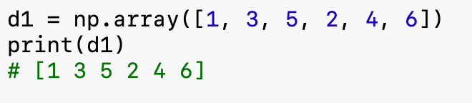
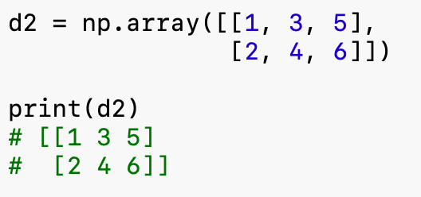
NumPy basics: Creating arrays
The ndarray is NumPy’s fundamental data structure
NumPy arrays store numerical data in one or more dimensions.
support fast mathematical operations across many values simultaneously.
We create arrays using np.array()
NumPy
NumPy
1. One-dimensional array (1D):
2. two-dimensional array (2D):

Slide 10
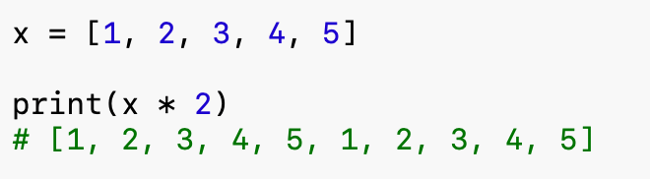
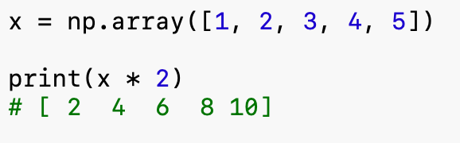
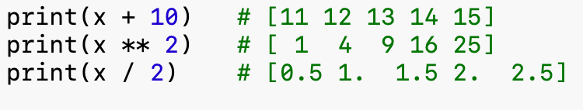
Python Lists vs. NumPy Arrays
1. Python lists
2. Numpy array
Multiplication operates on each element of the array.
Other operations:

Slide 11
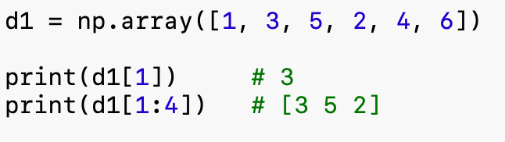
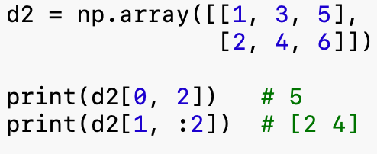

NumPy basics: Indexing and slicing arrays
Accessing elements of a 1-d array:
Accessing elements of a 2-d array:
Selecting entire rows or columns

Slide 12
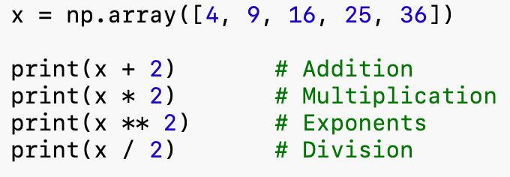
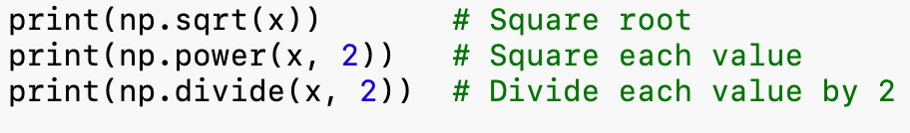
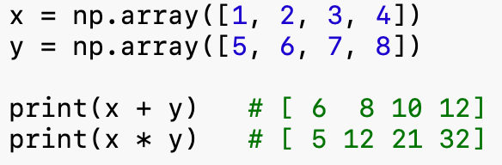
NumPy basics: Mathematical operations:
Basic mathematical operations:
Basic mathematical operations:
Operations between arrays:

Slide 13
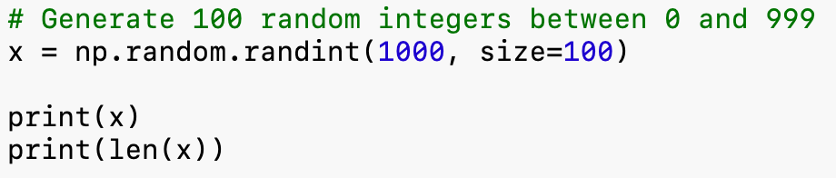
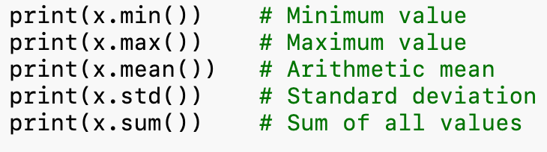
Numpy basics: Random numbers and summary stats:
Generating random numbers:
Summary statistics:
NumPy function | Description | Example
np.random.randint() | Random integers | np.random.randint(100, size=10)
np.random.random() | Random floats between 0 and 1 | np.random.random(10)
np.random.normal() | Random values from normal distribution | np.random.normal(0, 1, 100)

Slide 14
NumPy Basics: Iterating Over Arrays
Iterating:
arr = np.array([[1, 2, 3], [4, 100, 150]])
for x in arr: # doesn’t matter if array is 1d or 2d
print(x)
Iterating over 1 column in a 2d array:
for x in arr[0:,2]:
print(x)

Slide 15
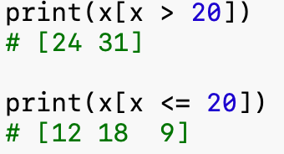
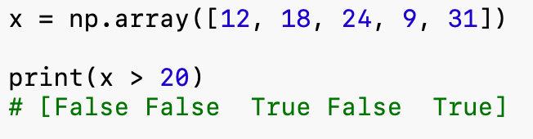
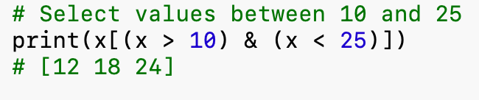
NumPy Basics: Boolean Indexing and Filtering
Boolean array:
Filtering with conditions:
Multiple conditions

Slide 16
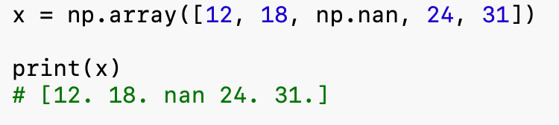
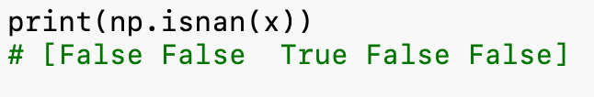
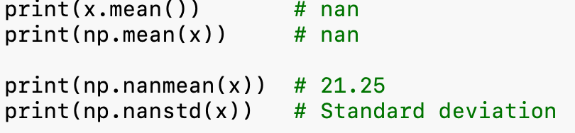
NumPy basics: Missing data
1. Representing missing values
NumPy uses np.nan (Not a Number) to represent missing numerical observations.
2. Identifying missing values
3. Missing values affect calculations

Slide 17
NumPy basics: reading and writing nparrays
Reading from files into ndarray format:
x2d = np.loadtxt("muricata_pops_lat_long.csv", delimiter=",")
print(x2d)
Writing numpy formatted arrays to files:
arr = np.array([[1, 2, 3], [4, 100, 150]])
np.savetxt("np_savetxt_test.txt", arr)
NumPy method | Description | Example
np.loadtxt() | Read numerical data from text/CSV files | np.loadtxt("data.csv", delimiter=",")
np.genfromtxt() | Read numerical data, including missing values | np.genfromtxt("data.csv", delimiter=",")
np.savetxt() | Write arrays to text/CSV files | np.savetxt("output.csv", x, delimiter=",")

Slide 18
Pandas DataFrame
- Two-dimensional data structure - tabular fashion in rows and columns.
- Components: the data, rows, and columns
Reading file as data frame:
import pandas as pd
df = pd.read_csv('data.csv')
print(df)

Slide 19
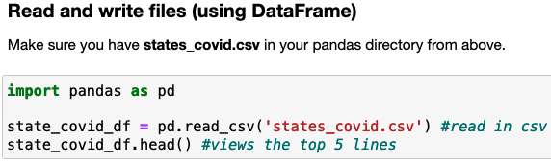
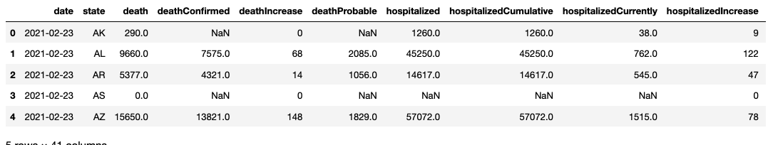

Slide 20
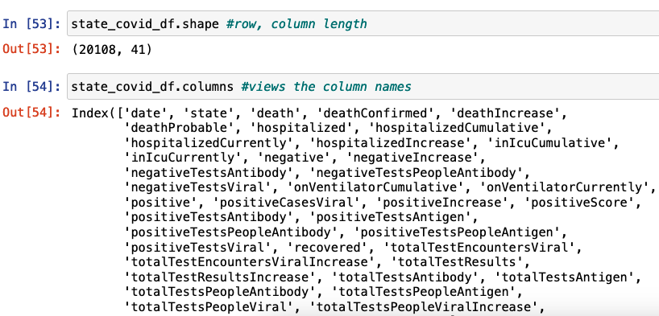

Slide 21
This week
primer_python6_numpy_pandasI.ipynb
We will continue with pandas, including more in depth demo and optional assignment next week
Progress on on independent projects

