Slide 1
Week 6: Getting started in python
I. Scalar types: strings, floats, integers
II. String functions
III. Type conversion
IV. f-strings
V. Interactive Python/Jupyter
VI. input()
For this week:
Python_I_primer.ipynb,
assignment_python1.md

Slide 2
First python script
#!/usr/bin/env python3
#this is a comment: testing my first program with a simple print statement
print ("I’m ready to learn python, and this is step 1")
From the command line:
$ python first_python.py
OR
$ chmod u+x first_python.py
$ ./first_python.py

Slide 3
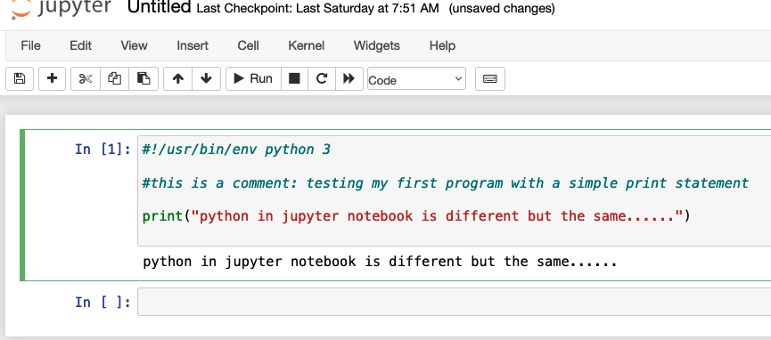

Slide 4
Three ways to run python
Same code, used in different environments
1. Python scripts (.py)
Write and save a complete program, run it from the terminal
python3 my_script.py
2. Interactive Python
Start Python from the terminal or Ipy and execute commands one at a time.
python3
>>> seq = "ATGCGTA"
>>> len(seq)
3. Jupyter notebooks**
Run Python in code cells, with code, output, and explanatory text together.

Slide 5
Scalars: strings
Assigning strings to variables (requires single or double quotes):
team = "lakers"
seq_one = "actgaaa"
seq3 = 'atcGGGC' # single or double quotes
val = '11.2' #something that looks like a float
sentence = "Joe Burrow is the real deal"

Slide 6
Scalars: built in string functions/methods
string_name.functionname
team = "lakers"
cap_team = team.upper() #change lakers to LAKERS
seq_one = "actgaaa"
new_seq = seq_one.replace('a', 't') # replaces a with t
new_seq = seq_one.count('A') # returns a count of match

Slide 7
Scalars: built in string functions/methods
StringName.functionname
seq = " atgctagCGATCGGctaacggttATGC \n"
seq = seq.strip()
seq = seq.upper()
print(seq)
.strip() strips specified character(s) from string. Default will strip whitespace. Commonly used to strip line endings:
seq = seq.strip("\n")

Slide 8
Scalars: built in string functions/methods
Turning Strings into data (or lists) with .split()
data = "wolf,12,24.5,Nevada"
fields = data.split(",”)
print(fields)
The above will return a list, which can then be controlled in a loop:
['wolf', '12', '24.5', 'Nevada']

Slide 9
Scalars: integers and floats
Integers: whole numbers (1, 3, 7, -99)
dig1 = 13 # no quotes for integers
dig2 = '111' # quotes make this a string
type(dig2) # will return var type, float in this case
Floats: ' floating’ decimal point (simply means there is a decimal)
F1 = 1.3333 # no quotes for floats
F2 = '.111' # quotes make this a string
F3 = float(F2) # float function converts to float

Slide 10
Formatting Output with f-strings
Combine text and variables to create clear, readable output
name = "Lebron"
points = 38
print(f"{name} scored {points} points")
value = 2 / 3
print(f"Value = {value:.3f}")

Slide 11
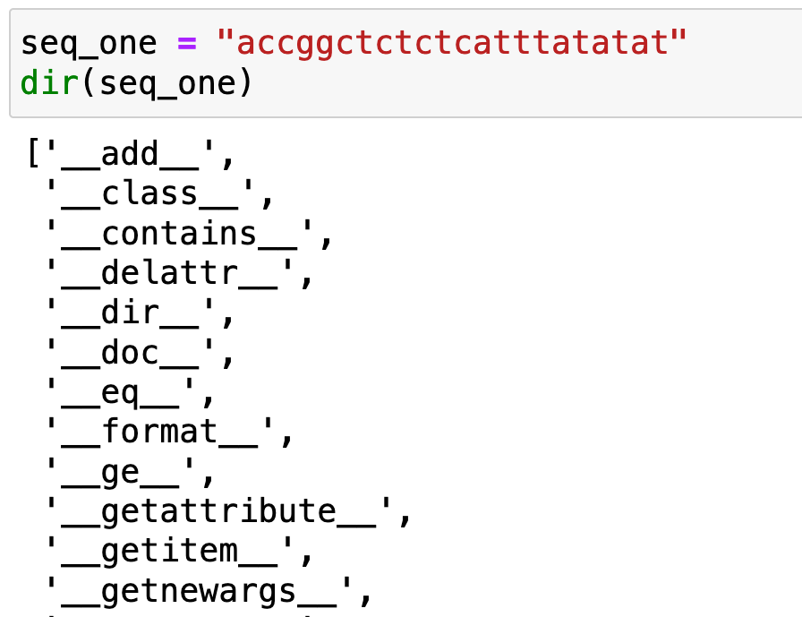
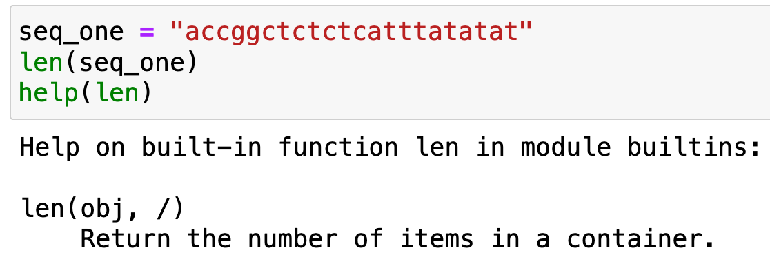
Exploring python: type(), help() and dir()
What is an object, and what can I do with it?
What is it? | What can it do? | How does it work?
type() | dir() | help()
Identify the type of an object | See available methods | Learn how a method works
type(seq) | dir(seq) | help(seq.count)
To change type of an object, you can apply:
float(var)
string(var)
int(var)

Slide 12
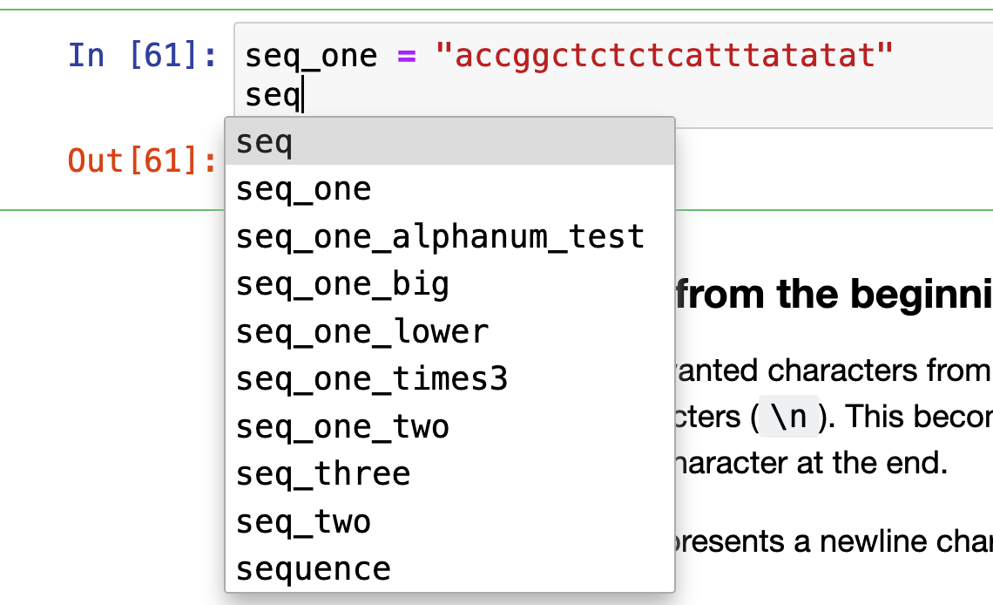
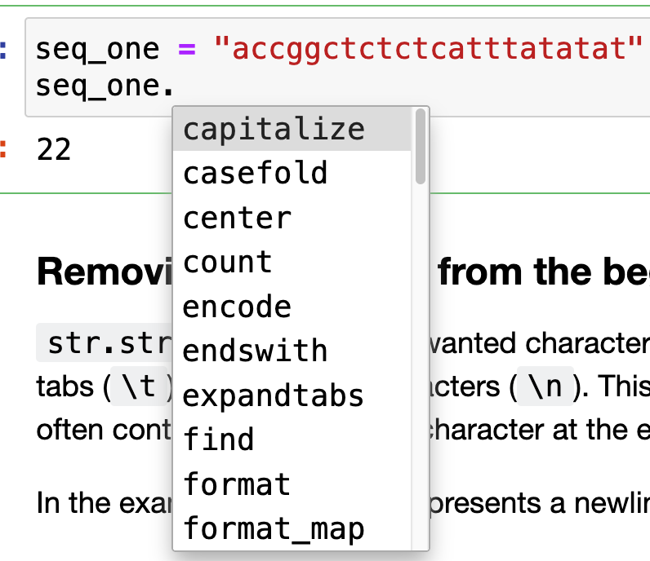
Jupyter: tab autocomplete helps a ton
List stored variables:
List methods by variable type:

Slide 13
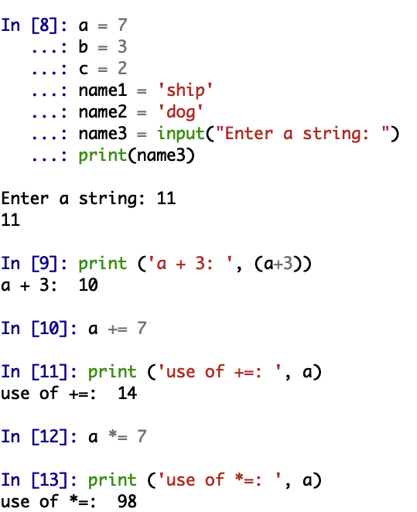
Interactive python: Ipy console
Launch Jupyter Qtconsole from Anaconda navigator
Functions dually as a terminal window and python interactive prompt, tab complete functionality

Slide 14
Pulling raw input from the command line (input())
In Python:
name3 = input("Enter a string: ")
print(name3)
At command line prompt:
‘Enter a string: ‘ prompt will appear at command line. Type a string
If ‘Burrow’ is typed and Enter hit,
‘Burrow’ should print to screen

Slide 15
Practice script 3. Write a python script to calculate expected genotype frequencies in a population under Hardy Weinberg Equilibrium based on known allele frequencies at a gene with TWO alleles. As a reminder, a population under Hardy-Weinberg equilibrium has genotype frequencies predictable from allele frequencies (p and q):
p**2 + 2pq + q**2 = 1
So, your script needs to return three values: The AA genotype freq: p**2
The Aa genotype freq.: 2pq
The aa genotype freq.: q**2 = 1)
Points (hints)
The program should use the input() function to prompt a user to enter a value for p (or q) from the command line.
A value provided from command line will be treated as a string. So, before doing math you will need to convert to float (A = float(Inputvalue))
As part of this exercise, you will need to control the precision of the floats printed (e.g., using f-string)

Slide 16
This week:
python_1_primer.ipynb
assignment_python1.md
  Email me jupyter notebook or scripts for 1, 2, 3.
Next week:
lists, conditionals, loops

Slide 17
Notes on schedule:
I.1-2 pager independent project description by mid October
If you don’t have datasets or specific ideas related to your research, other options might include:
Build a jupyter notebook or Rmd tutorial or demo for a specific python module (package) that you have an interest in learning in more detail or applying in your future work (we will cover R markdown in detail later in the semester, syllabus modifications pending).
Demo a linux based analysis workflow for analyses central to your research focus (example, MetaPhlAl workflow for metagenomic data; https://huttenhower.sph.harvard.edu/metaphlan/).
Design something new to automate commonly required tasks for your labs research workflow.

