Slide 1
Week 3: some more advanced Linux
1. Process monitoring, control (top, ps, kill, pgrep)
2. Copying and syncing directories (rsync)
3. Interacting with remote locations (curl, wget, ssh)
4. Permissions, file modes (chmod)
5. Introduction to shell scripts
linuxIII_primer.md, linux_assignment3.md
Haddock and Dunn chapters 5, 6, 16
Bradnam and Korf primer U29-U40

Slide 2
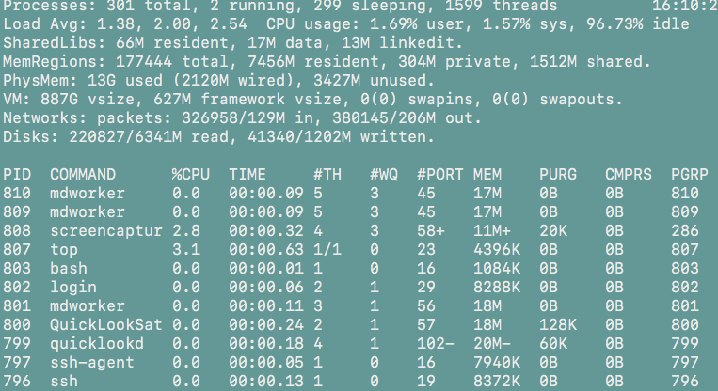
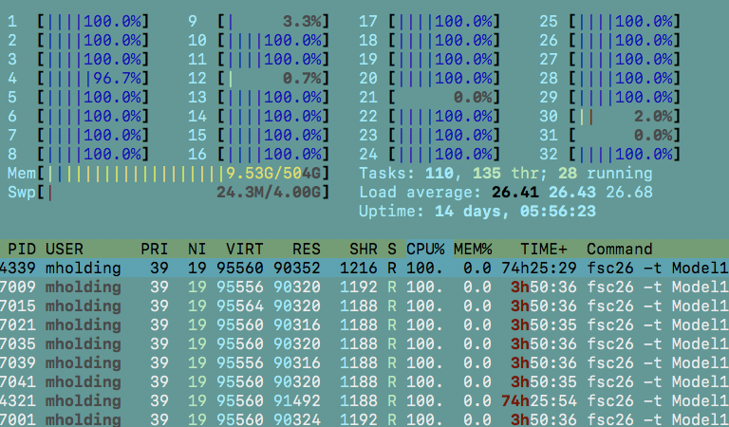
1. Process Monitoring (top and htop)
$ top
$ htop
$ man ps # for full list of command line arguments
$ ps aux # with options a, u, and x
$ ps aux | grep TextWrangler.bin
-pipes process list into grep, prints those that match search expression

Slide 3
Process control from Linux assignment 2
$ jot -r 1000000000 > test.txt &
#starting jot, running in the background (&)
$ ps aux | grep jot
#quickly accessing PID and all job information
$ pgrep jot
#just returns PID
$ kill 73451
#killing job

Slide 4

Important notes on removing files and directories
- Adding “rm –i” alias to your profile provided some protection
- You can override this with “rm –f” to avoid being prompted with the “are you sure?” message. CAUTION.
- You can also invoke this recursively to delete entire directories and their contents with “rm –rf”. CAUTION. This is the most dangerous of all Unix commands.

Slide 5
2. rsync: A versatile command for copying and syncing directories
$ rsync –av source/ destination/
Writes contents of source/ into destination/
$ rsync –av source destination/
Makes a source/ directory with all of its contents in destination/
- This is equivalent to ‘copying’ a directory to a new location
-av controls archive (keeps permissions and other information constant), and prints information on progress to screen

Slide 6
$ rsync –av source destination/
If source/ already exists in destination/, this will add any files from source/ that don’t previously exist in destination/source/ to destination/source/

Slide 7
rsync to mirror a directory to a drive
Understand exactly what --delete does. BE CAUTIOUS.
$ rsync –av --delete dirsource /Volumes/MYD/dirdestination/
the directory on your computer to copy/sync
Path to directory where you want to produce/sync copy

Slide 8
3. Interaction with remote servers (curl, wget, ssh)
May have to install curl or wget with apt or brew
$ wget "https://github.com/tparchman/F26_BIOL792/raw/refs/heads/main/week3_unixIII/yeast_genome.gff"
To get URL from github coursepage, go to file, click on raw
$ curl "https://eutils.ncbi.nlm.nih.gov/entrez/eutils/efetch.fcgi?db=nuccore&id=NM_007294.4&rettype=fasta&retmode=text" -o BRCA1.fasta

Slide 9
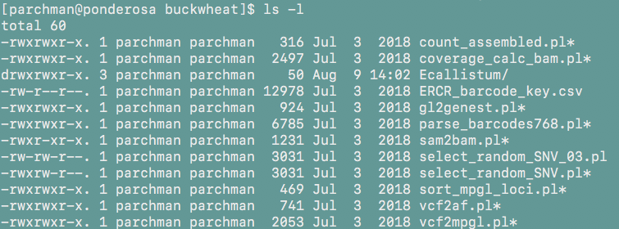
4. Permissions and file modes
$ ls –l #detailed file info, including permissions

Slide 10
Reading permissions
3 sets of 3 characters: user, group, other
r: read w: write x: executre
File type
-rwxr-xr-x
‘user’ has read, write, and execute permissions
‘group’ has read and execute permissions
‘other’ has read and execute permissions

Slide 11
changing permissions: chmod
$ chmod <userabrev><operators> file.txt
Abbrev. User level
u User
g Group
o Other
a All
Operator | Action/level
+ | add
- | Remove
= | sets permission
r | read
w | write
x | execute

Slide 12
Changing permissions: chmod
Convert the .sh file to executable for all users:
$ chmod a+x rsync_mirror_laptop.sh
This script can then be executed from the current directory:
$ ./rsync_mirror_laptop.sh

Slide 13
stdout, redirection (>), and pipes (|)
Pipes (|) send stdout from one command into another.
$ ls | wc -l
$ cut -f 3 yeast_genome.gff | sort | uniq
Extract the 3rd field from each line of yeast_genome.gff
sort lines
Print only unique items

Slide 14
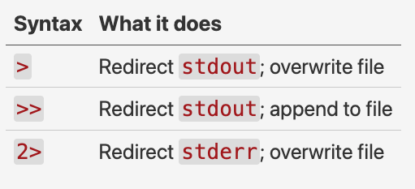
Sources of output, and redirection control
Standard output (`stdout`) - the normal output produced by a command.
Standard error (`stderr`) - error messages and warnings.

Slide 15
Sources of output, and redirection control
Redirects stdout to a file, genes.txt. Creates file on the fly or overwrites if file of this name exists:
$ grep "gene" yeast_genome.gff > genes.txt
Appends stdout to a file, genes.txt, making file larger:
$ grep "gene" yeast_genome.gff >> genes.txt
Writes stdout to a file, genes.txt, and writes stderr (error messages) to errors.txt:
$ grep "gene" yeast_genome.gff > genes.txt 2> errors.txt

Slide 16
Two ways to write shell scripts (or Unix programs)
1. Save the commands you want to execute in a file, e.g., commands.txt and use the unix source command:
$ source commands.txt OR
$ zsh commands.txt
## This will execute the linux commands you have saved in that file
2. Write a shell script (basically the same idea, but preferred for a variety of reasons)
Top line of your shell script needs to be:
#!/bin/zsh
#This tells your system that bash is the interpreter to use, and that it lives in usr/bin/ ** You will do something similar when writing python code.

Slide 17
Simple shell script examples
#!/bin/zsh
STR="Good Dog Shipley!"
echo $STR
Save this in a text file, simple1.sh
From the command line:
$ zsh simple1.sh
#!/bin/zsh
echo "List of files:"
ls -l
echo "home:"
pwd
echo "Today:"
date
Save this in a text file, simple2.sh
From the command line:
$ zsh simple2.sh

Slide 18
Simplest bash scripts continued
#!/bin/zsh
echo "The script starts now"
echo "Hi, $USER!"
echo "I am setting two variables"
COLOR="black"
VALUE="9"
echo "This is a string: $COLOR"
echo "And this is a number: $VALUE"
echo "We are now done"
Save this as simple3.sh
From the command line:
$ zsh simple3.sh

Slide 19
Two ways you can run scripts:
Specify the interpreter from the command line
$ zsh mybash_script.sh
Change the script to executable:
$ chmod a+x mybash_script.sh
$ ./mybash_script.sh

Slide 20
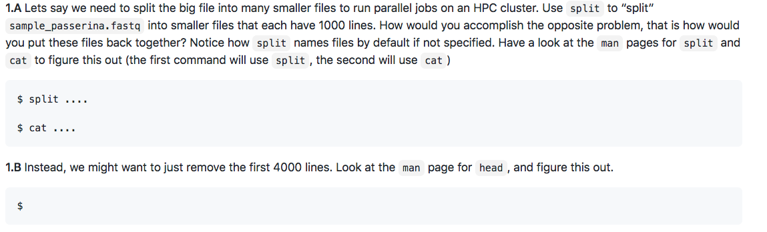
Week 3 primer and assignment:
Unix commands involved: split, cat, head, tail, curl, wget, grep, tr
Turn in text file with commands from assignment by Monday evening (each week assignments will be due at this time). Ideally use markdown for this……
Fields in assignment requiring solutions will be marked:

