Slide 1
Week 9: regular expressions
- Review: file input/output, loops, and accumulating results
- Intro to regular expressions (re module)
- Finding, counting matches with re.findall and re.finditer
- repeated patterns and capturing groups
- Applying regular expressions to biological sequence data
python4_primer_week9.ipynb | assignment_4_python.md

Slide 2
Initializing variables
Variables that need to exist outside and within loops need to be initialized outside of the loop
SeqNo = 0
TAT = 0
For Line in IN:
List = Line.split(“,“)
TAT += List[1]
SeqNo += 1
Created new each time through loop
Initialized outside, grows each time through
Variables assigned within the loop live and die within the loop

Slide 3
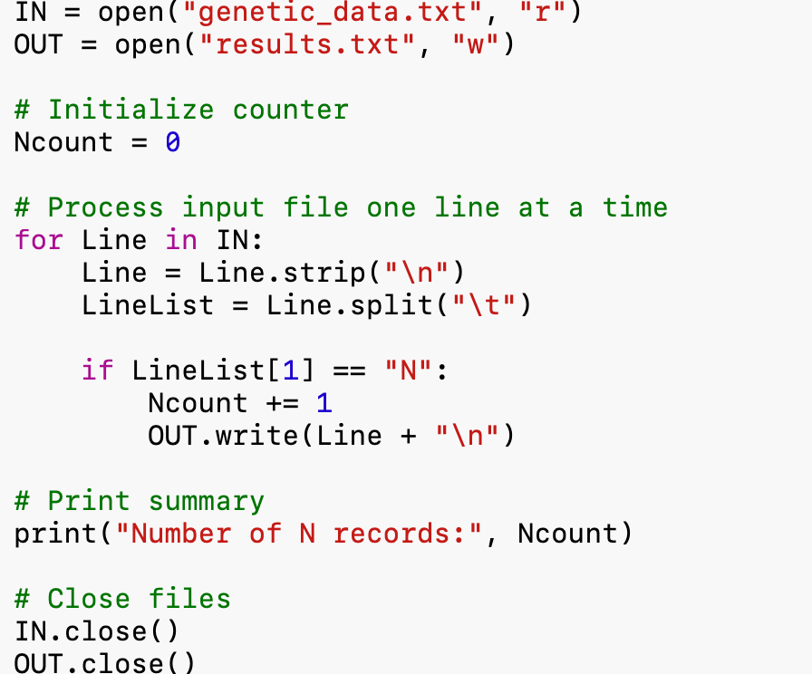
Review: Reading and Processing Files

Slide 4
Regular Expressions: finding patterns in data
Common applications in biological data science:
Genomics: Identify DNA motifs, restriction sites, and repetitive sequences.
Ecology: Extract dates, coordinates, or environmental variables from large datasets.
Neuroscience: Identify experimental conditions, trial numbers, and timestamps.
Analytical chemistry: Extract sample identifiers, retention times, or compound information from GC-MS and HPLC output.

Slide 5
Regular Expressions: finding patterns in data
Using exact matches:
import re
Seq = "ATCGATATATATGGCTAG"
if re.search("ATAT", Seq):
print("Pattern found!")
Looser matches:
import re
Seq = "ATCGATATATATGGCTAG"
re.search(r"(AT){4,}", Seq):
# any stretch of AT repeating 4 or more times

Slide 6
I. Regular Expressions (re)
re.search returns true/false and a data object for match. Only saves first match
re.finditer finds all matches, returns data object with information on matches.
re.findall finds all matches, returns a list of matches (good for counting matches, extracting matches)
re.sub finds and substitutes pattern match with a different string
re.split splits strings based on pattern rather than standard delimiter
General syntax: re.search(pattern, string)
re.findall(pattern, string)
re.sub(pattern, replacement, string)

Slide 7
Introduction: regular expressions
re.search returns true/false; match occurs or doesn’t, and stores match object. Mostly used for conditionals. General usage follows:
re.search(expression, string):
import re
Seq = "ATCGGGGCCTAGAAT"
if re.search("TAG", Seq):
print("Stop codon (TAG) found.\n")

Slide 8
re.search example actions/syntax
import re
Seq = "ATCGGGGCCTAGAAT"
if re.search("TAG", Seq):
print("Stop codon (TAG) found.\n")
Some example regular expressions
re.search("TTA(A|G)", Var): # A or G
re.search("TTA[ATCG]", Var): #[]s enclose character class
re.search("\d+", Var): #1 or more digit
re.search("\s+", Var): #1 or more whitespace

Slide 9
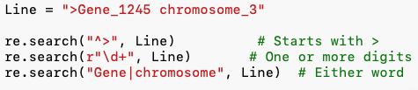
Expression | Meaning | Example
^ | Match at beginning of string | ^> matches FASTA headers
$ | Match at end of string | ATG$ matches strings ending in ATG
[ATCG] | Match any one character in brackets | Any DNA nucleotide
[0-9] | Match any digit | 0 through 9
\d | Match any digit | Equivalent to [0-9]
\s | Match whitespace | Space, tab, newline
| | Alternative (OR) | ATG|TAG matches either motif

Slide 10
Quantifiers
Quantifier | Meaning | Example
+ | One or more occurrences | A+ matches A, AA, AAA…
* | Zero or more occurrences | A* matches zero or more A’s
? | Zero or one occurrence | A? matches A or nothing
{n} | Exactly n occurrences | A{4} matches AAAA
{n,} | At least n occurrences | A{4,} matches AAAA, AAAAA…
Seq = "ATCGAAAAATATATATGGG"
re.findall(r"A+", Seq) # ['A','AAAAA','A','A','A','A']
re.findall(r"A{4,}", Seq) # ['AAAAA']
re.findall(r"(?:AT){3,}", Seq) # ['ATATATAT']

Slide 11
Writing Regular Expressions
Python regular expression cheat sheet

Slide 12
Capturing Groups
Parentheses () allow us to group parts of a regular expression and store specific portions of a match, which can be accessed using .group().
Sample = "Site_NV034_2025”
Match = re.search(r"Site_([A-Z]{2})(\d+)", Sample)
print(Match.group()) # Site_NV034
print(Match.group(1)) # NV
print(Match.group(2)) # 034

Slide 13
Counting the number of matches in a string
re.findall finds all matches in a string, stores in a list. The length of the list gives you the number of matches
Seq = "CTGCATTATATATATATATATAT"
MatchList = re.findall('AT', Seq) ##Stores matches in list
len(MatchList) #Length of list gives number of matches
OR, more simply
len(re.findall('AT', Seq)) ##straight to number of matches

Slide 14
Storing and counting matches in lists
The example below finds AT microsatellite repeats, as you will do with your python assignment for the week.
Seq = ”TATATATATAGGTATATATACCCTATATATATATAT”
ATlist = re.findall("(?:AT){4,}", Seq)
for Rep in ATlist:
print(Rep, len(Rep))
ATATATAT 8 # will print
ATATATATATAT 12

Slide 15
Storing matches with re.finditer()
SSR = 'ATATATGGGCGATATATATCCATATC’
matches=re.finditer("(AT){2,}", SSR)
for m in matches:
print(m.group())
Will return matches of AT repeated 2 or more times:
﻿ATATAT
ATATATAT
ATAT

Slide 16
Replacing matches in strings
re.sub finds a match and replaces it with something else.
re.sub(‘pattern to match’, ’pattern to replace’, String)
Seq = 'CO_MT_134545 0 1 0 2 1’
result = re.sub('CO_', '', Seq) # Deletes CO
result = re.sub('\s+', ' ', Seq) # Delete extra space
Let = 'abcdefghi’
result = re.sub('abc(def)ghi', r'\1', Let) # Replace string with a part of itself

Slide 17
For this week
Restriction Enzymes: cut double stranded DNA at specific sequences
Microsatellites (Simple Sequence Repeats): Short sequence motifs that occur in repetitive strings. Due to high mutation rate and high polymorphism, commonly developed as molecular markers
Whole transcriptomes (DNA sequences representing the expressed, genic portion of a genome) for this week:
taeda_unigenes.fasta (Loblolly pine, Pinus taeda)
Manacus_vitellinus.gene.cds.fa (Golden collared manakin)

Slide 18
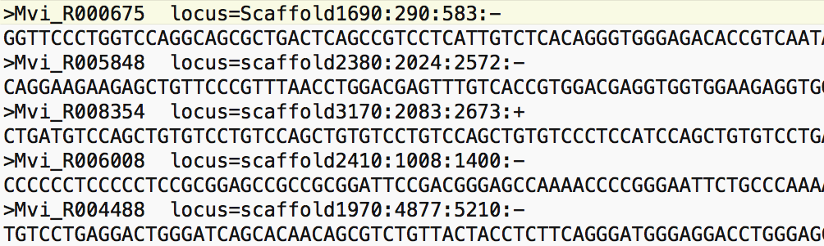
Processing two lines at a time:
Fasta ID line
Sequence
for Line in IN:
Fasta = Line.strip("\n")
print(Line)
Seq = IN.readline()
Seq = Seq.strip("\n")
print(Seq)
Fasta ID line, stored as ‘Fasta’
Next line, stored as ‘Seq’

Slide 19
For this week
I. python_4_primer.ipynb
II. assignment_python4.md
III. Turn in script or jupyter notebook by next Tuesday
IV. Get me written description of your independent project

Slide 20
Semester through November
Week of 10/27, 10/29: Reading many files at one, data management problem
Week of 11/3, 11/5 Numpy and Pandas: Data Science modules
Week of 11/10, 11/12 Data Visualization (matplotlib, seaborn)
Week of 11/17, 11/19 Dictionaries

