Slide 1
BIOL 792 (1028)
Data Science for Biology I
FH 19
Tuesday and Thursday 6:00 – 7:15
Dr. Thomas Parchman

Slide 2
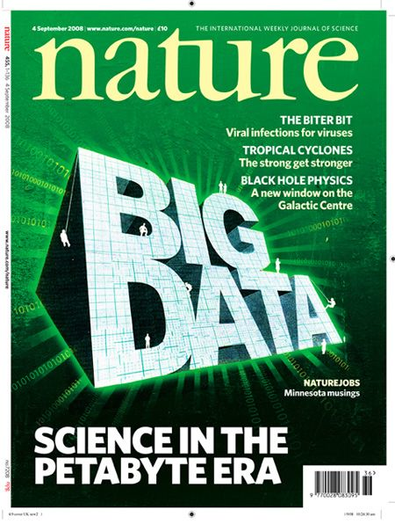
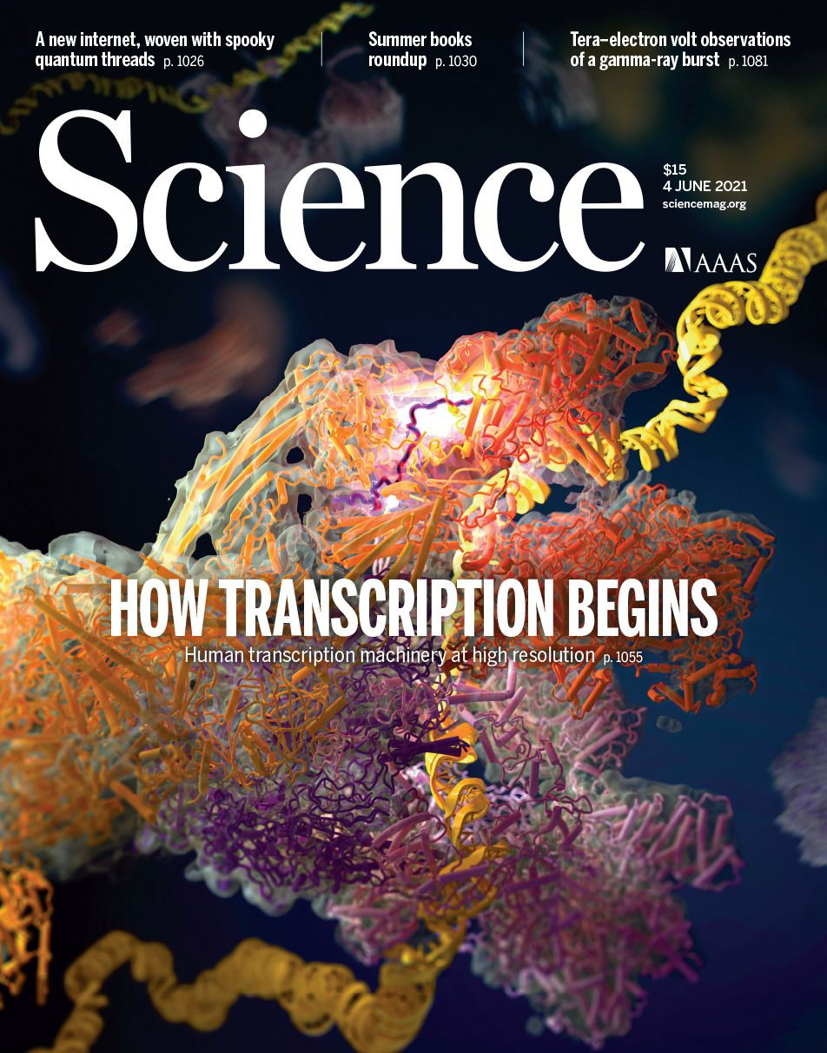
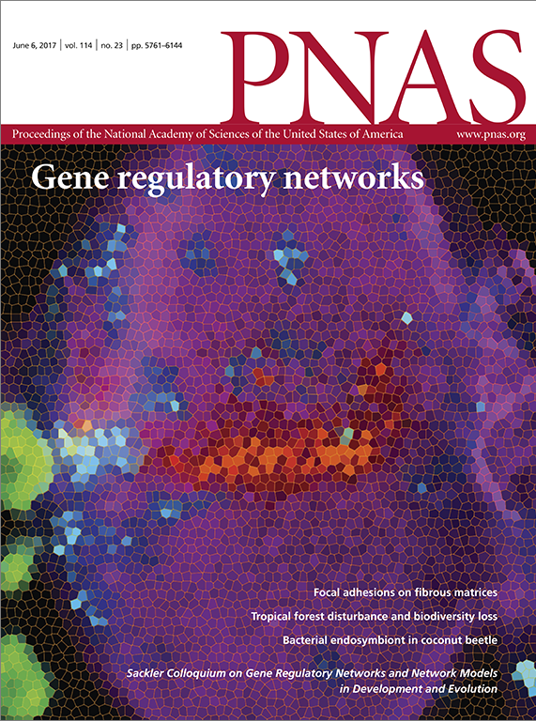
The Big Data Era is Well Underway
Data-driven research is at the forefront of most fields of biology

Slide 3
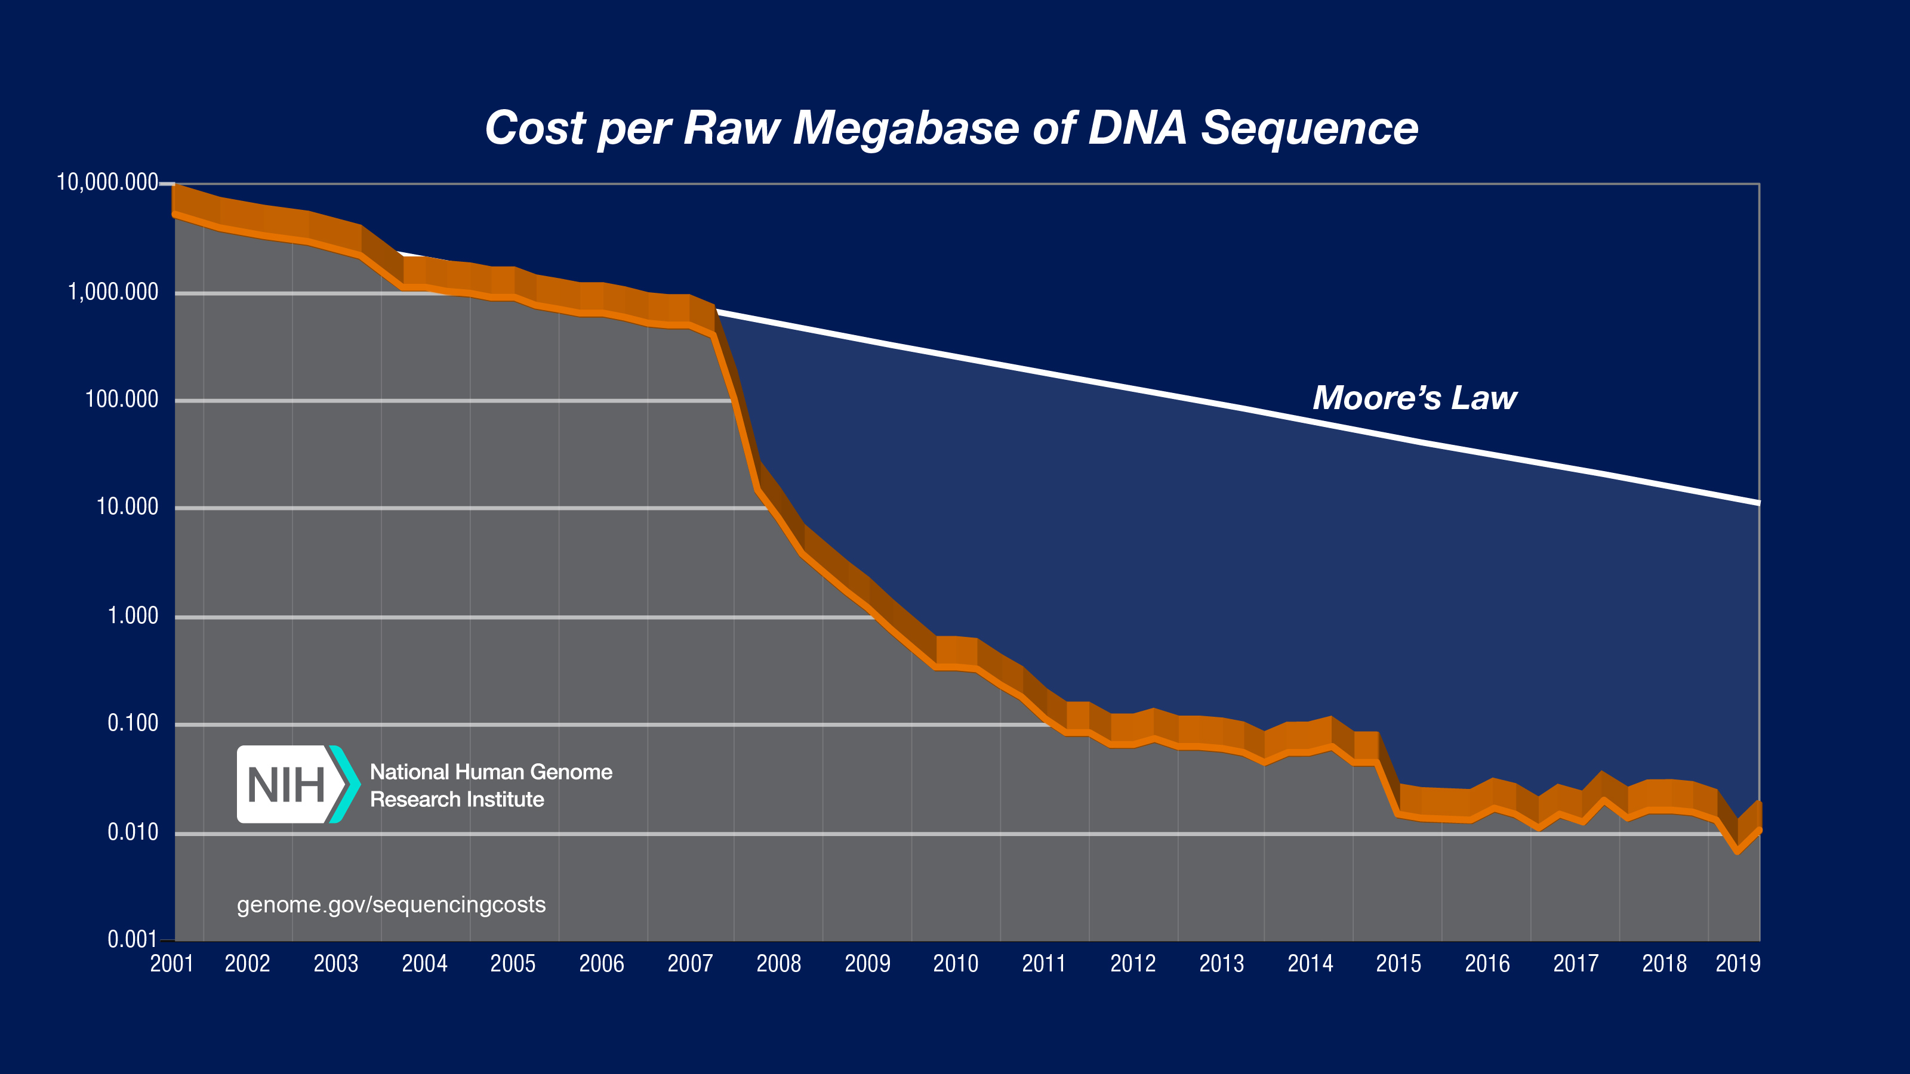
Big Data Science: Genomics
Next generation
sequencers debut
Cost of DNA sequencing is now 1,000,000 times cheaper and about 100,000 times faster than 10 years ago

Slide 4
Big data is relevant for all of science
Scientists are spending less time generating data
and
more time handling and analyzing data

Slide 5
Why learn Linux?
Accessing, manipulating, and moving large data around (around your computer, or among computers).
Working on remote computers and high-performance computing clusters.
>250,000 built in tools and commands, can be used for efficient scripting of workflow.
First step at becoming enabled for data science and more generally for data handling and analysis.

Slide 6
Why learn Python?
- Among the most common languages used in biology and other fields of science. A lot of documentation, guidance, examples, and opinion on the internet.
- Excellent capabilities for manipulating text, suiting it well to bioinformatics and data science, and pretty much anything else.
- It uses consistent syntax, which makes learning specific code relatively easy.
- It has many built-in libraries to facilitate common tasks.
- If you learn this as your first language, it will make learning others much easier.

Slide 7
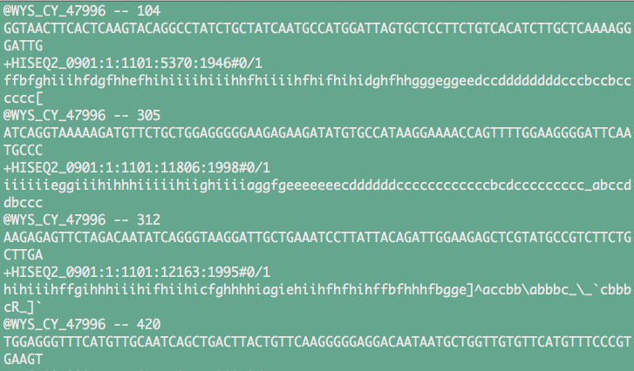
Information from the first four DNA sequences from a data file that has 800,000,000 DNA sequences generated with an Illumina instrument

Slide 8


Slide 9
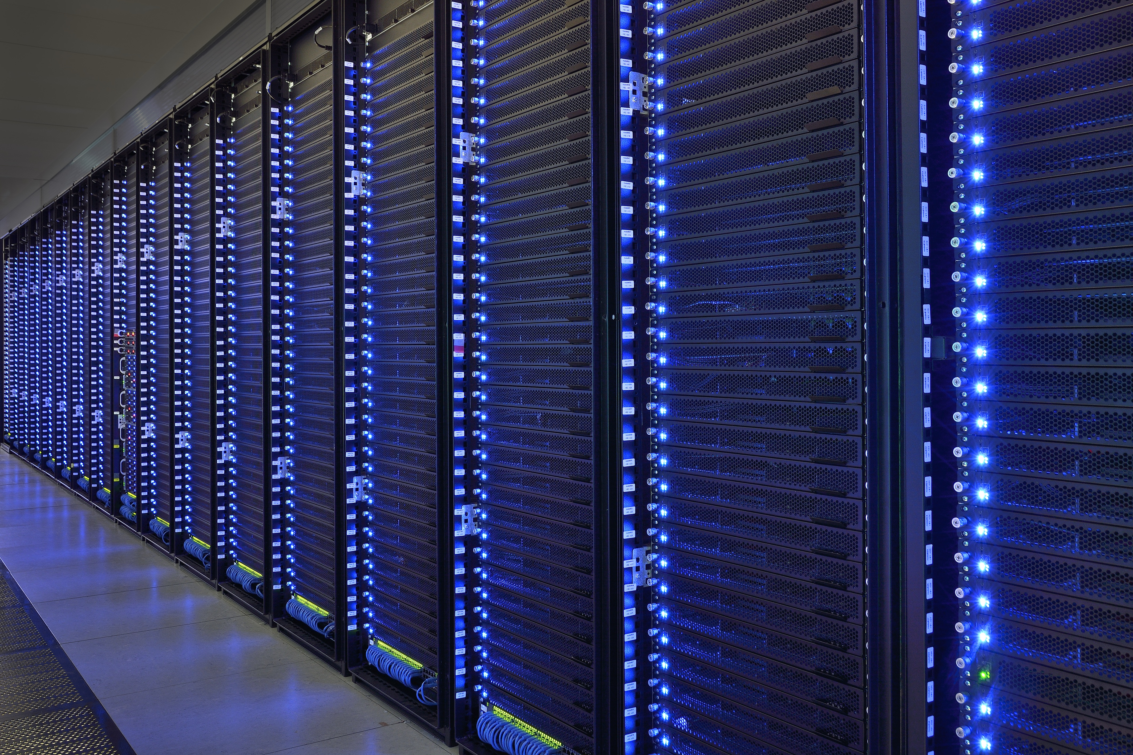
High performance computing clusters are accessed and run with Unix (or Linux)
Unix tools: ssh, sftp, wget, ftp, job schedulers (torque, sungrid engine)

Slide 10
UNR high performance computing cluster: Pronghorn
CPU partition features 108 nodes, 3,456 CPU cores, and 24.8TB of memory.
GPU partition features 44 NVIDIA Tesla P100 GPUs, 352 CPU cores, and 2.75TiB of memory.
The Visualization partition is composed of three NVIDIA Tesla V100 GPUs, 48 CPU cores, and 1.1TiB of memory.
Account signup - https://www.unr.edu/cyberinfrastructure/high-performance-computing/accounts
https://github.com/UNR-HPC/pronghorn/wiki/

Slide 11
Why Learn Linux & Python Before Using AI?
The Grammar of Computing
Linux and Python are languages for data science. The structure and rules of them make big things possible.
Understand Problem Solving
With a basic coding foundation, you can recognize how and why solutions work, rather than relying on a black box.
Harness AI Effectively
AI becomes a productivity tool only when you know enough to guide it, check results, adapt code to your needs.
AI can’t replace learning Linux and Python
But it can make the process faster and more rewarding by shortening the path between learning/frustration and doing/problem solving.

Slide 12
Academic and scientific integrity and transparency
Responsibility: Write code you can defend and verify. Responsible science means ensuring your methods are correct and transparent.
Reproducibility: Code should be shareable and reproducible so others can replicate and build upon your work.
Repeatability: Analyses must produce the same results when repeated.
Collaboration: Transparent, well-documented code allows collaboration across labs, disciplines

Slide 13
At the end of this course, you should:
Be comfortable with using Linux for basic and progressively more advanced needs
Be able to write and effectively execute Python code (and feel encouraged to learn more on your own).
Be able to use Unix, Python, and shell scripting to manipulate, organize, and analyze large data sets.
Feel enabled and equipped to work with big data, and motivated and capable of learning more on your own.
Be prepared for more advanced courses.

Slide 14
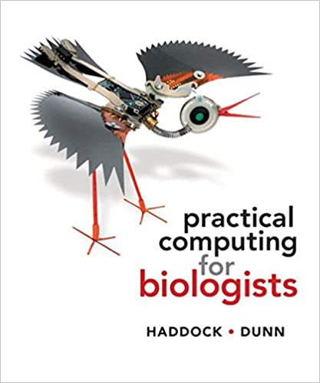
Course Resources
Computer with Linux and Python installed, preferably mac or machine running linux.
Supplementary data and problem sets for projects will be provided throughout the semester on the course github page.
Optional extbook (to left), and supplemental unix material from ”Unix and Perl to the Rescue”, Bradnam and Korf.

Slide 15
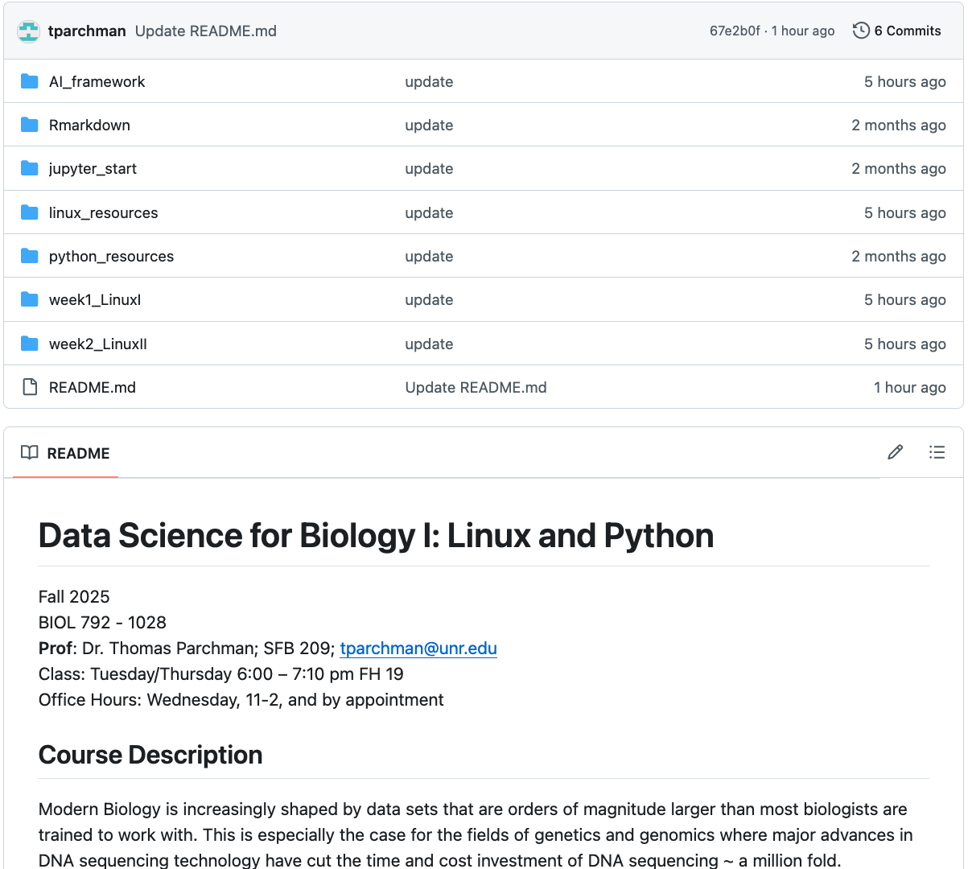
Course site: https://github.com/tparchman/F25_BIOL792
Weekly primers and assignments
Supplemental material
Repositories for sharing code with each other

Slide 16
Other suggested resources:
- Primer for a supplemental book that is very useful for Unix (and Perl if you so desire)
http://korflab.ucdavis.edu/Unix_and_Perl/current.html
- Python documentation:
https://docs.python.org/3/
- Online Python for Biologists (by Martin):
https://pythonforbiologists.com/introduction
- Learn Python Interactive (has built in interpretter)
https://www.learnpython.org/
- Python guru (excellent, has built in interpretter)
https://thepythonguru.com/
*I suggest bookmarking a few of the above and revisiting regularly

Slide 17
Course Outline
Weeks 1 through 3/4: Learning how to work and live in Linux
-directory navigation, moving, copying, syncing
-basic Linux tools for efficient data handling
-scripting for automation
Weeks 3/4 through 10/11: Basic programming in Python
-input/output, basic syntax, debugging
-data structures (scalars, arrays, hashes)
-conditionals, loops, control structures
-regular expressions, mathematical operation, indexing, data wrangling
Weeks 11 through 15: Incorporating what you have learned in Linux and Python to manipulate and work with batches of big data
AI integration after we have gotten started from scratch with Linux and Python
AI will make you faster, but only if you understand what it produces.

Slide 18
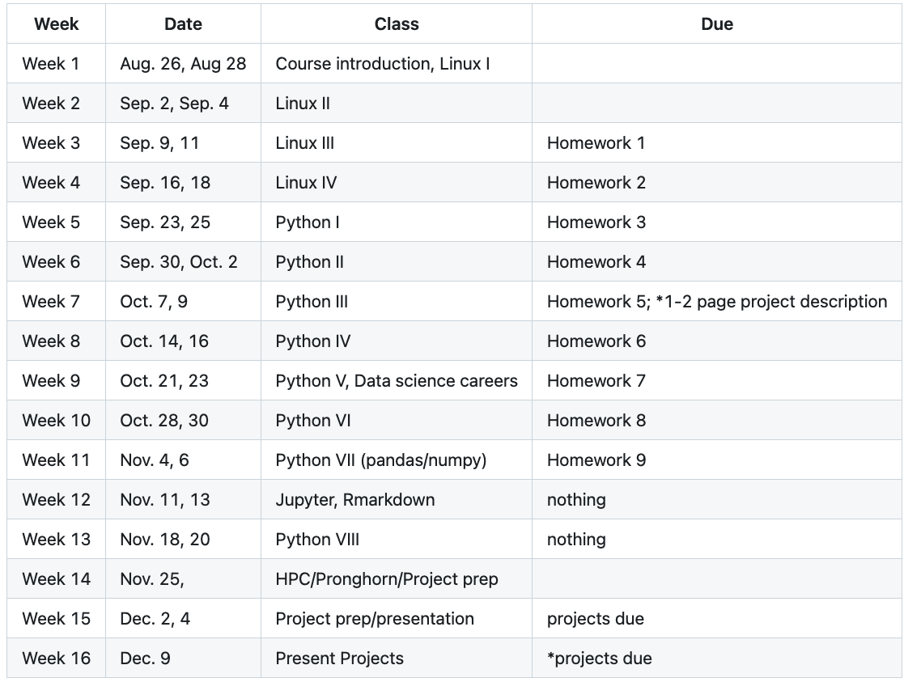
Timeline in the syllabus may shift depending on pace

Slide 19
Grading for the course:
Participation (30%)
Weekly Assignments (50%)
Project material in directories that contain a type of data file, an explanation of the problem, and advice on how to use Unix, Python, or R to parse data, conduct some analyses, or just do some stuff.
For these projects, and especially for real world computational projects, keeping track of EVERYTHING you do will be essential.
For Linux projects, you will turn in annotated notes of the commands you executed and what they accomplished.
For Python projects, you will turn in your scripts, with comment lines used to explain your rationale.

Slide 20
Grading for the course (continued):
3. Independent (or group) project (20%)
Identify a task or problem in your research (or the group you work within) that either requires, or can be made much more efficient, using Linux or Python code. The idea here is to force you to identify a real problem, and to build something useful to solve it and to drive your research forward
Deliverables:
Before week 5: Turn in a 1-2 page description of the problem, the data, and how you plan to implement something in Unix, Python, or both, to accomplish something.
By week 14: Turn in your Unix and/or Python code and a 1-3 page description of how your creation works.
Weeks 14/15. 15 minute presentation to the class on your problem and how you solved it.

Slide 21
Before Thursday:
Read Haddock and Dunn (pgs 1-15 only), first half of Chapter 4.
Make sure you have access to a computer with Unix/Linux
If you have a mac, you are set
If you can run linux (ubuntu for example) on your computer, you are set.
If you have a PC, read up on options in week1 primer
See Linux_suggestions_for_setup_MacOS.md or Linux_suggestions_for_setup_PC.md under week1_LinuxI
3. Pick and install a text editor. (You will not want to use notepad or a word processing software). I strongly suggest Bbedit, TextWrangler, or Visual Studio Code.

Slide 22
A note on text editors:
- Programs are typically just text files; they contain text written commands for operations, functions, input/output, etc.
- Microsoft Office Documents and Excel documents are NOT text files; We will NOT be using either.
- Syntax recognition is built into editors used for programming (VIM, Emacs, TextWrangler, BBedit)
**This will help with understanding the code you are writing, and more importantly in debugging.

Slide 23
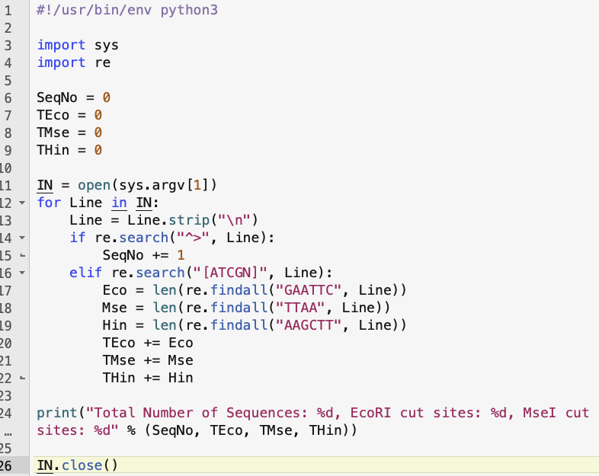
BBEdit – Recommended for this course
Python
script

Slide 24
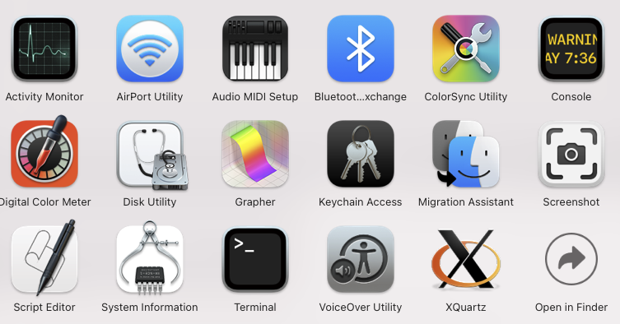
Introduction to the Unix terminal
Applications -> Utilities
Put a link somewhere to make opening this quick, as you will use it for everything in this course (add it to dock on a mac)

Slide 25
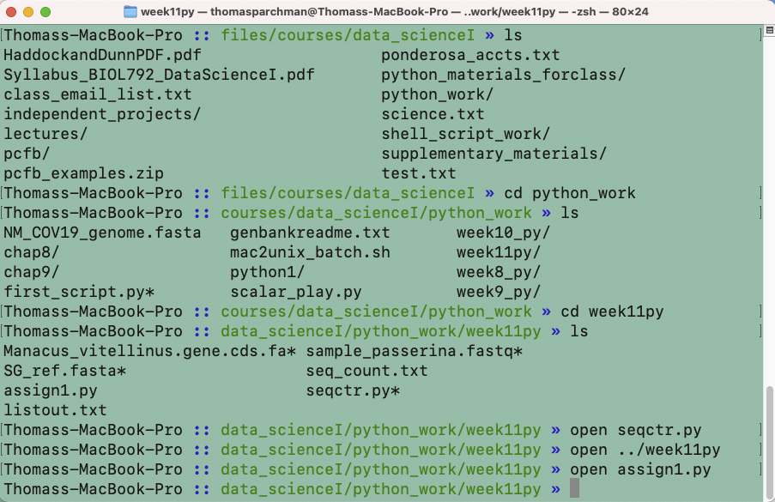
- make the text larger/smaller (hold down ‘command’ and either ‘+’ or ‘–’)
- have multiple terminal windows on screen (see the ‘Terminal’ menu)
- have multiple tabs open within each window (again see the ‘Terminal’ menu)
- Command ‘N’ to open additional windows

Slide 26
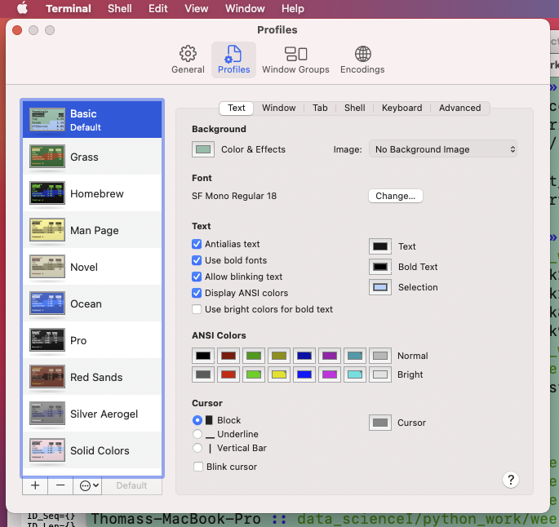
Customize Terminal
Background color,
text size, font, color, etc.

