Slide 1
Independent Projects: Deliverables
Presentations: Brief overview of your project, data, methods, and results
Code: (jupyter notebook, scripts, or linux in markdown format)
White paper covering goals, what was accomplished, what is still to be done (could all be in a jupyter notebook or R markdown)

Slide 2
Week 12: Pandas and some data visualization
Pandas:
- reading, organizing, manipulating data
- filtering, sorting, grouping
- working with large data sets
Data Visualization:
- brief introduction to matplotlib, seaborn, and plotly
This week:
- Pandas and visualization primer on github repo, optional assignment, work on independent projects

Slide 3
pandas: organizing, manipulating, and analyzing structured datasets
- DataFrames: 2d tables of rows and columns
- Data manipulation: Select, filter, sort, merge, and modify data.
- Missing data: Identify and handle missing values (NaN).
- Summarizing data: Group observations and calculate summary statistics.
- Integration: Works with NumPy and visualization libraries such as matplotlib and seaborn.
pandas is particularly useful as operations that would require multiple loops and conditionals in basic Python can often be accomplished with short bits of code.

Slide 4
Installing python numpy and panda libraries
From the command line:
$ python -m pip install pandas matplotlib seaborn plotly
Or, if using conda:
$ conda install pandas matplotlib seaborn plotly
import pandas as pd
import matplotlib.pyplot as plt
import seaborn as sns
import plotly.express as px
Import libraries, with conventional aliases:

Slide 5
Importing libraries
Import libraries:
import os,re,sys (import multiple libraries in single line)
Import libraries with conventional aliases:
import pandas as pd
import matplotlib.pyplot as plt
import seaborn as sns
import plotly.express as px
Installing a library makes it available in your Python environment; importing it makes its functionality available in your current Python session.

Slide 6

Pandas DataFrames
Rows: Individual observations (e.g., samples, individuals, populations).
Columns: Variables associated with each observation.
Index: Labels used to identify and access rows.
Operations: Select, filter, sort, modify, merge, and summarize data.
sample_id | population | latitude | heterozygosity
A01 | NV1 | 39.5 | 0.24
A02 | NV1 | 39.5 | 0.27
B01 | CA2 | 38.2 | 0.31

Slide 7
Common pandas operations:
Read and write data: Import files and export modified datasets.
Inspect data: Examine dimensions, columns, data types, and missing values.
Select and filter: Extract particular columns or observations.
Manipulate data: Create variables, rename columns, and sort observations.
Group and summarize: across populations, treatments, or other categories.
Visualize: Integrate with matplotlib, seaborn, and plotly.

Slide 8
Reading and writing DataFrames
Reading file as dataframe:
import pandas as pd
df = pd.read_csv('data.csv’)
df.head() # previews top 5 rows of df
Writing dataframe to file:
df.to_csv('file1.csv’, index=False)
Useful options:
pd.read_csv("data.csv", sep="\t") # Tab-delimited file
pd.read_csv("data.csv", na_values=["NA", "-999"])

Slide 9
Inspecting pandas DataFrames
Method | What it does
df.head() | Display the first 5 rows
df.shape | Number of rows and columns
df.columns | List column names
df.info() | Data types and non-missing values
df.describe() | Summary statistics for numerical columns
df = pd.read_csv("states_covid.csv")
df.head()
df.shape
df.info() # useful for identifying data types and finding missing values
df.describe()

Slide 10
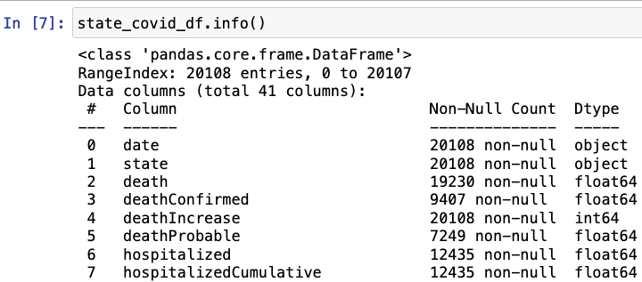
.info() function displays the information on each variable (column).
A useful quality control step to see how variables are being treated on default after creating a dataframe.

Slide 11

Working with Dates in Pandas
Convert column to datetime format:
Extract information from dates:
Filter rows by date:

Slide 12
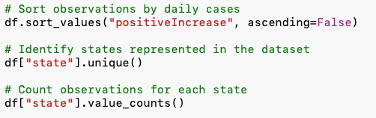
Summarizing DataFrames
Method | Purpose
.sort_values() | Sort observations by one or more columns
.unique() | Identify unique values in a column
.value_counts() | Count observations in each category
.groupby() | Group observations based on a variable
.agg() | Calculate summary statistics for groups
.sort_values() changes the order of observations in the returned DataFrame but does not modify the original unless the result is assigned to a variable or inplace=True is used.

Slide 13
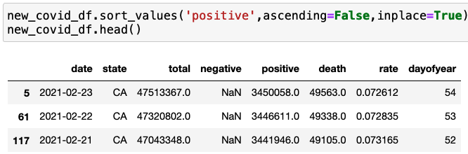
Summarizing data frames
.sort_values(), .unique(), .groupby(), .agg[]

Slide 14
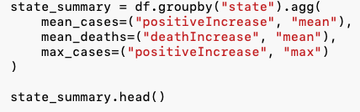
Grouping and Aggregating Data
.groupby() divide observations into groups based on a categorical variable
.agg() summary statistics for each group
Split observations into groups (states).
Apply statistical operations (mean, maximum).
Combine results into a new DataFrame.

Slide 15


Selecting and filtering data frames
Select particular columns:
Filter rows based on condition:
Combine multiple conditions:

Slide 16
Data visualization
- primer_python8_pandas_matplotlibdemo.ipynb covers some examples of data visualization, using states_covid.csv
Library | Primary strengths | Common applications
matplotlib | Flexible plotting and customization | Line plots, scatterplots, multipanel figures
seaborn | Attractive statistical graphics | Boxplots, violin plots, heatmaps, pairplots
plotly | Interactive visualizations | Interactive scatterplots, maps, animations
import matplotlib.pyplot as plt
import seaborn as sns
import plotly.express as px
* All work directly with pandas dataframes

Slide 17
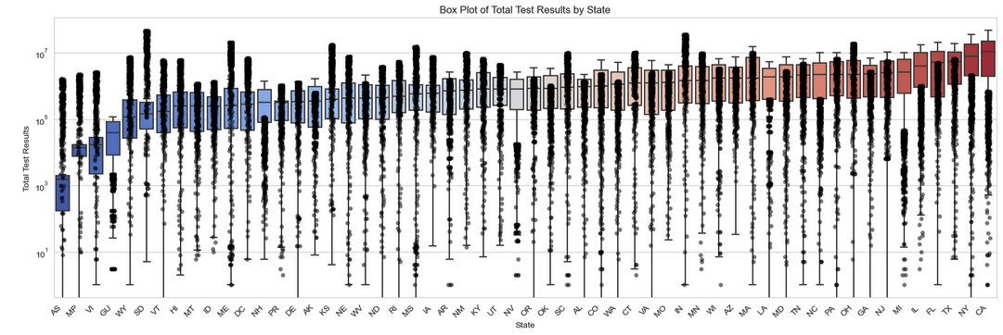

Slide 18
This week
Pandas and visualization
- Work through primer_python8_pandas_matplotlibdemo.ipynb.
- Experiment with different plot types, color palettes, and formatting.
- Consider which approaches might be useful for your own research.
2. Optional practice assignment (not required!)
- Explore the states_covid.csv dataset.
- Practice filtering, grouping, summarizing, and visualizing data.
3. Work on independent projects (especially if there is overlap with pandas and visualization)

