Slide 1
Week 7
Moving from individual values to simple data processing
I. lists (and useful functions)
II. Decisions (if-elif-else)
III. loops (for)
python_2_primer.ipynb, assignment_python2.md
Notes:
Last week was largely about individual variables and strings. This week we start organizing collections of data, making decisions based on values, and repeating operations across those data.

Slide 2
Variables can hold more than one value I: lists
Scalars store one value:
Lists store multiple values:
heights = [12.7, 15.2, 9.8, 14.1]
populations = ["Reno", "Tahoe", "Austin", "Ely"]
height = 12.7
population = "Reno"
A list is an ordered collection of Python objects.

Slide 3
Variables as Containers - lists
One dimensional lists:
ColorList = ['blue', 'red', 'green', 'violet', 'orange’]
NumList = ['9', '83', '85', '11', '52’]
Lists are ordered, with 0 as first element. Access elements with list[]
ColorList[0] = 'blue’
ColorList[4] = 'orange'
Useful, and often used: can loop through lists rapidly, performing the same set of actions on each element.

Slide 4
Accessing list elements
:
0
1
2
3
4
'a'
'b'
'c'
'd'
'e'
-5
-4
-3
-2
-1
:
List = ['a', 'b', 'c', 'd', 'e’]
List[0] #returns 'a'
List[2] #returns 'c'
List[0:3] #returns 'a' 'b' 'c'

Slide 5
Accessing list elements
:
0
1
2
3
4
'a'
'b'
'c'
'd'
'e'
-5
-4
-3
-2
-1
:
List = ['a', 'b', 'c', 'd', 'e’]
List[-2] #returns 'd'
List[-3:-1] #returns 'c' 'd'

Slide 6
Slicing lists
Extracting part(s) of a list
numbers = [10, 20, 30, 40, 50, 60]
numbers[1:4] # [20, 30, 40]
numbers[:3] # first three
numbers[3:] # index 3 through end
numbers[-2:] # last two

Slide 7
Lists can be modified
populations = ["Reno", "Tahoe", "Austin"]
populations[2] = "Ely”
print(populations) # ['Reno', 'Tahoe', 'Ely']
populations.append("Tonopah") # adds to the end
del populations[1] # removes 2nd element

Slide 8
Building lists while we work
Start empty, then .append()
large_values = []
large_values.append(12.4)
large_values.append(15.1)
large_values.append(19.8)
print(large_values)
# [12.4, 15.1, 19.8]
[]
↓ append 12.4
[12.4]
↓ append 15.1
[12.4, 15.1]
↓ append 19.8
[12.4, 15.1, 19.8]

Slide 9
Strings to lists and lists to strings:
String to list conversion
For single string:
DNAseq = "ATGGGCCTTATATATATA"
List_Dseq = (DNAseq) list
If delimited:
Temp = "65,76,77,77,65,67,65,45,45,90,91,91"
List_Temp = Temp.split(",")

Slide 10
List to string conversion
To join without any delimiter:
List_AminoAcids = ['A', 'P', 'T', 'T', 'T', 'U', 'Y', 'H']
AA_string = ''.join(List_AminoAcids)
To join with comma delimiter:
List_Temp = ['65', '76', '77', '77', '65', '67', '65', '45', '45', '90', '91', '91’]
Temp_string = ','.join(List_Temp)

Slide 11
Programs make decisions: conditional statements
Input
In python:
other statements
if Num > 0:
print("positive")
if
false
true: do something
Rest of code

Slide 12
Conditional statements: if
- ‘:’ after conditional
code to be executed if the condition is met MUST be indented
If evaluates True or False
X = 4
if (X > 3):
print(f"{X} is greater than 3")
Seq='ATCGGGGCGTTTT'
if len(Seq) != 10: # not equal
print("more or less than 10 bases")

Slide 13
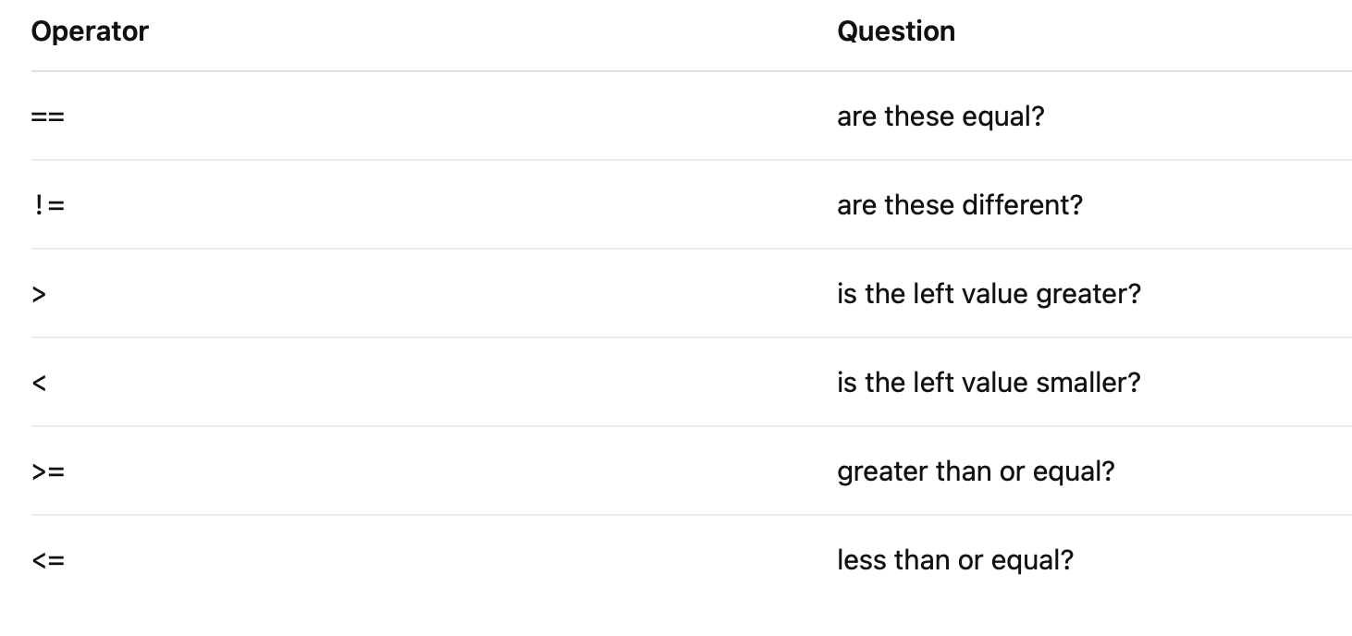
Comparison operators for if / else

Slide 14
To possible paths: if-else
- else simply specifies an action when if conditional doesn’t hold
gc_content = 0.42
if gc_content >= 0.50:
print("GC-rich")
else:
print("AT-rich")
Colon : starts a block
Indentation identifies the code belonging to that block

Slide 15
More than two possibilities
- Use elif when several outcomes are possible
gc_content = 0.52
if gc_content >= 0.60:
classification = "high GC"
elif gc_content >= 0.40:
classification = "intermediate GC"
else:
classification = "low GC"
print(classification)
Notes:
Note that order matters in elif

Slide 16
Combining conditions
and, or, and not allow more complicated questions
and - both must be true
if population == "NV" and gc_content >= 0.50:
print("Keep sample")
or – either can be true
if population == "NV" or population == "CA":
print("Western sample")

Slide 17
Doing the same thing repeatedly
for loops let us process every element in a collection
samples = ["HOWR_01", "HOWR_02", "HOWR_03"]
We could do:
print(samples[0])
print(samples[1])
print(samples[2])
We should do (same outcome, more efficient):
for sample in samples:
print(sample)
Notes:
conditionals let the program decide what to do; loops let it do those things repeatedly.

Slide 18
Doing the same thing repeatedly
for loops let us process every element in a collection
Basic idea:
for item in collection:
do_something
numbers = [4, 7, 10]
for num in numbers:
doubled = num * 2
print(doubled)

Slide 19
Keeping track with a counter
Variables can accumulate information as a loop runs
samples = ["HOWR_01", "HOWR_02", "HOWR_03"]
counter = 0
for sample in samples:
print(f"{counter}: {sample}")
counter += 1
counter starts at 0:
HOWR_01 → counter = 0
HOWR_02 → counter = 1
HOWR_03 → counter = 2
counter += 1 means counter = counter + 1

Slide 20
Building a list with a loop
Start with an empty list and .append() results
numbers = [4, 7, 10, 13]
doubled = []
for num in numbers:
doubled.append(num * 2)
print(doubled)
The original list supplies the data; the loop builds the result

Slide 21
Loops + conditionals
Process every item, but act only on the ones we want
measurements = [4.2, 11.7, 8.3, 15.1, 19.6]
large_values = []
for value in measurements:
if value >= 10:
large_values.append(value)
print(large_values)
LOOP → TEST → ACT

Slide 22
Putting it all together
Most data-processing tasks are combinations of a few simple steps
DATA samples = [...]
↓
LOOP for record in samples:
↓
EXTRACT fields = record.split(",")
sample = fields[0]
↓
TEST if population == "NV":
↓
ACT / SAVE nv_samples.append(sample)
↓
RESULT ["HOWR_01", "HOWR_03", etc]

Slide 23
This week’s assignment
From individual Python operations to simple data-processing workflows
Problem 1: Strings and lists
Split a structured data string, extract fields, calculate sequence properties, use slicing, and make a simple classification.
Problem 2: Building and filtering lists
Convert data to numbers, loop through values, build new lists with .append(), accumulate a total, and use conditionals.
Problem 3: Processing sample records
Use a loop to process multiple biological samples:
split → extract → calculate → classify → save/count
Problem 4: Putting the pieces together

Slide 24
This week and next
1. Write the specified scripts in Chapter 9 (focusing on lists, we will come back to dictionaries later in more detail)
2. Review python_2_primer.md, write code for assignment_pythonII.md
3. Turn in scripts 2 and 3 from assignment. Short project description 1-pager due by October 19 (if you haven’t sent already).
Next Week: working with files, controlling input/output (reading and writing).
Notes:
“When you get to the assignment and a problem looks complicated, don’t try to solve the whole thing at once. Ask what the first small operation is. Do I need to split a string? Extract something from a list? Loop through values? Test a condition? Save a result? Get each piece working, and then put the pieces together.”

