Slide 1
2021 GAIN
Module 5:
Computational Tools for Data Science
Day 2:
Getting started with Python

Slide 2
Overview:
Basic concepts of programming to guide your thinking with python and other languages.
Terminology
Variable types
Control structures
Input/Output

Slide 3
Compiled vs. Interpreted Languages
Compiled
- C, C+, Java
- Translated from human readable code (source code) to computer understandable instructions – must be compiled
Interpreted (or scripting languages)
- perl, python, ruby, R
- Scripts are processed by an interpreter each time they run – don’t have to be compiled
- Program itself is the source code, easy to modify and can be run on any machine

Slide 4
Basic programming terminology
Arguments – values that are sent to the program when it is run
$ bash mac2unix.sh *macfiles.txt
Statement – a line of a program or script which can assign a value, do a comparison or perform other operations.
print(“ATCGGGC”)
Parameters – Values that are sent to a function when it is called
No_A = DNAseq.count(A)

Slide 5
Basic programming terminology
Function – a subprogram used to repeatedly to perform the same task
len(DNAseq)
Return – the value created and sent back from a function
SeqLength = len(DNAseq)
Parse – To extract particular data elements from a larger set

Slide 6
How to write a program – four questions
1. What do you want to do?
2. How will you control input and output? And What variables to you want to make/use?
3. What will the workflow be? How will you conduct operations on your variables?
4. What should you return at the end?

Slide 7
Scalar Variable types
Integer: whole numbers
- 1, 3, 5, 99, etc.
Float: any number, with decimal (“floating point”)
- 11.23, 0.0222, 3 x 10⁻¹⁰, 3e12
String: sequence of text characters
- “ACGGGTTAACCCTTT”
- “Western Conference Finals”
- “3.14159 approximates Pi”
Boolean: True or False

Slide 8
Variables as Containers - lists
One dimensional array (a list)
ColorList = (‘blue’, ‘red’, ‘green’, ‘violet’, ‘orange’ )
NumList = (‘9’, ‘83’, ‘85’, ‘11’, ‘52’ )
Lists are ordered, with 0 as first element
ColorList[0] = ‘blue’; ColorList[4] = ‘orange’;
Multidimensional arrays (e.g., rows of columns, or a 2-d array)
ColorNum[0,2]
Useful, and often used: can ‘loop’ through arrays rapidly, performing the same set of actions on each element

Slide 9
Associative arrays (Dictionary in python, hash in perl)
Unordered sets of key:value pairs
- efficient because they allow more rapid access to paired information
In python, called dictionaries
- key:value pairs, multiple keys can have same value, keys must be unique
HetEst[Loc12] = [0.12]
HetEst[Loc19] = [0.32]
HetEst[Loc15] = [0.12]
Functions in python facilitate work with dictionaries. Like arrays, we can ‘loop’ through dictionaries to perform the same set of code action on each element.

Slide 10
Control structures, flow:
if conditional decision making
if-else conditional decision making
for repeating operations in a loop
while open ended loop

Slide 11
if conditional decision making
Input
In python:
other statements
if Num > 0:
print "negative"
if
false
true: do something
Rest of code

Slide 12
if-else conditional decision making
Input
In python:
other statements
if Num > 0:
print "negative"
else Num > 0:
print "positive"
if
false
true
else
do something
Rest of code

Slide 13
for iterative loop
Input
In python:
for Num in range(10):
print Num *10
for Name in Nlist:
print Name
for Base in ‘ACTGCCC’:
print Base
other statements
For each item
Do something
(exit loop when nothing left to do)

Slide 14
while iterative loop
Input
In python:
while X < 100:
X = X + 2
print X
other statements
while
(condition is true)
Do something
(exit loop when nothing left to do)

Slide 15
Input/Output
- Nearly always, your programs will process information from files you specify
- Nearly always, your programs will write information to files you specify
- Sometimes this will involve one file at a time; often it will involve many (which can be just as easy)

Slide 16
Input/Output in Python
Input example:
FileName = “file_from_working_directory.txt”
InFile = open(FileName, ‘r’)
for Line in InFile:
print (Line)
Output example:
OutFileName = “output_to_working_directory.txt”
OutFile = open(OutFileName, ‘w’)
OutFile.write(Line)

Slide 17
Why Python?
- It is one of the most common languages used in biology and other sciences. Thus, you will find a lot of documentation and examples online.
- Excellent for text manipulation, well suited to bioinformatics and data science.
- It uses consistent syntax, which makes learning specific code relatively easy.
- Many built in libraries/functions to facilitate common tasks
- Widely used, across science and industry.

Slide 18
For Today:
Make sure you have python 3 installed (follow primer)
Write your first, and simplest possible, python program
Go through short python_1_primer.md
Review Haddock and Dunn Chapter 8 pdf (pdf on course page)

Slide 19
Useful resources to explore and keep nearby
Python documentation:
(https://www.python.org/doc/)
Python for Biologists online materials:
(https://pythonforbiologists.com/introduction)

Slide 20
Getting started in python
I. First script
II. Strings, floats, integers
III. String functions
IV. Interactive mode
V. Float precision
VI. Some practice scripts
Extra materials on course page:
Haddock and Dunn chapter 8,
** PythonLesson1_Chapter8.pdf for chapter 8 with python3 modifications
python_1_primer.md,
Try assignment_python1.md

Slide 21
First python script
#!/usr/bin/env python3
#this is a comment: testing my first program with a simple print statement
print ("I’m ready to learn python, and this is step 1")
From the command line:
$ python first_python.py
OR
$ chmod u+x first_python.py
$ ./first_python.py

Slide 22
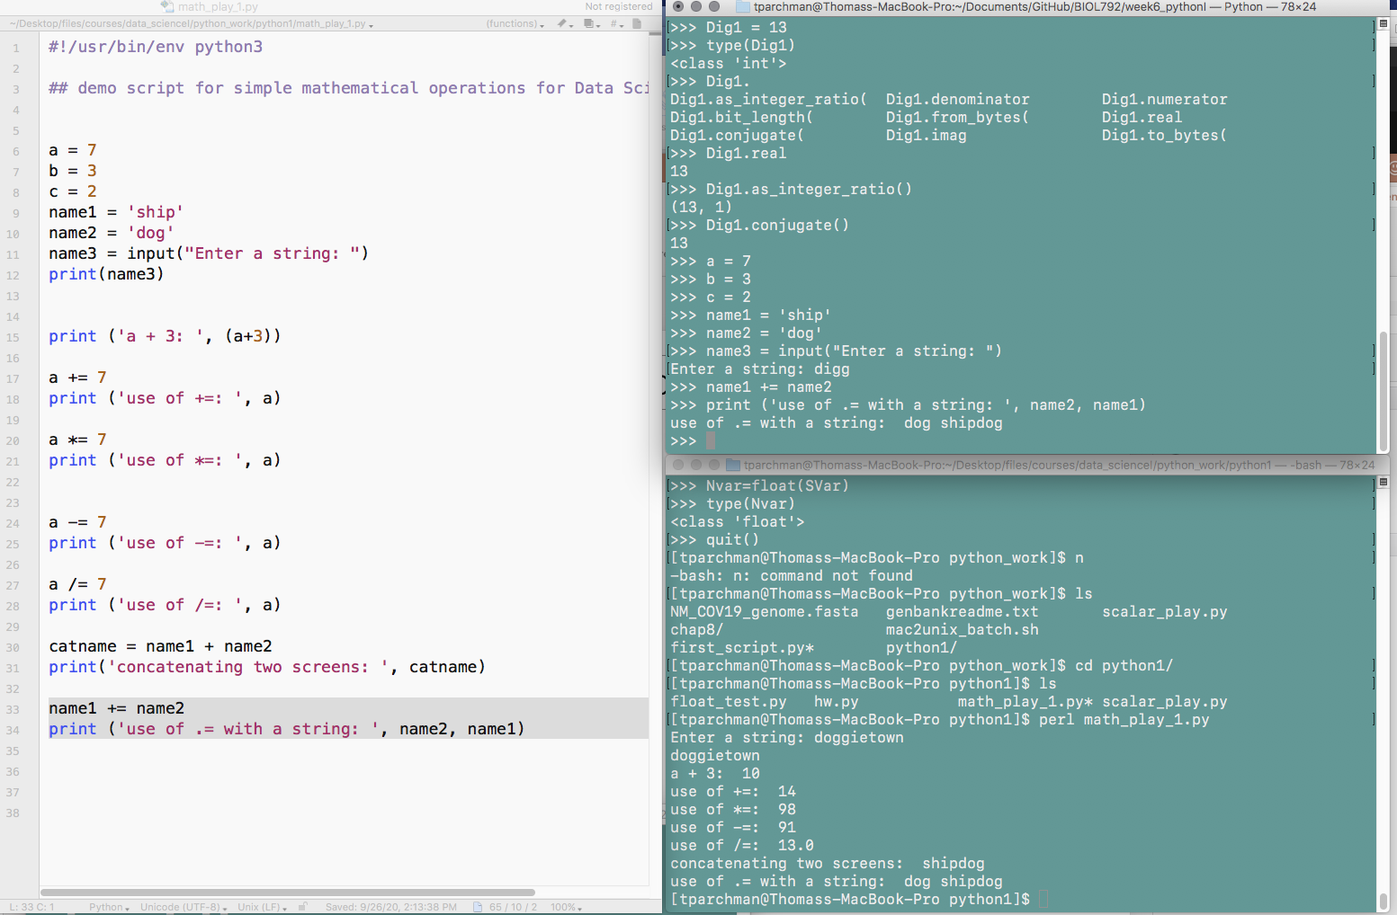
Interactive mode
Enter by simply typing:
$ python3
Amazingly useful for testing code while you are building your scripts

Slide 23
Scalars: strings
Assigning strings to variables (requires single or double quotes):
Team = "lakers"
Seq_one = "actgaaa"
Seq3 = 'atcGGGC' # single or double quotes
Val = '11.2' #something that looks like a float
Sentence = "Joe Burrow is the real deal"

Slide 24
Scalars: built in string functions/methods
StringName.functionname
Team = "lakers" CapTeam = Team.upper() #change lakers to LAKERS
Seq_one = "actgaaa"
NewSeq = Seq_one.replace('a', 't') # replaces a with t
NewSeq = Seq_one.count('A') # returns a count of match

Slide 25
Scalars: integers and floats
Integers: whole numbers (1, 3, 7, -99)
Dig1 = 13 # no quotes for digits
Dig2 = '111' # quotes make this a string
Floats: ' floating’ decimal point (all is means is there is a decimal)
F1 = 1.3333 # no quotes for floats
F2 = '.111' # quotes make this a string
F3 = float(F2)

Slide 26
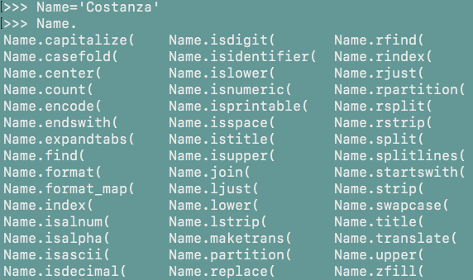
Interactive mode help() and dir()
help(str)
# provides brief description of str function
Hitting tab after variable name followed by . will list methods available to that variable.

Slide 27
Practice script 3. Write a python script to calculate expected genotype frequencies in a population under Hardy Weinberg Equilibrium based on known allele frequencies at a gene with TWO alleles. As a reminder, a population under Hardy-Weinberg equilibrium has genotype frequencies predictable from allele frequencies (p and q):
p**2 + 2pq + q**2 = 1
So, your script needs to return three values (e.g., AA: p**2; Aa: 2pq; aa: q**2 = 1)
Points (hints)
The program should use the input() function to prompt for the command line entry of two values from the command line.
If you supply two values, e.g., 0.2 and 0.8, python will want to treat these as strings. So, before doing math you will need to convert them to floats (A = float(Inputvalue))
As part of this exercise, you will need to control the precision of the floats printed (e.g., % %)

Slide 28
% operator:
controlling format of scalars in print statements
%d for an integer, %f for a float, and %s for a string.
%f controls precision of floats printed.
Prod = 2/3
print ("2/3 should equal roughly %.3f" % (Prod))
Temp = 72.3
Seq = "ATCCC"
Num = 23
print("Primer %d, bases %s, melting point %f" % (Num, Seq, Temp))

Slide 29
This morning:
Read through chapter 8 (*note PythonLesson1_Chapter8.docx under week6 is updated to reflect python3).
Try writing the script specified in the chapter as you go through it
python_1_primer.md, try python1_practice_scripts.md

